Slide 1
Unit 08
Logical Data Modeling

Slide 2
Agenda
What is Logical Data Modeling?
Components of the Relational Logical Model
Mapping Entities and Attributes
Mapping 1-M relationships
Mapping 1-1 relationships
Mapping M-M relationships
Special Cases

Slide 3

What is Logical Data Modeling?

Slide 4
What is A Logical Data Model?
A Logical Data Model is the implementation of a conceptual data model using a particular database implementation model.
The logical model will depend on an implementation but does not represent an actual implementation.
Conceptual Data Model
An Implementation Model
Logical Data Model

Slide 5

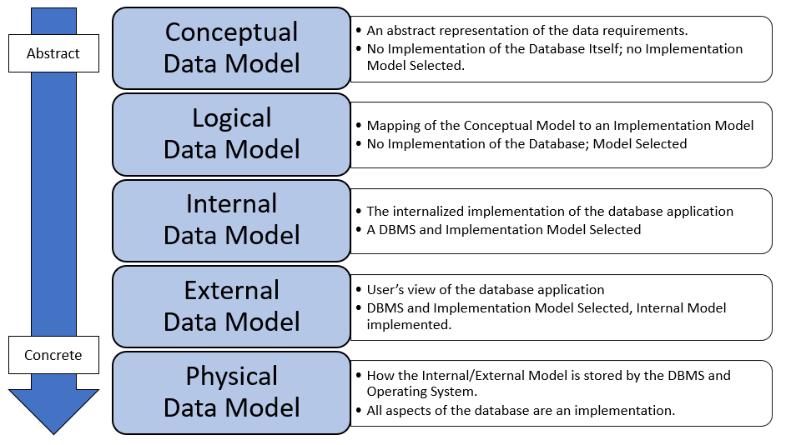
Recall: Data Models
Notes:
For any database there are 5 different representations of it, depending on the level of abstraction.

Slide 6

Purpose Of The Logical Data Model
Technical documentation
Communication with DBA’s and DBD’s.
Any skilled individual can read a logical data model and know exactly how to build the database schema from it.

Slide 7
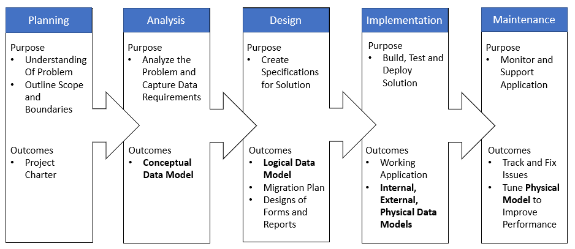
Recall: DBLC
Notes:
The database development lifecycle is a framework for building a database application. It starts with feasibility and ends with the maintenance of the completed application.

Slide 8
Recall: Implementation Models
Implementation Models
Key / Value
Document
Columnar / Wide Table
Graph
Timeseries
Relational
A logical model must consider an implementation.
The approach to logical modeling will depend on the implementation.
E.g. The way we design a relational logical model is different than a columnar logical model.
Relational is a good choice as it is general-purpose.

Slide 9
Logical Modeling With Relational
Conceptual Data Model
Relational Model
Relational Logical Data Model
E-R Requirements,
Crow’s foot ERD
Tables, Columns, Keys, Constraints
Relational Diagram

Slide 10

Check Yourself: Logical Modeling
Logical Data Modeling requires:
A conceptual data model
A chosen implementation model
Both A and B
None of the above
Notes:
C – a logical model required an implementation model + a conceptual model

Slide 11
Check Yourself: Logical Modeling
The logical data model is best suited for which key stakeholders?
Database administrators
End-Users
Managers of the End-Users
All of the above
Notes:
A Logical models are technical documentation and therefore best suited for individuals involved in the implementation of the database.

Slide 12
Check Yourself: Logical Modeling
Logical Data Modeling is part of which phase of the Database Development Lifecycle?
Analysis
Planning
Implementation
None of the above
Notes:
D – it is a part of the design phase of the DBLC

Slide 13
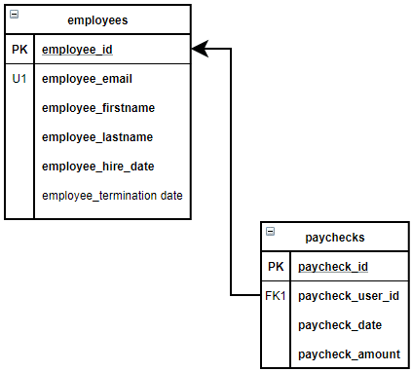
Relational Notation

Slide 14

Relational Notation
Box is a table. Name of table is at the top.
Columns are placed below the table name in the box.
Primary Key columns are Underlined, Boldface and labeled with PK annotation.
Unique constraints are labeled with the U annotation.
Required columns are in Boldface
A PK/FK Relationship between tables are established with an arrow (→), which always POINTS TO THE PRIMARY KEY of the relationship.
Foreign Key columns are labeled with FK annotation

Slide 15
Transitioning from Conceptual to Logical
Conceptual | Relational Logical
ERD | Relational Diagram
Entity Set | Relation / Table
Entity | Row in Table
Attribute | Column in Table
Unique Property (Natural Key) | Unique Constraint
Required Property | Do Not allow NULL
Relationship | Foreign Key
?????? | Primary Key

Slide 16
Check Yourself: Relational Notation
In relational notation, the arrow points towards the:
Table
Primary Key in a PK/FK relationship
Foreign Key in a PK/FK relationship
Unique key in the Table
Notes:
B – the arrow points towards the referring table’s PK in a PK/FK relationship.

Slide 17
Check Yourself: Relational Notation
In relational notation, columns which do not allow NULL are annotated with:
A column in boldface
The [R] property
The [N] property
An underlined column
Notes:
A – not null columns should be bold.

Slide 18
Mapping
The process of transforming a conceptual data model into a relational logical data model

Slide 19
Mapping Entities and Attributes

Slide 20
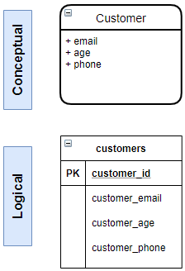
Mapping Entities to Tables
Entities are Singular
Tables are Plural
Tables are like entity sets – they contain more than one entity.
Logical Models are technical documentation, so follow your naming conventions!
Exactly how you want the tables created! Foreign Key columns are labeled with FK annotation

Slide 21
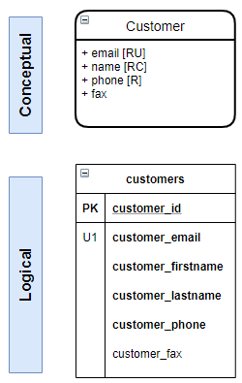
Mapping Attributes
Follow naming conventions
Assign primary key (PK) for each table, typically a surrogate key or natural key.
[U] attribute properties get a unique key constraint.
[C] attribute properties are broken up into simple attributes
[R] attribute properties are not null, represented in boldface
Non-PK constraints are annotated and numbered within the table U1, U2 FK1, FK2.
Unique Property Map
Composite Property Map
Required Property Map

Slide 22
Naming Conventions
Table names – plural, all lower case. E.g. customers
Multiple words in any object name – separated with an underscore character. E.g. customer_phone
Column names – prefixed with the singular of the table name, all lower case. E.g. customer_last_name
Surrogate keys – suffixed with _id E.g. customer_id
Constraint names – constraint type (pk, fk, u, ck, df) + table + column. E.g. pk_customers_customer_id or fk_orders_customer_id

Slide 23
Primary Key Selection
What does one row in this table mean?
Always preserve Entity Integrity!
When you use a surrogate key, you will need a unique constraint.
student_id | student_name | student_major | student_gpa
1 | Bobby | Accounting | 3.14
2 | Johnny | Finance | 4.00
3 | Rickey | Informatics | 3.51
4 | Mike | Music | 2.90
5 | Mike | Music | 2.90

Slide 24
Check Yourself: Primary Key Selection
Why is primary key selection important?
We must preserve referential integrity
We must preserve entity integrity
We cannot insert data without a primary key
All of the above
Notes:
B – entity integrity is essential to ensuring the table still satisfies the conceptual data requirements.

Slide 25
Check Yourself: Primary Key Selection
For entity foo with attribute bar. What should be the mapped table column name?
foo
bar
bar_foo
foo_bar
Notes:
D – the column name should include the table name as part of the naming conventions.

Slide 26
Mapping 1-M Classifications

Slide 27
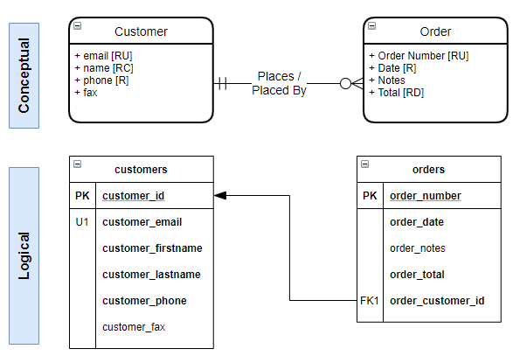


Mapping 1-M Classifications
For relationships with a 1-M classification, the FK is placed on the Many side of the relationship.
The one side of the relationship determines if the FK allows null FK NULL FK NOT NULL

Slide 28
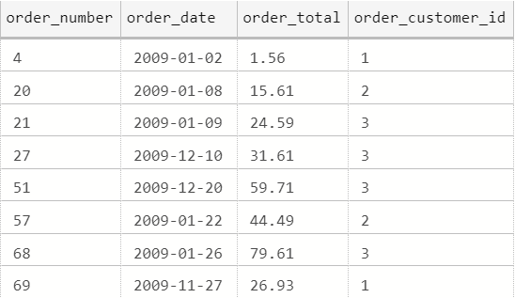
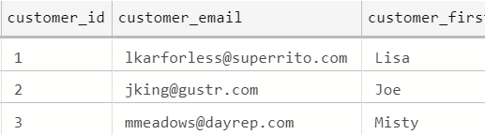
Visualizing Relationships with Rows of Data
A customer places 0 or More orders; An order is placed by 1 and only 1 customer
orders
customers

Slide 29
Mapping 1-M Weak Entity w/A Natural Key
Natural Key is the PK.
FK is once again placed on the Many side of the relationship.
Foreign Key is required (not null) to ensure mandatory participation.

Slide 30
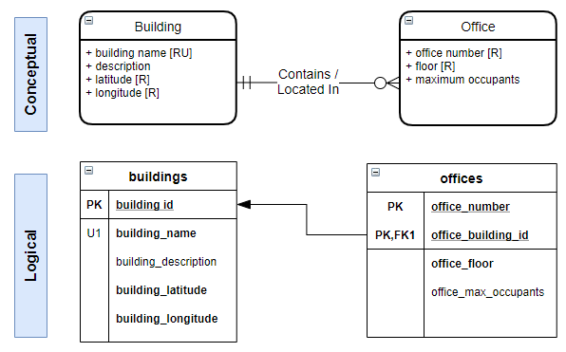
Mapping 1-M Weak Entity w/No Natural Key
With no Natural key, the Weak entity should be mapped as a composite PK (the FK is part of the PK)
The two values which make up the PK ensure entity integrity.

Slide 31
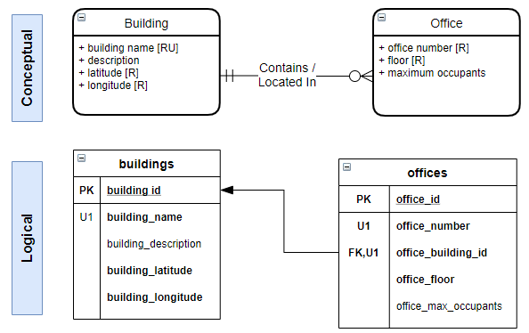
Mapping 1-M Weak Entity w/Surrogate Key
If a surrogate PK is chosen for the weak entity, then a unique constraint will be required to ensure entity integrity.
The unique key should be composite and include the FK.

Slide 32
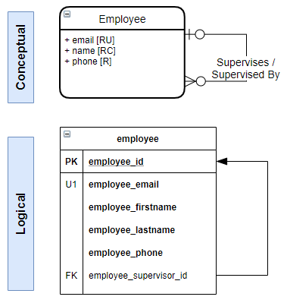
Mapping 1-M Unary Relationship
When an entity is related to itself, it is a unary relationship.
To map, we follow the same rule placing the FK on the many side, which adds the FK to the same table.
Notice in this example NULLS are allowed in the FK.

Slide 33
Check Yourself: 1-M Mapping
“A eats one or more M, M eaten by zero or more A”. How should this relationship be mapped?
FK in table A, NULL
FK in table A, NOT NULL
FK in table M, NULL
FK in table M, NOT NULL
Notes:
D – the one side is optional so NOT NULL. The many side is M so the FK goes there.

Slide 34
Check Yourself: 1-M Mapping
When mapping a Weak entity with a Surrogate key we have
A composite primary key
A composite foreign key
A composite unique key constraint
None of the above
Notes:
C – because the surrogate key is primary key the unique key constraint is necessary to preserve entity integrity.

Slide 35
Mapping 1-1 Classifications

Slide 36
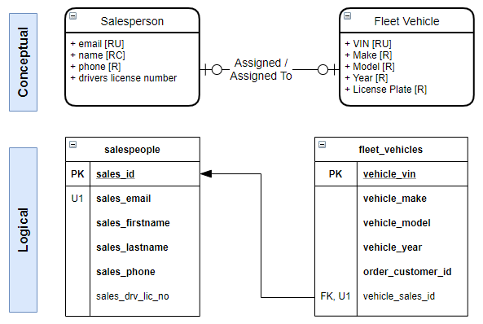
Mapping 1-1 Optional
1-1 classifications are uncommon.
FK placement is on the optional side and combined with a Unique Constraint
If both sides are optional, the side with more rows should be the PK side.

Slide 37
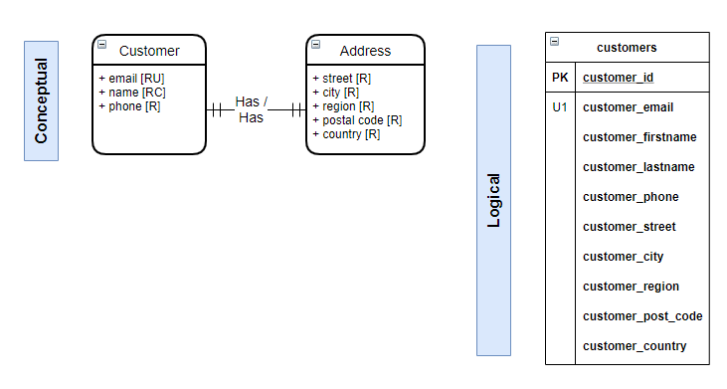
Mapping 1-1 Mandatory
Often there is no meaningful conceptual business rule.
Since both sides are mandatory combine attributes into a single table.

Slide 38
Check Yourself: 1-1 Mapping
1-1 optional relationships should be consolidated into a single table
True
False
Notes:
B – false – one to one mandatory should be consolidated into a single table

Slide 39
Mapping M-M Classifications

Slide 40
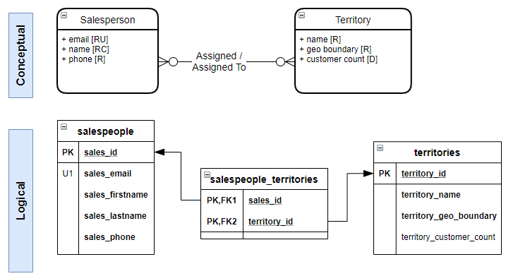
Mapping a M-M relationship
True M-M relationships are mapped with a bridge table, consisting of a composite PK comprised of both FK’s.
The bridge table has no non- key columns

Slide 41
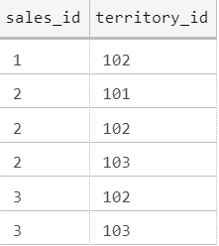
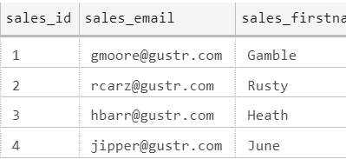
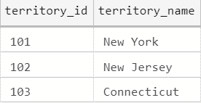
Visualizing Relationships with Rows of Data
A salesperson is assigned 0 or More territories
salespeople_territories
salespeople
territories

Slide 42
Visualizing Relationships with Rows of Data
A territory is assigned to 0 or More salespeople
salespeople_territories
salespeople
territories

Slide 43
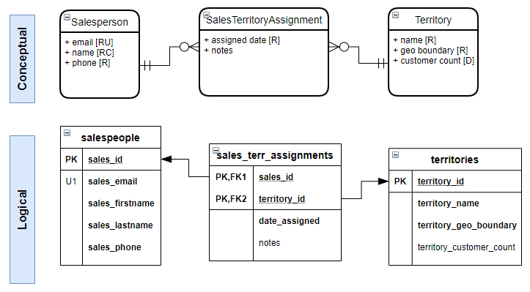
Mapping Associative Entities – Composite PK
Associative Entities where the two FK values cannot repeat (in order to preserve entity integrity), should be mapped as a bridge table, with a composite PK consisting of both FK’s.
Notes:
In this case only one combination of sales person to territory can exist at the same time. For example bob can not be assigned to the NE territory, twice.

Slide 44
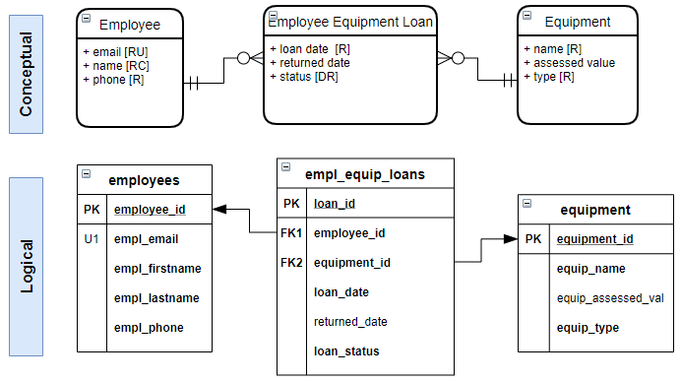
Mapping Associative Entities – Surrogate PK
Associative Entities where the two FK values can repeat, should be mapped as two regular 1-M relationships.
The one side is always mandatory.
Notes:
In this case multiple combinations of employee and equipment can repeat bob loans a jack hammer, returned it, then at a later date and time he loans the same jack hammer again.

Slide 45
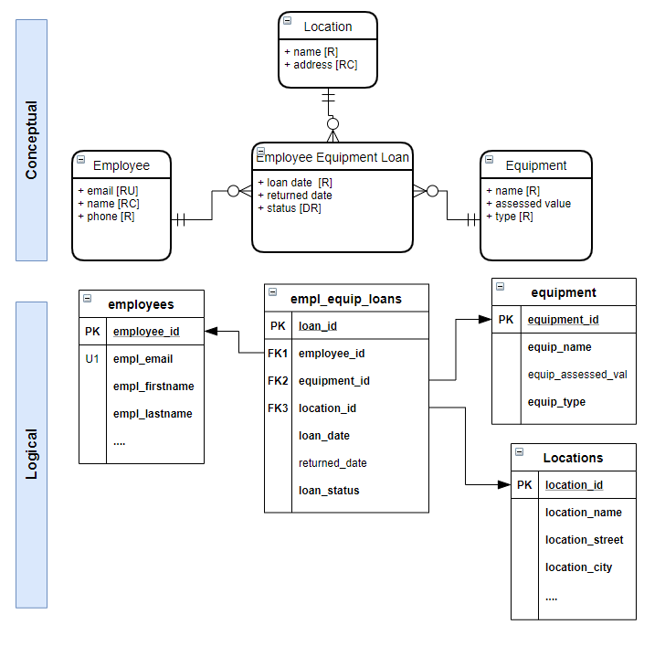
Mapping Tertiary Relationships
N-Ary relationships are mapped in the same manner as associative entities.
Once again, the decision to use a composite PK is based on whether the values can repeat.
In this case we used a surrogate key.

Slide 46
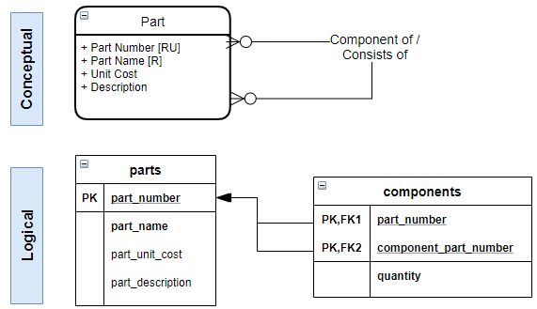
Mapping a M-M Unary Relationship
Map as a bridge table with itself.
These are most often associative entities and have attributes on the relationship.
quantity

Slide 47
Check Yourself: M-M Mapping
To map a M-M relationship we need a
Bridge table
Composite Primary Key
Both A and B
None of the above
Notes:
C a bridge table with composite key is required

Slide 48
Check Yourself: M-M Mapping
Associative entities with a Natural key should map As:
A bridge table with composite Primary Key
A regular 1-M mandatory relationship
A regular 1-M mandatory relationship with composite Unique key constraint
None of the above
Notes:
B – they should map similar to a 1-M relationship where the Pk has been established on the M side.

Slide 49
Check Yourself: M-M Mapping
When it is not necessary to preserve entity integrity in the associative entity, what should we use as a primary key?
Composite Primary Key consisting of foreign keys
A surrogate key
Composite Primary Key consisting of all required columns in the table
Notes:
B – a surrogate key should be used.

Slide 50
Advanced Attribute Mapping

Slide 51
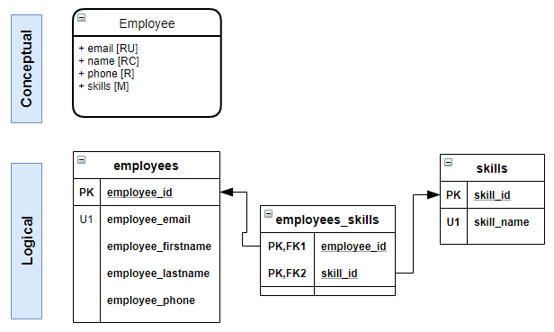
Mapping M Attributes
Treat the M attribute as a lookup table, then follow the M-M relationship rule.
The PK can be the attribute itself or a surrogate key, as in this example.

Slide 52
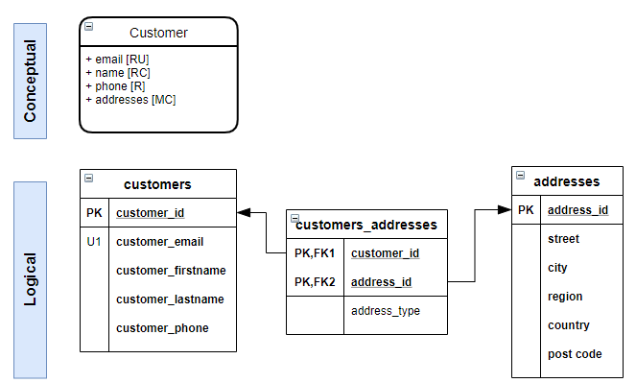
Mapping MC Attributes
For MC Attribute mapping, treat the attribute as its own table, then join back to original table in M-M relationship.
Include type discriminator, if needed.

Slide 53
Check Yourself: Attribute Mapping
Mapping a [M] attribute most closely resembles:
M-M mapping
1-M mapping
Tertiary Relationship Mapping
Associative Entity Mapping
Notes:
A- it is actually a hidden M-M relationship.

Slide 54

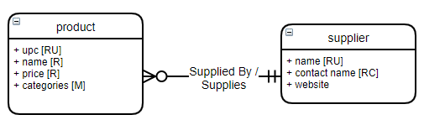
Demo: Draw A Logical Model
We will use Draw.io from Diagrams.net to draw the diagram.
Conceptual E-R Requirements

Slide 55
Summary
Logical data modeling is a technical specification for how a database should be built. It considers an implementation model but is not an actual implementation.
Entities map to tables; Attributes map to table columns
When mapping 1-M relationships, the FK goes on the M side, and the 1 side cardinality determines NULL in the FK
Mapping M-M relationships requires a bridge table with a composite PK.
[M] attribute properties map similarly to M-M relationships.

Slide 56

Exit Ticket
What I Learned
Share one important thing you learned from this lesson!
Notes:
‘__0_’

