Slide 1

Microsoft PowerApps Walkthrough
Easily Create Data-Driven Mobile Apps for Business

Slide 2
What are PowerApps?
A cloud service for building data-driven business applications which run in the browser and on mobile.
Low Code / No Code Solution / RAD Platform

Slide 3
RAD and Low/No Code Platforms
Develop Apps with very little to no code.
Suitable for Data-Driven Applications / Forms over Data
Notes:
(If you can write excel functions, you can use PowerApps)

Slide 4
















PowerApps is an N-Tier/Microservices Model
Presentation Layer are Web or Mobile clients
Business Logic in the Cloud with PowerApps and Power Automate
Data Logic Through Connectors to Data Sources
Data Sources are the data layer - objects available from the connector
Presentation
Business Logic
Data Logic
Data

Slide 5
Data Sources, Connections, Gateways
Data Source – Tabular Data
Connection – Credentials and permissions to connect to a data source
Connectors – Types of connections SQL Server, Excel, MySQL, MSN Weather, Google Drive, Etc…
Gateways – Connections to On-Premises Systems like SQL Server.
Connectors => Connections => Data Source
Examples:
(connection → connector → data source)
(Excel → Excel Workbook in OneDrive → Tab)
(SQL Server → Your SQL DB in Azure → Table)

Slide 6
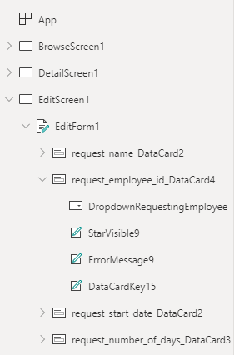
PowerApps Programming Model
Controls
Gallery
Data Table
Form
Card
Label
Text
Drop Down
Combo Box
Date Picker
Slider
Radio
Check Box
List Box
Toggle
Slider
Button
App (Canvas App)
Screens - UI Screen. App consists of Many Screens
Data Source Controls – bound to a Data Source
Gallery / Data Table – displays multiple rows
Columns from the data source are displayed using controls
Form - displays one row from data source
Columns from the data source displayed as cards
Each card has a label and control

Slide 7
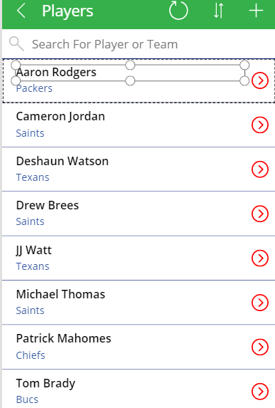
Gallery
Gallery displays multiple rows from a data table.
It is a display only feature.
The layout is customizable

Slide 8
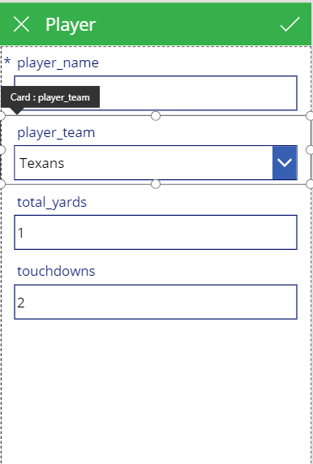
Edit Form
For editing a row of data from the data source.
Consists of Cards, which are label / control pairs.
Cards can be customized.

Slide 9
Low Code: Properties And Functions
You Code By Assigning Functions to properties of Controls
Common Properties if Controls
OnSelect – do this when the control is selected
Items – the specific data to display from the data source
Text – what to display
Default – the default value
Update – The update to apply to the data source when the control value changes
Functions
https://docs.microsoft.com/en-us/powerapps/maker/canvas-apps/formula-reference

Slide 10
Walk-Through
Fudgemart PowerApp For Employee Directory and Vacation Requests

Slide 11
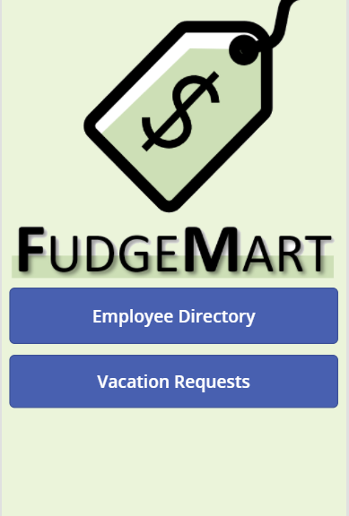
Main Menu (ScreenMainMenu)
Add Two buttons
Set the background
Add the picture

Slide 12
Connect Data Sources
Connect to SQL Server on Azure
Add Tables:
Fudgemart_employees
Fudgemart_vacation_requests

Slide 13
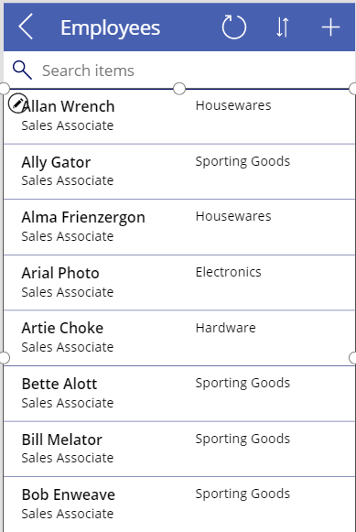
Employees (ScreenEmployees)
List Screen
Gallery Data Source
Fudgemart_employees
Change Fields: Name, Jobtitle, Department
Chage Item Properties to
Add Searching
Add Sorting
Back Icon Navigation
Fix Navigation Between Both Screens
Notes:
SortByColumns(Search(fudgemart_employees,TextSearchBoxEmployees.Text, "employee_firstname","employee_lastname","employee_department"),"employee_firstname",If(SortDescending1,Descending,Ascending))

Slide 14
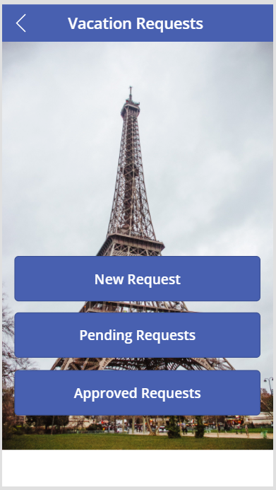
Vacation Requests Screen (ScreenMenuVacationRequest)
Set Background Image
Insert a Shape
Add Title and Back Icon
Add Three Buttons
Fix Navigation Between Both Screens

Slide 15
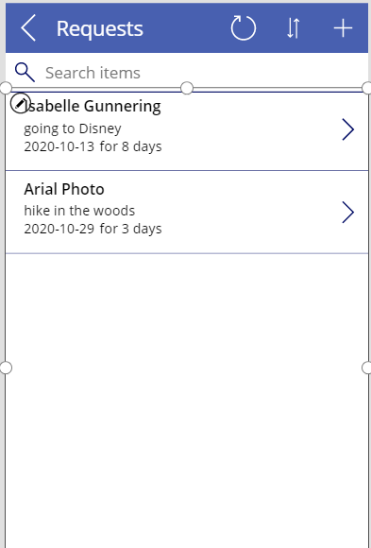
Pending Requests (ScreenVacationRequests)
List Screen
Gallery Data Source
Fudgemart_Vacation_Requests With filter of not approved
Change Fields: Name, employee, date, days
Change Item Properties to
Add Searching
Add Sorting
LookUp name from employee_id
Fix Navigation Between Both Screens
Notes:
SortByColumns(Search(Filter(fudgemart_vacation_requests, Len(request_approved_employee_id) =0),TextSearchBoxVacationRequests.Text, "request_name"),"request_name",If(SortDescending1, Descending, Ascending))
LookUp(fudgemart_employees,employee_id= ThisItem.request_employee_id, employee_firstname & " " & employee_lastname)

Slide 16
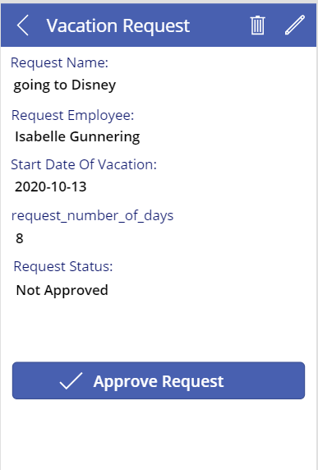
View Vacation Request (ScreenViewVacationRequest)
New Form Screen
Delete The EditForm, add the Detail Form
Set Fields: name, employee, date, days, approved employee
Edit the Templates of each card
Configure Delete function
Screen Navigation
How does it know which one to show? Item property!
Notes:
Request Employee.Text = LookUp(fudgemart_employees,employee_id=ThisItem.request_employee_id, employee_firstname & " " & employee_lastname)
StartDate.Text = Text(ThisItem.request_start_date,"[$-en-US]yyyy-mm-dd")
Request Status.Text = If(Len(ThisItem.request_approved_employee_id)=0,"Not Approved", "Approved")
Remove(fudgemart_vacation_requests,BrowseGalleryVacationRequests.Selected)

Slide 17
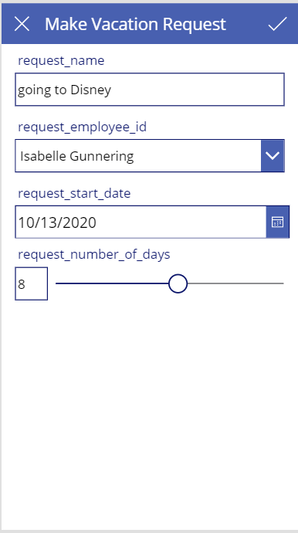
Edit/Add Vacation Request (ScreenEditVacationRequest)
New Edit Screen
Add Fields name, employee date, days
Remove Locks from cards to change controls
Drop-Down, Date and Slider
Save and Cancel
Test Form Navigation
Notes:
The Drop Down:
Items = ShowColumns(AddColumns(fudgemart_employees, "employee_name", employee_firstname & " " & employee_lastname), "employee_name", "employee_id")
Default = LookUp(fudgemart_employees, employee_id= ThisItem.request_employee_id, employee_firstname & " " & employee_lastname)
Card.Update = DataCardValueDropDownEmployee.Selected.employee_id
[X] = Back()
[V] = SubmitForm(EditFormVacationRequest);Back()

Slide 18
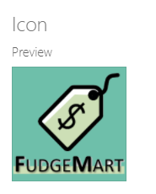
Settings And Publishing
File → Settings
File → Save
File → Save → Publish (Makes App Available to Share)
File → Save → See All Versions (Each time you save, a version is created!)

Slide 19
On Your Own!

Slide 20

The Rest – On your own
Make a Screen To Approve Vacation Request
Make a Screen To View Vacation Requests That Have been Approved
Make Sure All buttons work for navigation.
Demo!

