Slide 1
Unit 10
SQL Programming

Slide 2
Agenda
What is SQL Programming and Why is it useful?
What role does it play in an Database Application
Learn the basic constructs of SQL Programming
Cover the 4 Types of Data Logic: Views, Stored Procedures, Triggers and User-Defined Functions

Slide 3

The What and Why of SQL Programming

Slide 4
SQL Programming ?
Code can be written in SQL
This goes beyond simple INSERT, SELECT, etc.
Common Use Cases and Examples:
Insert a value only if it does not exist already
When insert into table X update value in table Y
Persist a shopping cart into an order
Lookup a postal code based on a city and region
Sanitize input (e.x. Obfuscate Credit sensitive data)
This is called Data Logic.

Slide 5

Recall: Layers of a Modern Data-Oriented Application
Presentation
Code and layout responsible for the user interface
Business Logic
Data Logic
Data Management Operations (CRUD)
Database
Transformational logic at the heart of what the application does
Data storage and retrieval

Slide 6

Data Logic
Data logic can be defined loosely as any logical operation that requires more than one read or write from the database
Such operations are candidates for the data Logic layer to minimize the network communication between layers
Data Logic is a special type of business logic, solely on data management. It does nothing else!
Operation: Insert or Update User
Business Logic
User 15 exists?
Update user 15
Yes
Success
Database

Slide 7
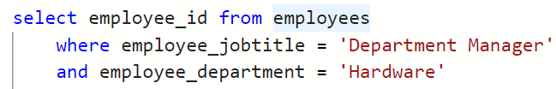

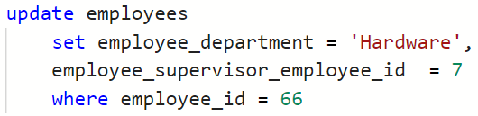

Example As Business Logic
Business Logic: Transfer Employee to New Department
Example: Transfer Employee id=66 from ’Toys’ to ‘Hardware’ Department
Network
Business Logic
Database
sup_id = get_supervisor_id ('Hardware')
Read
Transfer_dept( (66, 'Hardware’, sup_id)
Update
Notes:
This is a simple example. The act of changing departments for an employee involves 2 crud operations as we must first find the employees new supervisor by locating the employuee id of the supervisors department.
Remember the DBMS only understand SQL so it is the BLL’s responsibility to generate the SQL to get the supervisor ID and then another SQL statement executed afterwards to update the employee and set the new department and supervisor.

Slide 8
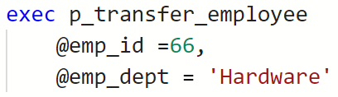
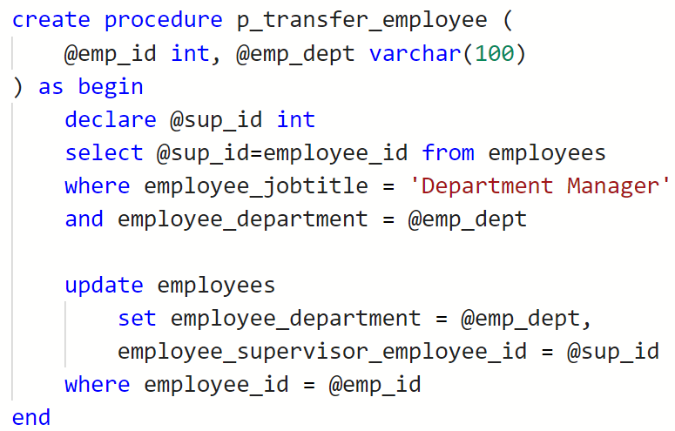
Sample Example as Data Logic
Business Logic: Transfer Employee to New Department
Example: Transfer Employee id=66 from ’Toys’ to ‘Hardware’ Department
Network
Business Logic
Database
transfer_employee (66, 'Hardware')
Notes:
Data Logic pushes the CRUD responsibility into the database or data access layer. It creates an API (application programming interface) for the Database so there does not need to be several network trips between the database and the business logic itself.
This improves performance of the application and increases the data consistency.

Slide 9
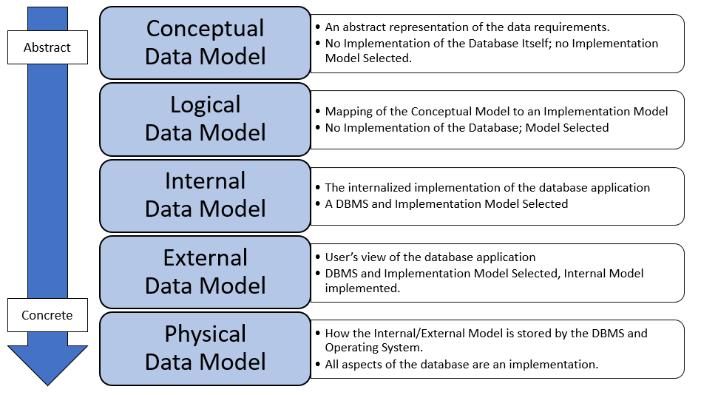
Recall: Data Models: Where is Data Logic?
Data Logic
Notes:
For any database there are 5 different representations of it, depending on the level of abstraction.

Slide 10

Check Yourself: Business Logic or Data Logic?
Sending an Email after a customer registers (new customer added to the table)
Business logic
Data Logic
Notes:
Business – Databases don’t send emails

Slide 11
Check Yourself: Business Logic or Data Logic?
When the order is placed the total of the order is calculated from the prices and quantities of the order details.
Business logic
Data Logic
Notes:
Data – all CRUD

Slide 12
Check Yourself: Business Logic or Data Logic?
Each month when a subscription is billed a payment processor approves the credit card purchase before the bill is added to the history table
Business logic
Data Logic
Notes:
Busines Logic - payment gateways are not CRUD operations

Slide 13
Check Yourself: Business Logic or Data Logic?
Whenever text is written to the database, the first word after each period is capitalized.
Business logic
Data Logic
Notes:
Data logic -crud

Slide 14
SQL Programming Basics

Slide 15
Disclaimer: Every DBMS Is Different
Every DBMS has their own dialect of SQL for Programming.
These are usually Called PL/SQL For “Procedural Language SQL” They are based on SQL, with more traditional programming logic.
Important Disclaimer: The concepts we will learn are the same, but the specifics of each DBMS implementation is not
You learn one DBMSs PL you’ve learned them all:
Microsoft SQL Server → T-SQL
Oracle → PL/SQL
PostgreSQL → PL/pgSQL
IBM DB2 → PL/SQL

Slide 16
Variables

Slide 17
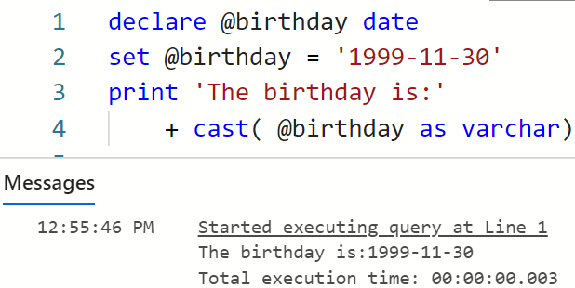
Variables, DECLARE and SET
A variable is a named location in memory that stores a value.
Each variable must begin with an @ symbol.
Variables must be one of the SQL data types.
The declare keyword creates the variable.
The set keyword assigns a value to the variable.

Slide 18
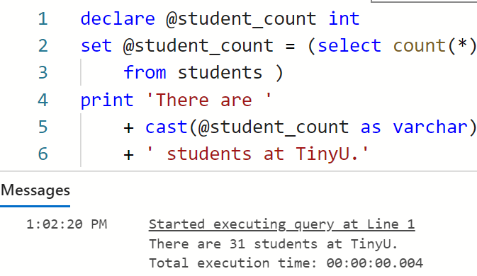
Assign SQL Output To A Variable
You can assign the output of SQL select statement to a variable.
First write the SQL select, then assign it to a variable.
The SQL must return a single value (one row, one column)
Notes:
declare @student_count int
set @student_count = (select count(*)
from students )
print 'There are '
+ cast(@student_count as varchar)
+ ' students at TinyU.'

Slide 19
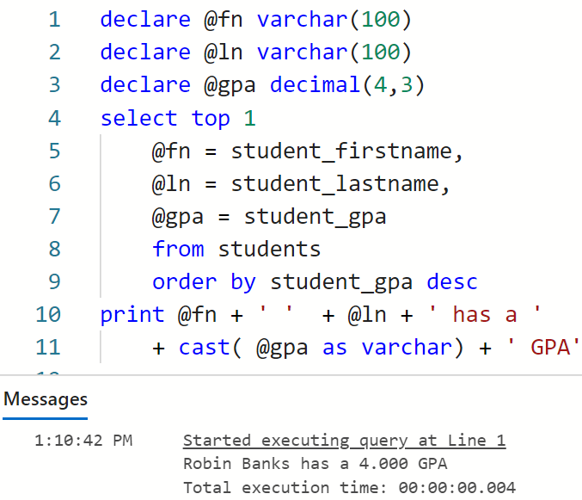
Assign Multiple Columns to Variables
You can assign multiple columns of output to variables.
The SQL must return a single row, or else the last row will be assigned to the variables
Notes:
declare @student_count int
set @student_count = (select count(*)
from students )
print 'There are '
+ cast(@student_count as varchar)
+ ' students at TinyU.'

Slide 20

Demo: T-SQL Variables
We will use the Azure Data Studio application.
We will use the payroll database.
Write data logic to change departments for an employee.
Find the new supervisor
Update the supervisor and department
Notes:
declare @sup_id int
select @sup_id=employee_id from employees
where employee_jobtitle = 'Department Manager'
and employee_department = @emp_dept
update employees
set employee_department = @emp_dept,
employee_supervisor_employee_id = @sup_id
where employee_id = @emp_id

Slide 21
Check Yourself: Variables
To Create a variable in T-SQL we use:
SET
DECLARE
@
=
Notes:
The declare keyword creates a variable

Slide 22
Check Yourself: Variables
To name a variable in T-SQL we use:
SET
DECLARE
@
=
Notes:
@ in front of the identifier makes it a variable.

Slide 23
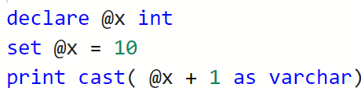
Check Yourself: Variables
What prints on the last line of this program?
Notes:
@ in front of the identifier makes it a variable.

Slide 24
Built-In Functions

Slide 25
Built In Functions
Most PL/SQL implementations have a variety of built-in functions to allow us to manipulate text, dates, do math, etc…
T-SQL Function Reference
https://docs.microsoft.com/en-us/sql/t-sql/functions/functions

Slide 26
Common Text String Functions
LEN( column )
Returns the number of characters in the column
LEFT( column, count )
Returns the left-most count of characters from the column
RIGHT( column, count )
Returns the right-most count of characters from the column
CHARINDEX( find, column )
Returns the first index of find in the column; indexes start at 1

Slide 27
Examples
declare @msg nvarchar(20)
set @msg = 'hello, world'
print len(@msg) -- 12
print left(@msg, 5) -- 'hello'
print right(@msg, 5) -- 'world'
print charindex(',', @msg) -- 6
print left(@msg, charindex(',', @msg)-1) --hello
1 | 2 | 3 | 4 | 5 | 6 | 7 | 8 | 9 | 10 | 11 | 12
h | e | l | l | o | , |  | w | o | r | l | d

Slide 28
Check Yourself: Text String Functions
What prints on the last line of this program?
Notes:
ny

Slide 29
Common Date/Time Functions
DATEPART(part, date)
Returns the part of the date you specify as an integer
DATENAME(part, date)
Returns the part of the date you specify as a string (varchar)
print getdate() -- today's date and time
print datepart(month, '2018-07-20') -- 7
print datename(month, '2018-07-20') – 'July'
print datepart(year, '10:34:39 PM') -- 1900 1900-1-1 is epoch
print datepart(hour, '10:24:39 PM') -- 22
print datename(second, '10:24:39 PM') -- '39'

Slide 30
Demo: Date Functions
We will use the Azure Data Studio application.
We will use the fudgemart_v3 database.
Let’s get counts of orders by day of the week for each customer, a PIVOT
Customer in rows
Day of week in columns
Count of orders in intersection
Notes:
with source as (
select order_id, customer_id,
cast( datepart(WEEKDAY, order_date) as varchar) + '-' + datename(WEEKDAY, order_date) as day_of_week
from fm_orders
)
select * from source pivot (
count(order_id) for day_of_week in ([1-Sunday], [2-Monday], [3-Tuesday],[4-Wednesday])
) as pvt

Slide 31
More Useful String Functions
ISNULL (check_expression, replacement_value)
When check_expression is null, use replacement_value
STRING_AGG (expression, separator) [<order clause>]
Aggregate operator returns a single row of expression separated by separator
Useful for turning rows into single column lists of data
STRING_SPLIT (string, separator)
Returns a single column table of values of string separated by separator
Useful for turning single column of data lists into rows
Requires CROSS APPLY join.

Slide 32
Demo: Built In Functions
We will use the Azure Data Studio application.
We will use the fudgemart_v3 database.
Use ISNULL to replace null with a Flag
STRING AGG
emails by state
All orders by customer
STRING_SPLIT
STRING_SPLIT with CROSS APPLY for keyword extraction
Notes:
Use fudgemart_v3
GO SELECT vendor_name, vendor_website,
isnull(vendor_website, '**No Website**') as vendor_website2
FROM fm_vendors
select customer_state, string_agg(customer_email, ', ')
from fm_customers
group by customer_state
select c.customer_id, customer_email, string_agg(order_id, ' ') as orders
from fm_customers c
join fm_orders o on c.customer_id=o.customer_id
group by c.customer_id, customer_email

Slide 33
Check Yourself: Functions
To transform delimited data such as the following: 'a b c'
into a table rows like this
a
b
c
We use:
STRING_SPLIT
STRING_AGG
ISNULL
CROSS APPLY
Notes:
String split!!!

Slide 34
Program Flow Control

Slide 35
Branching
The T-SQL IF statement allows us to branch our script based on a true/false value.
IF true-false-expression BEGIN statements-when-true END ELSE BEGIN statements-when-false END

Slide 36
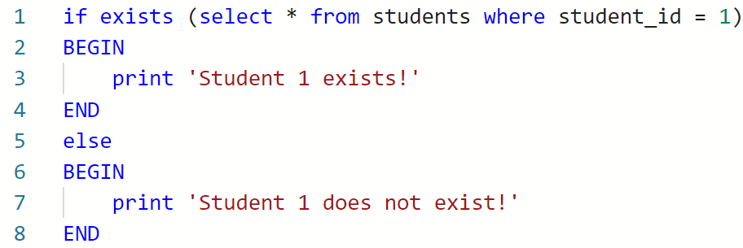
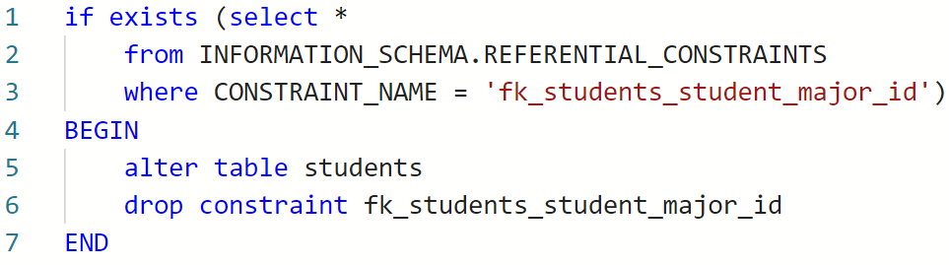
Example: Exists
Commonly Used For Schema Inspection

Slide 37
Types of Data Logic in the RDBMS
Views
Stored Procedures
Triggers
User Defined Functions

Slide 38

Views

Slide 39
Recall: SQL Views
A View is a means to save a SQL query to the database under a name.
It is database object / metadata.
create view view_name as
select ...
drop view view_name
To see the views in the database including their definitions, you can use INFORMATION_SCHEMA:
select * from INFORMATION_SCHEMA.VIEWS

Slide 40
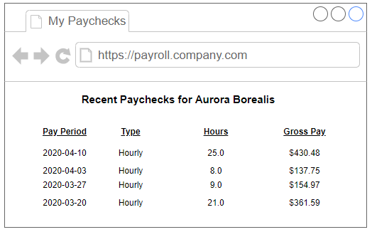
Demo: View Data Logic
My Paychecks!
VIEW to allow an employee to see their last 4 paychecks on the company portal
Notes:
create view [dbo].[v_payroll] as
select e.*, p.*, pp.payperiod_date
from paychecks as p
join employees as e on e.employee_id = p.paycheck_employee_id
join pay_periods as pp on pp.payperiod_id = p.paycheck_payperiod_id
select employee_id, employee_firstname, employee_lastname,
payperiod_date, paycheck_employee_payroll_type,
paycheck_total_hours_worked, paycheck_gross_pay
from v_payroll
where employee_id=66
order by payperiod_date desc

Slide 41
Stored Procedures

Slide 42
Stored Procedures
A stored procedure is a group of T-SQL statements that encapsulate data logic under a single command.
They help us build the external data model, creating data logic in our applications.
Examples:
Write a customer record. If the customer exists, update; if not, insert.
Create a new customer bank account that requires us to insert into several tables.
When an order is added with a new shipping address, update the address in the customer table.

Slide 43
Benefits of Stored Procedures
Keeps data logic “close to the data,” resulting in less network traffic
Isolated security—you can deny access to a table but allow access to a stored procedure which inserts into the table
Performance—the T-SQL in the stored procedure that is pre-compiled to it executes faster than the equivalent T-SQL code
Implement the external data model—abstracting relational complexity from the middle-tier programmer
Notes:
Which os not a benefit of stored procedures

Slide 44
Check Yourself: Stored Procedures
Which of the following is not a benefit of stored procedures?
Performs better than the equivalent T-SQL
Encapsulates data logic under a same
Supports multiple outputs
Can be secured separately from the underlying objects
Notes:
C only supports 0 or 1 output.

Slide 45
Syntax: Stored Procedures
A stored procedure has 0 or more inputs and 0 or 1 output.
CREATE PROCEDURE procedure_name ( [@parameter_name AS type] [, …n]
) AS
BEGIN T-sql-statements [RETURN value] END
Procedure inputs (parameters)
Procedure output

Slide 46
Calling a Stored Procedure
To execute or call a stored procedure
EXEC procedure_name arg1, arg2
Return value can be set to a variable
EXEC @var = procedure_name arg1, arg2
The arguments can be named for readability
EXEC @var = procedure_name @param1=arg1, @param2=arg2

Slide 47
Demo: Stored Procedure Data Logic
Switching Departments
Same example from before, but we will write it as a stored procedure
Inputs:
Employee Id,
New Department
Find manager of new department
Update employee with new department and
Execute the procedure!
Notes:
drop procedure if exists p_transfer_employee
GO
create procedure p_transfer_employee (
@emp_id int, @emp_dept varchar(100)
) as begin
declare @sup_id int
select @sup_id=employee_id from employees
where employee_jobtitle = 'Department Manager'
and employee_department = @emp_dept
update employees
set employee_department = @emp_dept,
employee_supervisor_employee_id = @sup_id
where employee_id = @emp_id
End
exec p_transfer_employee @emp_id=66, @emp_dept = ‘Toys’

Slide 48
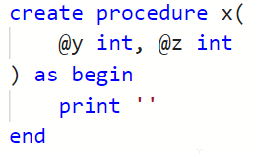
Check Yourself: Stored Procedures
What is the name of this procedure?
Notes:
x

Slide 49
Check Yourself: Stored Procedures
How many arguments does this procedure require?
Notes:
2

Slide 50

Triggers

Slide 51
Triggers
A trigger is a special type of stored procedure which will execute automatically based on a DML operation and event.
These are the DML operations, any combination of:
INSERT, UPDATE, or DELETE
There are two events:
AFTER: Trigger fires after the DML operation completes, after integrity constraints.
INSTEAD OF: Trigger fires before the DML operation completes, before integrity constraints.

Slide 52
Trigger Use Cases
Prevent Automatic Updates
Audit Changes to the Database
Ensure Data Integrity
Notes:
Prevent Automatic Updates
Example not allowed to update a row where its disabled
Audit changes to the database
adding a last update timestamp to table
Ensure Data integrity
Complex business logic beyond what a table constraint can do!

Slide 53
CREATE TRIGGER Statement
CREATE TRIGGER trigger_name ON table_name AFTER | INSTEAD OF { [INSERT] [,] [UPDATE ] [,] [DELETE] } BEGIN sql statements END

Slide 54


Trigger Sequencing
UPDATE majors SET major_name = 'Comp Sci' WHERE major_code = 'CSC'
INSTEAD OF Trigger Event
Data Integrity Constraints Checked
AFTER Trigger Event
Data State After DML Statement
Data State Before DML Statement
majors Table: 'Computer Science'
inserted Table: ‘Comp Sci’
deleted Table: 'Computer Science’
Deleted Table
Check, Unique, Default, PK,FK constraints,
inserted Table: ‘Comp Sci’
deleted Table: 'Computer Science’
Deleted Table
Majors Table: ‘Comp Sci'

Slide 55
Trigger Tables
How does one access the internal data affected by a trigger?
SQL Server provides two special tables to assist:
Inserted: table consisting of data to be
added, or
updated
Deleted: table consisting of data to be
removed, or
prior to being updated

Slide 56
Demo: Understanding The Trigger Tables
We will use the Azure Data Studio application.
We will use the payroll database.
A trigger to display the inserted and deleted tables
Execute the p_transfer_employee procedure
Follow changes
Notes:
use payroll
GO
drop trigger if exists t_employees_demo
GO
create trigger t_employees_demo
on employees
after insert,update,delete
as BEGIN
select 'INSERTED: How the data is',
employee_id, employee_firstname, employee_lastname,
employee_department, employee_supervisor_employee_id
from inserted
select 'DELETED: How the data was',
employee_id, employee_firstname, employee_lastname,
employee_department, employee_supervisor_employee_id
from deleted
END
GO
select employee_id, employee_firstname, employee_lastname,
employee_department, employee_supervisor_employee_id
from employees where employee_id = 67
exec p_transfer_employee @emp_id = 67, @emp_dept='Customer Service'
select employee_id, employee_firstname, employee_lastname,
employee_department, employee_supervisor_employee_id
from employees where employee_id = 67

Slide 57
Check Yourself: Triggers
The data that was deleted by an AFTER DELETE trigger is stored in which trigger table?
Notes:
deleted

Slide 58
Demo: AFTER Trigger
We will use the Azure Data Studio application.
We will use the payroll database.
An AFTER trigger to automatically change the supervisor_employee_id to match the department.
Demonstrate it works on an update and a batch update.
Notes:
use payroll
GO
drop trigger if exists t_employees_demo
drop trigger if exists t_employees_update_department
GO
create trigger t_employees_update_department
on employees
after insert,update
as BEGIN
update employees
set employee_department = inserted.employee_department,
employee_supervisor_employee_id = ( select employee_id from employees
where employee_jobtitle = 'Department Manager'
and employee_department = inserted.employee_department)
from inserted
where inserted.employee_id =employees.employee_id
end
go
select employee_id, employee_firstname, employee_lastname,
employee_department, employee_supervisor_employee_id
from employees where employee_id in (66,67)
update employees set employee_department = 'Toys'
where employee_id in (66,67)
select employee_id, employee_firstname, employee_lastname,
employee_department, employee_supervisor_employee_id
from employees where employee_id in (66,67)

Slide 59
Demo: INSTEAD OF Trigger Add to Trans
We will use the Azure Data Studio application.
We will use the payroll database.
An INSTEAD OF trigger to prevent making changes to any employee who has been terminated. automatically change the supervisor_employee_id to match the department.
Demonstrate it works on an update and a batch update.
Notes:
use payroll
go
drop trigger if exists t_employees_deny_edit_if_terminated
go
create trigger t_employees_deny_edit_if_terminated
on employees
instead of update as
BEGIN
if exists(select * from inserted where employee_termination_date is not NULL )
BEGIN
; --huh?
THROW 50005, 'No changes permitted, cannot change values for a terminated employee',1
rollback
END
END
select employee_id, employee_firstname from employees where employee_id = 49
update employees set employee_firstname = 'Tye' where employee_id = 49
select employee_id, employee_firstname from employees where employee_id = 49

Slide 60
Check Yourself: Triggers
When will this trigger fire?
create trigger x on y after insert ...
When data is added to table x
When data is added to table y
When data is updated to table x
When data is updated to table y
Notes:
B – when data is added to table y

Slide 61

User Defined Functions

Slide 62
User-Defined Functions
You can define your own functions in T-SQL.
This allows us to encapsulate data logic into our databases and make our intentions clear.
The function can be used in the same manner as a built-in function:
In a SELECT query
As part of a derived column
As part of a check constraint
In the FROM clause (table-valued function)

Slide 63
Syntax: User-Defined Functions
A function has 0 or more inputs and exactly 1 output.
CREATE FUNCTION function_name ( [@parameter_name AS type] [, …n]
) RETURNS type AS BEGIN function_body RETURN value END
Function inputs
(parameters)
Function output
Notes:
Capilaized words are keywords

Slide 64
Demo: User-Defined Function
We will use the Azure Data Studio application.
We will use the payroll database.
Get Manager for Department
Given the department name as input
Returns the manager employee ID as output, or null if no match.
Favor joins over data lookup functions.
Name last first function as a better example
Notes:
use payroll
drop function if exists f_get_manager
GO
create function f_get_manager(
@department varchar(100)
) returns int AS
BEGIN
declare @sup_id INT
set @sup_id = (
select employee_id
from employees
where employee_jobtitle = 'Department Manager'
and employee_department = @department
)
RETURN @sup_id
END
GO
select department, dbo.f_get_manager(department) as manager_id
from department_lookup
GO
drop function if exists f_name_last_first
GO
create function f_name_last_first(
@fn varchar(50),
@ln varchar(50)
) returns varchar(max) AS
BEGIN
return @ln + ', ' + @fn
end
GO
select employee_id, dbo.f_name_last_first(employee_firstname, employee_lastname) from employees

Slide 65
Check Yourself: UDF’s
How many inputs are there in the following function?
CREATE FUNCTION dbo.foo( @a INT, @ b INT ) RETURNS int AS BEGIN RETURN @a + @b END
Notes:
2 @a AND @b

Slide 66
Table-Valued Functions
Table-valued functions are a non-scalar select statements wrapped in a function.
Unlike views, table-valued functions take parameters as input.
Unlike a view, a table-valued function can contain multiple T-SQL statements.

Slide 67
Create Function (Table-Valued)
CREATE FUNCTION function_name ( [@parameter_name AS type] [, …n]
) RETURNS TABLE AS RETURN ( select-statement )
SELECT * from function_name(arg1);

Slide 68
Views vs. Table-Valued Functions
 | Views | Table Functions
Accepts parameters | No | Yes
Expanded out by query optimizer | Yes | Yes
Can be materialized in advance | Yes (indexed view) | No
Is updateable | Yes | Yes
Can contain multiple statements? | No | Yes
Can have triggers | Yes | No
Can use side-effecting operator? | Yes | No
Notes:
https://stackoverflow.com/questions/4960137/table-valued-functiontvf-vs-view

Slide 69
Demo: Table-Valued Functions
My Paychecks!
A TVF to allow an employee to see their last 4 paychecks on the company portal, just like the View but with a parameter.
Notes:
drop function if exists f_my_paycheks
GO
create function f_my_paychecks( @emp_id int )
returns table as
return (
select employee_id, employee_firstname, employee_lastname,
payperiod_date, paycheck_employee_payroll_type,
paycheck_total_hours_worked, paycheck_gross_pay
from v_payroll
where employee_id=@emp_id
)
GO
select * from dbo.f_my_paychecks(66)

Slide 70
Check Yourself: TVF’s
Every table-valued function must return a _____ valued expression.
Notes:
table

Slide 71
Summary
SQL Programming is useful for creating data logic.
Data logic business logic which strictly focuses on CRUD operations.
There are 4 Types of Data Logic which can be Created in RDBMS : Views, Procedures, Functions and Triggers

Slide 72

Exit Ticket
Confusion Says…
Is there anything from this lesson that still has you confused?
Notes:
‘__0_’

