Slide 1
Unit 12
The Physical Model, Performance and Indexing

Slide 2
Agenda
What is the Physical Data Model?
The details of the SQL Server Physical Model: Pages, Files and Filegroups.
Clustered and non-clustered indexes.
Understanding Query plans.
Correcting page fragmentation in indexes.
Columnstore indexes and indexed queries.

Slide 3



The Physical Data Model

Slide 4
Physical Data Model
Implementation of the Logical Data Model
Dependent on the selected Implementation Model (Relational, etc…) and the Specific DBMS (SQL Server, MySQL, etc…)
The Physical Data Model is concerned with performance and should consider the DBMS architecture

Slide 5

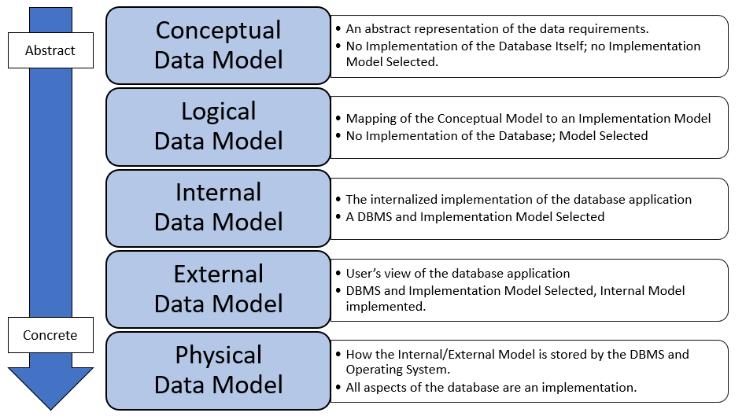
Recall: Data Models
Notes:
For any database there are 5 different representations of it, depending on the level of abstraction.

Slide 6
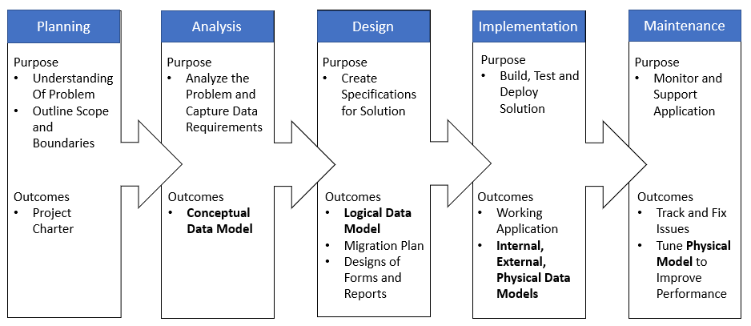
Recall: DBLC
Notes:
The database development lifecycle is a framework for building a database application. It starts with feasibility and ends with the maintenance of the completed application.

Slide 7
Physical Database Design
Does it matter?
It does if you care about performance!

Slide 8

Check Yourself: Physical Model
The physical model is dependent upon the chosen DBMS?
True
False
Notes:
True – the chosen dbms must be considered when implementing the physical data model.

Slide 9
SQL Server Physical Data Model

Slide 10
The Physical Abstraction of SQL Server
Server: installed on an operating system or in a container.
Instance: one or more “setups” of SQL Server on the same physical server (Test, prod, dev.)
Database: stored as one or more files
databasenname.mdf → primary file, member of the PRIMARY filegroup
Othername.ndf → secondary files used to spread data across physical partitions/disks
databbasename_log.ldf → transaction log file holds transactions/recovery information
Filegroup (tablespace): a logical name for one or more physical files. All database objects are written to a filegroup.
Page: set of continuous table rows inside a physical file
Notes:
Virtualization has led to less instances, so rather than install 3 instances on one server, we tend to install 3 servers.

Slide 11
SQL Server Physical Model
Hardware, Virtual Machine, or Container
Boundary:
Physical
Logical
Server
Instance (default)
Instance
Database
Filegroup (primary)
The page is fixed size and owned by various objects like tables, indexes, and so on. It is the smallest physical unit in the DBMS.
File
Page

Slide 12
Check Yourself: SQL Server Physical Model
Which of the following is a logical structure?
Server
File
Filegroup
Instance
Notes:
Filegroup is a logical structure

Slide 13
What is a Page Exactly?
In the DBMS rows of data are written to physical blocks inside the file called pages
The page size in SQL Server is 8 KB (kilobytes)
This is the smallest unit of storage in the database. E.g. even if you update just one column in a table an entire page is written.
Table boundary is the page
Table: employees
Table: paychecks
Database: payroll
Filegroup: PRIMARY
File: payroll.mdf
Page 1
Page 2
Page 3
Page 4
…

Slide 14
How Data Are Inserted into Pages
File in File Group
Page 1
Page 2
1
2
5
6
7
9
10
INSERT table VALUE (9)
Page 1
Page 2
1
2
5
6
7
8
9
10
Page 1
Page 2
Page 3
INSERT table VALUE (3)
1
2
7
8
9
10
3
5
6
Notes:
When there is room on the page, data is added to the page.
When a new page is required, the file size is expanded and the page is added to the end of the file. The data on the page is split with the new page containing the inserted value plus any additional values after it from the previous page.

Slide 15
Check Yourself: Which Page?
Which page will the value 6 be added to?
Page 1
Page 2
New Page 3
Page 1
Page 2
1
2
5
8
9
10
Notes:
6 will be added to page 1

Slide 16
Check Yourself: Which Page?
Which page will the value 4 be added to?
Page 1
Page 2
New Page 3
Page 1
Page 2
1
2
5
6
8
9
10
Notes:
Since page 1 is full it will be added to a new page 3

Slide 17
SQL: Filegroups
Logical Storage for database object like tables
Cannot exist outside a database
Every SQL Server database as a default filegroup called PRIMARY
ALTER DATABASE database_name ADD FILEGROUP file_group_name
View the filegroups in a database
SELECT * FROM sys.filegroups

Slide 18
SQL: Files in Filegroups
Filegroups require one or more physical files on disk.
Filegroup is a logical structure the file is where data are actually stored.
Every SQL Server database as a file database_name.mdf in the default filegroup PRIMARY
ALTER DATABASE database_name ADD FILE ( NAME = logical_name, FILENAME = path_to_file ) TO FILEGROUP file_group_name

Slide 19
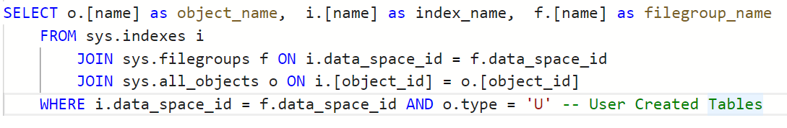
SQL: File / File group Inspection
View the filegroups in a database SELECT * FROM sys.filegroups
View the filegroups in a database SELECT * FROM sys.database_files
Show objects in filegroup:
Notes:
SELECT o.[name] as object_name, i.[name] as index_name, f.[name] as filegroup_name
FROM sys.indexes i
JOIN sys.filegroups f ON i.data_space_id = f.data_space_id
JOIN sys.all_objects o ON i.[object_id] = o.[object_id]
WHERE i.data_space_id = f.data_space_id AND o.type = 'U' -- User Created Tables

Slide 20

Demo: Database, File groups and files
We will use the Azure Data Studio application.
We will use the demo database.
Add filegroup to demo
Show filegroups
Create table, but cannot insert as there is no file
Add file to filegroup on demo
Insert show it now works.
Show files in filegroups, objects in filegroup
Move object to another filegroup
Show physical files on server instance
Notes:
use demo
go
-- create a file group
alter database demo add filegroup products
go
select * from sys.filegroups
-- add some files to the file group
alter database demo
add file (
NAME = products_data,
FILENAME = '/var/opt/mssql/data/products_data.mdf'
)
to FILEGROUP products
GO
select * from sys.filegroups
select * from sys.indexes
-- which tables are in which filegroup
select sys.objects.name as object_name,
sys.filegroups.name as file_group,
sys.indexes.name as clustered_index_name
from sys.filegroups
join sys.indexes on sys.filegroups.data_space_id = sys.indexes.data_space_id
join sys.objects on sys.indexes.object_id = sys.objects.object_id
where sys.objects.type = 'U'
-- move table fudgemart_products to the products file group:
CREATE UNIQUE CLUSTERED INDEX PK_fudgemart_products_product_id ON fudgemart_products (product_id)
WITH (DROP_EXISTING = ON)
ON products -- filegroup

Slide 21
Check Yourself: File and File Groups?
How many filegroups are created by this command:
CREATE DATABASE testing
0
1
2
4
Notes:
Every database has exactly one filegroup by default

Slide 22

Indexes

Slide 23
Database Index
Improves the searchability of our data, at the expense of maintaining multiple versions of it.
Just like the index in the back of a book takes us to a page where that word occurs…
The database index takes us to the database page where the data for which we’re searching can be found.
Scan traverses linearly, a page at a time.
Seek jumps to the page with the content.
Notes:
Scan you’re looking for the word “partition tolerance” in a textbook. You can go about this two ways you can open the book read each page sequentially until you find it (scan)
Or you can use the index to jump to the exact page you want (seek)

Slide 24
Clustered Index
Sorts and stores the data in the order of the key values.
There can only be one clustered index per table since rows can only be stored in that order.
By default, the primary key contains a clustered index, but this is not a requirement.
The pages are organized by the clustered index.

Slide 25

Primary Key as a Clustered Index
This is why auto-incrementing values are good for clustered indexes—it avoids page fragmentation
Int identity
Date/time stamp
Ideal key/clustered index
Narrow—not many bytes in size
Unique
Static—never changing
Ever-increasing

Slide 26
Clustered index visualized
Id | Name
1 | Apple
2 | Cherry
3 | Banana
4 | Orange
5 | Grapes
6 | Lemons
Id | Name
1 | Apple
2 | Cherry
3 | Banana
4 | Orange
Page 1
Id | Name
1 | Apple
2 | Cherry
3 | Banana
4 | Orange
5 | Grapes
Page 2
INSERT Lemons
INSERT Grapes

Slide 27
CREATE Table Revisited
CREATE TABLE table_name ( column, […], CONSTRAINT pk_name PRIMARY KEY CLUSTERED| NONCLUSTERED (columns) [ON filegroup_name] ) [ON filegroup_name]
PK can be clustered or non-clustered.
Separate filegroups can be specified for the table and the PK.
A table can only have one clustered index!
Non-Clustered PK’s make sense for natural keys.

Slide 28
Demo: Tables & Primary keys Revisited
We will use the Azure Data Studio application.
We will use the demo database.
Primary key with non-clustered index
Only can have one clustered index on a table
Natural Keys should be non-clustered
Create table clustered/non-clustered
You can store the index in the same filegroup or a different filegroup from the table
Notes:
CREATE TABLE [dbo].[accounts2](
[account] [varchar](50) NOT NULL,
[balance] [money] NOT NULL,
CONSTRAINT [PK_accounts] PRIMARY KEY NONCLUSTERED ([account] ASC) ON [PRIMARY]
) ON [PRIMARY]
GENERATED SCRIPT
GO
ALTER DATABASE [demo] ADD FILEGROUP [TESTING]
GO
ALTER DATABASE [demo] ADD FILE ( NAME = N'testing', FILENAME = N'/var/opt/mssql/data/testing.ndf' , SIZE = 8192KB , FILEGROWTH = 65536KB ) TO FILEGROUP [TESTING]
GO

Slide 29
Check Yourself: Primary Keys
A Primary Key must use a clustered index.
True
False
Notes:
False. The orimary k

Slide 30
Check Yourself: Primary Keys
A clustered index must be in the same filegroup as the table data.
True
False
Notes:
False.

Slide 31
Non-Clustered Index
Secondary indexes compared with the primary clustered index
Use to improve the performance of queries
You can create multiple non-clustered indexes on your table
The cost is extra space, and extra inserts
Every index on a table must be updated when the data in a table are updated

Slide 32
CREATE INDEX
CREATE [UNIQUE] INDEX index_name ON table_name (column,[…]) [INCLUDE (column, […])] [ON filegroup_name]
The columns next to the table are the index keys.
The index can be made unique—a constraint.
The columns in the INCLUDE clause are not part of the index key, but included in the index.
When these columns are in the projection of the SELECT statement, you get an index seek.

Slide 33
Non-Clustered Index Visualized
Id | Name | Type
1 | Apple | Fruit
2 | Carrot | Vegetable
3 | Banana | Fruit
4 | Orange | Fruit
5 | Celery | Vegetable
Type | Name | Id
Fruit | Apple, Banana, Orange | 1, 3, 5
Vegetable | Carrot, Celery | 2, 4
CREATE INDEX ix_produce_type ON produce (Type) INCLUDE (Name)

Slide 34
Faster Reads
Id | Name | Type
1 | Apple | Fruit
2 | Carrot | Vegetable
3 | Banana | Fruit
4 | Orange | Fruit
5 | Celery | Vegetable
Type | Name | Id
Fruit | Apple, Banana, Orange | 1, 3, 5
Vegetable | Carrot, Celery | 2, 4
SELECT Name FROM produce
WHERE Type=‘Fruit’

Slide 35
Slower Writes
Id | Name | Type
1 | Apple | Fruit
2 | Carrot | Vegetable
3 | Banana | Fruit
4 | Orange | Fruit
5 | Celery | Vegetable
6 | Tomato | Fruit
Type | Name | Id
Fruit | Apple, Banana, Orange, Tomato | 1, 3, 5, 6
Vegetable | Carrot, Celery | 2, 4
INSERT INTO produce VALUES (6, ‘Tomato’,’Fruit’)

Slide 36
Check Yourself: Non-Clustered Indexes
How does having too many non-clustered indexes degrade performance?
Notes:
Each write to the table required subsequent writes to the indexes. So with 5 indexes, the data would need to be written 6 times.

Slide 37

Query Tuning with Indexes

Slide 38
Scans and Seeks: Finding a Row of Data
Worst
Table scan: search for—row by row—looking for data in each column; worst-case scenario
Clustered index scan: use the clustered index (primary key, usually) to search row by row
Clustered index seek: jump to the correct page using the clustered index
Index scan: search the index row by row—better than scanning the clustered index, as it typically has less rows.
Index seek: uses the index to jump to the correct page—Nirvana!
Best
Notes:
Table scans are horribly inefficient. In essence a double for loop over rows and for each row each column!
Clustered index scan is better – just a for loop
Clustered index seek – jumps

Slide 39
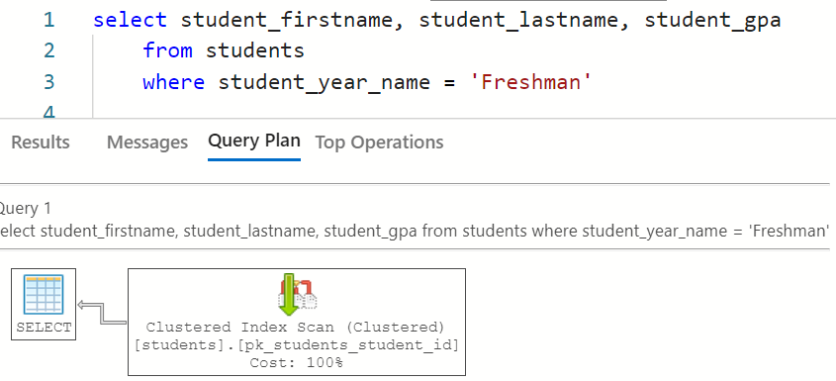
Query Plan Tool Shows Data Access
Notes:
select student_firstname, student_lastname, student_gpa
from students
where student_year_name = 'Freshman'
select student_year_name, avg(student_gpa)
from students
group by student_year_name
drop index if exists ix_students_by_year_name on students
go
create NONCLUSTERED index ix_students_by_year_name
on students (student_year_name)
include (student_firstname, student_lastname, student_gpa)

Slide 40
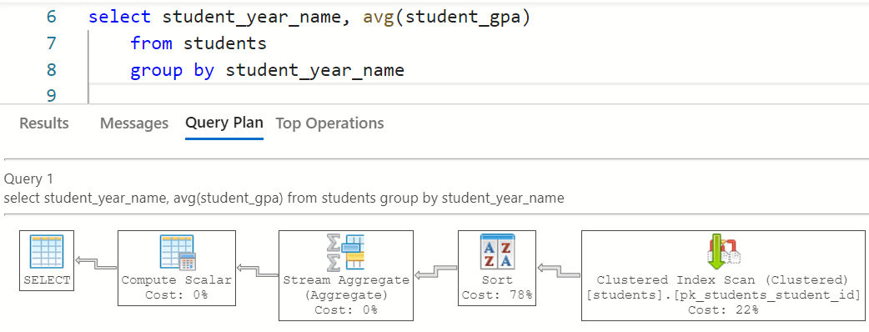
Still an Index scan, but now needs a sort

Slide 41
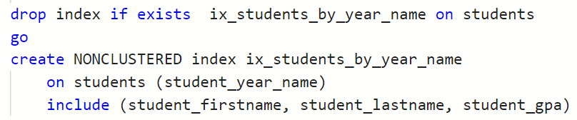
How to Cover you Query with an Index
Index key should be the column(s) in the:
WHERE,
GROUP BY, or
HAVING clases
Included Index Columns are columns from the projection
SELECT line
Notes:
select student_firstname, student_lastname, student_gpa
from students
where student_year_name = 'Freshman'
select student_year_name, avg(student_gpa)
from students
group by student_year_name
drop index if exists ix_students_by_year_name on students
go
create NONCLUSTERED index ix_students_by_year_name
on students (student_year_name)
include (student_firstname, student_lastname, student_gpa)

Slide 42
Query Plan: Before Index

Slide 43
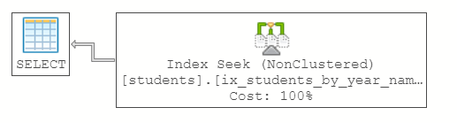
Query Plan: After Index

Slide 44
Query Plan: Before Index

Slide 45
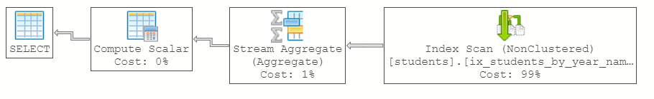
Query Plan: After Index
Notes:
We no longer need to sort because the index is sorted for us!!!

Slide 46
Demo: Understand Query Plans
We will use the Azure Data Studio application.
We will use the tinyu database.
Example of how to read query plans.
How window functions affects the query.
An adjustment to the window function improves performance.
Remove the sort operation with an index.
Notes:
use tinyu
go
-- basic query
select student_firstname, student_lastname, major_name, student_gpa
from students s
join majors m on s.student_major_id = m.major_id
-- original query with window function
select student_firstname, student_lastname, major_name, student_gpa
,avg(student_gpa) over (partition by major_name) as avg_gpa_by_major
from students s
join majors m on s.student_major_id = m.major_id
-- better as it uses a seek, keep the window function in the same table.
select student_firstname, student_lastname, major_name, student_gpa
,avg(student_gpa) over (partition by student_major_id) as avg_gpa_by_major
from students s
join majors m on s.student_major_id = m.major_id
---sort is the most costly operation, so let's use an index
GO
drop index if exists ix_students_by_student_major_id on students
GO
create NONCLUSTERED index ix_students_by_student_major_id
on students( student_major_id)
include (student_firstname, student_lastname, student_gpa, student_year_name)
GO
select student_firstname, student_lastname, major_name, student_gpa
,avg(student_gpa) over (partition by student_major_id) as avg_gpa_by_major
from students s
join majors m on s.student_major_id = m.major_id
select student_firstname, student_lastname, major_name, student_gpa
from students s
join majors m on s.student_major_id = m.major_id
-- final look at simple query
select student_firstname, student_lastname, major_name, student_gpa
from students s
join majors m on s.student_major_id = m.major_id

Slide 47
Check Yourself: Non-Clustered Indexes
The best performing table lookup is a/an:
A. Table scan
B. Table seek
C. Index Scan
D. Index Seek
Notes:
Index seek, of course!

Slide 48
Check Yourself: Non-Clustered Indexes
To improve this SQL SELECT what should be the index key?
SELECT a,b,c,d FROM z WHERE a=1 and b=2
A. a
B. b
C. Either a or b
D. Both a and b
Notes:
Both a and b are required to be index keys for this index to be used.

Slide 49
Non-Clustered Index Rules of Thumb
Use Indexes
Avoid Indexes
The table contains over 100,000 rows
The searchable field (indexed column) has a wide range of values
The searchable field has a large number of null values
The searchable field is queried frequently
Queries retrieve less than 2–4% of the table’s rows
There are relatively few rows in the table
The column is not used for searching
The majority of the queries that retrieve more than 2–4% of the table’s rows
There is high insert or update transaction volatility

Slide 50
Rebuilding Indexes
As data are inserted, updated, and deleted into your tables, your indexes will no longer be optimal
The pages will not be stored efficiently, and your indexes become fragmented
Reorganize: move the pages around
Rebuild: create the index from scratch, fill factor is % of each page to fill.
ALTER INDEX index_name ON table REORGANIZE
ALTER INDEX index_name ON table REBUILD [WITH FILLFACTOR=n)]

Slide 51
Index Page Fragmentation - Reorganize
Page 1
Page 2
Page 3
CURRENT INDEX
1
2
7
8
9
10
3
5
6
INDEX
REORGANIZE
Page 1
Page 2
Page 3
1
2
3
5
6
7
8
9
10
Notes:
Indexes can become fragmented over time.
A REOGANIZE sorts the pages within the file so that adjacent pages are next to each other in the file this avoids skipping around in the file to locate the adjacent page, improving performance of the index.

Slide 52
Index Page Fragmentation - Rebuild
Page 1
Page 2
Page 3
CURRENT INDEX
1
2
7
8
9
10
3
5
6
INDEX
REBUILD
Page 1
Page 2
Page 3
1
2
3
5
6
7
8
9
10
Notes:
Indexes can become fragmented over time.
A REBUILD re-creates the index. This optimizes all of the pages and the data within the pages.

Slide 53
Index Page Fragmentation – Rebuild Fill Factor
Page 1
Page 2
Page 3
CURRENT INDEX
1
2
7
8
9
10
3
5
6
INDEX
REBUILD
WITH (FILLFACTOR=75)
Page 1
Page 2
Page 3
1
2
3
5
6
7
8
9
10
Notes:
Indexes can become fragmented over time.
Fill factor of 75 fills each page 75% full leaving 25% space on each page. This can be done to avoid index fragmentation when you know more data will be inserted or updated.

Slide 54
Demo: Index Statistics
We will use the Azure Data Studio application.
We will use the demo database.
Create a table and index.
Add Data … Not Fragmented is on one page!
Perform some random updates
Check index fragmentation.
Rebuild and reorganize
Notes:
use demo
GO
-- with size 5 and 2 this will not be fragemented as all the data fits on a single page!
-- with sizes 5 and 2000
-- the table will be fragmented (clustered index not insereted ascending order)
-- the index will not be fragmented still fits in one page
-- with sizes 500 and 2000
-- both are fragemented! index out of order, and clustered index out of order
go
drop table if exists items
go
create table items (
item_name varchar(100) not null,
item_qty char(500) not null, --5
item_space_waster char(2000) not null, -- 5
constraint pk_item_name primary key clustered (item_name)
)
GO
create NONCLUSTERED index ix_items on items(item_qty)
GO
insert into items values ('alarm clock', '50',' ')
insert into items values ('blanket', '44',' ')
insert into items values ('cheese', '50',' ')
insert into items values ('soap', '87',' ')
insert into items values ('bedding', '88',' ')
insert into items values ('phone', '30',' ')
insert into items values ('glass', '88',' ')
insert into items values ('jewel', '58',' ')
insert into items values ('zebra', '12',' ')
insert into items values ('bouy', '99',' ')
insert into items values ('broom', '20',' ')
insert into items values ('backpack', '44',' ')
insert into items values ('fan', '10',' ')
insert into items values ('file', '1',' ')
insert into items values ('fund', '7',' ')
insert into items values ('game', '14',' ')
insert into items values ('yam,', '14',' ')
insert into items values ('apple', '44',' ')
insert into items values ('knife', '88',' ')
insert into items values ('jam', '44',' ')
insert into items values ('bucket', '21',' ')
insert into items values ('armoire', '50',' ')
insert into items values ('egg', '14',' ')
insert into items values ('worm', '76',' ')
insert into items values ('rice', '50',' ')
insert into items values ('dough', '14',' ')
insert into items values ('knot', '50',' ')
insert into items values ('banana', '12',' ')
insert into items values ('hammer', '90',' ')
insert into items values ('tape', '1',' ')
insert into items values ('wire', '25',' ')
insert into items values ('owl', '40',' ')
insert into items values ('heater', '92',' ')
insert into items values ('ash', '99',' ')
insert into items values ('figurine', '71',' ')
insert into items values ('saw', '99',' ')
insert into items values ('slate', '50',' ')
-- check fragmentation
SELECT s.[name] +'.'+t.[name] AS table_name
,i.NAME AS index_name
,index_type_desc
,ROUND(avg_fragmentation_in_percent,2) AS avg_fragmentation_in_percent
,record_count AS table_record_count
FROM sys.dm_db_index_physical_stats(DB_ID(), NULL, NULL, NULL, 'SAMPLED') ips
INNER JOIN sys.tables t on t.[object_id] = ips.[object_id]
INNER JOIN sys.schemas s on t.[schema_id] = s.[schema_id]
INNER JOIN sys.indexes i ON (ips.object_id = i.object_id) AND (ips.index_id = i.index_id)
ORDER BY avg_fragmentation_in_percent DESC
alter index pk_item_name on items rebuild
alter index pk_item_name on items REORGANIZE
alter index ix_items on items rebuild
alter index ix_items on items REORGANIZE

Slide 55
Check Yourself: Index Statistics
No index can be fragmented unless, it
A. Has a primary key
B. Lacks a primary key
C. Spans more than one page
D. Resides on one page
Notes:
An index must span more than one page to become fragmented.

Slide 56
Columnstore Index
The standard for storing and querying large tables with many columns
Rather than storing the data in rows, the data are stored in columns
Appropriate for tables with many columns (wide tables) and those with many similar values as found in data warehouse fact tables
Comes in clustered/non-clustered versions
Data are compressed and cached in memory
Notes:
You can only have one clustered index so if you make a columnstore index, you mustdrop the other clustered index.

Slide 57
Tangent: What is a Columnstore
Physical Row Store
Easier to retrieve a column
Easier to aggregate values or distinct values in a column
Used in analytics
Physical Col Store
Row 1 | US
 | Alpha
 | 3,000
Row 2 | US
 | Beta
 | 1,250
Row 3 | JP
 | Alpha
 | 700
Row 4 | UK
 | Alpha
 | 450
Country | US
 | US
 | JP
 | UK
Product | Alpha
 | Beta
 | Alpha
 | Alpha
Sales | 3,000
 | 1,250
 | 700
 | 450
Logical Table
Country | Product | Sales
US | Alpha | 3,000
US | Beta | 1,250
JP | Alpha | 700
UK | Alpha | 450
Easier to add new rows
Simple to retrieve a row, update a row
Used for CRUD operations
Notes:
All files are stored sequentially. So here’s the advantages of each
Row store:
easier to add new rows. Just tack it on to the end.
Simple to retrieve a row, update a row
Used for CRUD operations
Col store
Easier to retrieve a column or two
Easier to count values or distinct values in a column
Used in Analytics

Slide 58
SQL: CREATE COLUMNSTORE
CREATE [CLUSTERED|NONCLUSTERED] COLUMNSTORE INDEX index_name ON table_name (column,[…])
Can be clustered or non-clustered; only one clustered index
The columns specified are not keys, they are the columns included in the column store index; the keys are the names of the columns!

Slide 59
Demo: Columnstore Index
We will use the Azure Data Studio application.
We will use the fudgemart_v3 database.
Run query on orders table and look at live statistics
Make a non-clustered index to improve this query
But it doesn’t work for other queries—we’d need another index
Columnstore to the rescue!
Notes:
use fudgemart_v3
go
-- clustered index scan
SELECT count(order_id),[ship_via]
FROM [fm_orders]
GROUP BY [ship_via]
create nonclustered index ix_fudgemart_orders on [fm_orders] (ship_via) ;
-- yay non clustered index scan - using our new index.
SELECT count(order_id),[ship_via]
FROM [fm_orders]
GROUP BY [ship_via]
-- but this does not :-(
SELECT count(order_id),customer_id
FROM [fm_orders]
GROUP BY customer_id
-- neither does this :-(
SELECT count(order_id),creditcard_id
FROM [fm_orders]
GROUP BY creditcard_id
-- and it would require two additional indexs, too. Blah!
-- let's try a columnstore
GO
drop index if exists ix_fudgmart_orders_col on fm_orders
go
create nonclustered columnstore index ix_fudgmart_orders_col
on fm_orders (ship_via, customer_id, creditcard_id)
-- uses our columnstore index
SELECT count(order_id),[ship_via]
FROM [fm_orders]
GROUP BY [ship_via]
-- this works too!
SELECT count(order_id),[customer_id]
FROM [fm_orders]
GROUP BY [customer_id]
-- this works too!
SELECT count(order_id),[creditcard_id]
FROM [fm_orders]
GROUP BY [creditcard_id]
-- and even this!!!
SELECT count(order_id),[creditcard_id]
FROM [fm_orders]
WHERE [customer_id] between 10 and 20
GROUP BY [creditcard_id]

Slide 60
Check Yourself: Columnstore index
One advantage of the columnstore index over a traditional or rowstore index is
A. A columnstore index improves the performance of record updates
B. A columnstore index will not cache its data into memory
C. A single columnstore index can cover several queried columns on the table
Notes:
C – a single columnstore index covers several queried columns in the table.

Slide 61
Indexed Views
Easy way to improve the performance of a view
An indexed view is SQL Server’s version of a materialized view
The output of the view is saved into an index table to improve read performance of the view
When the underlying data are updated, so is the view, just like an index!
Must bind the schema of the underlying tables—cannot alter the underlying table schema without dropping the view first
Notes:
A non deterministic view would be one which takes a random sample of rows.

Slide 62
Rules for Indexing a View
Use WITH SCHEMABINDING in the CREATE VIEW statement
The view must be deterministic—the same input yields the same output
All columns must be specified; no wildcard columns
Tables must be schema qualified dbo.
Must be a unique clustered index (like setting a PK)

Slide 63
Demo: Indexed Views
We will use the Azure Data Studio application.
We will use the tinyudatabase.
Query plan of a Vew
Add with schemabinding
Then index.
Query plan is now like a table!
Notes:
use fudgemart_v3
go
-- clustered index scan
SELECT count(order_id),[ship_via]
FROM [fm_orders]
GROUP BY [ship_via]
create nonclustered index ix_fudgemart_orders on [fm_orders] (ship_via) ;
-- yay non clustered index scan - using our new index.
SELECT count(order_id),[ship_via]
FROM [fm_orders]
GROUP BY [ship_via]
-- but this does not :-(
SELECT count(order_id),customer_id
FROM [fm_orders]
GROUP BY customer_id
-- neither does this :-(
SELECT count(order_id),creditcard_id
FROM [fm_orders]
GROUP BY creditcard_id
-- and it would require two additional indexs, too. Blah!
-- let's try a columnstore
GO
drop index if exists ix_fudgmart_orders_col on fm_orders
go
create nonclustered columnstore index ix_fudgmart_orders_col
on fm_orders (ship_via, customer_id, creditcard_id)
-- uses our columnstore index
SELECT count(order_id),[ship_via]
FROM [fm_orders]
GROUP BY [ship_via]
-- this works too!
SELECT count(order_id),[customer_id]
FROM [fm_orders]
GROUP BY [customer_id]
-- this works too!
SELECT count(order_id),[creditcard_id]
FROM [fm_orders]
GROUP BY [creditcard_id]
-- and even this!!!
SELECT count(order_id),[creditcard_id]
FROM [fm_orders]
WHERE [customer_id] between 10 and 20
GROUP BY [creditcard_id]

Slide 64
Check Yourself: Indexed View
Which is not a requirement for indexing a view?
All columns must be specified
PK must exist on every table in used in the view
Notes:
B – this is not a requirement.

Slide 65

Performance Factors
What constitutes poor RDBMS performance, and which factors lead to it?

Slide 66
Factors That Impact Physical Design
Structure
Volume
Volatility
Input Mode
Storage Format
Retrieval
Table and relationship count
Quantity of data
Rate of change of data
How does data get in
Data type selection
Optimizing data retrieval

Slide 67
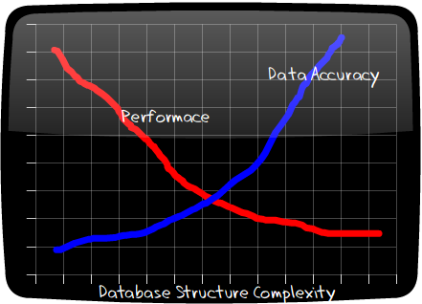
Structure
Structure is the trade-off between performance and data accuracy.

Slide 68
Example: Structure
Complex Structure
Simplified Structure
More normalized
Less chance of bad data
Will perform poorly at large scale
Less normalized
Greater chance of bad data
Better performing at scale
Title
PK | titleId
 | titleName
Employee
PK | empId
FK1 FK2 | empFirstName empLastName empTitleId empDeptId
Employee
PK | empId
 | empFirstName empLastName empDepartmentName empTitleName
Department
PK | deptId
 | deptName

Slide 69
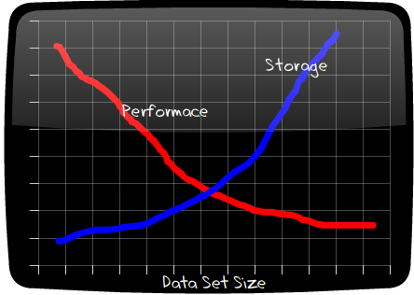
Data Volume
How much data do you have? Volume determines your hardware and DBMS selection. Can you scale horizontally?
Notes:
Hadoop handles high volumes of data and maintains good performance, contrary to

Slide 70
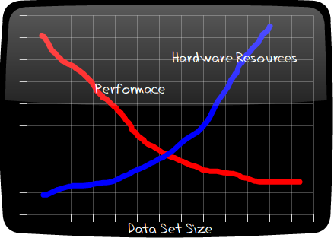
Volatility
The more frequently your data change, the more hardware resources should be dedicated to dealing with changes in data.
Notes:
Redis and Hbase and we will see in future weeks requires a lot of RAM to deal with High volatility, but again maintain a considerable performance.

Slide 71
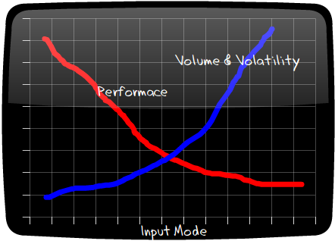
Input Mode
How are the data getting in? High input modes need simplified table designs and more hardware resources to combat volume/volatility.
Notes:
To Handle high input mode in the noSQL world we have Hbase, Cassandra and Kafka.

Slide 72
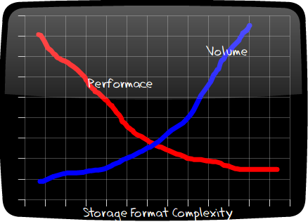
Storage Format
How you choose to store your data (your table designs) will effect volume and performance.

Slide 73
Storage Format
Right-size your column data types. Using more than you need negatively affects volume and performance.
Data Type | Range | Storage
bigint | –2^63 (–9,223,372,036,854,775,808) to 2^63–1 (9,223,372,036,854,775,807) | 8 bytes
int | –2^31 (–2,147,483,648) to 2^31–1 (2,147,483,647) | 4 bytes
smallint | –2^15 (–32,768) to 2^15–1 (32,767) | 2 bytes
tinyint | 0 to 255 | 1 byte
For SQL Server: http://msdn.microsoft.com/en-us/library/ms187752.aspx
Notes:
This factor does not change from SQL to noSQL as we will see. There is always a concern over storage forma.

Slide 74
Storage Format
Data Type Decisions
char or varchar?
char faster than varchar
char uses more space than varchar
int or decimal? or float?
Always choose int unless you need decimal
Same for decimal vs. float
Never use char for true/false—use bit.

Slide 75
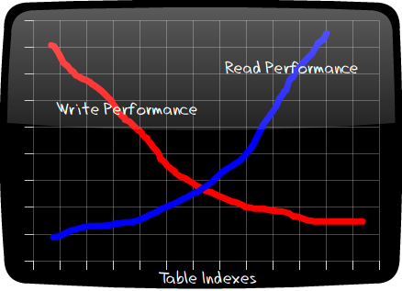
Retrieval
Optimizing data retrieval is the easiest factor you can improve; it impacts write operations adversely.

Slide 76
Retrieval
Index: a thread over columns in a table that speed up searches over it
Cluster: physically grouping rows of data in the same physical block on disk; only one clustered index per table
Products
ID | Name | Department
1 | Hammer | Hardware
2 | T-shirt | Clothing
3 | Wrench | Hardware
4 | Socks | Clothing
5 | TV set | Electronics
6 | Shoes | Clothing
7 | Drill | Hardware
Department Index
Department | IDs
Clothing | 2,4,6
Electronics | 5
Hardware | 1,3,7
As data change, the index must be rebuilt, hence the negative impact on write performance.
Notes:
ID is a cluster on the first table.

Slide 77
CHECK YOURSELF: Matching
The larger the data set, the lower the performance.
Is a trade-off between performance and accuracy of data
Improved reads at the expense of writes
Improving performance through data type selection
Data Structure
Data Retrieval
Data Volume
Data Storage Format
Notes:
A = 3, B = 4, C = 2, D = 1

Slide 78
Physical Performance Tricks
If your server has more than one disk, create one file per disk in the same filegroup to spread IO over the disks.
1
If your server has faster SSD (solid-state disks), create a filegroup on that disk to support high-velocity tables.
2
Do not store the database files on the same disk/partition as the operating system and SQL server itself. Minimize your IO contention.
3
Put fast growing time-series data and associative Entities in their own file group
4

Slide 79
Summary
The Physical Model is an implementation of the logical model on a DBMS.
The SQL Server Physical Model consists of Servers, Instances, Databases, Filegroups, Files and Pages
Indexes allow us to improve query performance at the expense of write performance.
Column store indexes store table data in columns for faster retrieval.
Views can be indexed to improve performance.

Slide 80

Exit Ticket
Confusion Says…
Is there anything from this lesson that still has you confused?
Notes:
‘__0_’

