Slide 1
Unit 13
Data Normalization

Slide 2
Agenda
What is data normalization?
Understanding data anomalies, and inconsistencies.
Defining the normal forms
Understanding, Identifying the normal forms.
Normalizing the table design and transitioning to other normal forms.

Slide 3


Data Normalization

Slide 4
What is Data Normalization?
Data Normalization is a process that seeks to improve the design of a relational database.
The normalization process consists of a series of ordered tests over the data in each table.
When a given test fails, there is a formal process we apply to improve the design.
This involves redesigning the tables then moving the data into the new versions of the tables.

Slide 5

Case Study: Cuse Rides
Community Ride Share Program with Fixed Rates! (Fictitious)
Drivers – people who drive other needing a ride share
Vehicles – fleet vehicles used to drive people around.
Each Driver must be certified to drive that vehicle by scoring better than 75/100 on the road test exam.
Pricing model is based on Driver + Vehicle

Slide 6
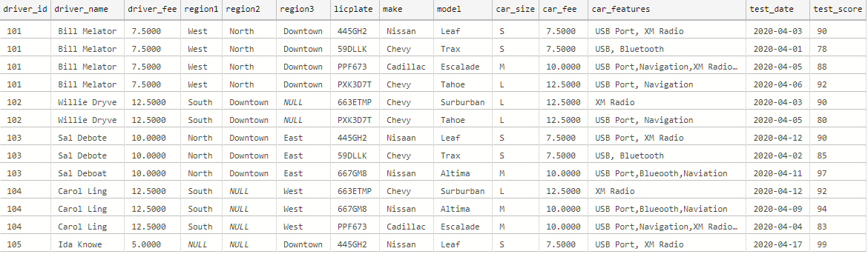
Case Study: Cuse Rides
Spreadsheet Database – One Big Table… poor design.

Slide 7
How Does Data Normalization Improve Database Design?
The process of normalization will identify hidden dependencies in the data which might have been overlooked throughout the design process.
These dependencies reveal themselves through data inconsistencies and data anomalies in the data within our tables.

Slide 8
Data Inconsistencies
Multiple representations of the same data cause it to become inconsistent.
Same Person
Same Car
Which Column is for Downtown?

Slide 9

Check Yourself: Data Inconsistencies
Which column has a data inconsistency in it?
Student Id | Name | GPA | Major
101 | Erin Detyers | 3.45 | Accounting
101 | Erin Detyers | 3.40 | Finance
201 | Gamble Moore | 2.98 | Accounting
201 | Gamble Moore | 2.98 | Psychology
Notes:
GPA – 2nd erin should be the same GPA as the first.

Slide 10
Data Anomalies Make Inconsistencies
Update Anomaly
Delete Anomaly
Insert Anomaly
Table is not DRY!

Slide 11
Update Anomaly
Raise Bill Melator’s fee? 4 Updates!?!?

Slide 12
Delete Anomaly
How do we Delete the Nissan Leaf? A Delete is an SQL UPDATE?

Slide 13
Insert Anomaly
How do we add Kent Belevit? Not until he takes a test Apparently!??! Then to insert the test is an SQL UPDATE?
Nulls Not Allowed Here!

Slide 14
Check Yourself: Data Anomalies
In order to remove data from the table you must perform an SQL UPDATE statement. Which type of Anomaly is this?
INSERT
UPDATE
DELETE
SELECT
Notes:
C – delete

Slide 15

What’s Next?
We Have
Data redundancy
Data anomalies and
Data inconsistencies
Caused by poor design
So how to we fix it?
Answer: Normalize
Identify the data dependencies, then resolve them!

Slide 16

Understanding Data Dependencies

Slide 17
Data Dependencies
Data dependencies define the data relationship between the attributes in two columns of a table.
Each column might:
Not be useable by the key
Act as a key
Be a key
Be part of a key

Slide 18

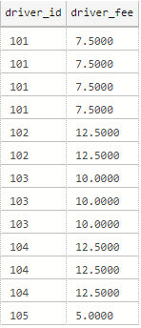
Key Dependency
Key dependency exists between columns A and B when column A is a key and can be used to lookup a single atomic value for column B.
With driver_id as the key, we can lookup a single atomic value for driver_fee
While the key does repeat, the same value is looked up for each key.

Slide 19
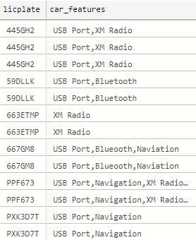
No Key Dependency
No key dependency exists between columns A and B when column A is a key and cannot be used to lookup a single atomic value from column B.
In this example, the key licplate cannot be used to lookup a single feature (not atomic, but multi-valued).
While the same licplate looks up the same features, you cannot select a single atomic feature like XM Radio.

Slide 20
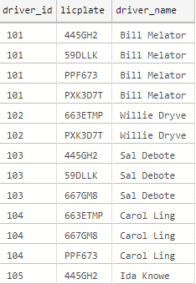
Partial Key Dependency
A partial key dependency exists between columns A and B when columns A+C are a key and only column A is only necessary to lookup a single atomic value for column B.
Columns driver_id + licplate are the key but only the driver_id is required to lookup single atomic values of driver_name

Slide 21
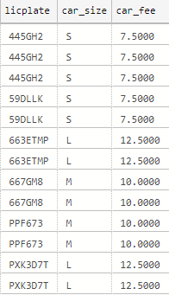
Transitive Dependency
A transitive dependency exists between columns A and B when column A is not a key but can be used to lookup a single atomic value in column B.
In this example, licplate is the key, but car_size can be used to lookup a single atomic value for car_fee.
Column car_size is acting ask as key on behalf of licplate hence the transitive dependency.

Slide 22
Check Yourself: Data Dependencies
Which type of dependency occurs between two columns which are not a key?
No Key
Partial
Transitive
Notes:
C – transitive

Slide 23
Check Yourself: Data Dependencies
Assume the key column(s) are underlined. Which column has no key dependency?
Friend | Hobbies | Address | City ST | Phone
Tom | Tennis, Skiing | 1313 Mockingbird | Utica, NY | 555-1234
Dick | Baseball, Skiing | 1313 Mockingbird | Utica, NY | 555-1234
Harry | Tennis | 141 West Ave | Rome, NY | 555-9902
Mary | Tennis, Baseball | 141 West Ave | Rome, NY | 555-9902
Jane | Skiing | 13 Jane Lane | Oswego, NY | 555-6767
Notes:
Hobbies – multi-valued

Slide 24
Check Yourself: Data Dependencies
Assume the key column(s) are underlined. Which column as a partial dependency?
Friend | Hobbies | Address | City ST | Phone
Tom | Tennis, Skiing | 1313 Mockingbird | Utica, NY | 555-1234
Dick | Baseball, Skiing | 1313 Mockingbird | Utica, NY | 555-1234
Harry | Tennis | 141 West Ave | Rome, NY | 555-9902
Mary | Tennis, Baseball | 141 West Ave | Rome, NY | 555-9902
Jane | Skiing | 13 Jane Lane | Oswego, NY | 555-6767
Notes:
None it is a one column key!

Slide 25
Check Yourself: Data Dependencies
Assume the key column(s) are underlined. Which column as a transitive dependency?
Friend | Hobbies | Address | City ST | Phone
Tom | Tennis, Skiing | 1313 Mockingbird | Utica, NY | 555-1234
Dick | Baseball, Skiing | 1313 Mockingbird | Utica, NY | 555-1234
Harry | Tennis | 141 West Ave | Rome, NY | 555-9902
Mary | Tennis, Baseball | 141 West Ave | Rome, NY | 555-9902
Jane | Skiing | 13 Jane Lane | Rome, NY | 555-6767
Notes:
Make MC
Address is a key for City, ST

Slide 26

Understanding Normal Forms

Slide 27
Normal Form
A Normal Form represents the state of the data within the table with respect to data dependencies.
Zero Normal Form (0NF) data has at least one column with no key dependency.
First Normal Form (1NF) has zero columns with no key dependency.
Second Normal Form (2NF) has zero columns with no key dependency and zero columns with partial key dependency.
Third Normal Form (3NF) as zero columns with no key dependency, zero columns with partial key dependency and zero columns with transitive dependency.

Slide 28
Progression of Normal Forms
RESOLUTION
3rd Normal Form
2nd Normal Form
1st Normal Form
Zero Normal Form
Resolve Transitive Dependencies
Resolve Partial Key Dependencies
Resolve No Key Dependencies
DATA STATE

Slide 29
Check Yourself: Which Normal Form?
A table with all key dependencies and no partial key dependencies is in which normal form?
0NF
1NF
2NF
3NF
Notes:
2NF

Slide 30
Check Yourself: Which Normal Form?
A table with one no key dependency is in which normal form?
0NF
1NF
2NF
3NF
Notes:
0NF

Slide 31

The Data Normalization Process

Slide 32
Data Normalization Process
Select Natural Key or Minimal Candidate Key of table
Transitive dependencies?
Partial Key dependencies?
NO
NO
Non-Key dependencies?
NO
1NF
2NF
3NF
YES
YES
YES
Resolve all No Key dependencies to new tables.
Resolve all Partial-Key dependencies to new tables.
Resolve all Transitive dependencies to new tables.
Notes:
Don’t spend a lot of time here, just explain we will walk through the process as see this diagram a lot.

Slide 33
Key Selection
Select Natural Key or Minimal Candidate Key of table
Transitive dependencies?
Partial Key dependencies?
NO
NO
Non-Key dependencies?
NO
1NF
2NF
3NF
YES
YES
YES
Resolve all No Key dependencies to new tables.
Resolve all Partial-Key dependencies to new tables.
Resolve all Transitive dependencies to new tables.

Slide 34

Key Selection
For each table to be normalized a key must be selected from the table data.
This key cannot be a surrogate key, since these keys are meaningless the have no data dependencies.
A natural or business key should be selected.
If there is no natural key, the minimal candidate key should be selected.

Slide 35
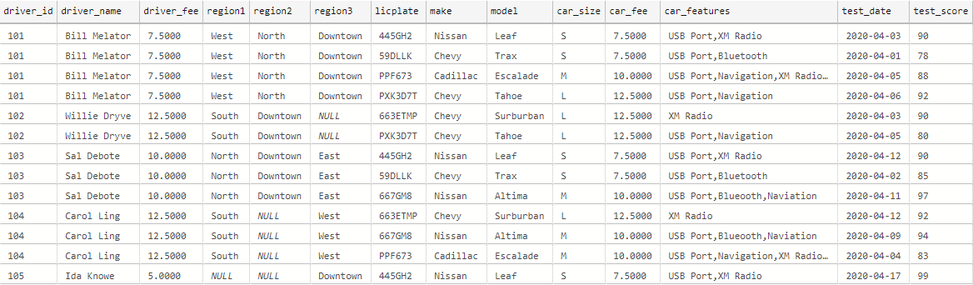
Cuse Rides: Key Selection
One row represents a driver passing a vehicle exam. It does not make sense for the driver id and license plate to repeat.

Slide 36
Check Yourself: Normalization Keys
Which of the following makes for the best key selection for data normalization of a table?
Surrogate Key
Candidate Key
Minimal Candidate Key
Natural Key
Notes:
Natural key is the best selection for normalization, when not available use the minimal candidate key.

Slide 37
Identifying No Key Dependencies
Select Natural Key or Minimal Candidate Key of table
Transitive dependencies?
Partial Key dependencies?
NO
NO
No Key dependencies?
NO
1NF
2NF
3NF
YES
YES
YES
Resolve all No Key dependencies to new tables.
Resolve all Partial-Key dependencies to new tables.
Resolve all Transitive dependencies to new tables.

Slide 38
Identifying No Key Dependencies
No-Key dependencies are Multi-valued attributes which where implemented in the relational table as multiple values in a single column or multiple columns with similar names.
In both cases, the data are not query able in the current format because you must inspect inside the field or know which of many fields to choose.
From the data modeling perspective consider No Key dependencies as [M] attributes which were never resolved to a M-M relationship.

Slide 39

Cuse Rides: No Key Dependencies
The Cuse Rides fleet table has two no key dependencies.
A driver drives in many regions such as west side or downtown
A car is equipped with many convenience features such as USB ports or Bluetooth
Regions implemented as many columns
Many Car Features implemented into one column

Slide 40
Resolve No-Key Dependencies
Select Natural Key or Minimal Candidate Key of table
Transitive dependencies?
Partial Key dependencies?
NO
NO
No Key dependencies?
NO
1NF
2NF
3NF
YES
YES
YES
Resolve all No Key dependencies to new tables.
Resolve all Partial-Key dependencies to new tables.
Resolve all Transitive dependencies to new tables.

Slide 41
Resolving No Key Dependencies
These are many-to-many relationships, hidden inside a single column or group of columns
So we need to add lookup table and a bridge table.
Lookup table holds the multi-values; bridge table sustains the original relationship to the key.
No Key Dependencies are moved to the bridge table, unique values go in the lookup table.
Original Table
Bridge Table
Lookup Table of multi-valued attributes
PK
FK
FK
PK

Slide 42


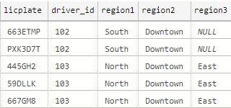
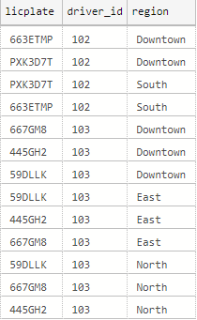
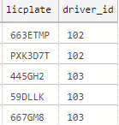

Cuse Rides: Resolve Regions
Bridge
Table
Lookup Table
Dependencies Removed

Slide 43

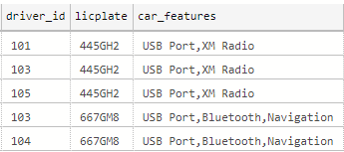
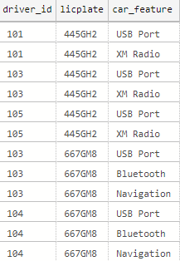

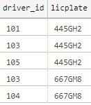
Cuse Rides: Resolve Car Features

Slide 44

Demo: Resolve No Key Dependencies
We will use the Azure Data Studio application.
We will use the demo database, cr_fleet table.
Create the tables
cr_regions (lookup table)
cr_fleet_regions (bridge table)
cr_features (lookup table)
cr_fleet_features (bridge table)
Don’t do the FK’s until we are done normalizing.
Migrate data
UNPIVOT for multiple columns region1, region2, region3
STRING_SPLIT for single column car_features
INSERT INTO SELECT, SELECT INTO

Slide 45
Check Yourself: No Key Dependencies
From the video demo, which SQL is called the Make table query?
INSERT INTO
INSERT INTO … SELECT
SELECT FROM
SELECT INTO
Notes:
Select into makes a new table

Slide 46
First Normal Form
Select Natural Key or Minimal Candidate Key of table
Transitive dependencies?
Partial Key dependencies?
NO
NO
No Key dependencies?
NO
1NF
2NF
3NF
YES
YES
YES
Resolve all No Key dependencies to new tables.
Resolve all Partial-Key dependencies to new tables.
Resolve all Transitive dependencies to new tables.

Slide 47
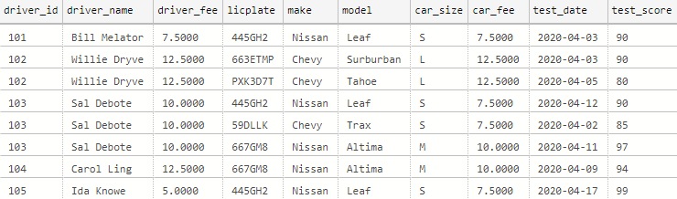
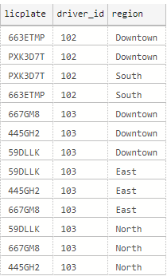
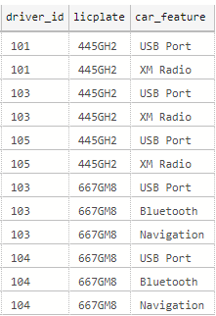


Cuse Rides: Resolved No Key Dependencies, Now in 1NF
fleet
fleet_regions
fleet_features
regions
features

Slide 48
Identifying Partial Key Dependencies
Select Natural Key or Minimal Candidate Key of table
Transitive dependencies?
Partial Key dependencies?
NO
NO
No Key dependencies?
NO
1NF
2NF
3NF
YES
YES
YES
Resolve all No Key dependencies to new tables.
Resolve all Partial-Key dependencies to new tables.
Resolve all Transitive dependencies to new tables.

Slide 49
Identifying Partial Key Dependencies
Partial key dependencies occur when there is a composite key, and only a part of the key is necessary to lookup a single atomic value.
These are usually many-to-many relationships, embedded within a single table.
If the table has a single column key, it cannot have a partial dependency.
If the table does not have any non-key columns it cannot had a partial dependency.

Slide 50

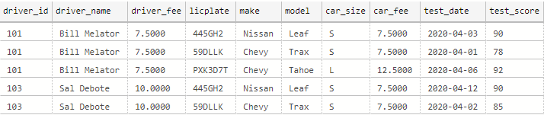
Cuse Rides: Partial Key Dependencies
The Cuse Rides fleet table has two partial key dependencies.
Only the driver_id is necessary to lookup driver_name and driver_fee
Only the licplate is needed to lookup make, model, car_size, & car_fee
Only needs driver_id
Only needs the licplate
Need Both!

Slide 51
Resolving Partial Key Dependencies
Select Natural Key or Minimal Candidate Key of table
Transitive dependencies?
Partial Key dependencies?
NO
NO
No Key dependencies?
NO
1NF
2NF
3NF
YES
YES
YES
Resolve all No Key dependencies to new tables.
Resolve all Partial-Key dependencies to new tables.
Resolve all Transitive dependencies to new tables.

Slide 52
Resolving Partial Key Dependencies
Partially-dependent non-key values are removed from the original table and added to a new table.
The primary key of the new table is the part of the key in which the columns are dependent.
The original table is now an associative entity, with each part of the primary key now a foreign key to the new tables.
Partial Key
Dependent
Table 1
Original Table
Partial Key
Dependent
Table 2
PK
FK
FK
PK

Slide 53

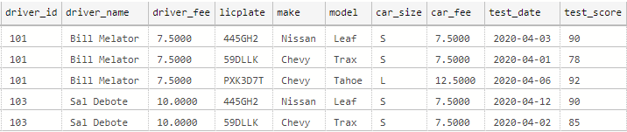
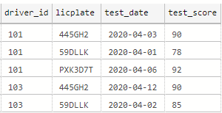
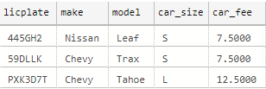

Cuse Rides: Resolve Partial Dependencies
Fleet
table
Partial dependencies for driver_id
Partial dependencies for licplate
Dependencies Removed

Slide 54


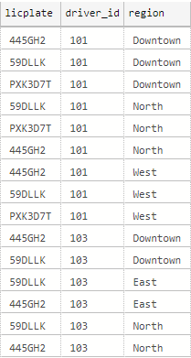
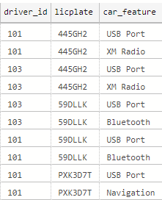
Cuse Rides: Resolve Partial Dependencies
Now that we have a separate drivers table, in the fleet_regions table we no longer need the licplate column. This table will now be joined to drivers.
Eliminate Unnecessary Columns from the key
Now that we have a separate vehicles table, in the fleet_features table we no longer require the driver_id column. This table will now be joined to vehicles.

Slide 55
Demo: Resolve Partial Key Dependencies
We will use the Azure Data Studio application.
We will use the demo database, cr_fleet table.
Create the tables
cr_drivers (partial table)
cr_vehicles (partial table)
Migrate data
SELECT DISTINCT to reduce rows.
INSERT INTO SELECT, SELECT INTO
Alter cr_fleet_drivers removing redundant key
Alter cr_fleet_drivers removing redundant key

Slide 56
Check Yourself: Partial Key Dependencies
From the video, to get the unique values for the partial table we use:
SELECT DISTINCT
SELECT INTO
SELECT with UNION
SELECT with PIVOT
Notes:
A select distinct

Slide 57
Second Normal Form
Select Natural Key or Minimal Candidate Key of table
Transitive dependencies?
Partial Key dependencies?
NO
NO
No Key dependencies?
NO
1NF
2NF
3NF
YES
YES
YES
Resolve all No Key dependencies to new tables.
Resolve all Partial-Key dependencies to new tables.
Resolve all Transitive dependencies to new tables.

Slide 58
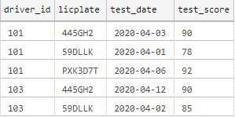

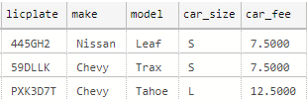
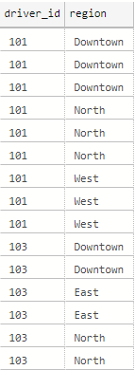
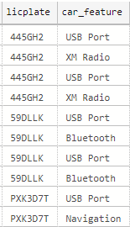
Cuse Rides: Resolved Partial Key Dependencies, Now in 2NF
fleet
drivers
vehicles
driver_regions
vehicle_features
features
regions

Slide 59
Identifying Transitive Dependencies
Select Natural Key or Minimal Candidate Key of table
Transitive dependencies?
Partial Key dependencies?
NO
NO
No Key dependencies?
NO
1NF
2NF
3NF
YES
YES
YES
Resolve all No Key dependencies to new tables.
Resolve all Partial-Key dependencies to new tables.
Resolve all Transitive dependencies to new tables.

Slide 60
Identifying Transitive Dependencies
When a non-key column functions as a key for one or more other columns, we have a transitive dependency.
Transitive dependencies happen when a one-to-many relationship is embedded within a table.
To identify transitive dependences, we must focus on the non-key columns within the table.
The table requires at least two non-key columns for a transitive dependency to exist.

Slide 61
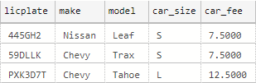
Cuse Rides: Transitive Dependencies
The Cuse Rides vehicles table a transitive dependency.
The car_size column acts as a key for values in the car_fee column.
It is transitive because car_fee does not require the licplate directly.
Trans. Dep.

Slide 62
Resolving Transitive Dependencies
Select Natural Key or Minimal Candidate Key of table
Transitive dependencies?
Partial Key dependencies?
NO
NO
No Key dependencies?
NO
1NF
2NF
3NF
YES
YES
YES
Resolve all No Key dependencies to new tables.
Resolve all Partial-Key dependencies to new tables.
Resolve all Transitive dependencies to new tables.

Slide 63
Resolving Transitive Dependencies
Transitively dependent columns will be removed from the current table and added to a new table.
The primary key of the new table is the column they are transitively dependent upon, the column acting as key.
The original table’s column acting as key is now the foreign key referencing the new table.
Original Table
Transitively
Dependent
Table
FK
PK

Slide 64

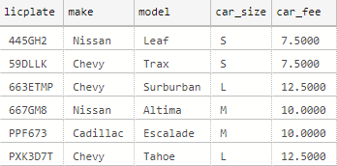
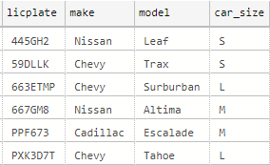
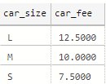
Cuse Rides: Resolve Transitive Dependencies
vehicles
table
Transitive dependencies for car_size
Dependencies Removed

Slide 65
Demo: Resolve Transitive Dependencies
We will use the Azure Data Studio application.
We will use the demo database, cr_fleet table.
Create the tables
cr_vehicles_sizes (transitive table)
Migrate data
SELECT DISTINCT to reduce rows.
INSERT INTO SELECT, SELECT INTO
Now that we are in 3NF, we can add the FK’s

Slide 66
Check Yourself: Transitive Dependencies
In which table does the FK reside after a transitive dependency is resolved?
New Table
Original Table
Both – uses a bridge table
Neither – no new table is created
Notes:
A – new table

Slide 67
Third Normal Form
Select Natural Key or Minimal Candidate Key of table
Transitive dependencies?
Partial Key dependencies?
NO
NO
No Key dependencies?
NO
1NF
2NF
3NF
YES
YES
YES
Resolve all No Key dependencies to new tables.
Resolve all Partial-Key dependencies to new tables.
Resolve all Transitive dependencies to new tables.

Slide 68

Cuse Rides: Resolved Transitive Dependencies, Now in 3NF
fleet
vehicles
drivers
vehicle_sizes
driver_regions
vehicle_features
features
regions

Slide 69
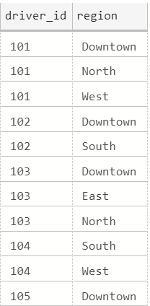
fleet
vehicles
drivers
vehicle_sizes
driver_regions
2NF
vehicle_features
features
regions
3NF
1NF

Slide 70
1NF
2NF
3NF

Slide 71
De-Normalization

Slide 72
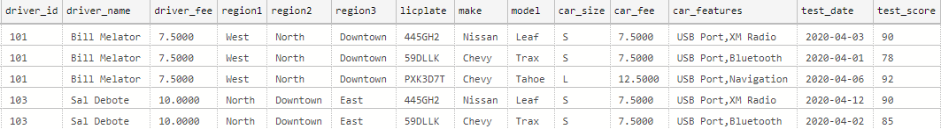
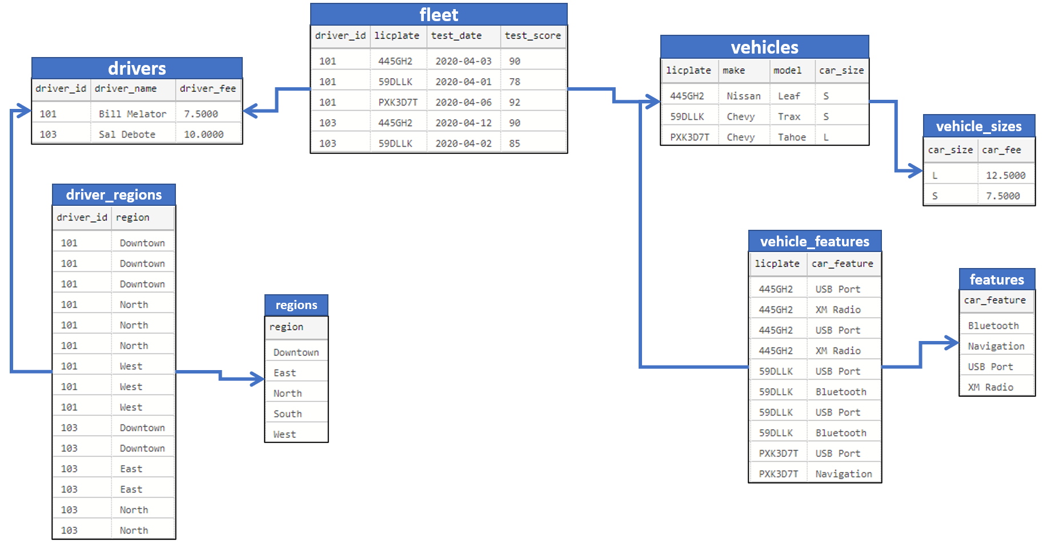
Taking it too far?
fleet
We went from one table.
To 8 tables!!!
Yes, the design is better but is it necessary?

Slide 73
How far should we normalize?
It is a trade-off
Higher normal forms are complex but introduce less chances for data anomalies.
General Rules
1NF is required? It depends 1NF introduces 2 new tables and quite some complexity. But makes the data easier to query and maintain.
2NF is required? Yes. You are hiding a M-M relationship
3NF – depends. Maybe? Is the table used elsewhere like zip code or address?
Never design or normalize in a vacuum, following the rules blindly.
Let the needs of the database application dictate the design!

Slide 74
Summary
Data normalization improves our table designs by eliminating data anomalies which can cause redundancies and inconsistencies.
Normalization is a series of checks based on columns with no key dependencies, partial key dependencies or transitive dependencies.
The normalization process involves identifying, then resolving each of these types of dependencies.
Normalization is not a cure all; the database application and its use should be considered.

Slide 75

Exit Ticket
Sticky Point…
What was the more difficult aspect of this lesson?
Notes:
‘__0_’

