Slide 1
IST769 Unit I
Graph Databases

Slide 2
Agenda
What is a Graph Database?
Neo4j Architecture
????

Slide 3
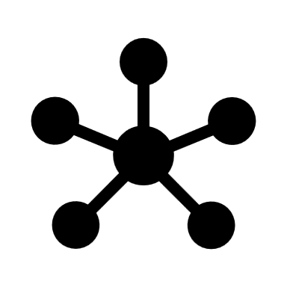
Graph Databases

Slide 4
Graph Databases
The Graph Data Model consists of Nodes and Edges
Nodes are like Entities. They have a type and attributes.
Edges connect nodes. They can be one-way or two-way.
Edges can carry attributes as well
User: Tom
Sales Team
Sales Team
Employment
Reference To
User: Harry
User: Dick
Supervises

Slide 5
Graph Vs Relational
Graph
Relational
Node Label
Node
Node Property
Relationship
Relationship Direction
Relationship Attributes
Table
Row in Table
Column in Table
Foreign Key
(No equivalent)
Associative Entity / Bridge table

Slide 6
Why Graph instead of Relational?
Relational is not good for complex relationships
One-way Relationships (Most Common)
Paying an Invoice, Enrolling in a course
Recursive Relationships (Parent-Child)
Organizational Charts
Product Categories
Security Permissions
File Systems
Complex Relationships (True Graphs)
Email Interactions / Social Media – Community detection
Path finding
Centrality – like Google’s PageRank Algorithm

Slide 7
Check Yourself – True or False
Relationships in the graph data model are two-way.
The graph data model cannot store attributes with the relationship
The graph data model is better suited for parent-child relationships than the relational data model.
Notes:
F
F
T

Slide 8

Neo4j
Open Source Graph Database

Slide 9
Neo4j
Open-Source Graph Model Database
ACID-Compliant
Commercial Version supports High-Availability
Custom Query Language called Cypher
Written in Java
Very performant:
Can handle billions of nodes on a single instance
Can traverse 1000’s of relationships in sub-second time

Slide 10
Neo4J Physical Data Model
Each Node Contains:
Labels
Attributes
Defined Relationships
Pointers to other nodes that satisfy the relationship
Relationship data stored, not calculated
Faster than relational indexing
Can’t be queries with Standard SQL
Customer:
Name: bob
ORDERS:
Number: 1234 <product ptr>
Number: 1234 <product ptr>
Product:
AB12
Amount: $25
Name: Mouse
Product:
AB17
Amount: $75
Name: Keyboard

Slide 11
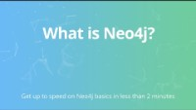
Video: What is Neo4j?

Slide 12
Check Yourself – True or False
Neo4j stores relationships within nodes.
Neo4j does not require an index to find data.
Neo4j is open source.
Notes:
T
T
T

Slide 13
Demo: Neo4J
Start Neo4j in docker
Connect to web UI:
http://localhost:7474/
Load up some sample data:
:play movie graph
:play northwind graph

Slide 14
Neo4j Logical Model
Community Edition limited to single database - neo4j
Labels allow us to group common nodes together.
No required schema for nodes.

Slide 15
Cypher Basics

Slide 16
CREATE Nodes

Slide 17
MERGE to avoid dupes

Slide 18
CREATE Relationships

Slide 19
UPDATE data

Slide 20
DELETE data

Slide 21
MATCH queries

Slide 22
Importing Data

Slide 23
Import CSV

Slide 24
Importing JSON
Need the “Awesome Procedures on Cypher” plugin
with 'https://raw.githubusercontent.com/mafudge/ist769/main/datasets/json-samples/stocks.json' as uri
CALL apoc.load.json(uri)
yield value
return value;

Slide 25
Neo4j and Spark

Slide 27
Graph Data Modeling
https://neo4j.com/developer/data-modeling/

Slide 29
Graph Data Science Library
https://neo4j.com/product/graph-data-science-library/

Slide 30
Algorithms

Slide 31
Check Yourself - Matching
String
Lists
Ordered Sets
Hashes
Pub/Sub
Storing a webpage
Creating a table of data
Real-Time Messaging
Creating a queue
Building a leaderboard
Notes:
Please copy and use this slide each time you are pausing your lecture to ask students a question. Please delete this slide if you do not need to use it.
Matching lists, strings, sets, hashes

Slide 32
Exit Ticket
Is there a something you find still unclear about today’s lesson

