Slide 1
IST769 Unit K
Streaming Data and Apache Kafka

Slide 2
Agenda
Why Streaming Databases?
What Is Apache Kafka?
Concepts
Architecture
Confluent KSqlDb Event Streaming Db
Persistent Streams & tables
Window Queries

Slide 3


Streaming Databases
What are Streaming Databases?

Slide 4
What is a streaming database?
A streaming database processes data in motion, unlike most databases that process data at rest.
Data streams are classified by topic.
The format of the data stream can be anything.
Unstructured, Semi-structured (JSON), or binary.
Clients that send data to topic are publishers.
Clients that receive data from a topic are subscribers.
Also Known as: Message Queues, Service Busses

Slide 5
Demo: Pub-Sub with Kafka
Let's start Kafka!
Lots of services running more on this later!
Open two terminals
Connect to the broker in each window:
docker-compose exec broker bash
Demo
Create a topic called test
Start a producer in one window
Consumer in the other
Bask in your pub-sub glory!
Notes:
DOCKER SETUP
.\kafka> docker-compose up –d
.\kafka> docker-compose exec broker bash
DEMO START
$ kafka-topics --zookeeper zookeeper:2181 --create --topic test --replication-factor 1 --partitions 1
TERMINAL WINDOW 1
$ kafka-console-producer --broker-list localhost:9092 --topic test
TERMINAL WINDOW 2
$ kafka-console-consumer --bootstrap-server localhost:9092 --topic test
Let the data stream flow over you!!!! Anything can be placed in the stream!
Stop the consumer and restart it you only see new messages.
$ kafka-console-consumer --bootstrap-server localhost:9092 --topic test
Stop the consumer and restart it –from-beginning gives you the old messages.
$ kafka-console-consumer --bootstrap-server localhost:9092 --topic test --from-beginning

Slide 6





Recall: Polyglot Persistence
In our new world of micro services architectures and polyglot persistence, how do we integrate disparate data sources and have them exchange timely data?
E-commerce application
Shopping cart
Product catalog
Web analytics
Recommendations
Notes:
In the new world of microservice architectures where systems are architected to handle single responsibilities in order to address scalability, we have unique data challenges.
READ SLIDE
Mainly around data integration. That is with our data stored in 4 different places, how to we insure that each of these persistent data stores contain the most timely and accurate information?

Slide 7


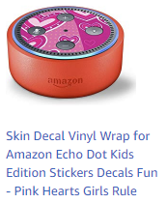
An Abridged Example
Shopping cart
Recommendations
Product added to shopping cart
Product catalog
Web analytics
Shopping cart + Product Data analytics to make
Recommendations
Recommendation Graph Stored
Notes:
For example
[1] when a product is added to the shopping cart, it gets stored in the Redis key-value store so that this information can be quickly access by the website.
[2] This same shopping cart information in addition to the product catalog data, needs to land in the Hadoop web analytics platform so that we use machine learning to update the product recommendations in real time.
[3] These product recommendations are stored in neo4j, a graph database which provides the best performance for this type of data on our website.

Slide 8
Seems Simple. Why the Fuss?
This is just one case of inter-service communication.
In a micro services application, there can be hundreds of messages being passed from one service to another.
Payment processing
Updating user settings
E-mail opt-in/out
Fulfillment of orders
Returns
Product reviews
Customer support/live chat
And so on…

Slide 9
A Solution
Shopping cart
Recommendations
Example:
The recommender dispatch service would publish Redis data to a topic.
The recommendation service would subscribe to that same topic, collect the data from Hadoop and Mongo Db, create a recommendation in Spark and then write it to Neo4J
A data backbone to handle:
Event processing
Data exchange
Message passing among persistent stores
Product catalog
Web analytics

Slide 10
Traditional Vs Streaming
Traditional DBMS
Streaming DBMS
Data at rest
Stores all data over time
Data volume grows over time
Data once written remains relevant.
Complex retrospective analytics
Data in Motion
Stores a window of data over time
Data volume fluctuates based on the volume within the window
Data phases out of relevance at some point
Real-time analytics

Slide 11
Check Yourself: Matching
Publish
Subscribe
Topic
Data in Motion
Data a Rest
Real-time analytics
Receive a message
Send a message
Retrospective Analytics
The subject of the message
Notes:
C
B
E
A
D

Slide 12

Apache Kafka
Overview

Slide 13

Apache Kafka
“The industrial-strength data-sharing backbone”—three key capabilities:
Publish and subscribe to streams of records, similar to a message queue or enterprise messaging system
Store streams of records in a fault-tolerant durable way
Process streams of records as they occur

Slide 14
Kafka Background
Developed by Linked.in, open sourced in 2011, then spun off by the company Confluent.io
Used for:
Event processing
Message queueing
Data exchange between systems
Real-time data analytics
Used by these notables:
Linked.in, Netflix, Square, Twitter, Etsy, Coursera, IFTTT, Mailchimp

Slide 15
Kafka 101
A distributed commit-log architecture
Time-ordered
Append only
Elastically scales out horizontally
Highly fault-tolerant
Data organized by topic—a subject area like “orders” or “shipping notifications”
Data In is time-ordered, append only immutable
Data Out is processed exactly once by each consumer

Slide 16
Kafka Core Features
Broker – node in the kafka cluster.
Producers: push messages
Consumers: pull messages
Stream processors: pull, manipulate, then push
Connectors: Any producer or consumer built for an external system. Can be a source or a sink.
Producers
App
App
App
App
DB
Connectors
Kafka Cluster
Stream Processors
DB
App
App
App
App
Consumers
Notes:
The Producer API allows an application to publish a stream of records to one or more Kafka topics.
The Consumer API allows an application to subscribe to one or more topics and process the stream of records produced to them.
The Streams API allows an application to act as a stream processor, consuming an input stream from one or more topics and producing an output stream to one or more output topics, effectively transforming the input streams to output streams.
The Connector API allows building and running reusable producers or consumers that connect Kafka topics to existing applications or data systems, such as relational databases.

Slide 17
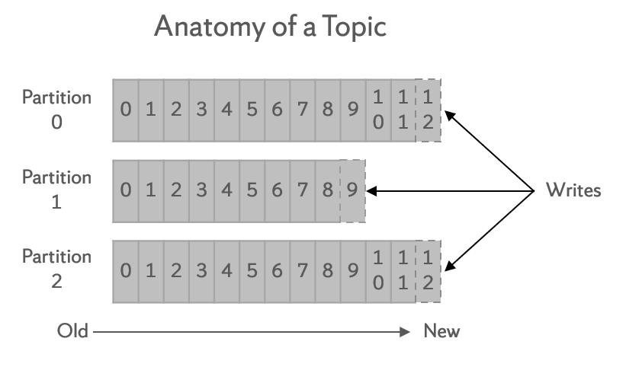
Kafka Topics
Brokers: a participant in a Kafka cluster
Topic: stream or feed of similar messages; these are immutable and append only
Partition: topics are divided into partitions to increase scalability
Replica: a backup of a partition, on another broker; provides fault tolerance
Anatomy of a Topic
Partition 0
0 | 1 | 2 | 3 | 4 | 5 | 6 | 7 | 8 | 9 | 1 0 | 1 1
1 2
Partition 1
0 | 1 | 2 | 3 | 4 | 5 | 6 | 7 | 8
9
Writes
Partition 2
0 | 1 | 2 | 3 | 4 | 5 | 6 | 7 | 8 | 9 | 1 0 | 1 1
1 2
Old
New
Notes:
For example when 3 messages arrive the first might be written to partition 0, the second to partition 1 and the 3rd to partition 2.

Slide 18
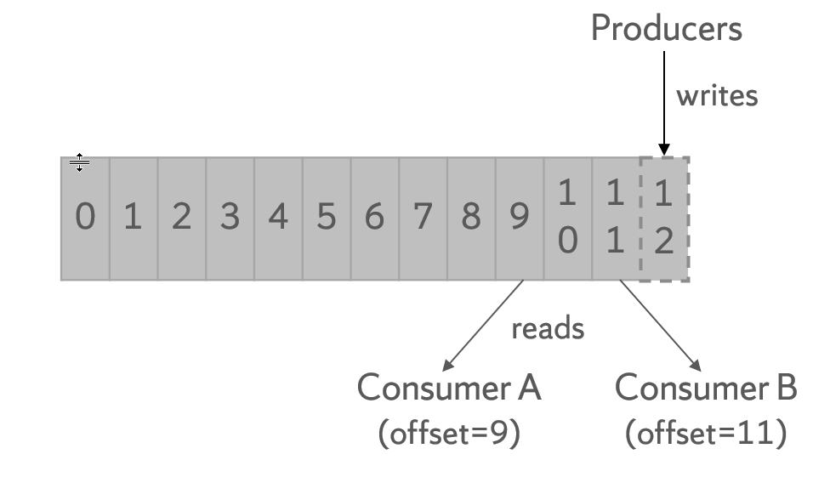
Consumer Offset
Every consumer tracks an offset to track what they have have last read from the topic.
This way no message is missed; they can pick up where the left off.
Producers
writes
0 | 1 | 2 | 3 | 4 | 5 | 6 | 7 | 8 | 9 | 1 0 | 1 1
1 2
reads
Consumer A (offset=9)
Consumer B (offset=11)

Slide 19
Demo: Understanding Topic Offsets
From the Kafka Setup:
Drill http://localhost:8047
Configure Kafka Connector
show tables
Each "table" is a topic
Launch Jupyter http://localhost:8888
Run the Weblogs-Producer to generate a stream
Query with Drill
select * from kafka.`weblogs`
Observe the offset value partion+offset are unique per topic.

Slide 20
Check Yourself: Matching
Broker
Topic
Partition
Replica
Consumer
Producer
Sends messages to a topic
How messages are classified.
How topics are divided
Nodes in a Kafka cluster
Reads messages from a topic
Copies of a partition
Notes:
D
B
C
F
E
A

Slide 21
Apache Kafka
Scalability

Slide 22
Kafka Scalability and Fault Tolerance
The topic partition is the unit of parallelism.
The more partitions, the more consumers can access data concurrently.
Consumers in a consumer group perform the same operation on the topic. Best practice is the same number of consumers in the group as there are partitions.
Partitions are replicated across brokers for fault tolerance. A replication factor of N has 1 original and N-1 replicas.
Excessive partitions and replicas can increase system latency, as messages must be replicated across each partition.
Producers select a partition based on a provided key or, if no key is provided, a round-robin strategy.

Slide 23
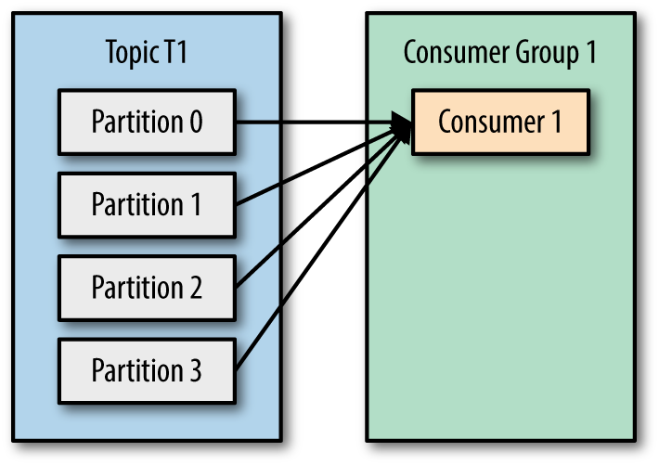
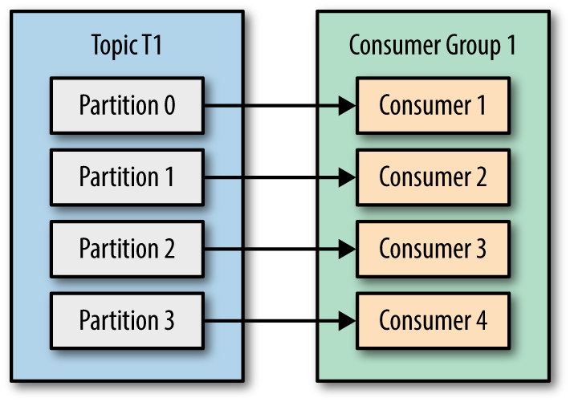
Consumer Group Scalability Example
Imagine that this consumer group “sends an e-mail.”
Each consumer in the consumer group preforms the same function
The 2nd Example is 4x the performance!
Notes:
With a single consumer, there is no scale. As data is written from producer to one of the four partitions in a round-robin fashion, the single consumer must read from all 4 partitions.
With 4 consumers in a consumer group, as data is written from producer to one of the four partitions in a round-robin fashion, each consumer can receive messages from its own partition. Allowing emails to be sent at 4x the rate.

Slide 24
Kafka Cluster Visualized 1/5
This Kafka cluster has three brokers: A, B, and C.
There is a single topic “test” with a replication factor of 3 and two partitions. Lead partitions are underlined.
Broker A
Broker B
Broker C
Partition 0
Partition 0
Partition 0
Partition 1
Partition 1
Partition 1
Consumer 0
Consumer 1
Notes:
This Kafka cluster has 3 Broker A, B and C.
There is a single topic “Test” with replication factor of 3 and 2 partitions.
The lead partitions are underlined. These are assigned by the Zookeeper service which is required to run a kafka cluster.

Slide 25
Kafka Cluster Visualized 2/5
Each consumer in the consumer group for topic “test” is assigned to a partition. This is spread across brokers.
Notice in this example that Broker B is not used, as there are not enough partitions and consumers.
Broker A
Broker B
Broker C
Partition 0
Partition 0
Partition 0
Partition 1
Partition 1
Partition 1
Consumer 0
Consumer 1
Notes:
For maximum scalability, you want the number of consumers in a consumer group to match the number of partitions in a topic.

Slide 26
Kafka Cluster Visualized 3/5
When a producer writes a message to this topic, a lead partition is selected based on key, or round-robin if no key.
Topic: “Test” Message: “Foo”
Producer
Broker A
Broker B
Broker C
Partition 0
Partition 0
Partition 0
Partition 1
Partition 1
Partition 1
Consumer 0
Consumer 1

Slide 27
Kafka Cluster Visualized 4/5
In round-robin, the next message is written to the next lead partition, Partition 1 in this case.
Topic: “Test” Message: “Bar”
Producer
Broker A
Broker B
Broker C
Partition 0
Partition 0
Partition 0
Partition 1
Partition 1
Partition 1
Consumer 0
Consumer 1

Slide 28
Kafka Cluster Visualized 5/5
Should Broker A go down, for example, Zookeeper will shift the lead partition to another broker containing a replica (in this case, Broker B).
Topic: “Test” Message: “Baz”
Producer
Broker A
Broker B
Broker C
Partition 0
Partition 0
Partition 0
Partition 1
Partition 1
Partition 1
Consumer 0
Consumer 1

Slide 29
Check Yourself: True/False
Messages sent to a topic can be updated
Consumer groups help topics to be processes in parallel
Partition number + offset number are unique for each topic
Every consumer is not guaranteed to receive every message in a Kafka topic for which it is subscribed
Topics are replicated across each broker.
Notes:
F (topics are append-only no updates)
T
T
T (consumers in a consumer group distribute topics)
F (partitions are replicated)

Slide 30

Confluent Kafka
And kSqlDb

Slide 31
kSqlDb
Open Source Streaming database by confluent.io
"SQL over Kafka"
Uses Kafka topics and stream processors under the hood with custom services for :
REST API (rest-proxy)
Managing the data Schemas (schema-registry)
Query plans and processing (kqsldb-server)

Slide 32
Streams
Stream: unbounded continuous flow of records, based on a topic; data sent in real time; records are key-value pairs; we want to process the records as they arrive
Consumes data from a Kafka topic and writes the manipulations to another Kafka topic
KSQL let's us perform SQL-Like Manipulations
Kafka Topic “IN”
KSQL
Kafka Topic “OUT”

Slide 33
Demo: Streams in KSQL
Connect to the KSqlDb Server:
docker-compose exec ksqldb-cli ksql http://ksqldb-server:8088
Let’s create a KSQL stream
CREATE STREAM USERS (user varchar) with (kafka_topic='atm', value_format='json');
SHOW STREAMS;
SELECT * FROM users EMIT CHANGES;
What’s going on here? Stopping the program
Using limit to end the query
Notes:
View schema of ATM again in the consumer
KSQL> CREATE STREAM USERS (user varchar) with (kafka_topic='atm', value_format='json');
# Explain this statement!!!
# RUN A PROGRAM USING THIS STREAM
KSQL> select * from USERS emit changes;
# Discuss what is seen in the output. But don’t explain it all at this time!
# This is a non-persistent query. Press CTRL + C to break
KSQL> select * from USERS emit changes limit 3;
# You only get 3

Slide 34
Create Stream
Like the create table statement but makes Kafka stream processor
CREATE STREAM stream_name ( { column_name data_type } [, ...] ) WITH ( property_name = expression [, ...] );
Example:
CREATE STREAM atm_amounts ( user VARCHAR, amount DOUBLE ) WITH ( KAFKA_TOPIC='users', VALUE_FORMAT='JSON');

Slide 35
KSQL Data Types and Properties
Data Types
Properties
BOOLEAN
INTEGER (4 Bytes)
BIGINT (8 Bytes)
DOUBLE
VARCHAR (or STRING)
KAFKA_TOPIC
VALUE_FORMAT (JSON | DELIMITED)
TIMESTAMP (set timestamp column)
KEY (set key column to match topic key)

Slide 36
Other KSQL Commands
SHOW TOPICS;
SHOW STREAMS;
CREATE STREAM stream (cols) WITH (kafka_topic, value_format);
DESCRIBE stream EXTENDED;
DROP STREAM stream;

Slide 37
Demo: More KSQL Streams
Let's create a stream with key and timestamp then query it.
More KSQL Commands:
CREATE STREAM atmwithdrawls (id varchar key, timestamp bigint,user varchar, amount double, location varchar, status varchar) with (kafka_topic='atm', value_format='json', timestamp='TimeStamp');
DESCRIBE atmwithdrawls EXTENDED;
SELECT * FROM atmwithdrawls EMIT CHANGES limit 5;
SHOW STREAMS;
Notes:
View schema of ATM again in the consumer
KSQL> CREATE STREAM USERS (user varchar) with (kafka_topic='atm', value_format='json');
# Explain this statement!!!
# RUN A PROGRAM USING THIS STREAM
KSQL> select * from USERS emit changes;
# Discuss what is seen in the output. But don’t explain it all at this time!
# This is a non-persistent query. Press CTRL + C to break
KSQL> select * from USERS emit changes limit 3;
# You only get 3

Slide 38
Persistent Queries
The queries we run execute in the KSQL console. What if we want to run these in the background?
CREATE STREAM stream_name AS SELECT …
This creates a new Kafka topic with the same stream name, running in the background.
Use SHOW QUERIES; to list the persistent queries.
Use TERMINATE to stop the query.
Must re-create to run again.

Slide 39
Demo: Persistent Queries
Let's create a persistent query and manage it.
More KSQL Commands:
CREATE STREAM big_withdrawls AS select * from atmwithdrawls where amount > 100;
SHOW STREAMS;
SHOW QUERIES;
DESCRIBE big_withdrawls EXTENDED;
SELECT * FROM big_withdrawls EMIT CHANGES limit 3;
TERMINATE;
Notes:
View schema of ATM again in the consumer
KSQL> CREATE STREAM USERS (user varchar) with (kafka_topic='atm', value_format='json');
# Explain this statement!!!
# RUN A PROGRAM USING THIS STREAM
KSQL> select * from USERS emit changes;
# Discuss what is seen in the output. But don’t explain it all at this time!
# This is a non-persistent query. Press CTRL + C to break
KSQL> select * from USERS emit changes limit 3;
# You only get 3

Slide 40
Demo: Aggregates
Why don't aggregates work?
Must group by a key: you can't stream this…
Select count(*) from atmwithdrawls;
Key is now user, and there are updates
select user, count(*) as wd_count from atmwithdrawls group by user emit changes;
You can't persist this as a stream, key is gone.
Create stream user_wd_counts as select user, count(*) as wd_count from atmwithdrawls group by user emit changes;
Notes:
View schema of ATM again in the consumer
KSQL> CREATE STREAM USERS (user varchar) with (kafka_topic='atm', value_format='json');
# Explain this statement!!!
# RUN A PROGRAM USING THIS STREAM
KSQL> select * from USERS emit changes;
# Discuss what is seen in the output. But don’t explain it all at this time!
# This is a non-persistent query. Press CTRL + C to break
KSQL> select * from USERS emit changes limit 3;
# You only get 3

Slide 41
Check Yourself: True/False
To create a query, we create a stream from a select statement
The explain command provides information about a stream
You can query a topic in KSQL without creating a stream
Notes:
True
False – DESCRIBE
False – you must add the schema

Slide 42
Persistent Tables
Like streams, persistent tables are Kafka stream processors.
Persistent tables are used in place where the stream is no longer at the original published level
aggregation of streams
Joins of multiple streams
Consider any persistent table as a materialized view.

Slide 43
Tables vs. Streams
Stream
Table
An unbounded sequence of events
Sourced from a Kafka topic
Row by row
Example: bank transactions
A materialized view of events with only the latest value for each key
Aggregate or summary
Example: account balances
Any summary must be a table. Original rows are no longer accessible.

Slide 44
Demo: Persistent Tables
Create table from this:
create table wd_by_user as select user, count(*) as wd_count from atmwithdrawls group by user emit changes;
Then use:
show tables;
show queries;
select * from wd_by_user emit changes;

Slide 45
Check Yourself Table or Stream?
For each of the following, which should they be persistent as a table or stream?
SELECT a,b,c FROM x WHERE a = 5;
SELECT a, sum(b) FROM x GROUP BY a;
SELECT a,c FROM x GROUP BY a,c;
SELECT a,b FROM x;
Notes:
Stream
Table
Table
Stream

Slide 46
Scalar Functions
Function | Example | Description
CONCAT | CONCAT(col1, '_hello') | Concatenate two strings
EXTRACTJSONFIELD | EXTRACTJSONFIELD (message, '$.log.cloud') | Given a string column in JSON format, extract the field that matches
LEN | LEN(col1) | The length of a string
STRINGTOTIMESTAMP | STRINGTOTIMESTAMP(col1, 'yyyy-MM-dd HH:mm:ss.SSS') | Converts a string value in the given format into the BIGINT value representing the time stamp
SUBSTRING | SUBSTRING(col1, 2, 5) | Return the substring with the start and end indexes
TIMESTAMPTOSTRING | TIMESTAMPTOSTRING(ROWTIME, 'yyyy-MM-dd HH:mm:ss.SSS') | Converts a BIGINT timestamp value into the string representation of the timestamp in the given format
TRIM | TRIM(col1) | Trim the spaces from the beginning and end of a string

Slide 47
Windowing
Since streams are unbounded, you need a time window for aggregations.
Example: count web page views for today
Windowing allows us to do just that group streams of data by time into buckets, rather than aggregate from the beginning of query execution.
These buckets provide a way to get concrete results from a continuous stream of data.
They must be windowed by a key in the GROUP BY clause.

Slide 48
Windowing Options
When grouping, KSQL provides three different windowing functions:
Tumbling: fixed size, non-overlapping; the SIZE of the window needs to be specified
Hopping: fixed size, possibly overlapping.; the SIZE and ADVANCE parameters need to be specified
Session: fixed size, starting from the first entry for a particular key; it remains active until no more messages are received within the session window, with each new key, the window resets.
https://docs.ksqldb.io/en/latest/concepts/time-and-windows-in-ksqldb-queries/

Slide 49
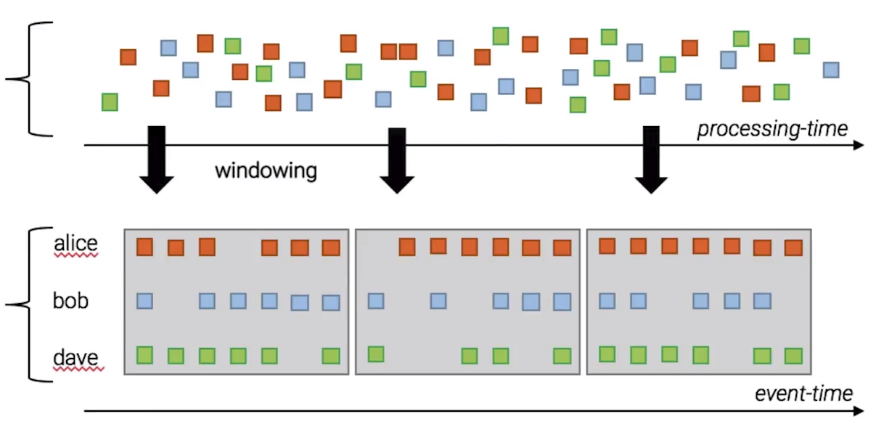
Example: Tumbling Window
Information is still reported as it arrives; aggregate is reset when the window moves.

Slide 50
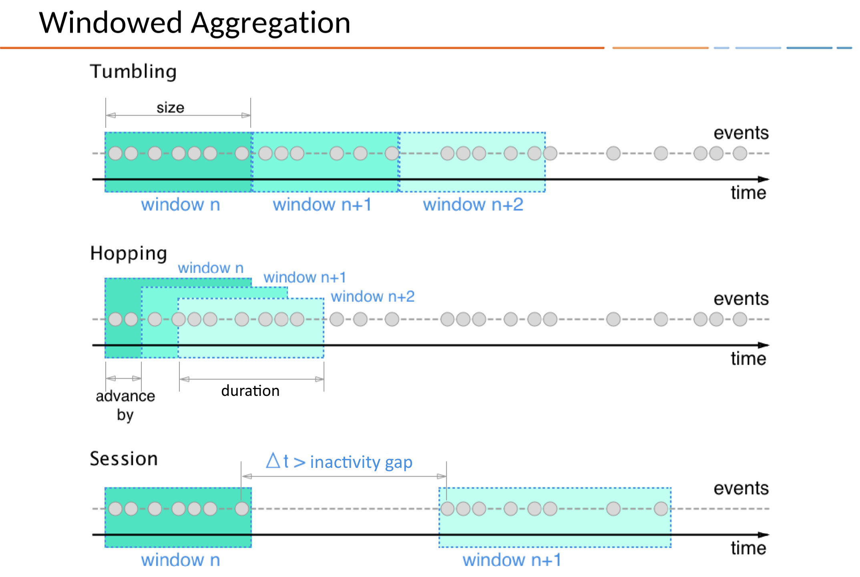

Slide 51
Demo: Windows
Tumbling window: total user withdrawals 30 seconds.
select user, sum(amount) as total_amount, count(*) as transaction_count from atmwithdrawls window tumbling (size 30 seconds) group by user emit changes;
Hopping window: activity by location every 15 seconds in 30 second windows
select location, count(*) from atmwithdrawls window hopping (size 30 seconds advance by 15 seconds ) group by location emit changes;
Session window: like tumbling but key dependent. More than 2 withdrawls in a 5 second window at any location
select location, count(*) from atmwithdrawls window session (5 seconds) group by location having count(*) >= 2 emit changes;

Slide 52
Check Yourself: Windows
Which type of window resets after N hours of no activity?
Which type of window resets after N minutes?
Which type of window allows for overlaps in ranges?
Notes:
1, Session
2. Tumbling
3. Hopping

Slide 53
Summary
Data is an asset; the more data the more value; extracting value is hard
Relational is not well suited to large volumes of data or unstructured data.
The CAP theorem explains the limitations of distributed database systems.
NoSQL databases address horizontal scalability and different database models
Polyglot Persistence embraces data complexity by using the right database for the task at hand.
Service-orientation decouples the applications API from the database API.

Slide 54
Exit Ticket
What was the most difficult concept from this week’s lesson?

