Slide 1
IST769 Unit K
Search Databases

Slide 2
Agenda
What is a Search Database?
Use Cases
Elasticsearch Architecture
Data ingestion methods
Kibana dashboards

Slide 3

Search Databases

Slide 4
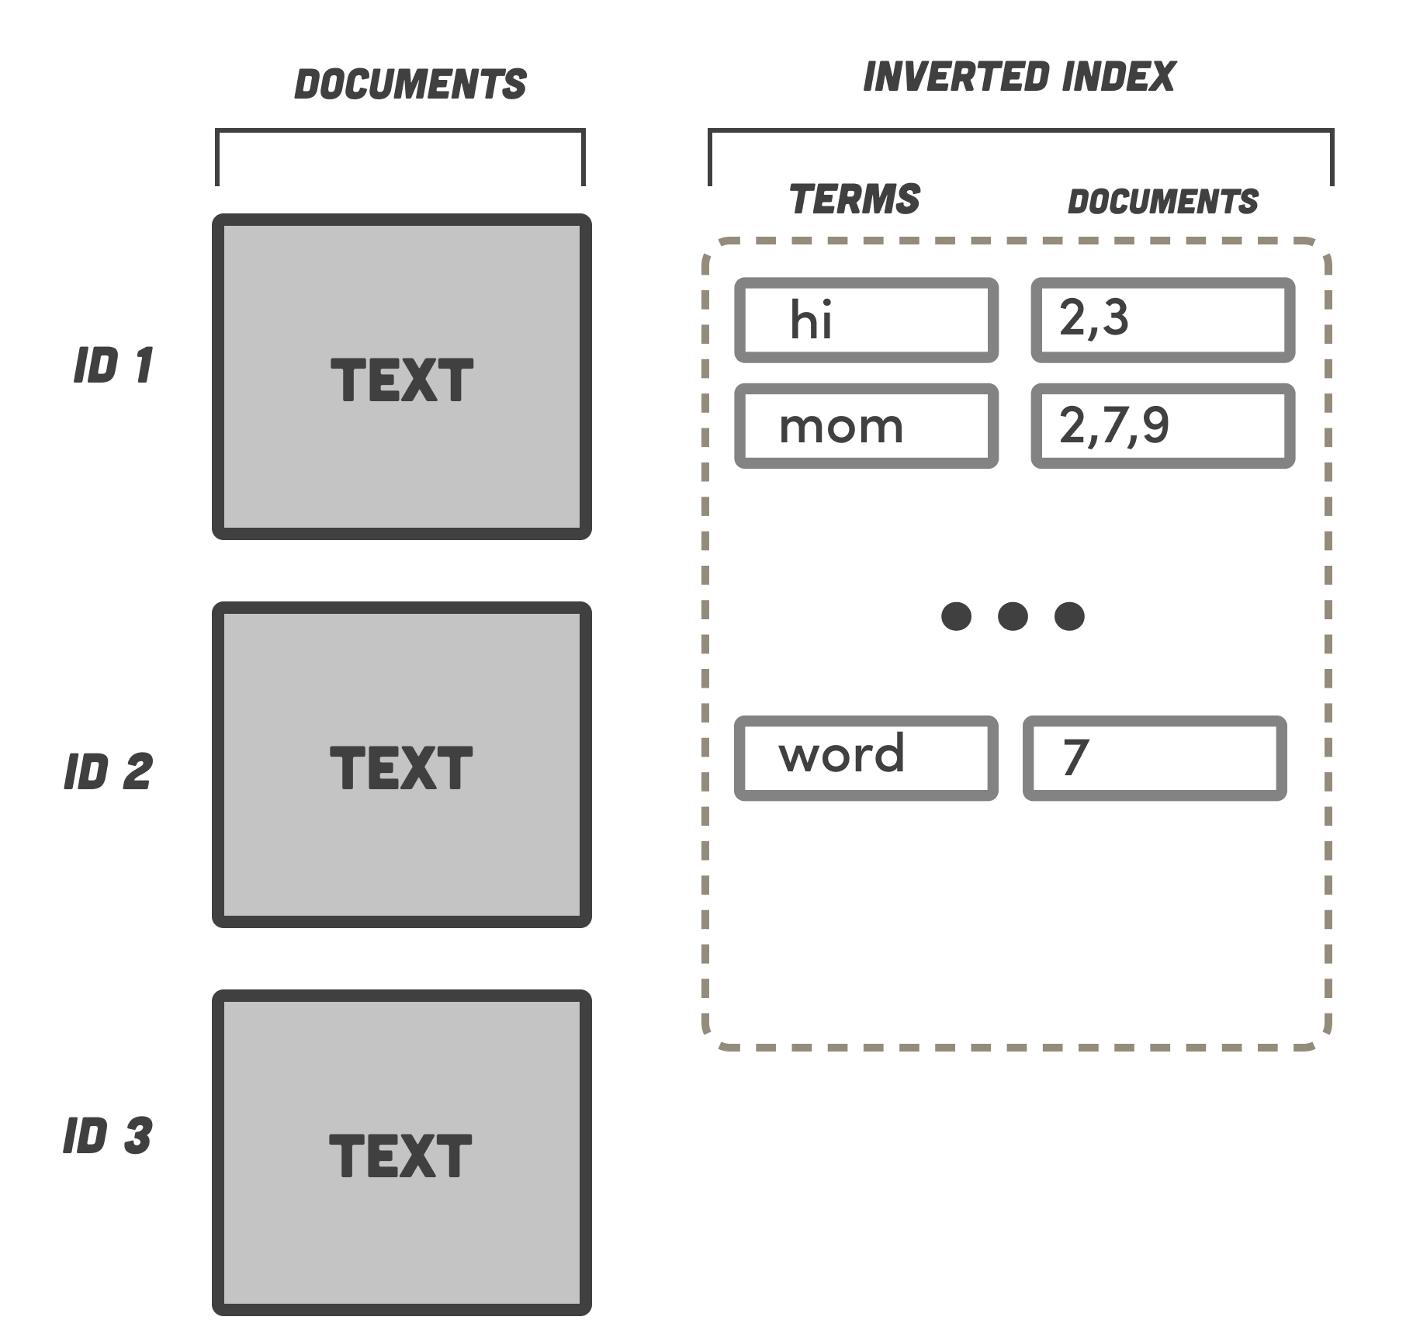
Search Databases
Non-Relational database dedicated to search.
Designed to support the retrieval of documents.
Not full CRUD, Typically CR
BASE, not ACID
Fast search is retrieved with an inverted index.
Commonly used in concert with other databases.

Slide 5
Use Cases
Text search over documents
Traditional search over HTML
Custom search engine
Log Analytics
Observe what is happening on your systems in near-real time
Marketing
Discover what customers are doing
Metrics / Operations
Real-time measurements of data over short windows.

Slide 6
Check yourself – True/False?
Search databases are eventually consistent?
A common use case for search is CRUD of reference data like customers.
Search databases store data in an inverted index.
Notes:
T
F
T

Slide 7

Elastic Search Elastic Stack
Quick Tour of The Elastic Stack

Slide 8
Elasticsearch
Based on Apache Lucene
Scales horizontally through data shards across nodes (like Cassandra and MongoDb)
Consists inverted indexes (like MongoDb collections) of documents.
Inverted index lists every unique word appearing any document within the collection.
Complete REST API for adding documents and querying them.
Near-real time query capability.

Slide 9
The Elastic Stack ELK
Data Ingestion
Logstash – batch ingestion of log data or output from any application
Beats – real-time metrics lightweight data shipper of transactions from a variety of sources.
Elastic Search
Creates indexes on ingested documents
Distributes documents across the Elastic cluster for better performance
Provides a HTTP REST API to search, add data.
Kibana
Analysis / Dashboarding tool

Slide 10
Which Parts are Elastic Community?
Elastic Stack (Apache License)
X-Pack (Elastic License)
Kibana
Elastic Search
Logstash and Beats
Security
Monitoring
Alerting
Graph
Reporting

Slide 11

Logstash
Data processing pipeline
Ingest data from a variety of sources
Apply transformations before storing in Elasticsearch
GeoIP, or DNS lookups
Date parsing
Hashing
Advanced transformations in Python or other languages
https://www.elastic.co/guide/en/logstash/current/index.html

Slide 12

Beats
Beats are data shippers
Newer approach than logstash
You install them on your hosts as agents
There are different types of beats, more than one can be installed on a host.
Filebeat – watch file output (logs)
Heartbeat – check availability (of host or service)
Packetbeat – inspect network traffic
Metricbeat – check host metrics
https://www.elastic.co/guide/en/beats/libbeat/current/index.html

Slide 13

Kibana
Search, Observe, Manage, and Monitor data in Elastic Search
Allows for building Dashboards
Serves as GUI client for Elastic Search
Supports custom query language Kibana Query Language KQL
https://www.elastic.co/guide/en/kibana/current/index.html

Slide 14
Check Yourself - Matching Concepts
The Search Engine
Batch Data ingestion
Near Real Time ingestion
Visualization Client
Beats
Elasticsearch
Kibana
Logstash

Slide 15
Elastic Search In-Depth

Slide 16
Starting The Elastic Stack
Let's start the elastic stack!
Elastic Search API http://localhost:9200/
Kibana UI http://localhost:5601/
Two sections:
Management → Stack Management
Index Management
Index Patterns
Analytics → Discover

Slide 17
Elastic Search Architecture and Data Model
Cluster consists of nodes
Documents are stored in an index
Indexes can be divided into types. Types are required; default type is _doc.
Indexes can be sharded
Shards are replicated across the nodes
Node1 Index: Orders Type: customer
Doc: Customer 1 Doc: Customer 2
Type: order
Doc: Order A Doc: Order B
Node2 …
Node3 …

Slide 18
Elastic Search REST API
ACTIONS HTTP VERBS
Fetch HTTP GET
Create HTTP POST
Update HTTP PUT
Remove HTTP DELETE
Some Common Endpoints:
_bulk – import data in newline JSON format
_search – search documents in an index
_mapping – set the mappings (how to infer types from the data)

Slide 19
Demo: Elastic Search REST API
Let's create an index and documents with the rest API
Create people index of students type
curl -X POST "http://localhost:9200/people/students" -H 'Content-Type: application/json' -d '{ "name" : "mike", "major" : "math", "gpa" : 3.4 }'
Get count on index
curl -X GET "http://localhost:9200/_cat/count/people"
Search for Math majors
curl -X GET "http://localhost:9200/people/_search?pretty&q=major:math"
Notes:
# Add threee
curl -X POST "http://localhost:9200/people/students" -H 'Content-Type: application/json' -d '{ "name" : "mike", "major" : "math", "gpa" : 3.4 }'
curl -X POST "http://localhost:9200/people/students" -H 'Content-Type: application/json' -d '{ "name" : "phil", "major" : "math", "gpa" : 3.2 }'
curl -X POST "http://localhost:9200/people/students" -H 'Content-Type: application/json' -d '{ "name" : "pete", "major" : "bio", "gpa" : 3.7 }'
# GET INFO ON INDEX
curl -X GET "http://localhost:9200/_cat/count/people"
# Math majors
curl -X GET "http://localhost:9200/people/_search?pretty&q=major:math"

Slide 20
Check Yourself: Elasticsearch
True or False?
The only way to integrate with Elasticsearch is through its HTTP REST API?
An index represents a single document stored in Elasticsearch
Every index requires a type.
Notes:
T
F
T

Slide 21
Demo: Kibana Is A Client of Elastic Search
View People Index in Kibana
Kibana cannot search without an index pattern
Create an index Pattern for people
Creates fields automatically
Keyword type for term level queries (match entire value)
Add Dean's list field 3.5 or higher
emit( doc['gpa'].value > 3.5)
Kibana Discover

Slide 22
Data Ingestion Options
Load in Data Sets via the Kibana interface
Use the API
Logstash
Beats

Slide 23
Demo: Data Ingestion Options
Kibana UI
Python Script VIA API
Tweets
Instructions for Beats and Logstash

Slide 24
Kibana Details

Slide 25
Kibana Visualizations
Discover – Ad Hoc Search and Insights
Dashboard – Create interactions among the data
Canvas
pixel perfect presentations
Supports SQL like syntax.
Refined Dashboard
Maps
Machine learning – Licensed instances only! ☹

Slide 26
Tour of Kibana Visualizations
Flight Visualizations Demo Data
Dashboard - Flights
Canvas – Flights Overview
Map – Origin Time Delayed

Slide 27
Creating Kibana Visualizations
Fudgemart Tweets
Turn on the Tweet Machine
Create Dashboard – Overview of Types
Create Map – Tweet Users
Need to add a new column to the index pattern
emit(doc['lat'].value, doc['lon'].value);
Create Canvas of users / tweet counts

Slide 28
Check Yourself: Kibana
True or False:
Canvas visualizations are display only.
Maps can include more than one index
A dashboard allows for user interactions.
Dashboard can be queried with SQL.
Notes:
True
True
True
False

Slide 29
Elastic Search with Spark and Drill
Drill and Spark Support

Slide 30
Apache Drill
Storage Configuration
Queries
{
"type": "elastic",
"hosts": [
"http://es01:9200"
],
"enabled": true
}
select * from elastic.people
select t.text, t.user, t.timestamp_formatfrom elastic.tweets as t

Slide 31
PySpark
Requires Elasticsearch-Spark connector
https://www.elastic.co/guide/en/elasticsearch/hadoop/current/spark.html#spark-python

Slide 32
Demo Elastic Integrations with Spark/Drill
Load Customer Data into Elasticsearch Using Spark
Query It with Kibana
Query it with Drill

Slide 33
Exit Ticket
Is there a something you find still unclear about today’s lesson

