Slide 1
IST769 Unit F
Document Databases

Slide 2
Agenda
What is a Document Database?
Comparing the Relational and Document Models
Mongo Db Architecture
Mongo Db Data Model
Mongo Db Commands

Slide 3

Document Database
What is a Document Database?

Slide 4
What Exactly is a Document Database?
Designed to store semi-structured data, in JSON or XML format. This is the “Document”
Full CRUD support.
Documents Stored in Collections; Fetched by Key
Popular Document Databases”
AWS Document Db
Google Firebase
MongoDb
CouchDb

Slide 5
Typical Document Db Data Model
Database
Boundary for one or more collections
Collection
A subject area for documents to be stored
Document
An individual subject in a collection

Slide 6
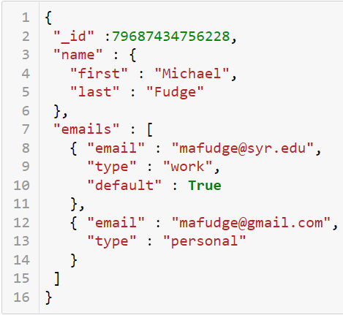
The Document (JSON Example)
Tree-like structure
Multiple Keys and Values
Document has composite data
Self-Describing (Schema is with the data)
No rigid schema. Anything can be saved in the collection.

Slide 7
Document Database Use Cases
Good For ☺
No So Good For ☹
Collections of complex data attributes associated with a single entity.
Items retrieved as a whole
Examples:
Content Management
Product Catalogs
Immutable Data (Orders History)
Complex Data Relationships
Retrieving “Part” of the Document
Data with a high rate of change

Slide 8
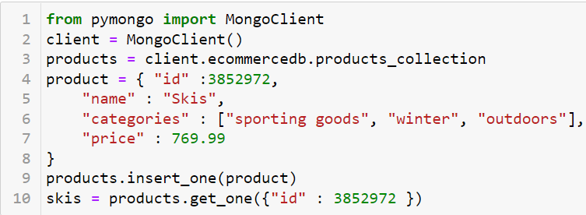
Document Databases are Programmer Friendly
Read and Store Complex Data
No Schema Required, No SQL Required
Simple CRUD, Limited support for partial updates.

Slide 9
Document Database Concepts
Document
Database
Collection
Self-Describing
No Rigid Schema
Documents of a single subject
Schema is stored in the Document
A collection of collections
Anything can be stored in the collection
Smallest unit in a document database

Slide 10

Relational vs Document
Comparison of the Two Models
Differences in design approaches

Slide 11
Relational vs. Document
Relational
Document
Designed for use by database administrators
Complex data model, normalized
Flexible, performant query operations
Related information stored in individual tables
Data redundancy is exception to the rule
Designed for use by programmers/developers
Simplified data model, denormalized
Query not as performant
Related information stored with document
Data redundancy is expected

Slide 12
Customer: The Relational Way
Customer is many other entities like phones and addresses
Can update phones / addresses independent from customer
3rd Normal Form; Data Integrity
Keys. Keys everywhere!
Customer Phones
Cid (PK, FK)
Order (PK)
Phone number
Number type
Customer Addresses
Cid (PK, FK)
Aid (PK, FK)
Address type
Customers
Cid (PK)
Email
First name
Last name
Addresses
Aid (PK)
Street
Postal_code (FK)
Postal Codes
Postal_code (PK)
City
State
Notes:
Explain what you see, then
Pros and cons:
Highly normalized. Concerns are separated. i.e there’s a table with only phone numbers in it.
Schema before data (we make these tables before we can insert rows. This allows for constraints to ensure addresses have valid zip codes at the data access layer.
To add a customer we require many writes. At least one to each of these 5 tables, if not more.
Foreign keys are required to tie the tables together into a single conceptual entity “Customer”

Slide 13
Customer: The Document Way
Self-Describing / Schema-less
Denormalized; all related data stored together.
Data Integrity shifts from data logic to business logic.
Easier to store, harder to query.
Do two customers have the same address?
{ cid : 1, email: mafudge@syr.edu, first name: Michael, last name: Fudge, phones: [ { type : home, number: 555-1234 }, { type : cell, number: 555-9283 } ], addresses: [ { type: billing, street: 1313 Mockinbird Ln, city: Syracuse, state: NY, zip: 13244 } ] }
Notes:
Simplified data model – reading and writing one “thing” the document.
Pros and cons:
Schema-less. The labels are written with the actual data. If I need to add middle initial, I just write it.
Write all the data at once with the conceptual entity.
Harder to perform cross-cutting queries, such as getting a list of phone numbers, or finding two people who share the same address.
Burden of data integrity shifts from the database management system to the application’s business logic layer.

Slide 14
Think About it!
With the relational model, we strive for data normalization, to reduce redundancy.
With the document model, we store related data in the document.
Normalized data prevents data redundancy, the document model has data redundancy.
Is this a problem?
Notes:
Use Cases! The document model is not suited for all data applications! Redundancy is acceptable

Slide 15
Designing for Document Databases
ER Modeling works. Entities are documents in the collection.
Reference-Oriented Data
Store composite, Multi-Valued with main Entity
Ensure Slow Rate of Change. High rate of change is not a good use case.
Can support full CRUD
Process-Oriented Data
Design to be Immutable or Historical
Should support only CR (no updates or deletes)
Minimize the number Entities and Relationships.

Slide 16
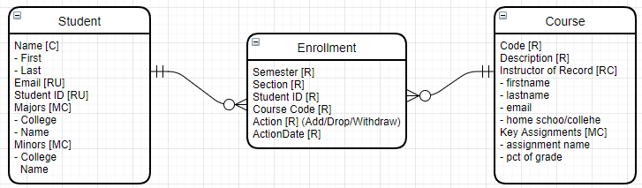
Example: Student Enrollment
Each entity is an example of a document in a collection. 3 Collections.
Student and Course are reference-oriented. Composite data such as majors, minors get stored with student. Full CRUD support for these collections.
Enrolment is process-oriented but designed to be document immutable. When a student drops another document is added.

Slide 17
Design It!
Computer Software Inventory:
Computer – make, model, RAM, Disk Total, Disk Free, Office computer is in, employee who owns the computer, operating system (version, name).
Software Application - application data (name, version, hardware requirements), publisher information (name, website)
Tracking which application are installed or removed from each computer and when.
Design a model suitable for a document database.

Slide 18

Mongo Db
Architecture

Slide 19
MongoDB
Document Database
Database → Collections → Documents
Documents are JSON Schemas
Single Master Architecture
Scales well horizontally, but has a single point of failure
Supports Consistent reads
Supports sharding with data replication
Data Model
Document data model—schema-less
Every document stored has a key
Uses JavaScript as a query language and JSON as a data format
There are only integrity constraints on the key; it must be unique per collection

Slide 20
Mongo Db CAP
Based on the description of MongoDB, where does it fit in the CAP Theorem? Among Consistency, Availability and Partition Tolerance Which two guarantees does it provide?

Slide 21
Relational vs. Document

Slide 22
Relational vs. Document
Relational
Document
Designed for use by database administrators
Complex data model, normalized
Flexible, performant query operations
Related information stored in speared tables
Data redundancy is exceptional
Designed for use by programmers/developers
Simplified data model, denormalized
Query not as performant
Related information stored with item
Data redundancy is expected

Slide 23
Customer: The Relational Way
Customer Addresses
Cid (PK, FK)
Aid (PK, FK)
Address type
Customers
Cid (PK)
Email
First name
Last name
Customer Phones
Cid (PK, FK)
Order (PK)
Phone number
Number type
Addresses
Aid (PK)
Street
Postal_code (FK)
Postal Codes
Postal_code (PK)
City
State
Notes:
Explain what you see, then
Pros and cons:
Highly normalized. Concerns are separated. i.e there’s a table with only phone numbers in it.
Schema before data (we make these tables before we can insert rows. This allows for constraints to ensure addresses have valid zip codes at the data access layer.
To add a customer we require many writes. At least one to each of these 5 tables, if not more.
Foreign keys are required to tie the tables together into a single conceptual entity “Customer”

Slide 24
Customer: The Document Way
{ cid : 1, email: mafudge@syr.edu, first name: Michael, last name: Fudge, phones: [ { type : home, number: 555-1234 }, { type : cell, number: 555-9283 } ], addresses: [ { type: billing, street: 1313 Mockinbird Ln, city: Syracuse, state: NY, zip: 13244 } ] }
Notes:
Simplified data model – reading and writing one “thing” the document.
Pros and cons:
Schema-less. The labels are written with the actual data. If I need to add middle initial, I just write it.
Write all the data at once with the conceptual entity.
Harder to perform cross-cutting queries, such as getting a list of phone numbers, or finding two people who share the same address.
Burden of data integrity shifts from the database management system to the application’s business logic layer.

Slide 25
Notes:
Please copy and use this slide each time you are pausing your lecture to ask students a question. Please delete this slide if you do not need to use it.
With the relational model, we strive for data normalization. With the document model, normalization is not recommended. Normalized data prevents data redundancy so why is redundant data not an issue with the document model?

Slide 26
Mongo Db Clustering

Slide 27
Sharding and Replication
Sharding
Replica
Splits the database into partitions so that each node hosts part of it
Distributes the I/O over several hosts
Synced copies of nodes
Each replica contains an exact mirror of its primary node
Notes:
The essence of Horizonal Scalability

Slide 28
MongoDB Cluster Visualized
Consider a mongo database…

Slide 29
MongoDB Cluster Visualized
It is sharded into three nodes. Each node (hosts 1–3) has different data—no single node has the same data.
Host 1
Host 2
Host 3

Slide 30
MongoDB Cluster Visualized
Each of the three nodes has one replica. Hosts 4–6 are a mirror copy of hosts 1–3, respectively.
Host 1
Host 2
Host 3
Host 4
Host 5
Host 6

Slide 31
Notes:
Please copy and use this slide each time you are pausing your lecture to ask students a question. Please delete this slide if you do not need to use it.
Scalability question for mongo db

Slide 32
MongoDB Data Model And Basic Commands

Slide 33
MongoDB Data Model
Database—boundary for one or more collections
Collection—a subject area for documents to be stored
Document—an individual subject in a collection

Slide 34
Basic MongoDB Commands
use database
show collections
db.collection.insert(jsonData)
db.collection.find()

Slide 35
Demo: MongoDB Basics
Current database
See all databases
Use a database—does not need to exist!
See collections in a DB
Insert data
See data
Notes:
# Current Database
> db
# Show all databases
> Show databases
Use a database, does not have to exist
> Use demo
#show collections
> Show collections
# insert some data
db.cars.insert({ “make”: “Chevy”, “model” : “Cruze” })
db.cars.insert({ “make”: “Chevy”, “model” : “Traverse” })
db.cars.insert({ “make”: “Chevy”, “model” : “Trax” })
# show all documents
db.cars.find()
#better looking
Db.cars.find().pretty()
# Insert same thing twice … mongo don’t care!
db.cars.insert({ “make”: “Honda”, “model” : “Civic” })
db.cars.insert({ “make”: “Honda”, “model” : “Civic” })
# there a generated Id, we can add by specific ID,
db.cars.insert({ “make”: “Honda”, “model” : “Accord” }, “_id” : 1 )
# but cannot add again
db.cars.insert({ “make”: “Honda”, “model” : “Accord” }, “_id” : 1 )
Db.

Slide 37
Demo: _id

Slide 38

_id
Every document in a MongoDB collection must have a unique ID.
This can be specified when you add the data. If you do not, one will be auto-generated.

Slide 39
Demo: _id
Insert same data—just makes another ID
Use explicit ID
Cannot insert data again
Notes:
# added 3 times
db.cars.insert( { "make" : "Honda", "model" : "CRV"})
db.cars.insert( { "make" : "Honda", "model" : "CRV"})
db.cars.insert( { "make" : "Honda", "model" : "CRV"})
# added once
db.cars.insert( { "make" : "Honda", "model" : "CRV"}, “_id” : 2)
# cannot be added again
db.cars.insert( { "make" : "Honda", "model" : "CRV"}, “_id” : 2)

Slide 40
Demo: Updates and Deletes

Slide 41
Updates and Deletes
You find a document and replace it with update. Partial updates are not allowed.
db.collection.update(query, object)
You find documents and remove them with remove.
db.collection.remove(query)

Slide 42
Demo: Updating and Deleting
Delete a group on documents
Update the CRV and make the vehicle type SUV
Partial updates don’t work!
The document gets replaced
JavaScript for partial updates
Notes:
# delete all the CRV’s
Db.cars.remove( { “model” : “CRV” } )
Db.cars.find()
# update – partial does not work
db.cars.update ({ "_id" : 1}, { "style" : "sedan" } )
#where did it go?
Db.cars.find()
# full overwrite, so you must replace
db.cars.update ({ "_id" : 1}, { "make" : "Honda", "model" : "Civic", “style” : “sedan”, "_id" : 1 })
# easier to do with full JavaScript code
var cruze = db.cars.findOne( { "model" : "Cruze", "make" : "Chevy"} )
cruze["style"] = "sedan“
db.cars.update( {"model" : "Cruze"}, cruze)

Slide 44
Demo: Find

Slide 45
Find Queries
The find method is used to query documents in collections.
The first argument is the column and values to match.
The second argument, which is optional, specifies the columns to return.
db.collection.find(query, [columns])

Slide 46
Demo: Find Queries
Column projections
Dot notation ex. products.department
Items that exist or do not exist
Notes:
# column projection: Just the names and websites of the vendors
Db.vendors.find({}, {“name”: 1, “website” :2})
# use the dot notation to access attributes inside other attributes
db.vendors.find( { "products.department" : "Hardware" }, { "name" : 1, “website” : 2 })
# name, product name and retail price of sporting goods
db.vendors.find( { "products.department" : "Sporting Goods" }, { "name" : 1, "products.name" :2, “products.retail_price” : 3 })
# vendors with no website
db.vendors.find( { website: { $exists : false } }, { "name" : 1, “website” : 2 })
# vendors with websites
db.vendors.find( { website: { $exists : true } }, { "name" : 1, “website” : 2 })

Slide 47
Demo: Find Methods
Methods can be attached to the results of the query
Count—still counts documents
Limiting output
Sorting output
Notes:
# sort the output
db.vendors.find( { "products.department" : "Hardware" }, { "name" : 1 }).sort( { "name" : 1} )
Db.vendors.find().limit(3)
Db.vendors.find().sort( “name” : 1)
# you can combine
Db.vendors.find().sort( “name” : 1).limit(4)

Slide 48

Really Advanced Queries
Need to be written in JavaScript
Or at least require an understanding of JavaScript
This is beyond the scope of the course

Slide 49
Notes:
Check yourself: queries

Slide 50
Demo: Indexing

Slide 51
Simple Indexing
MongoDB indexes work similarly to RDBMS indexes.
They improve query performance at the expense of creating an index table of data.
You are limited to 64 indexes per collection.
To create an index over a column in a collection:
db.collection.createIndex(columnName:1)
Or over several columns:
db.collection.createIndex(colA:1, colB:2)

Slide 52
Demo: Indexing
Let’s use explain(“executionStats”) to demonstrate the need to index.
Add an index over the query column.
Now the query only accesses the documents in the filter!
Notes:
# querying by region!
db.countries.find( {"subregion" : "Eastern Europe"}).explain("executionStats")
Seaches through all 53 countries…. Blah. (docsExamined)
# Let’s add an index.
db.countries.createIndex( {subregion:1})
db.countries.find( {"subregion" : "Eastern Europe"}).explain("executionStats")
db.countries.find( {"subregion" : “Southern Europe"}).explain("executionStats")

Slide 57
What is Object Storage
Cloud-based Network-Attached storage
Client uses an API such as the AWS S3 API to get and put objects.
Popular Object Storage Providers
AWS S3 (Simple Storage Service)
Azure Blob Storage
Google Cloud Storage
Minio

Slide 58
Use Cases
Storing BLOBs (pictures and video)
Static Website Hosting
Backup and Disaster Recovery
Data Lakes
Analytics

Slide 59

Minio Open-Source Object Storage
Open-Source and compatible with the AWS S3 API
Minio high-performance object storage
Used as an HDFS replacement
Tiny, fast with little overhead. Focus on performance.
Consistent, Distributed and Available
Active-Active replication
Scale out via server pools
“Min” “I/O”

Slide 60
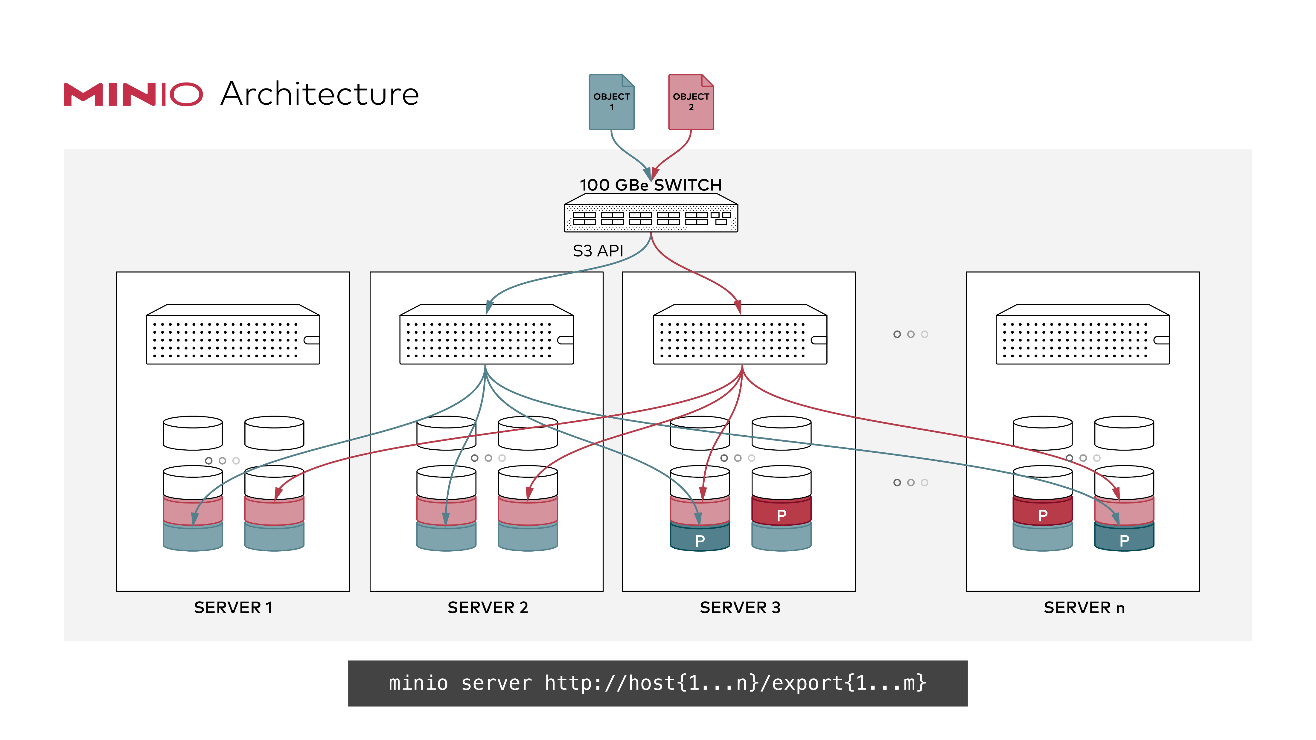
Minio Distributed mode
Pool multiple disks, even on different hosts into a single server
The client sees this as a single instance
Follows strict read-after-write and list-after-write consistency model for all I/O operations.
Erasure code protection ensures 50% of disks can be lost without data loss

Slide 61
Erasure Code Protection
File is broken into blocks
Block are expanded to include redundant data pieces
Blocks are distributed to disks
In the event of failure, data can be reconstructed from the redundant pieces in each block.
Files are protected without full replication!
https://min.io/product/erasure-code-calculator

Slide 62
Object Storage Concepts
Bucket
Folder
File
Alias
Mount point in that Object Storage System
A named reference to a Remote Object Storage System
alias/bucket/folder/file

Slide 63
Match the Term to its Definition
Bucket
Alias
Erasure Code
S3
A Named reference to an object storage system
Amazon’s Object Storage system
A Method of data protection without replication
The mount point for an object storage system

Slide 64
Minio commands

Slide 65
The Minio Client
https://dl.min.io/client/mc/release/linux-amd64/mc
Accessing From Jupyter Lab:
$ wget https://dl.min.io/client/mc/release/linux-amd64/mc \ && chmod +x mc \ && sudo mv -f mc /usr/local/bin
Accessing The Container From Your Command Line
$ docker-compose exec minio-client bash

Slide 66
Minio Alias Commands
$ mc alias list
$ mc alias set <alias> <server> <user> <password>
$ mc alias set \ my_server http://minio:9000 minio SU2orange!
$ mc alias rm my_server

Slide 67
Minio Bucket Commands
$ mc ls <alias> → list contents (in this case, all buckets)
$ mc mb <alias>/<bucket> → create bucket on alias (or folder)
$ mc rb <alias>/<bucket> → remove a bucket
$ mc tree <alias>/<bucket> → view folder tree
$ mc du <alias>/<bucket> → disk usage of bucket

Slide 68
Minio File Commands
$ mc cp <src> <tgt> → copies files and folders from source to target
$ mc rm <tgt> → deletes the target
$ mc mv <src> <tgt> → moves files and folders from source to target
$ mc mirror <src> <tgt> → Mirrors all files and folders from source to target

Slide 69
Minio Commands
Connect to the Minio Client
Create a bucket, testing
Copy local files into the bucket
List files in bucket
View Space used by bucket
Delete the bucket

Slide 70
Minio commands
Assuming the alias is sugar:
What is the command to create a bucket named foo?
What command copies the file bar.txt into the bucket foo?
What is the command to delete bar.txt from the bucket in question 2?

Slide 71

Spark
Lightning Fast Cluster Computing

Slide 72
Spark
General-purpose data-processing/analytics/computing engine
Developed at UC Berkeley AMP Lab, now an Apache project
Step up from Hive and Pig, which are still batch-oriented
Stores working data in memory for fast processing (RDDs, data sets, data frames)
APIs/language support for Python, Scala, Java, and R
Support for Streaming, Graph Processing, and Machine Learning

Slide 73
Spark Use Cases
Interactive/exploratory analytics including machine learning tasks
Real-time analytics and event processing
Building data pipelines and Extract-Transform Load pipelines
Machine learning pipelines

Slide 74
Spark Libraries
Four libraries built on Spark Core
MLlib: a machine learning library
Spark Streaming: enables high-throughput, fault-tolerant stream processing of live data streams
Spark SQL: runs SQL and HiveQL queries, accesses Metastore
GraphX: an API for graphs and graph-parallel computation
Spark SQL
Spark Streaming
MLlib (machine learning)
GraphX (graph)
Apache Spark

Slide 75
Spark Deployments
Standalone
Spark Client Mode (for development / testing all parts on one host)
Spark Cluster Mode (below)
Code executes on worker nodes
Data cached on worker nodes
Also runs on Hadoop/YARN and Kubernetes
Worker Node
Executor
Cache
Driver Program
Task
Task
Spark Context
Cluster Manager
Worker Node
Executor
Cache
Task
Task

Slide 76
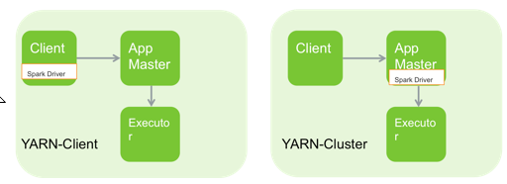
Spark on Yarn Deployment Modes
Spark on YARN (two modes)
Spark Driver on Client
Spark Driver on Cluster—useful for low latency between client and cluster
Notes:
Since Spark was developed at UC Berkeley it can run without a Hadoop cluster or so called standalone mode. However when integrated with YARN as in HDP, there are two modes to choose. In local mode the spark code runs on the client machine (aka utility server/edge node/gateway server). In cluster mode, spark code is managed inside an application manager. The next several slides will detail these architectures.

Slide 77
Spark Notes
Where does the code execute on Spark?
What are the 4 libraries on Spark core?
Spark supports which languages?
Notes:
The worker nodes?
MLLib, SQL, GraphX, Streaming
Java, Scala, Python, R

Slide 78
Spark Basics

Slide 79
Spark Concepts
SparkSession
SparkContext
Main entry point for your Spark Application 2.0 and beyond.
Code sent through the spark session to the workers.
Pre Spark 2.0 entry point for Spark Application

Slide 80
Demo – Setting up Minio and SparkSession
Let’s Open the cookbook
http://127.0.0.1:8888/lab/tree/work/PySparkCookbook.ipynb
Creating Session
Viewing Session details

Slide 81
Loading Data Into Spark++
Spark can read from a variety of sources
HDFS
S3 / Object Storage
Databases (RDBMS, Mongo, Cassandra)
Streams (Kafka)
Local files *
And more ++
Spark Can handle a variety of file formats
Text
Csv / Delimited
XML
JSON
ORC
Parquet
And More ++
* not practical in a clustered environment, since code runs on the worker nodes.
++ You can write your own sources and file format providers

Slide 82
Spark Data
Resilient Distributed Dataset
Data Frame
RDD are the lowest level of data
Immutable lists of values
Allows for parallel execution of data transformations
Lazy execution –nothing runs until results are requested.
Tabular data
Based on RDD’s
High-level extraction over RDDs

Slide 83
Demo – Loading into Data Frame
Let’s Open the cookbook
http://127.0.0.1:8888/lab/tree/work/PySparkCookbook.ipynb
Browse Minio
http://127.0.0.1:9000/
Csv, text, json
What is lazy execution?
Different options for csv
Sep= → the delimiter
Header= → is there a header?
inferSchema= → guess data types?
Cache() → load onto worker nodes.

Slide 84
What does .cache() do?
spark.load.csv("s3a://ufo-sightings").cache()
Minio
Or S3
Send data to the workers so that its not fetched at lazy execution.
Spark Workers

Slide 85
Spark Session and Loading Data
In spark.read.csv()
What is spark ?
What is csv() ?
How to we see a data frame’s schema?
How do we see a data frame’s values?
What does .cache() do?
What is lazy execution?
Notes:
Spark Sesson
Method / function to load delimited data
printSchema
Show
Pre-fetches the data to the worker nodes

Slide 86
Spark Data Frame Transformations
These are the heart of spark core library
Allow us to shape data
Similar to SQL-type transformations you know already
.select()
.withColumn() .withColumRenamed()
.filter()
.sort()
.groupBy().agg()
.union()
.join()

Slide 87
Column References
There are 3 methods of accessing referencing a column
For data frame customers
String/SQL: customers.select("firstname") customers.filter("age>50")
Property: customers.select(customers.firstname) customers.filter(customers.age>50)
Data Frame: customers.select( customers["firstname"] customers.filter( customers["age"] > 50)

Slide 88
Basic Transformations Demo
Using the UFO dataset, let’s apply some transformations
Column projections
Rename column
Filter
GroupBy.agg
Sort
Using explain() to see the execution plan.

Slide 89
Advanced Transformations
from pyspark.sql.functions import explode,split,udf
explode – handle nested arrays of data
split – parse strings into multiple values
udf – apply a user-defined function

Slide 90
Advanced Transformations Demo
Using the Google Places JSON output, let’s apply some transformations
Extracting sub-values
Explode nested arrays data
Split data into multiple columns
Create a udf
Using explain() to see the execution plan.

Slide 91
Spark SQL
Use .createOrReplaceTempView() to name a dataframe as a temp SQL view.
Then use spark.sql() to query it!
Useful for those really more familiar with SQL
df.createOrReplaceTempView("sometable")
spark.sql("select * from sometable").show()

Slide 92
Spark SQL and Saving Data
Run some SQL over Google Places data
Save output back to Object Storage

Slide 93
Exit Ticket
Is there a something you find still unclear about today’s lesson

