Slide 1
IST769 Unit C
Hadoop

Slide 2
Agenda
The What, Why, and How of Hadoop
HDFS
MapReduce and YARN
Key Hadoop Applications
Hive
Hbase
Hcatalog
Impala

Slide 3

Get Ready To Follow Along!
Let’s Start Our Docker Environments!
Hadoop in docker requires a lot of resources.
Start: docker-compose up -d
Is It done starting?: docker-compose logs (Check for impala server…)
Access the shell: docker-compose exec cloudera bash -c "su -l cloudera"
Hue Access: http://localhost:8080

Slide 4

Hadoop
The What, Why and How

Slide 5

What is Hadoop?
A System for Storing, Processing and Managing Data
Just Like a DBMS only for “big data”
What does that mean? Scales Out by design, both the data and compute to process it.

Slide 6
Hadoop Origins
The origins of Hadoop can be traced back to the internet companies of the 2000’s
Google, Facebook and Yahoo!
These companies had a similar problem.
The solution was to split the data and distribute chunks of it to be processed in parallel.
Time to process one day’s worth of data
24 hours!

Slide 7
They did the math…
Relational DBMS
Hadoop
60 Minutes to read 500GB of data off the disk on 1 node (assuming 1Gbps)
14 seconds to read the same 500GB with 40 nodes x 8 disks per node.
60 min
14 sec
1.56GB
1.56GB
…
500GB
1.56GB
1 Node
40 Nodes 8 Disks = 320 Independent reads

Slide 8
How does Hadoop Work?
Let’s Explore the concepts of Hadoop (Data Lake, Schema On Read)

Slide 9
The Hadoop Philosophy is Simple
Capture data as is and store it do not create a schema for it.
Do not transform the data before storing it. We don’t know what we plan to do with it yet!
Keep everything. You never know what you will need when!
When you retrieve the data, we then transform it to suit our needs.
This is very different from relational modeling where we are not able to store data without creating a table first.

Slide 10
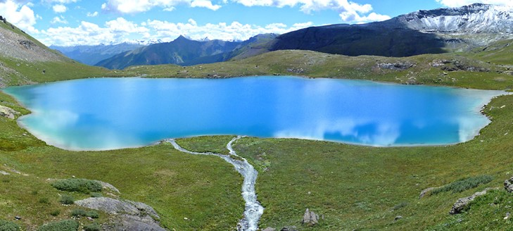

The Data Lake
Contrast this to the data mart which is filtered and packaged for consumption!
An industry term for vast amounts of data stored in its native format.
Hadoop data are stored in a data lake.
Like real lakes, data lakes are unprocessed and vast.
Notes:
Like a real lake the water is unprocessed and vast
The water is sourced from streams (data lake from streams of data sources)
Compare this to a bottle of water which is filter, packaged and processed for consumption – like the highly structured data associated with a business application or data mart.

Slide 11
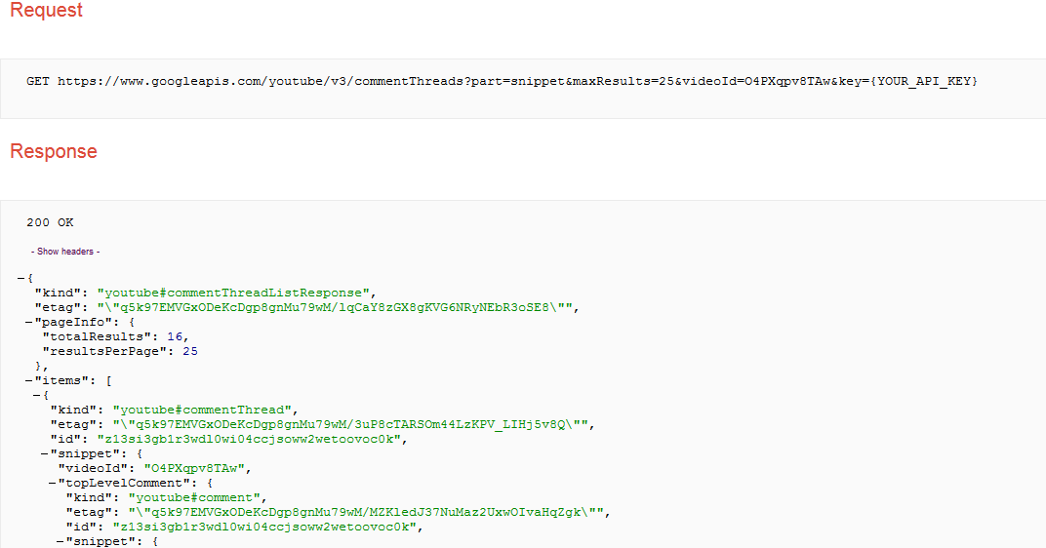
Collect and Store Data into the Data Lake
You know there is value in your
Organization’s YouTube channel,
but you don’t know what exactly
that might be.
You extract the API output weekly
& load the data into your
Hadoop Data lake.
Notes:
Common use case of Hadoop is collect output from another system, and store it as is because you don’t know how you want to analyze it yet.
You don’t know what parts of the JSON output you will need. This data is schema-less which means we don’t have to apply any logic at write-time as we would normally with a relational database management system.

Slide 12


Apply a Schema on Read/Query
When we want to perform analysis on the data, we add a schema when the data are read.
This will create a table of data, like a relational table.
videoId | likes | text | pub_date
O4PXqpv8TAw | 0 | excellent video!\ufeff | 2015-02-02T02:05:16.042Z
… | … | … | …
Notes:
When we want to perform analysis on our data, we apply a schema as it is read to that it can be placed in a tabular form for analysis.
You don’t have to define a full schema to all the data – only the data you care about.
Once the schema is applied we can further process the data in tabular format.

Slide 13

Analyze Your Data
videoId | likes | text | pub_date
O4PXqpv8TAw | 0 | excellent video!\ufeff | 2015-02-02T02:05:16.042Z
… | … | … | …
The table is not stored. It is a program that adds schema when we execute the actual analytics.
In this case, an SQL SELECT statement, but it could be any code.
Export/ Visualize
videoId | sum(likes)
O4PXqpv8TAw | 56
V56Xqyy-2wq | 14
… | …
Notes:
When your data is in tabular format you can process it further and then visualize it.
Hadoop has tools to visualize your data, you can also export the data, provided it has been reduced to a reasonable side.
The entire process can be automated so that as new data is collected it can be processed and visualized.

Slide 14
What Exactly Is “Schema on Read”? Again?
Traditional RDBMS
You cannot write data without a table
Cannot insert data unless data fit into table’s single design
Large up-front design costs
Conceptual models
Table design
“Schema on write”
Hadoop’s
You write the data “as they are” to the Data Lake
Schema applied when data are read—multiple designs
Very little up-front design costs
Just write to disk
Apply schema when you need it
“Schema on read”

Slide 15
Check Yourself! True or False
In schema on write you cannot write without creating a table first.
Data in the data lake must have a schema.
In schema on read, we create a table as we read the data.
In Hadoop we usually transform the data prior to storing it in the data lake.
Most of the time we know what information we want to extract from the data in our data lake.
Notes:
True
False
True
False
False

Slide 16
Hadoop Architecture

Slide 17
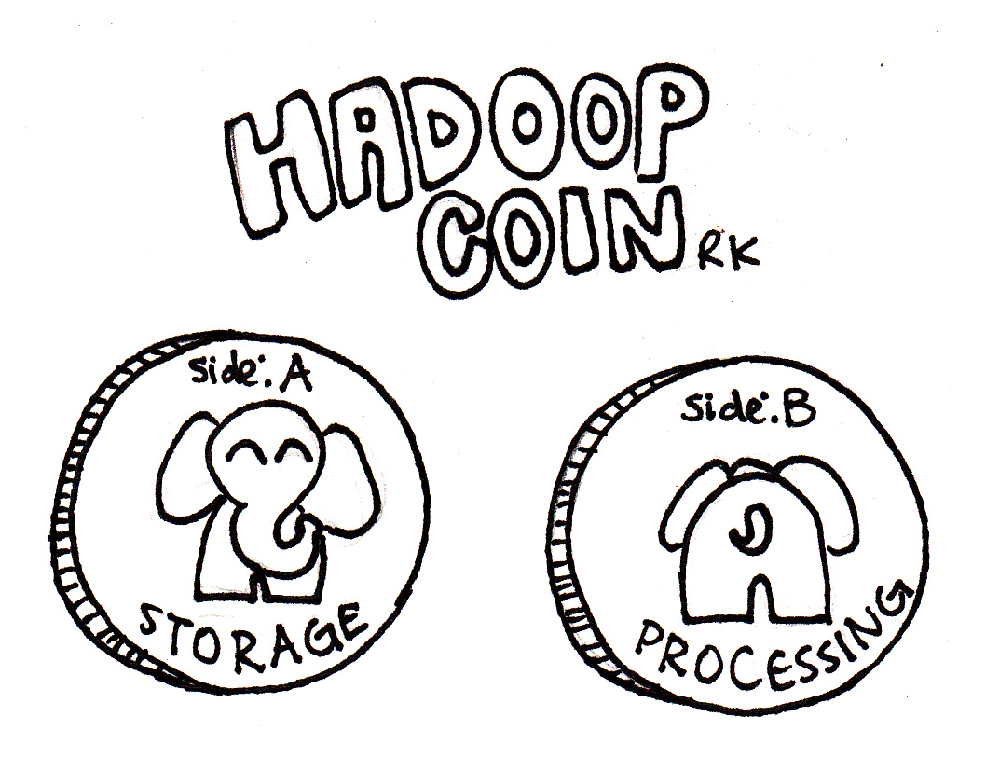
Two Essential Components of Hadoop
Distribute the data across nodes in the data lake by splitting it up. HDFS does this.
Move the compute to where the data lives. MapReduce/YARN does this.
HDFS
YARN

Slide 18


A Preview: Hadoop Cluster Nodes
Master Nodes
Manages the Hadoop infrastructure
Runs one of each of these services per cluster, on a single server or many
Should run on server-class hardware
Very few of these nodes
YARN:
App Timeline Server,
Resource Manager,
History Server
HDFS:
NameNode
YARN: Node Manager
HDFS: DataNode
YARN: Node Manager
HDFS: DataNode
YARN: Node Manager
HDFS: DataNode
Worker Nodes
Store data and perform processing over it
Each node runs the same services
Runs on commodity hardware
Lots and Lots these nodes
YARN: Node Manager
HDFS: DataNode
YARN: Node Manager
HDFS: DataNode
YARN: Node Manager
HDFS: DataNode

Slide 19
HDFS
Hadoop Distributed File System

Slide 20
HDFS – Hadoop Distributed File System
Based on Google’s GFS – Used by search.
CP System: NameNode master + several DataNode workers.
Distributed data storage paradigm
A single file is divided into blocks
Blocks are spread across nodes
Blocks are written multiple times for redundancy
A
B
C
DataNode 1
DataNode 2
DataNode 3
DataNode 4
A
B
C
A
B
C

Slide 21
Example: HDFS Write
Client put file: data.csv
NameNode
That’s 4 blocks on nodes 1-4
1
2
3
1
3
2
4
3
2
DataNodes
4
3
1
4
2
1
4
5
6
Notes:
In this example we have a single namenode and 6 data nodes in our cluster.
Client makes a request to the name node to write a file.
Name node stores metadata about the file’s whereabouts (data.csv consists of 4 blocks on nodes 1-4) and instructs the client where to write the file.
The client sends its data to the data nodes. Data is written in parallel so the I/O is vastly improved over non distributed options
Each data node replicates (make a copy of its’ block) to other datanodes as instructed by the Namenode. In this example there is a replication factor of 3, so two copies are made.

Slide 22
Example: HDFS Read
Client put file: data.csv
NameNode
That’s 4 blocks on nodes 1-4
1
2
3
4
1
2
3
1
3
2
4
3
2
DataNodes
4
3
1
4
2
1
4
5
6
Notes:
In this example we have a single namenode and 6 data nodes in our cluster.
Client makes a request to the name node to read a file.
Name node knows where the data is located. The datanodes are reporting “what they have” to the name node on an interval.
The client requests the data in parallel from the data nodes.
The data in assembled in the right order by the client.

Slide 23


HDFS: Heartbeat and Block Report
“Sorry, DataNode 3, but I’m going to assume you are dead.”
NameNode
Heartbeat and block report
Heartbeat and block report
Heartbeat and block report
DataNode 1
DataNode 2
DataNode 3
DataNode 4
HDFS DataNodes send routine heartbeats and block reports to the NameNode.
This is how the NameNode knows where the blocks of a file are located.
Notes:
- If a DataNode fails to send a Heartbeat to the NameNode, that DataNode is labeled as dead
- Any data that was registered to a dead DataNode is not available to HDFS anymore
- The NameNode does not send new I/O requests to a dead DataNode, and its blocks are replicated to live DataNodes

Slide 24
HDFS
Why is an HDFS file divided into blocks?
Why is a block written more than once to a separate data node?
Which service explains where the file blocks are located?

Slide 25
Example: HDFS Failover
Client put file: data.csv
NameNode
4 blocks on nodes 1,3,4 and 5
No Heartbeat! Node 2 down!
1
2
3
4
1
2
3
1
3
2
4
3
2
DataNodes
4
3
1
4
2
1
4
5
6
Notes:
Once again with our cluster
Node 2 goes down, as the namenode has yet to see a heartbeat. Its No big deal as we have blocks 2 and 4 replicated to nodes 3/6 and 4/5 respectively.
Client requests a file. Namenode reports block from available nodes to get the file.
The rest happens as expected.

Slide 26
HDFS Commands
hdfs dfs –command [args]
Here are a few (of the almost 30) HDFS commands:
-cat: displays file content (uncompressed)
-text: just like cat but works on compressed files
-chgrp,-chmod,-chown: changes file permissions
-put,-get,-copyFromLocal,-copyToLocal: copies files from the local file system to the HDFS and vice versa
-ls, -ls -R: list files/directories
-mv,-moveFromLocal,-moveToLocal: moves files
-stat: statistical information for any given file (block size, number of blocks, file type, etc.)
Note: replacement for “Hadoop fs”
Notes:
Concerted effort to move from “hadoop fs” to “hdfs dfs”. http://hadoop.apache.org/docs/current/hadoop-project-dist/hadoop-common/FileSystemShell.html states that “hdfs dfs” is a synonym for “hadoop fs” when HDFS is being used (i.e. the “hadoop fs” command can interact with other file systems that Hadoop supports such as local FS, HFTP FS, S3 FS, and “others”) which makes sense with HDP.
Feel free to demo some of these if time allows.

Slide 27
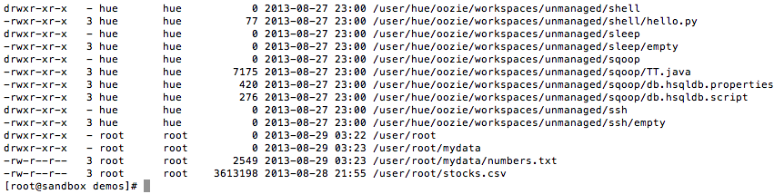
HDFS File Permissions—Like *nix Permissions
Files and directories have owners and groups
r = read
w = write
x = permission to access the contents of a directory
Notes:
- For files, the r permission is required to read the file and the w permission is required to write or append to the file
- For directories, the r permission is required to list the contents of the directory, the w permission is required to create or delete files or directories, and the x permission is required to access a child of the directory.

Slide 28
Demo: HDFS Commands
Assume the identity of the user
File system
Put files
Copy
Delete
Combine with cat
Combine with getmerge
Notes:
# need to be the cloudera user. In basic Hadoop security the current logged on user has the same permissions in HDFS
$ su cloudera
# Basic Commands
$ hdfs dfs –command
OR
$ Hadoop fs –command
# what is the current directory?
$Hadoop fs –ls
# its /user/cloudera
# make a folder
$ Hadoop fs –mkdir grades
# upload to Hadoop
$ Hadoop fs –put *.tsv grades/
# copy a file
hadoop fs -cp grades/fall2015.tsv grades/foo.tsv
# combine with cat
Hadoop fs –cat grades/*
# make a file with getmerge – a useful command when a reducer produces more than one fgile
Hadoop fs –getmerge grades/* allgrades.tsv

Slide 29
HDFS Commands
What is the HDFS command to upload a local file blob.txt to the remote HDFS folder blink?
What is the HDFS command to view the contents of the folder blat?

Slide 30
YARN (and MapReduce)
Yet Another Resource Negotiator

Slide 31
YARN – Hadoop 2.0
YARN is a job executor and resource schedule for Hadoop.
MapReduce is a distributed batch process algorithm
Hadoop v1 could old do Map-Reduce
Hadoop v2 added YARN so any distributed application could run
YARN made applications like Spark and Hive possible.
Map-Reduce is just one of the many applications which run on YARN

Slide 32
Hadoop 2 vs. Hadoop 1
Hadoop 1
Hadoop 2
Batch processing only
No high availability or failover capability
Only MapReduce applications
DataNodes and NameNodes are dependent
Applications execute and quit
Suited to a variety of distributed tasks
High availability and failover
Runs any distributed application, including MapReduce
DataNode and NameNodes (NodeManagers) are independent
Applications can remain resident

Slide 33
MapReduce Algorithm
A programming model for large-scale distributed data processing
Phases
Map → apply a transformation to a data set
Shuffle → transfer output from Mapper to Reducer nodes
Reduce → aggregate items into a single result
Combine → output of Reducer nodes into single output
Map
Shuffle
Reduce
Combine
We must supply the Mapper and Reducer functions.

Slide 34
Example MapReduce: “Total Orders by State”
Source
file
HDFS blocks each node
Mapping
Shuffle
Reduce
Combine
JAN, NY, 3
JAN, PA, 1
JAN, NJ, 2
JAN, CT, 4
FEB, PA, 1
FEB, NJ, 1
FEB, NY, 2
FEB, VT, 1
MAR, NJ, 2
MAR, NY, 1
MAR, VT, 2
MAR, PA, 3
JAN, NY, 3
JAN, PA, 1
JAN, NJ, 2
NY, 3
PA, 1
NJ, 2
CT, 4
NJ, 2 NJ, 1 NJ, 2
CT, 4 NJ, 5
JAN, CT, 4
FEB, PA, 1
FEB, NJ, 1
CT, 4
PA, 1
NJ, 1
CT, 4 NJ, 5
NY, 6
PA, 5
VT, 3
NY, 3
NY, 2
NY, 1
NY, 6
FEB, NY, 2
FEB, VT, 1
MAR, NJ, 2
NY, 2
VT, 1
NJ, 2
PA, 1 PA, 1 PA, 3
PA, 5
MAR, NY, 1
MAR, VT, 2
MAR, PA, 3
NY, 1
VT, 2
PA, 3
VT, 1 VT, 2
VT, 3
Notes:
Let’s start with a source file. This file contains the month and state and count of orders for that month/state. We would like to process this “big data” and get a count of total orders by state For example if you add up the NY orders it would be 6.
When this file is uploaded to HDFS it is broken up into blocks. The blocks are split evenly across the block size. In this example the block size chosen results in 4 blocks, conveniently one block per node. This is not always the case – just how it works out in this example.
Next we perform a mapping. The mapping phase uses the key State code to return a list of order counts. For example On the first node “NY” returns a one item list of NY,3.
Next we must move data to the reducer nodes. This is called a shuffle. The shuffle can be the most I/O intensive part of the process. In this example we have 4 reducer nodes (the same number of mappers and data nodes) data is shuffled to reducer so that each node can process its data in parallel.
In the reduce phase we take our key and apply an aggregate function to the data. For example in this case if we look at the first reducer node it will sum up the orders by key state.
At this point the map-reduce is complete and 4 files are written to HDFS (one for each reducer) we can combine these files easily to produce a single output.

Slide 35
Demo: M-R and YARN
Calculating pi
Word counts
What’s running?
What ran?
Job details
Kill a running job
Notes:
$ export MREX=/usr/lib/hadoop-mapreduce/hadoop-mapreduce-examples.jar
# estimate pi
$ yarn jar $MREX pi 1 100
# can we be more accurate?
$ yarn jar $MREX pi 1 10000
# make a file
$ echo "I love Hadoop you should love Hadoop too as Hadoop is cool" > msg.txt
# write to HDFS
$ hadoop fs –put msg.txt /user/cloudera/msg.txt
# run a wordcount
$ yarn jar $MREX wordcount /user/cloudera/msg.txt /user/cloudera/msg-out
# What happened?
$ hdfs dfs -ls msg-out
$ hdfs dfs -cat msg-out/*
$yarn application -list -appStates FINISHED
$yarn application -list
$yarn application -status application_1533052372690_0010
yarn application -kill application_1533052372690_0010
yarn application -list -appStates KILLED
yarn application -status application_1533052372690_0010

Slide 36
Check Yourself: YARN
What is the costliest step in the Map-Reduce process? Why?
What is the command to see the current running YARN jobs?

Slide 37
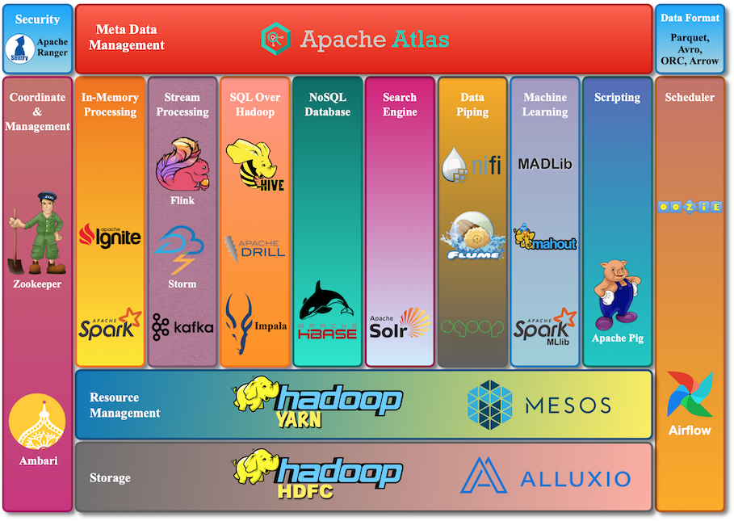
https://www.cloudduggu.com/hadoop/ecosystem/
Notes:
The Hadoop Ecosystem

Slide 38


An Oversimplified Version of the Hadoop Ecosystem in Action
Relational business data
Sqoop: ingest relational data
HDFS Data Lake Data stored “as is”
Pig, Spark: explore data,
transform data, add structure
Flume: ingest logs and data streams
Unstructured data (logs, social, text, etc.)
Mahout, Spark MLlib, R: mine structured data for predictive and prescriptive analytics
Hive, Impala, Spark-SQL: ad-hoc query structured data for descriptive and diagnostic analytics

Slide 39

HIVE
SQL Over Hadoop HDFS

Slide 40
What is HIVE?
SQL Over Hadoop!
Apply a table schema over the data in HDFS
Schema is not persistent – its “schema on read”
Provides a means to query HDFS data with SQL
Not standard SQL, but HiveQL – HQL
Developed by Facebook
Hive v1 used Map-Reduce, Hive v2 is in-memory on YARN.
Hcatalog / Hive metastore provides table access to other tools in the Hadoop ecosystem.

Slide 41

Hive Metastore
The Hive metastore holds schema / metadata information for hive database objects:
Databases
Tables
Views
Indexes
The actual data itself are stored on HDFS.
Metastore:
HDFS:
SELECT * FROM orders;

Slide 42
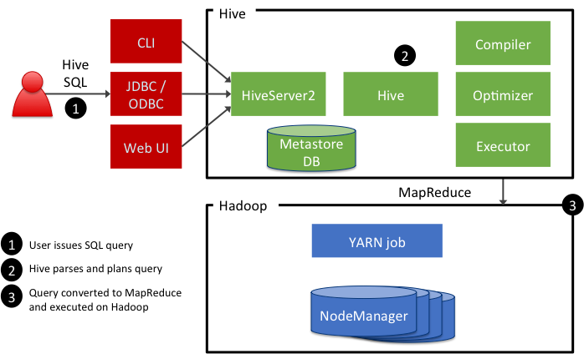
Hive Architecture
Notes:
Hive queries are submitted to a HiveServer2 process that typically runs on a master node in the cluster. The Hive query is converted to either a:
MapReduce job, or
Tez job
NOTE: Later in the slides it will be explained that the original CLI cannot access HS2, but only its predecessor, HiveServer.

Slide 43
Demo: Connecting to Hive
Beeline Hive client
Show databases
Show tables
Create database
beeline -u jdbc:hive2://localhost:10000/default -u cloudera -p cloudera –silent=true
Notes:
beeline -u jdbc:hive2://localhost:10000/default -u cloudera -p cloudera –silent=true
Show databases
Show tables
Create database

Slide 44
Two Types of Hive Tables
Internal (Hive-Managed)
External
Data and Schema are managed by the Hive, like an RDBMS
Data are moved into a special HDFS folder /user/hive/warehouse
Drop table → deletes data
Table over existing HDFS location
Only the schema is managed by the Hive
Drop table → deletes the schema only

Slide 45
Defining a Hive-Managed (Internal) Table
CREATE TABLE customer (
customerID INT,
firstName STRING,
lastName STRING,
birthday TIMESTAMP
) ROW FORMAT DELIMITED
FIELDS TERMINATED BY ',';
A Hive-managed table means that, when the table is dropped, the underlying folder in HDFS is deleted.
Notes:
A Hive managed table means that when the table is dropped, the underlying folder in HDFS is deleted.

Slide 46
Loading Data Into Hive-Managed Tables
Not in HDFS
LOAD DATA LOCAL INPATH '/tmp/customers.csv' OVERWRITE INTO TABLE customers;
LOAD DATA INPATH '/user/train/customers.csv' OVERWRITE INTO TABLE customers;
INSERT INTO TABLE birthdays
SELECT firstName, lastName, birthday
FROM customers
WHERE birthday IS NOT NULL;
Already in HDFS
Already another HIVE Table
Notes:
The data does not actually get “loaded” into anything, but the data does get moved:
- For Hive-managed tables, the data is moved into a special Hive subfolders of /users/hive/warehouse
- For external tables, the data is moved to the folder specified by the LOCATION clause in the table’s definition

Slide 47
Demo Internal tables
Let’s create a grades table
Query the table
Load data from local into the table
Query the table again
Drop table
Table and data are gone!
Notes:
beeline> select * from grades_int;
# where does it load the data? Into a hive managed table
!sh hadoop fs -ls /user/hive/warehouse/grades_int
beeline> drop table grades_int;
# data is gone
!sh hadoop fs -ls /user/hive/warehouse/grades_int

Slide 48
Hive Managed Tables
What are the Three methods of importing data into a Hive-managed table?

Slide 49
Defining an External Table
CREATE EXTERNAL TABLE salaries (
gender string,
age int,
salary double,
zip int
) ROW FORMAT DELIMITED FIELDS TERMINATED BY ',' LOCATION '/path/to/hdfs/';
If the table is EXTERNAL, then the data remain in HDFS if the table is dropped. External tables require a location.
Notes:
If the table is EXTERNAL, then the data remains in HDFS if the table is dropped.

Slide 50
Demo External tables
Let’s create a grades table
Query the table
Copy data into HDFS folder
Query the table again – data is there!
Drop table
Table is gone, data is not!
Notes:
beeline> create external table grades_ext (
year int,
term string,
course string,
credits int,
letter string
) row format delimited
fields terminated by '\t'
location '/user/cloudera/grades';
beeline> select * from grades_ext;
beeline> drop table grades_ext;
# data is still there
!sh hadoop fs -ls /user/cloudera/grades

Slide 51
Internal –vs- External Tables
Which Hive table
will drop the schema and data?
is located in /user/hive/warehouse?
must specify a location?
Notes:
Internal
Internal
External

Slide 52
Query Hive Like SQL!
SELECT * FROM customers;
FROM customers SELECT firstName, lastName, address, zip WHERE orderID > 0 ORDER BY zip;
SELECT customers.*, orders.* FROM customers JOIN orders ON (customers.customerID = orders.customerID);
Notes:
This is a simple slide that is meant to demonstrate how Hive queries look exactly like SQL queries.
You can even do joins, left, right and full outer joins.

Slide 53
Other Hive Features

Slide 54
Create a Table from a Query
CREATE TABLE lastest_customers
STORED AS AVRO | ORC | PARQUET | JSONFILE | TEXTFILE AS SELECT * FROM customers
WHERE reg_year = 2018;
The default format is TEXTFILE
The same as adding STORED AS TEXTFILE
Notes:
The only Hive queries the students have seen up until now have run from the Hive shell. Here we finally discuss how to store the result into a folder.

Slide 55
File Formats
ORC: optimized row columnar; stores data in a columnar format, compressed
Parquet: column-oriented binary format; contains schema; compressed
Avro: row-based, compressed with schema; used for data serialization
How to choose:
Text provides the best write performance.
Parquet and ORC provide the best read performance.
Avro is for data exchange/compatibility with other systems.

Slide 56
Storing Results to HDFS
INSERT OVERWRITE DIRECTORY '/user/train/ca_or_sd/’
row format delimited fields terminated by ',’ SELECT name, state FROM names
WHERE state = 'CA'
or state = 'SD';
Notes:
The only Hive queries the students have seen up until now have run from the Hive shell. Here we finally discuss how to store the result into a folder.

Slide 57
Creating Views
CREATE VIEW v_shipped_orders AS SELECT * FROM orders
WHERE status = 'Shipped'
AND delivery is not null
Notes:
The only Hive queries the students have seen up until now have run from the Hive shell. Here we finally discuss how to store the result into a folder.

Slide 58
Hive
Which Hive file format
Is best suited for high-performance reads?
Is compatible with a variety of other systems?
Notes:
Parqurt / ORC
AVRO

Slide 59

HBase
Wide Column Store over Hadoop HDFS

Slide 60

What Is HBase?
A wide column store database
Stores data on top of HDFS; uses HDFS for storage
Based on Google Big Table
No schema required. Create it as you store data.
Supports CRUD operations, and consistent reads
Like HDFS, HBase is a single-master system (CP)
Data stored under a row key, simple CRUD by row key only.

Slide 61
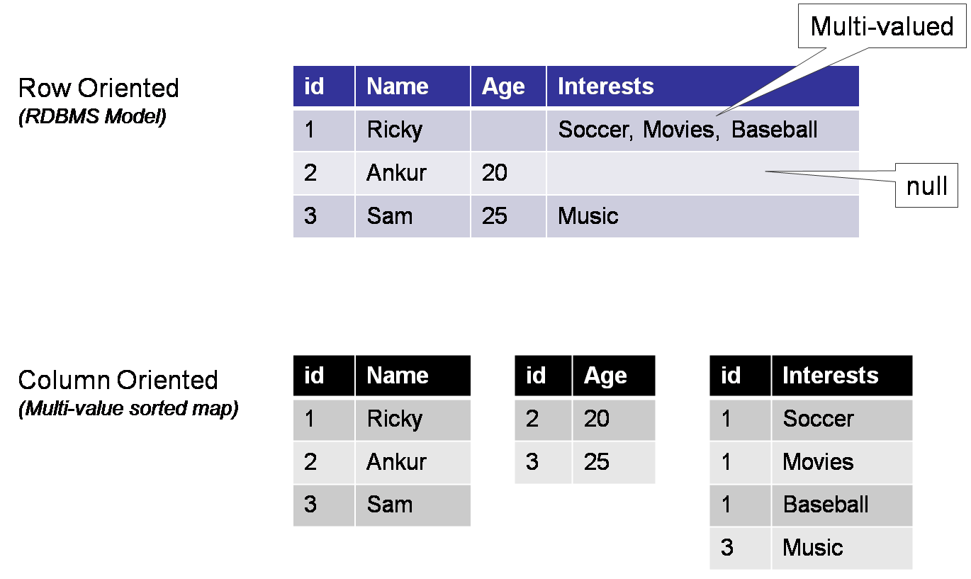
Understanding the column store
id is
The Primary Key in row-oriented storage
The Row Key in column-oriented storage
Notes:
Best way to understand the column store is to compare it to what we know already – the row store.

Slide 62
Hbase use cases
You need to store data at massive scale. You must outgrow the RDBMS!
Data requires updates
Process-oriented data, txt messages, stadium attendance
Super-sized reference data like tracking stars, large customer bases
One big table – no joins. Simplified design.

Slide 63
HBase Architecture
HMaster
Monitors the region servers
Controls load balancing and failover
Assigns regions to region servers
HRegionServer
Installed on Hadoop worker nodes with NDFS DataNode
Consists of multiple regions, called HRegions
Each HRegion consists of multiple data stores where the data are written
HMaster
HRegion Server1
HRegion Server2
HRegion Server3
HRegion Server4

Slide 64
HBase Physical Data Model Visualized
HRegionServer
HRegions
Tables
HFiles
Column families
Cell
Notes:
READ THIS!!!!
Here’s an example of a single region server in a Hbase cluster.
The HRegionServer has multiple regions
Tables – Logical collection of rows stored in HRegions. A single table is distributed across several regionservers.
Rows – A row is one instance of data in a table and is identified by a rowkey. Rowkeys are unique in a Table.
Column Families – Data in a row are grouped together into Column Families, which are groups of columns.
Columns in a family are stored together in a low level storage file known as HFile. Column Families form the basic unit of physical storage to which certain HBase features like compression are applied. Hence it’s important that proper care be taken when designing Column Families in table. They should be grouped physically, not logically.
Columns – A Column Family is made of one or more columns. A Column is identified by a Column Qualifier that consists of the Column Family name concatenated with the Column name using a colon – example: columnfamily:columnname. There can be multiple Columns within a Column Family and Rows within a table can have varied number of Columns.
Cell – A Cell stores data and is essentially a unique combination of table, rowkey, Column Family and the Column (Column Qualifier). The data stored in a Cell is called its value and the data type is always treated as an array of bytes.
Version – The data stored in a cell is versioned and versions of data are identified by the timestamp. The number of versions of data retained in a column family is configurable and this value by default is 3.

Slide 65
HBase Logical Data Model
Table: collection of rows and columns
RowKey: access to columns by row key
Column Family: a collection of columns physically stored together
Cell: the most atomic unit in HBase—a cell, row, column family, and column; every cell has a timestamp and value
>> get 'customers', 1, 'address:street’
timestamp=1533254769041, value=314 Hinds Hall
Table
RowKey
Column Family
Column

Slide 67
Hbase Table Commands
list—show tables
create—create a table, returns a table reference
alter—add a column family to a table
disable—disable a table
drop—drop a table
get_table—get a table reference
scan—query a table
get—read a row key from a table
put—write to a row key in a table
delete—delete a row key from a table

Slide 68
Commands or Table Reference
Commands can be issued with table name or using a reference.
> create 'demotable', 'myfamily' > disable 'demotable' > drop 'demotable'
With table references:
> d = create 'demotable', 'myfamily' > d.disable > d.drop

Slide 69
Demo: Hbase commands
Create ‘address’ column family in ‘customers’ table
Put data therein
Scan it out
Get by row key
Add another column family
Put more data
Scan query
Notes:
$ hbase shell
Hbase> Whoami
Hbase> Version
Create ‘customers’, ‘address’
Put ‘customers’, 1, ‘address:street’, ‘ 314 Hinds Hall’
Put ‘customers’, 1, ‘address:city’, ‘ Syracuse’
Put ‘customers’, 1, ‘address:state’, ‘ NY
Put ‘customers’, 2, ‘address:street’, ‘ 221b Baker Street’
Put ‘customers’, 2, ‘address:city’, ‘ London’
Put ‘customers’, 2, ‘address:country’, ‘ UK
Scan ‘customers’
Get ‘customers, 1
#not there is no way to get columns from customer 1 and 2. You must get my key first.
get 'customers',1, ['address:city', ‘address:state]
Alter ‘customers’, ‘name’
Put ‘customers’, 1, ‘name:first’, ‘Mike’
Put ‘customers’, 1, ‘name:last’, ‘Fudge’
Put ‘customers’, 1, ‘name:suffix’, ‘Jr’
get 'customers',1, [‘name:first, ‘address:city]
scan 'customers' , { COLUMNS => [ 'address:city'] }

Slide 70
HCatalog
Hive metastore for all Hadoop Applications

Slide 71

About HCatalog
Bob, I need today’s data.
This is analyst Joe. He uses Hive to build reports and answer ad hoc queries.
This is programmer Bob. He uses Hbase to edit data.
Okay.
Is it done yet? Where is it? What format did you use to store it in today? Is it compressed? And can you help me load it into Hive?
Dude, we need HCatalog.
Notes:
Makes the Hive metastore available to users of other tools on Hadoop
Provides connectors for MapReduce and Pig so that users of those tools can read data from and write data to Hive’s warehouse
Allows users to share data and metadata across Hive, Pig, and MapReduce
Provides a relational view through an SQL-like language (HiveQL) to data within Hadoop
Allows users to write their applications without being concerned about how or where the data is stored
Insulates users from schema- and storage-format changes

Slide 72



HCatalog
Exposes the Hive Metastore to other Hadoop Applications:
Spark, Pig, Impala, Hbase, Whatever!
Everything is stored in HDFS, so this makes perfect sense.
All that is needed is a schema over the data so that Hadoop understands how to read it contextually!
This is Hcatalog – a global schema over your Hadoop data!
HCatalog
Hadoop Applications
Hive
HBase
HDFS

Slide 73
Example: Integrating HBase With Hive
This can be integrated two ways:
Existing HBase tables can be seen as external tables in Hive.
New HBase tables can be created in Hive and data loaded into them with HQL.
Use the HBaseStorageHandler Class
Must set the special serializer/de-serializer mappings, SERDEPROPERTIES
Hcatalog must know how to “handle” the data format. This is the point of a SERDE.

Slide 74
Example: Hive Table
CREATE EXTERNAL TABLE people (key int, name string, phone string)
STORED BY 'org.apache.hadoop.hive.hbase.HBaseStorageHandler'
WITH SERDEPROPERTIES( "hbase.columns.mapping"="person:name,person:phone“ ) TBLPROPERTIES ( "hbase.table.name"="people" );

Slide 75
Demo: Hbase and Hive
In Hive
Create external table for Hbase customers from previous example
Query it in Hive… So much easier than Hbase!
In Hbase
Add a new row key
Update another row hkey
Back to Hive
Query it again and see the updated data!
Notes:
create external table customers_hbase(key int, street string, city string, state string, country string) stored by 'org.apache.hadoop.hive.hbase.HBaseStorageHandler'
WITH SERDEPROPERTIES("hbase.columns.mapping" = "address:street,address:city,address:state,address:country") TBLPROPERTIES("hbase.table.name"="customers");
select * from customers_hbase;
Back to Hbase
put 'customers', 3, 'address:street', '1313 Mockingbird lane’
Back to hive
select * from customers_hbase;

Slide 77

Impala
A MPP (Massive Parallel Processing) Database for Hadoop

Slide 78

What Is Impala?
Impala is an interactive SQL-like query engine for Hadoop
Query data are loaded into memory on each worker node to improve processing—MPP architecture
Requires a lot of RAM on each worker node to work effectively
Impala is an open source created by Cloudera
Top-level open source project in 2017
Other Non-Hadoop: MPP Systems, SQL Server MPP, Oracle Grid, and MemSQL

Slide 79
Impala vs. Hive (Original Hive)
Impala
Hive
Interactive SQL over Hadoop
Processes queries in memory on worker nodes
Working data loaded into memory for faster query times
Does not generate MapReduce jobs
Batch SQL over Hadoop
Processes queries via MapReduce
Working data remain on disk
Query generates a MapReduce job
Newest Hive is also MPP and on par with Impala. Our Hadoop version has old Hive.

Slide 80
Metadata Caching
It is the reason the Impala queries improve from the first query to the next.
Each Impala worker node maintains a copy of Hive Metastore metadata.
This metadata contains information about the table definition, data format, and block storage in HDFS.
As a result, table changes in Hive or updates to the underlying data in HDFS or HBase will go unnoticed by Impala.
REFRESH command will fix this on the table level
INVALIDATE METADATA clears out the metadata entirely. Like querying again for the first time.

Slide 81
Demo Impala Vs Hive
Query table in Impala
Query it again – lightning fast!
Load additional data into an external table through HDFS
Query it in Hive—new data are there
Query it in Impala—new data are not there!
REFRESH table
Query it again—data are there

Slide 82
Summary
Hadoop is a distributed processing and storage system designed for big data
HDFS is the file system for Hadoop; All applications store data in HDFS
YARN is the resource scheduler for Hadoop; All applications are managed with YARN
HIVE is an SQL over Hadoop Application
Hbase is a wide column family database over Hadoop
Hcatalog integrates the Hive metastore with other Hadoop applications.

Slide 83
Exit Ticket
“Confusion Says”
In there anything from this unit that has you confused?

