Slide 1
IST769 Unit K
Search Databases

Slide 2
Agenda
What is a Search Database?
Use Cases
Elasticsearch Architecture
Data ingestion methods
Kibana dashboards

Slide 3

Search Databases

Slide 4
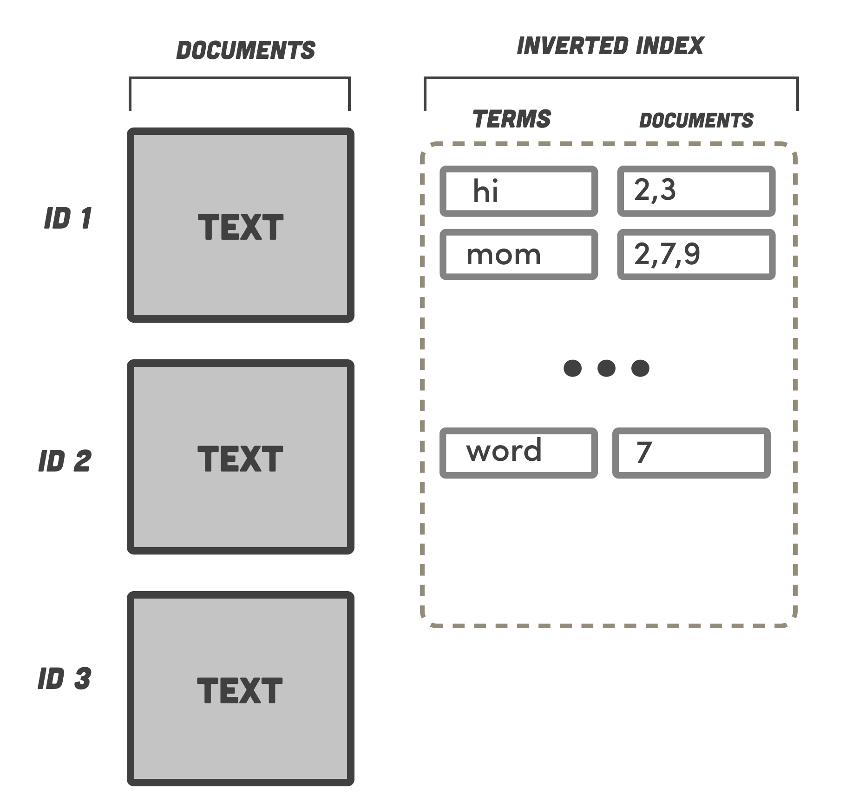
Search Databases
Non-Relational database dedicated to search.
Designed to support the retrieval of documents.
Not full CRUD, Typically CR
BASE, not ACID
Fast search is retrieved with an inverted index.
Commonly used in concert with other databases.

Slide 5
Use Cases
Text search over documents
Traditional search over HTML
Custom search engine
Log Analytics
Observe what is happening on your systems in near-real time
Marketing
Discover what customers are doing
Metrics / Operations
Real-time measurements of data over short windows.

Slide 6
Check yourself – True/False?
Search databases are eventually consistent?
A common use case for search is CRUD of reference data like customers.
Search databases store data in an inverted index.
Notes:
T
F
T

Slide 7

Elastic Search

Slide 8
Elasticsearch
Based on Apache Lucene
Scales horizontally through data shards across nodes (like Cassandra and MongoDb)
Consists inverted indexes (like MongoDb collections) of documents.
Inverted index lists every unique word appearing any document within the collection.
Complete REST API for adding documents and querying them.
Near-real time query capability.

Slide 9
The Elastic Stack ELK
Data Ingestion
Logstash – batch ingestion of log data or output from any application
Beats – real-time metrics lightweight data shipper of transactions from a variety of sources.
Elastic Search
Creates indexes on ingested documents
Distributes documents across the Elastic cluster for better performance
Provides a HTTP REST API to search, add data.
Kibana
Analysis / Dashboarding tool

Slide 10
Which Parts are Elastic Community?
Elastic Stack (Apache License)
X-Pack (Elastic License)
Kibana
Elastic Search
Logstash and Beats
Security
Monitoring
Alerting
Graph
Reporting

Slide 11

Logstash
Data processing pipeline
Ingest data from a variety of sources
Apply transformations before storing in Elasticsearch
GeoIP, or DNS lookups
Date parsing
Hashing
Advanced transformations in Python or other languages
https://www.elastic.co/guide/en/logstash/current/index.html

Slide 12

Beats
Beats are data shippers
You install them on your hosts as agents
There are different types of beats, more than one can be installed on a host.
Filebeat – watch file output (logs)
Heartbeat – check availability (of host or service)
Packetbeat – inspect network traffic
Metricbeat – check host metrics
https://www.elastic.co/guide/en/beats/libbeat/current/index.html

Slide 13

Kibana
Search, Observe, Manage, and Monitor data in Elastic Search
Allows for building Dashboards
Supports custom query language Kibana Query Language KQL
https://www.elastic.co/guide/en/kibana/current/index.html

Slide 14
Elastic Search Architecture and Data Model
Cluster consists of nodes
Documents are stored in an index
Indexes can be divided into types
Indexes can be sharded
Shards are replicated across the nodes
Node1 Index: Orders Type: customer
Doc: Customer 1 Doc: Customer 2
Type: order
Doc: Order A Doc: Order B
Node2 …
Node3 …

Slide 15
Search vs Relational
Indexes are like tables, or collections in document databases.
Documents are like rows in the table

Slide 16
Lots of integrations

Slide 17
Data Streams

Slide 21
Graph Vs Relational
Graph
Relational
Node Label
Node
Node Property
Relationship
Relationship Direction
Relationship Attributes
Table
Row in Table
Column in Table
Foreign Key
(No equivalent)
Associative Entity / Bridge table

Slide 22
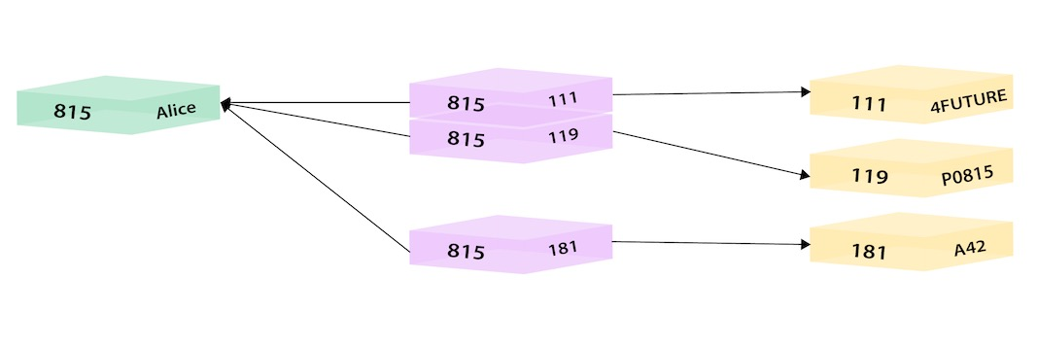
Relational
Employee and Departments w/ Associative Entity

Slide 23
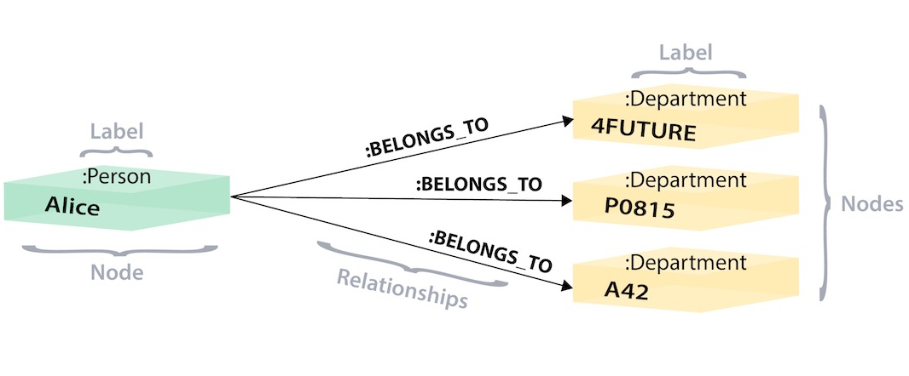
Graph
Employee and Departments – Relationships are pointers to Nodes

Slide 24
Why Graph instead of Relational?
Relational is not good for complex relationships
One-way Relationships (Most Common)
Paying an Invoice, Enrolling in a course
Recursive Relationships (Parent-Child)
Organizational Charts
Product Categories
Security Permissions
File Systems
Complex Relationships (True Graphs)
Email Interactions / Social Media – Community detection
Path finding
Centrality – like Google’s PageRank Algorithm

Slide 25
Check Yourself – True or False
Relationships in the graph data model are two-way.
The graph data model cannot store attributes with the relationship
The graph data model is better suited for parent-child relationships than the relational data model.
Notes:
F
F
T

Slide 26

Neo4j
Open Source Graph Database

Slide 27
Neo4j
Open-Source Graph Model Database
ACID-Compliant
Commercial Version supports High-Availability
Custom Query Language called Cypher
Written in Java
Very performant:
Can handle billions of nodes on a single instance
Can traverse 1000’s of relationships in sub-second time

Slide 28
Neo4J Physical Data Model
Each Node Contains:
Labels
Attributes
Defined Relationships
Pointers to other nodes that satisfy the relationship
Relationship data stored, not calculated
Faster than relational indexing
Can’t be queried with Standard SQL – Need a different Language
Customer:
Name: bob
ORDERS:
Number: 1234 <product ptr>
Number: 1234 <product ptr>
Product:
AB12
Amount: $25
Name: Mouse
Product:
AB17
Amount: $75
Name: Keyboard

Slide 29
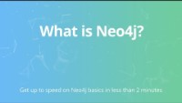
Video: What is Neo4j?

Slide 30
Check Yourself – True or False
Neo4j stores relationships within nodes.
Neo4j does not require an index to find data.
Neo4j is open source.
Notes:
T
T
T

Slide 31
Demo: Neo4J
Start Neo4j in docker
Connect to web UI:
http://localhost:7474/
Load up some sample data:
:play movie graph
Over To Spark
Query Notes from Neo4j

Slide 32
Neo4j Data Model
Community Edition limited to single database - neo4j
Labels allow us to group common nodes together. :Label
These are like a table, but with no required schema!
They just categorize common nodes.
Relationships connect nodes together –[RELATIONSHIP]->
Relationships are one way or two way
Attributes – key value pairs {key:value}
Can be assigned to nodes or relationships
Every node and relationship gets its own id, globally unique to the db.
(f:Faculty {name:'Mike'})-[r:TEACHES {semester:'fall2021'}]->(c:Course {code:'IST769'})

Slide 33
Cypher Basics
Cypher Query Language

Slide 34
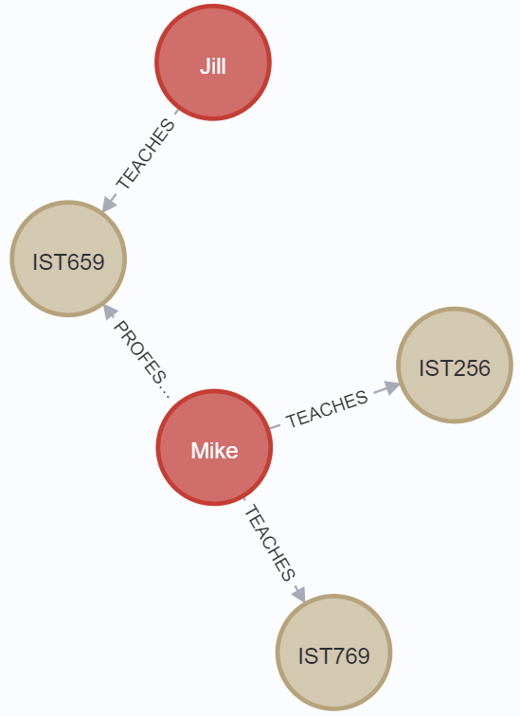
CREATE / MERGE
CREATE Adds a node and/or relationship. It will re-add the same data.
MERGE Will not a add the same data.
merge (f1:Faculty {name:'Mike'})- [t1:TEACHES {semester:'fall2021'}]-> (c1:Course {code:'IST769'})
merge (f1)-[t2:TEACHES {semester:'fall2021'}]-> (c2:Course {code:'IST256'})
merge (f1)-[p1:PROFESSOR_OF_RECORD]-> (c3:Course {code:'IST659'})
merge (f2:Faculty {name:'Jill'})- [t3:TEACHES {semester:'fall2021'}]->(c3)

Slide 35
MATCH
Match is used to query data.
Here is the SELECT * Equivalent
match (f:Faculty)-
[t:TEACHES]-> (c:Course)
return f,t,c

Slide 36
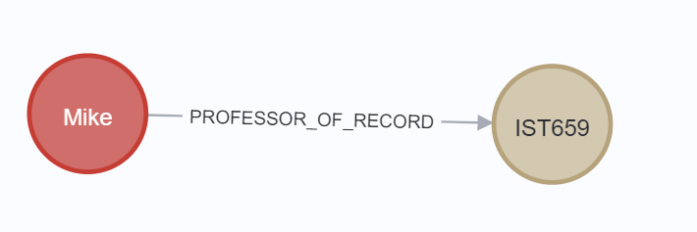
MATCH with WHERE
Who is the professor of record for IST659?
match (f:Faculty)- [p:PROFESSOR_OF_RECORD]->(c:Course)
where c.code ='IST659'
return f,p,c

Slide 37
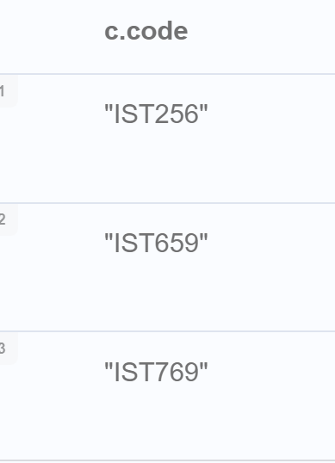
MATCH with ORDER BY
ORDER BY comes after the return. Makes sense as at this point the query has been materialized.
List of course codes sorted.
match (c:Course)
return c.code
order by c.code

Slide 38
Check Yourself – Neo4J Movie Graph
Build a graph of movies and reviewers
Complete the same thing, but only review ratings over 70
Build a graph of actors and directors with movies
Build a graph of people who acted and directed the same movie
Notes:
1.
MATCH (a:Person)-[d:REVIEWED]->(m:Movie)
RETURN a,d,m
2.
MATCH (a:Person)-[d:REVIEWED]->(m:Movie)
where d.rating > 70
RETURN a,d,m
3.
MATCH (p1:Person)-[a:ACTED_IN]->(m:Movie)<-[d:DIRECTED]-(p2:Person)
RETURN p1,a,m,d,p2
4.
MATCH (p:Person)-[a:ACTED_IN]->(m:Movie)<-[d:DIRECTED]-(p)
RETURN p,a,m,d

Slide 39
UPDATE data
Use UPDATE to update an existing node adding attributes
This adds an attribute called "type" to add more.
match (c:Course {code: 'IST256'})
SET c.type = "Undergraduate"
return c

Slide 40
REMOVE
Use Remove to delete properties or labels.
This removes the attribute we made in the previous step
match (c:Course {code: 'IST256'})
remove c.type
return c

Slide 41
DELETE
Delete can delete relationships or nodes.
WHERE clause can be used for exact match
Force Delete All Faculty nodes with relationships
match (n:Faculty)
detach delete n

Slide 42
Check Yourself – Neo4J Updates
How do I add credits = 3 to every course node?
Add "Mike" at the professor of record for IST769
Change IST256 from 3 credits to 4
Notes:
1.
match (c:Course)
set c.credits = 3
return c
2.
match (mike:Faculty {name:"Mike"})
match (ist769:Course {code:'IST769'})
merge (mike)-[r:PROFESSOR_OF_RECORD]->(ist769)
return mike, r, ist769
3.
match (c:Course )
where c.code = 'IST256'
set c.credits = 4
return c

Slide 43
Importing Data

Slide 44
Import CSV
You can easily import CSV data.
This example uses a named map to alias the row as n
LOAD CSV WITH HEADERS FROM "http://data.neo4j.com/northwind/products.csv" AS row
CREATE (n:Product)
SET n = row,
n.unitPrice = toFloat(row.unitPrice),
n.unitsInStock = toInteger(row.unitsInStock),
n.unitsOnOrder = toInteger(row.unitsOnOrder),
n.reorderLevel = toInteger(row.reorderLevel),
n.discontinued = (row.discontinued <> "0")

Slide 45
Importing JSON
Need the “Awesome Procedures on Cypher” plugin (APOC)
This example uses yield which waits for the call to complete.
You can query API's in this way
with 'https://raw.githubusercontent.com/mafudge/ist769/main/datasets/json-samples/stocks.json' as uri
CALL apoc.load.json(uri)
yield value
return value;

Slide 46
Graph Data Modeling
https://neo4j.com/developer/data-modeling/

Slide 47
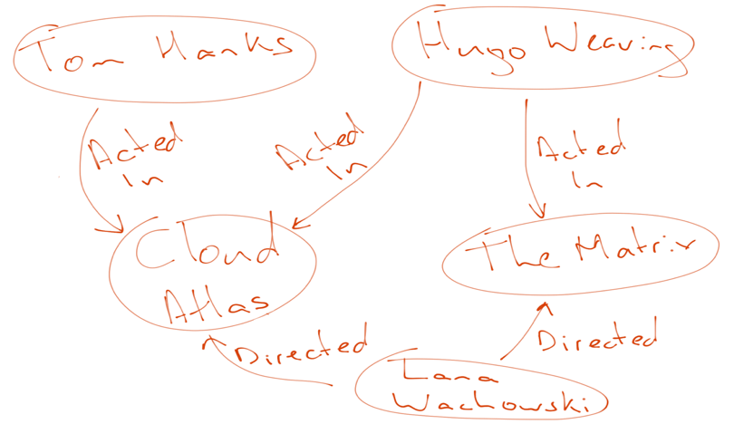
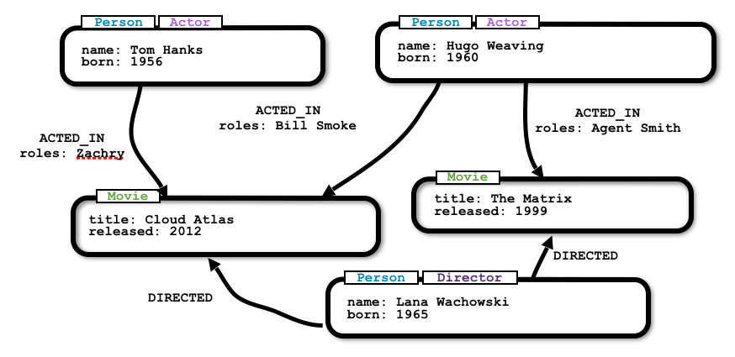
"Whiteboard Friendly"

Slide 48
Graph Data Modeling
Conceptual E-R Modeling works
Entities Become Nodes Labeled to match the Entity
Relationships become Relationships of course
Cardinality doesn't matter
Resolve Multi-valued attributes to Relationships
Lots of relationships are fine. This is what graph is for!
When is doubt:
more nodes and relationships with fewer attributes
Instead of fewer nodes / relationships with more attributes
Think: Exact opposite of the Document Model!!!

Slide 49
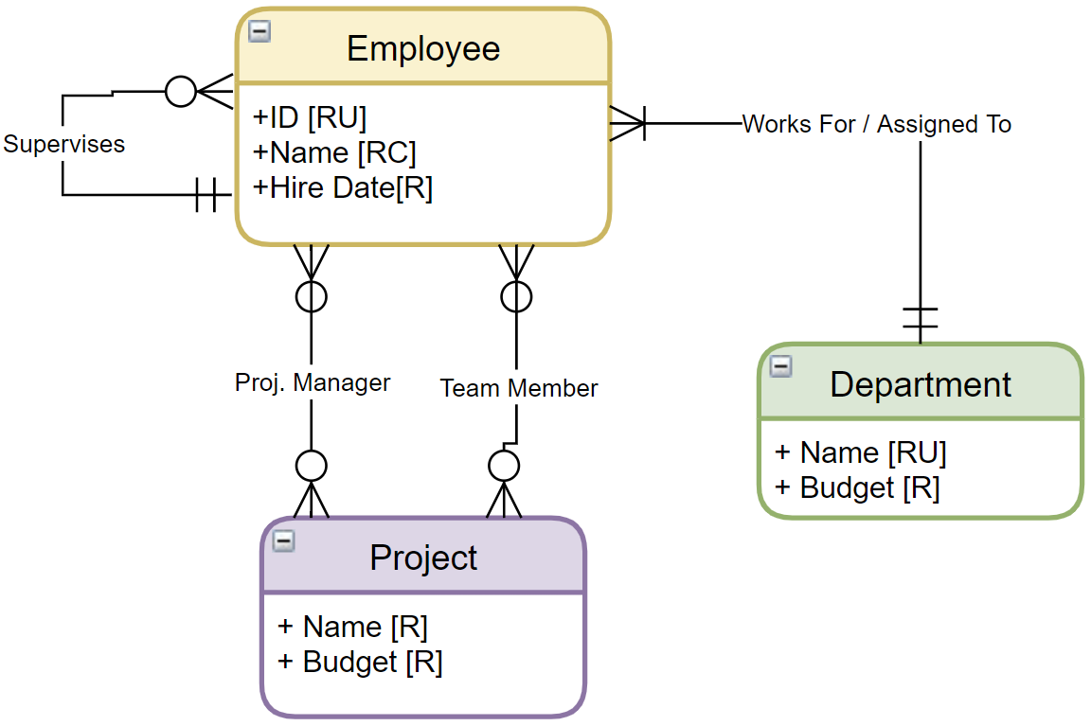
Graph model This!
Nodes?
Relationships?
Properties?
White Board it with real data!

Slide 50
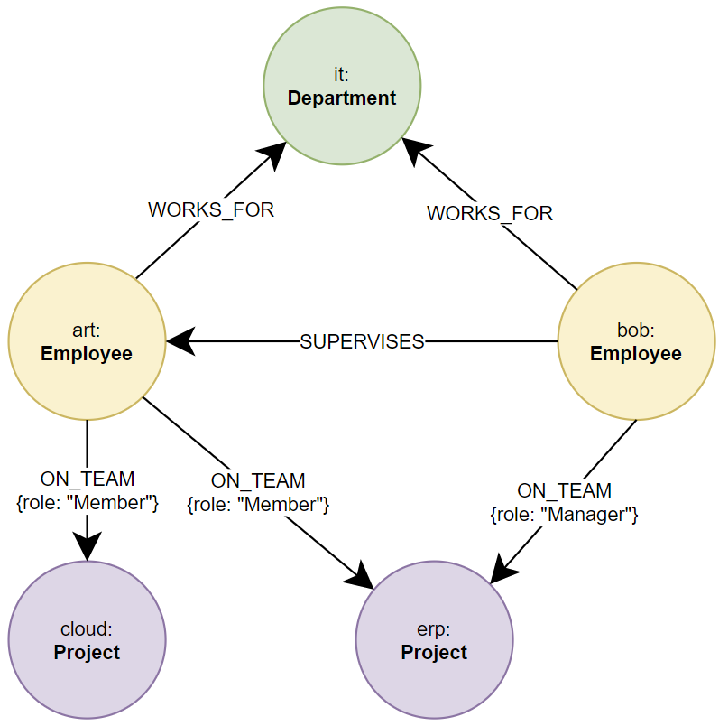
Solution?

Slide 51
Graph Data Science Library
https://neo4j.com/product/graph-data-science-library/

Slide 52
What is the Graph Data Science Library?
Perform Reasoning over your Graph

Slide 53
Algorithms
Community Detection – find significant interactions (relationships) among nodes.
Centrality (Importance) – Find influential nodes (PageRank)
Similarity – Discover similar nodes based on relationships / properties
Heuristic Link Prediction – predict the likelihood of a new relationship being formed.
Pathfinding – find shortest, or most efficient paths between nodes.
Node Embedding – Convert node relationships to vectors for ML tasks

Slide 54
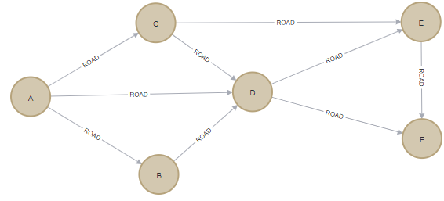
Example: Shortest Path
CREATE (a:Location {name: 'A'}), (b:Location {name: 'B'}), (c:Location {name: 'C'}), (d:Location {name: 'D'}), (e:Location {name: 'E'}), (f:Location {name: 'F'}), (a)-[:ROAD {cost: 50}]->(b), (a)-[:ROAD {cost: 50}]->(c), (a)-[:ROAD {cost: 100}]->(d), (b)-[:ROAD {cost: 40}]->(d), (c)-[:ROAD {cost: 40}]->(d), (c)-[:ROAD {cost: 80}]->(e), (d)-[:ROAD {cost: 30}]->(e), (d)-[:ROAD {cost: 80}]->(f), (e)-[:ROAD {cost: 40}]->(f);
CALL gds.graph.create( 'myGraph', 'Location', 'ROAD', { relationshipProperties: 'cost'
}
)

Slide 55
Example: The Algorithm Call on 'myGraph'
MATCH (source:Location {name: 'A'}), (target:Location {name: 'F'})
CALL gds.shortestPath.dijkstra.stream('myGraph', {
sourceNode: source, targetNode: target, relationshipWeightProperty: 'cost'
})
YIELD index, sourceNode, targetNode, totalCost, nodeIds, costs, path
RETURN
index,
gds.util.asNode(sourceNode).name AS sourceNodeName,
gds.util.asNode(targetNode).name AS targetNodeName,
totalCost,
[nodeId IN nodeIds | gds.util.asNode(nodeId).name] AS nodeNames,
costs, nodes(path) as path
ORDER BY index

Slide 56
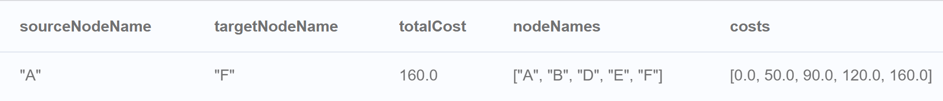
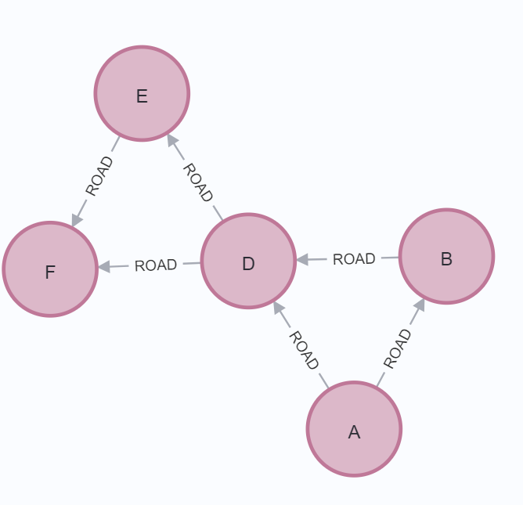
Example: Results
80
100

Slide 57
Check Yourself – Matching Summary
Google Pagerank
MERGE
REMOVE
APOC Library
Associative Entity
Delete a property on a node
Implemented in Graph as relationships with properties
Required to load JSON
Upsert into the graph
A Centrality Algorithm

Slide 58
Exit Ticket
Is there a something you find still unclear about today’s lesson

