Slide 1
IST769 Unit C
Hadoop

Slide 2
Agenda
The What, Why, and How of Hadoop
HDFS
MapReduce and YARN
Key Hadoop Applications
Hive
Hbase
Hcatalog
Impala

Slide 3

Get Ready To Follow Along!
Let’s Start Our Docker Environments!
Hadoop in docker requires a lot of resources.
Start: docker-compose up -d
Is It done starting?: docker-compose logs (Check for impala server…)
Access the shell: docker-compose exec cloudera bash -c "su -l cloudera"
Hue Access: http://localhost:8080

Slide 5
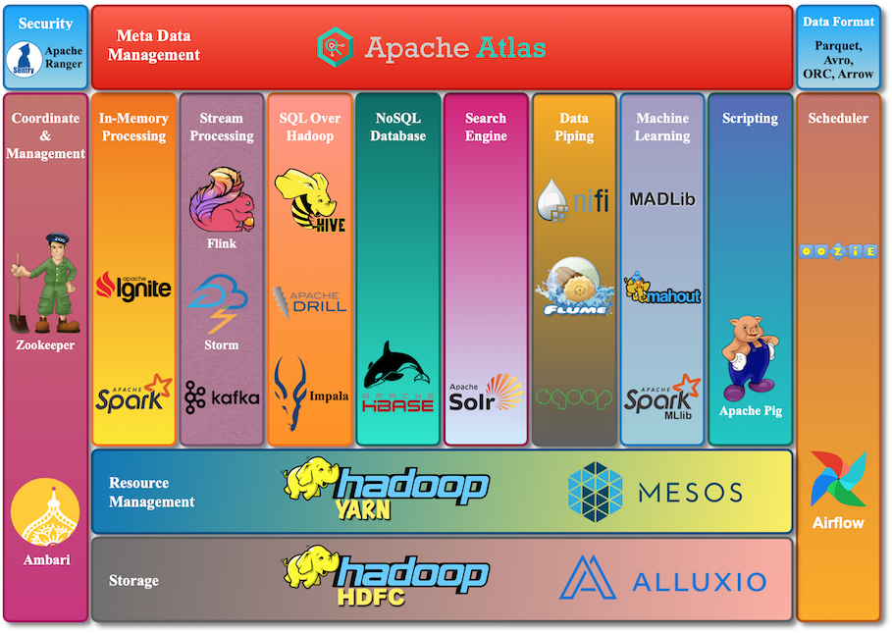
https://www.cloudduggu.com/hadoop/ecosystem/

