Slide 1
IST769 Unit E
SQL Over Anything with Apache Drill

Slide 2
Agenda
The evolution of Big Data
SQL over anything
Apache Drill Architecture
Drill Concepts
Drill SQL

Slide 3
Evolution of Big Data
From Data Warehouses, To Data Lakes, to Serverless Data Warehouses

Slide 4





RDBMS Data Warehouses
Organizations use data warehouses for business intelligence and data analytics.
Data in the DW is heavily cleaned and transformed
SQL Query
Orders
Heavy Data Transformations (ETL)
Analytics:
Who buys what?
When is it bought?
Customers
Cleaning
De-normalization
Data Lookups
Data Warehouse
(Relational Database)
Products

Slide 5




Hadoop Data Warehouse
Modern data is complex and comes from a variety of sources (polyglot).
Relational Db DW cannot keep up with the data volume, so we use Hadoop.
Store As-Is
Hadoop
Data Lake
SQL Query (Hive)
Reviews
Orders
Non-Relational
Sources
Heavy Data Transformations (ETL)
Analytics:
Who buys what?
When is it bought?
What products are people talking about?
Verified purchases.
Customers
Web Logs
Relational
Sources
Relational Database Data Warehouse
Products
Social Media

Slide 6
The Serverless Data Warehouse
Large up-front investment make Hadoop costly and impractical for all but the largest of use cases.
Agility is needed to query data from anywhere especially as cloud adoption increases.
Reviews
Direct SQL Query
Orders
RDBMS Connector for
Customers, Orders Products
S3 connector for Reviews and weblogs
HTTP connect for social media API’s
Analytics:
Who buys what?
When is it bought?
What products are people talking about?
Verified purchases.
Customers
Web Logs
Products
Social Media

Slide 7
Direct SQL Query
Query any source of data with SQL
Any Sources? Just about any
Hadoop, Relational Db, NoSQL Db, Object storage, Web API
Cloud Providers:
AWS Athena
Google BigQuery
Open Source:
Apache Drill

Slide 8

Apache Drill
SQL Over anything

Slide 9
Apache Drill
https://drill.apache.org/
Based on Google’s Dremel system which powers BigTable
“Open Source SQL Query Engine for BigData”
Distributed MPP Architecture
Supports the SQL2003 Standard
https://en.wikipedia.org/wiki/SQL:2003 (Window functions, CTE’s)
Queries a wide variety of sources
Supports a wide variety of file formats

Slide 10
Why Drill?
Query at Source: No need to move or transform data to query it
Schema on Read: No need for pre-defined schemas
Scalable, column store execution engine offers high performance
Query optimizer pushes the operations down to the source
Supports ODBC to connect to other tools
https://en.wikipedia.org/wiki/Open_Database_Connectivity
Allows query output to be used in other applications like Excel, Tableau, or PowerBI

Slide 11
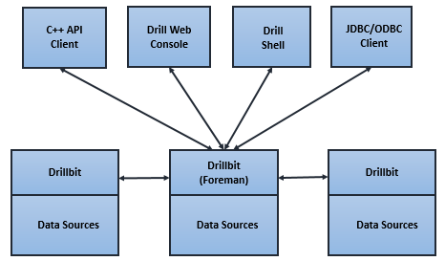

Drill Architecture
Clients
SQL Queries sent from clients to drill cluster
The drillbit service that receives the SQL is the foreman, responsible for parsing the SQL into a distributed execution plan.
The physical plan is carried out by each drillbit in the cluster
https://drill.apache.org/docs/drill-query-execution/
Drill Cluster

Slide 12
Drill Walk-Thru and Demo
The Docker-Compose
Drill Server
Drill Web Client http://localhost:8047/
Jupyter/Spark http://localhost:8888
Minio S3 http://localhost:9001
Walk-Thru Your First Drill Query
select * from cp.`employee.json`
Drill ODBC / Excel Demo
Driver: https://package.mapr.com/tools/MapR-ODBC/MapR_Drill/MapRDrill_odbc_v1.3.22.1055/

Slide 13
True or False
Drill is a distributed SQL query engine.
Drill supports the SQL 2007 standard
Drill has a web client.
The node that received the SQL is called the master node.
Notes:
T
F (SQL 2003)
T
F (Foreman)

Slide 14
Drill Concepts

Slide 15
Data Storage Plugins
Drill talks to Relational, NoSQL, and file-based sources using a plugin architecture
The configuration is in JSON format defines how to connect to the remote storage using a named alias
The SQL FROM clause must identify the storage plugin to use.
FROM cp.`employee.json`
Supported plugins:
Relational: Via ODBC/JDBC
Hadoop: Hbase, Hive, HDFS
NoSQL: MongoDb, Cassadra, ElasticSearch, Kafka
Object: S3, Minio
File System: Local path, Java ClassPath
HTTP for Web API’s
And more!

Slide 16
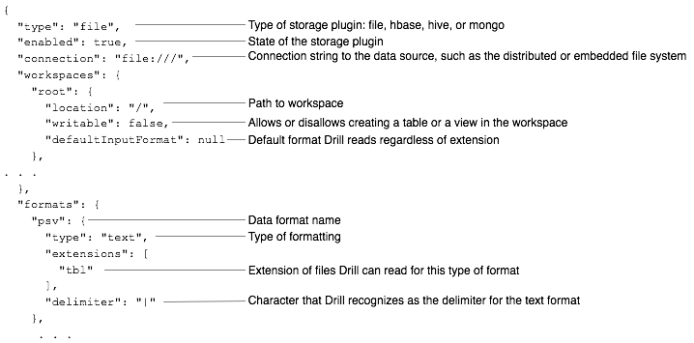
Plugin Config Spec
https://drill.apache.org/docs/plugin-configuration-basics/

Slide 17
File Formats Supported
Log Files, Common Log Format: https://en.wikipedia.org/wiki/Common_Log_Format
Text Files: CSV, TSV, PSV, Any Delimited
JSON files
XML Files
Excel Files
ESRI Shape files https://en.wikipedia.org/wiki/Shapefile
Big Data File formats: Parquet, HDF5

Slide 18
Connecting Drill to Minio
{
"type": "file",
"connection": "s3a://drill-demo/",
"config": {
"fs.s3a.access.key": "minio",
"fs.s3a.secret.key": "SU2orange!",
"fs.s3a.endpoint": "http://minio:9000",
"fs.s3a.connection.ssl.enabled": "false",
"fs.s3a.path.style.access": "true"
},
"workspaces": {
"root": {
"location": "/",
"writable": true,
"defaultInputFormat": null,
"allowAccessOutsideWorkspace": false
}
},
"formats": {
"tsv": {
"type": "text",
"extensions": [
"tsv"
],
"fieldDelimiter": "\t"
},
"excel": {
"type": "excel",
"extensions": [
"xlsx"
],
"lastRow": 1048576
},
"json": {
"type": "json",
"extensions": [
"json"
]
}
},
"enabled": true
}
Let’s connect Drill to Minio
Connect to Drill-Demo bucket
SHOW DATABASES
Excel file format to read excel
Complex queries can be written over your Excel Data!
Bin student scores into quartiles
Averages by class section and exam version.
Notes:
select ntile(4) over (order by student_score desc) as ranking,* from s3.`excel/exam-scores.xlsx`
select avg(Student_Score) over (partition by exam_version ) as avg_by_exam_version,avg(Student_Score) over( partition by class_section) as avg_by_class_section,* from s3.`excel/exam-scores.xlsx`

Slide 19
Querying Basics
Scope each table by storage plugin provider then workspace.
Used in the FROM clause to access a table.
If workspace is omitted, root is used.
SELECT *
FROM myprovider.root.`filespec`
Same as
SELECT *
FROM myprovider.`filespec`
"workspaces": {
"root": {
"location": "/",
"writable": true,
"defaultInputFormat": null,
"allowAccessOutsideWorkspace": false
},
"stuff": {
"location": "/stuff",
"writable": true,
"defaultInputFormat": null,
"allowAccessOutsideWorkspace": true
}

Slide 20
Understanding providers and namespaces
Which SQL command queries the foo provider and bar namespace for the baz resource?
SELECT * from foo,bar,baz
SELECT * from bar.foo.baz
SELECT * from foo.baz
SELECT * from foo.bar.baz
SELECT * from bar.baz
Notes:
ANS 4

Slide 21
Dealing with a lack of Schema
Use the COLUMNS[n] structure to extract columns from data without a schema.
Use CAST() to change type from string to int or
SELECT
COLUMNS[0] as first_col,
CAST(COLUMNS[1] as decimal) as second_col
FROM provider.filespec

Slide 22
Demo: Creating a schema
Going back to grades
No Schema
Using the COLUMNS[n] Data structure
Using CAST to set the data type.
Common-Table Expression to simplify things
Notes:
-- does not know how to delimit
SELECT * FROM s3. `grades/*`
-- no schema
SELECT * FROM s3. `grades/*.tsv`
-- schema
SELECT COLUMNS[0], COLUMNS[1] FROM s3. `grades/*.tsv`
--with names and types
SELECT cast(COLUMNS[0] as int) as year, COLUMNS[1] FROM s3..`grades/*.tsv`
-- as a CTE
with grades as (
select cast(COLUMNS[0] as int) as year,
COLUMNS[1] as semester,
COLUMNS[2] as course,
cast(COLUMNS[3] as int) as credits,
COLUMNS[4] as letter_grade
from s3.`grades/*.tsv`
)
select * from grades

Slide 23
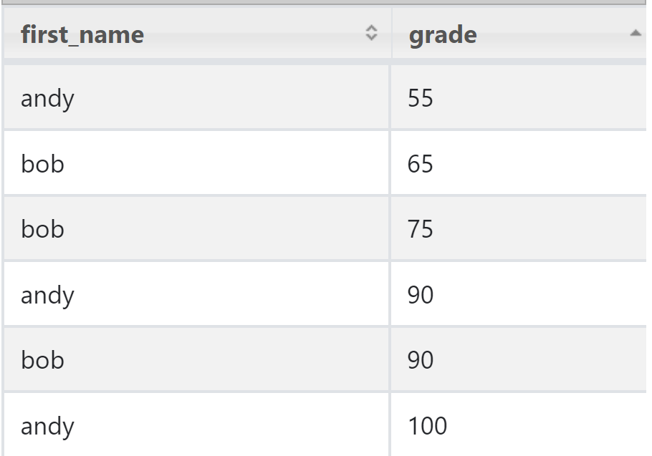
Querying Nested JSON
{ "name" : { "first": "andy" },
"grades" : [100,90,55]
},
{ "name" : {"first": "bob" },
"grades" : [75,90,65]
}
You must alias the table!
Use dot notation for JSON values
Use FLATTEN(col) for JSON arrays
SELECT s.name.first as first_name, FLATTEN(s.grades) as grade FROM s3.`sample.json` s

Slide 24
Demo Querying Nested JSON
Working with Google Places API output.
ERROR
https://stackoverflow.com/questions/38248521/apache-drill-querying-mongo-collection
ALTER SYSTEM SET `exec.enable_union_type` = true;
Dealing with nested JSON values
Dealing with nested JSON arrays
Notes:
select name, gp.geometry.location.lat, gp.geometry.location.lngfrom s3.`google-places/google-places.json` as gp
select name, FLATTEN(types)from s3.`google-places/google-places.json` as gp

Slide 25
Table Joins
Joins behave as expected.
Tables from different storage providers and/or workspaces can be joined.
SELECT *
FROM s3.`customers/customers.csv` AS c
LEFT JOIN s3.`customers/surveys.csv` AS s
ON c.Email = s.Email
Notes:
select * from s3.`customers/customers.csv` as c left join s3.`customers/surveys.csv` as s on c.Email = s.Email

Slide 26
Now You Try It!
Using customers/customers.csv and customers/surveys.csv
Return the names, emails and favorite department of married males.
For those who have placed at least 1 order and have completed the household income question on the survey, create a quartile based on total purchased. Show relevant columns.

Slide 27
Exit Ticket
Is there a something you find still unclear about today’s lesson?

