Slide 1
IST769 Unit D
Object Storage and Spark

Slide 2
Agenda
What is object storage?
Minio Architecture
Minio Commands
What is Spark?
Spark Architecture
Spark Commands

Slide 3

Minio Object Storage
With Minio

Slide 4
What is Object Storage
Cloud-based Network-Attached storage
Client uses an API such as the AWS S3 API to get and put objects.
Popular Object Storage Providers
AWS S3 (Simple Storage Service)
Azure Blob Storage
Google Cloud Storage
Minio

Slide 5
Use Cases
Storing BLOBs (pictures and video)
Static Website Hosting
Backup and Disaster Recovery
Data Lakes
Analytics

Slide 6
Minio Open-Source Object Storage
Open-Source and compatible with the AWS S3 API
Minio high-performance object storage
Used as an HDFS replacement
Tiny, fast with little overhead. Focus on performance.
Consistent, Distributed and Available
Active-Active replication
Scale out via server pools
“Min” “I/O”

Slide 7
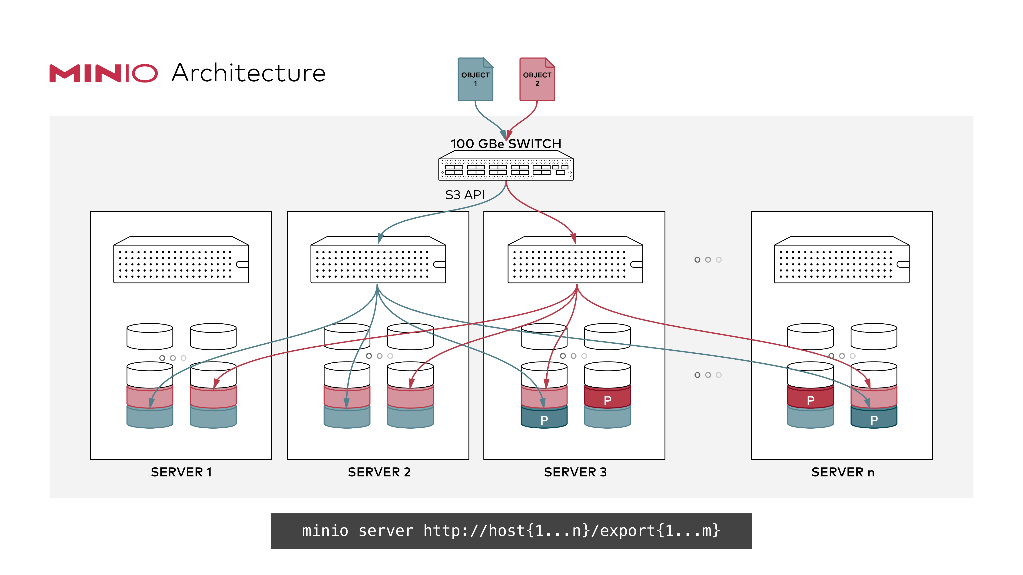
Minio Distributed mode
Pool multiple disks, even on different hosts into a single server
The client sees this as a single instance
Follows strict read-after-write and list-after-write consistency model for all I/O operations.
Erasure code protection ensures 50% of disks can be lost without data loss

Slide 8
Erasure Code Protection
File is broken into blocks
Block are expanded to include redundant data pieces
Blocks are distributed to disks
In the event of failure, data can be reconstructed from the redundant pieces in each block.
Files are protected without full replication!
https://min.io/product/erasure-code-calculator

Slide 9
Object Storage Concepts
Bucket
Folder
File
Alias
Mount point in that Object Storage System
A named reference to a Remote Object Storage System
alias/bucket/folder/file

Slide 10
Match the Term to its Definition
Bucket
Alias
Erasure Code
S3
A Named reference to an object storage system
Amazon’s Object Storage system
A Method of data protection without replication
The mount point for an object storage system

Slide 11
Minio commands

Slide 12
The Minio Client
https://dl.min.io/client/mc/release/linux-amd64/mc
Accessing From Jupyter Lab:
$ wget https://dl.min.io/client/mc/release/linux-amd64/mc \ && chmod +x mc \ && sudo mv -f mc /usr/local/bin
Accessing The Container From Your Command Line
$ docker-compose exec minio-client bash

Slide 13
Minio Alias Commands
$ mc alias list
$ mc alias set <alias> <server> <user> <password>
$ mc alias set \ my_server http://minio:9000 minio SU2orange!
$ mc alias rm my_server

Slide 14
Minio Bucket Commands
$ mc ls <alias> → list contents (in this case, all buckets)
$ mc mb <alias>/<bucket> → create bucket on alias (or folder)
$ mc rb <alias>/<bucket> → remove a bucket
$ mc tree <alias>/<bucket> → view folder tree
$ mc du <alias>/<bucket> → disk usage of bucket

Slide 15
Minio File Commands
$ mc cp <src> <tgt> → copies files and folders from source to target
$ mc rm <tgt> → deletes the target
$ mc mv <src> <tgt> → moves files and folders from source to target
$ mc mirror <src> <tgt> → Mirrors all files and folders from source to target

Slide 16
Minio Commands
Connect to the Minio Client
Create a bucket, testing
Copy local files into the bucket
List files in bucket
View Space used by bucket
Delete the bucket

Slide 17
Minio commands
Assuming the alias is sugar:
What is the command to create a bucket named foo?
What command copies the file bar.txt into the bucket foo?
What is the command to delete bar.txt from the bucket in question 2?

Slide 18

Spark
Lightning Fast Cluster Computing

Slide 19
Spark
General-purpose data-processing/analytics/computing engine
Developed at UC Berkeley AMP Lab, now an Apache project
Step up from Hive and Pig, which are still batch-oriented
Stores working data in memory for fast processing (RDDs, data sets, data frames)
APIs/language support for Python, Scala, Java, and R
Support for Streaming, Graph Processing, and Machine Learning

Slide 20
Spark Use Cases
Interactive/exploratory analytics including machine learning tasks
Real-time analytics and event processing
Building data pipelines and Extract-Transform Load pipelines
Machine learning pipelines

Slide 21
Spark Libraries
Four libraries built on Spark Core
MLlib: a machine learning library
Spark Streaming: enables high-throughput, fault-tolerant stream processing of live data streams
Spark SQL: runs SQL and HiveQL queries, accesses Metastore
GraphX: an API for graphs and graph-parallel computation
Spark SQL
Spark Streaming
MLlib (machine learning)
GraphX (graph)
Apache Spark

Slide 22
Spark Deployments
Standalone
Spark Client Mode (for development / testing all parts on one host)
Spark Cluster Mode (below)
Code executes on worker nodes
Data cached on worker nodes
Also runs on Hadoop/YARN and Kubernetes
Worker Node
Executor
Cache
Driver Program
Task
Task
Spark Context
Cluster Manager
Worker Node
Executor
Cache
Task
Task

Slide 23
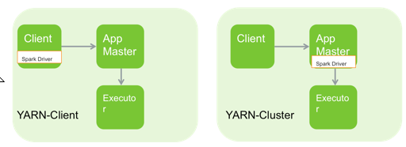
Spark on Yarn Deployment Modes
Spark on YARN (two modes)
Spark Driver on Client
Spark Driver on Cluster—useful for low latency between client and cluster
Notes:
Since Spark was developed at UC Berkeley it can run without a Hadoop cluster or so called standalone mode. However when integrated with YARN as in HDP, there are two modes to choose. In local mode the spark code runs on the client machine (aka utility server/edge node/gateway server). In cluster mode, spark code is managed inside an application manager. The next several slides will detail these architectures.

Slide 24
Spark Notes
Where does the code execute on Spark?
What are the 4 libraries on Spark core?
Spark supports which languages?
Notes:
The worker nodes?
MLLib, SQL, GraphX, Streaming
Java, Scala, Python, R

Slide 25
Spark Basics

Slide 26
Spark Concepts
SparkSession
SparkContext
Main entry point for your Spark Application 2.0 and beyond.
Code sent through the spark session to the workers.
Pre Spark 2.0 entry point for Spark Application

Slide 27
Demo – Setting up Minio and SparkSession
Let’s Open the cookbook
http://127.0.0.1:8888/lab/tree/work/PySparkCookbook.ipynb
Creating Session
Viewing Session details

Slide 28
Loading Data Into Spark++
Spark can read from a variety of sources
HDFS
S3 / Object Storage
Databases (RDBMS, Mongo, Cassandra)
Streams (Kafka)
Local files *
And more ++
Spark Can handle a variety of file formats
Text
Csv / Delimited
XML
JSON
ORC
Parquet
And More ++
* not practical in a clustered environment, since code runs on the worker nodes.
++ You can write your own sources and file format providers

Slide 29
Spark Data
Resilient Distributed Dataset
Data Frame
RDD are the lowest level of data
Immutable lists of values
Allows for parallel execution of data transformations
Lazy execution –nothing runs until results are requested.
Tabular data
Based on RDD’s
High-level extraction over RDDs

Slide 30
Demo – Loading into Data Frame
Let’s Open the cookbook
http://127.0.0.1:8888/lab/tree/work/PySparkCookbook.ipynb
Browse Minio
http://127.0.0.1:9000/
Csv, text, json
What is lazy execution?
Different options for csv
Sep= → the delimiter
Header= → is there a header?
inferSchema= → guess data types?
Cache() → load onto worker nodes.

Slide 31
What does .cache() do?
spark.load.csv("s3a://ufo-sightings").cache()
Minio
Or S3
Send data to the workers so that its not fetched at lazy execution.
Spark Workers

Slide 32
Spark Session and Loading Data
In spark.read.csv()
What is spark ?
What is csv() ?
How to we see a data frame’s schema?
How do we see a data frame’s values?
What does .cache() do?
What is lazy execution?
Notes:
Spark Sesson
Method / function to load delimited data
printSchema
Show
Pre-fetches the data to the worker nodes

Slide 33
Spark Data Frame Transformations
These are the heart of spark core library
Allow us to shape data
Similar to SQL-type transformations you know already
.select()
.withColumn() .withColumRenamed()
.filter()
.sort()
.groupBy().agg()
.union()
.join()

Slide 34
Column References
There are 3 methods of accessing referencing a column
For data frame customers
String/SQL: customers.select("firstname") customers.filter("age>50")
Property: customers.select(customers.firstname) customers.filter(customers.age>50)
Data Frame: customers.select( customers["firstname"] customers.filter( customers["age"] > 50)

Slide 35
Basic Transformations Demo
Using the UFO dataset, let’s apply some transformations
Column projections
Rename column
Filter
GroupBy.agg
Sort
Using explain() to see the execution plan.

Slide 36
Advanced Transformations
from pyspark.sql.functions import explode,split,udf
explode – handle nested arrays of data
split – parse strings into multiple values
udf – apply a user-defined function

Slide 37
Advanced Transformations Demo
Using the Google Places JSON output, let’s apply some transformations
Extracting sub-values
Explode nested arrays data
Split data into multiple columns
Create a udf
Using explain() to see the execution plan.

Slide 38
Spark SQL
Use .createOrReplaceTempView() to name a dataframe as a temp SQL view.
Then use spark.sql() to query it!
Useful for those really more familiar with SQL
df.createOrReplaceTempView("sometable")
spark.sql("select * from sometable").show()

Slide 39
Spark SQL and Saving Data
Run some SQL over Google Places data
Save output back to Object Storage

Slide 40
Exit Ticket
Is there a something you find still unclear about today’s lesson

