Slide 1
IST769 Unit D
Object Storage and Spark

Slide 2
Agenda
What is object storage?
Minio Architecture
Minio Commands
What is Spark?
Spark Architecture
Spark Commands

Slide 3

Minio Object Storage
With Minio

Slide 4
What is Object Storage
Cloud-based Network-Attached storage
Client uses an API such as the AWS S3 API to get and put objects.

Slide 5
Use Cases

Slide 6
Minio Features
Minio high-performance object storage
Used as an HDFS replacement
Tiny, fast with little overhead. Focus on performance.
Consistent, Distributed and Available
Active-Active replication
Scale out via server pools

Slide 7
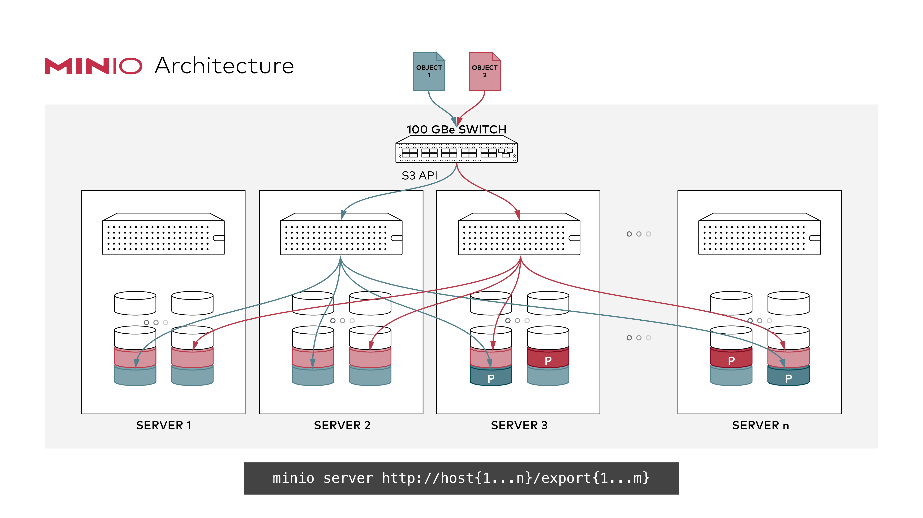
Minio Distributed mode
Pool multiple disks, even on different hosts into a single server
The client sees this as a single instance
Follows strict read-after-write and list-after-write consistency model for all i/o operations.
Erasure code protection ensures 50% of disks can be lost without data loss

Slide 8
Erasure Code Protection
File is broken into blocks
Block are expanded to include redundant data pieces
Blocks are distributed to disks
In the event of failure, data can be reconstructed from the redundant pieces in each block.
Files are protected without full replication!
https://min.io/product/erasure-code-calculator

Slide 9
Read After Write Consistency

Slide 10
Write After Read Consistency

Slide 11
Minio commands

Slide 12
Minio Alias Commands
List
Set
Remove

Slide 13
Minio Bucket Commands
Mb
Rb
Du
tree

Slide 14
Minio File command
Ls
Cp
Rm
mv

Slide 15

Spark
TODO

Slide 16

Spark
General-purpose data-processing/analytics/computing engine
Developed at UC Berkeley AMP Lab
Step up from Hive and Pig, which are still batch-oriented
Stores working data in memory for fast processing (RDDs, data sets, data frames)
APIs/language support for Python, Scala, Java, and R

Slide 17
Use Cases
machine learning tasks
interactive/exploratory analytics
real-time analytics
data pipelines
ETL flows
Machine learning pipelines

Slide 18
Spark Libraries
Four libraries built on Spark Core
MLlib: a machine learning library
Spark Streaming: enables high-throughput, fault-tolerant stream processing of live data streams
Spark SQL: runs SQL and HiveQL queries, accesses Metastore
GraphX: an API for graphs and graph-parallel computation
Spark SQL
Spark Streaming
MLlib (machine learning)
GraphX (graph)
Apache Spark

Slide 19
Spark Deployments
Standalone
Spark Client Mode (for development / testing all parts on one host)
Spark Cluster Mode (below)
Worker Node
Executor
Cache
Driver Program
Task
Task
Spark Context
Cluster Manager
Worker Node
Executor
Cache
Task
Task

Slide 20
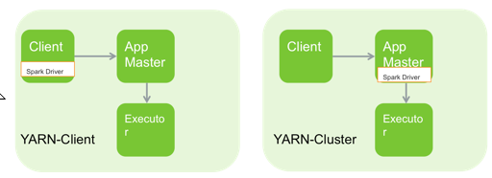
Spark on Yarn Deployment Modes
Spark on YARN (two modes)
Spark Driver on Client
Spark Driver on Cluster—useful for low latency between client and cluster
Notes:
Since Spark was developed at UC Berkeley it can run without a Hadoop cluster or so called standalone mode. However when integrated with YARN as in HDP, there are two modes to choose. In local mode the spark code runs on the client machine (aka utility server/edge node/gateway server). In cluster mode, spark code is managed inside an application manager. The next several slides will detail these architectures.

Slide 21
Spark vs. MapReduce
Why is Spark faster?
Caching data to memory can avoid extra reads from disk
Scheduling of tasks from 15–20 s to 15–20 ms
Resources are dedicated the entire life of the application
Can link multiple maps and reduces together without having to write intermediate data to HDFS
Every reduce doesn’t require a map
Like Impala, requires a lot of memory per worker—128 GB
Does not need HDFS, does not need YARN.
Notes:
Spark is faster than MapReduce for several reasons. First, and the biggest, is Spark can cache data into memory. Reading from memory is measured in nanoseconds, reading from disk is measured in milliseconds. Quite the increase in speed is seen from there. In addition, the scheduling of tasks in Spark has greatly decreased from MapReduce. Spark has dedicated resources, so scheduling of tasks doesn’t require a resource request. Because of this, scheduling has gone from 15-20s to 15-20ms. In spark, you can have multiple reduces and maps in a row. You do not need a map phase for every reduce phase. Skipping this extra map save reading and writing data to disk.

