Slide 1
IST769 Unit C
Hadoop

Slide 2
Agenda
The What, Why, and How of Hadoop
HDFS
MapReduce and YARN
Key Hadoop Applications
Hive
Hbase
Hcatalog
Impala

Slide 3

Get Ready To Follow Along!
Let’s Start Our Docker Environments!
Hadoop in docker requires a lot of resources.
Start: docker-compose up -d
Is It done starting?: docker-compose logs (Check for impala server…)
Access the shell: docker-compose exec cloudera bash -c "su -l cloudera"
Hue Access: http://localhost:8080

Slide 4

Hadoop
The What, Why and How

Slide 5

What is Hadoop?
A System for Storing, Processing and Managing Data
Just Like a DBMS only for “big data”
What does that mean? Scales Out by design, both the data and compute to process it.

Slide 6
Hadoop Origins
The origins of Hadoop can be traced back to the internet companies of the 2000’s
Google, Facebook and Yahoo!
These companies had a similar problem.
The solution was to split the data and distribute chunks of it to be processed in parallel.
Time to process one day’s worth of data
24 hours!

Slide 7
They did the math…
Relational DBMS
Hadoop
60 Minutes to read 500GB of data off the disk on 1 node (assuming 1Gbps)
14 seconds to read the same 500GB with 40 nodes x 8 disks per node.
60 min
14 sec
1.56GB
1.56GB
…
500GB
1.56GB
1 Node
40 Nodes 8 Disks = 320 Independent reads

Slide 8
How does Hadoop Work?
Let’s Explore the concepts of Hadoop (Data Lake, Schema On Read)

Slide 9
The Hadoop Philosophy is Simple
Capture data as is and store it do not create a schema for it.
Do not transform the data before storing it. We don’t know what we plan to do with it yet!
Keep everything. You never know what you will need when!
When you retrieve the data, we then transform it to suit our needs.
This is very different from relational modeling where we are not able to store data without creating a table first.

Slide 10
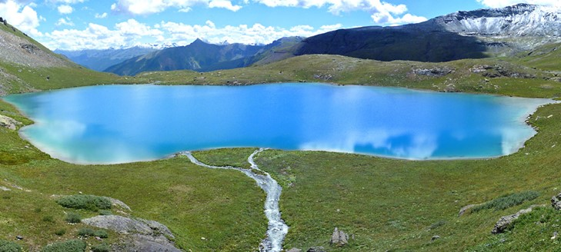

The Data Lake
Contrast this to the data mart which is filtered and packaged for consumption!
An industry term for vast amounts of data stored in its native format.
Hadoop data are stored in a data lake.
Like real lakes, data lakes are unprocessed and vast.
Notes:
Like a real lake the water is unprocessed and vast
The water is sourced from streams (data lake from streams of data sources)
Compare this to a bottle of water which is filter, packaged and processed for consumption – like the highly structured data associated with a business application or data mart.

Slide 11
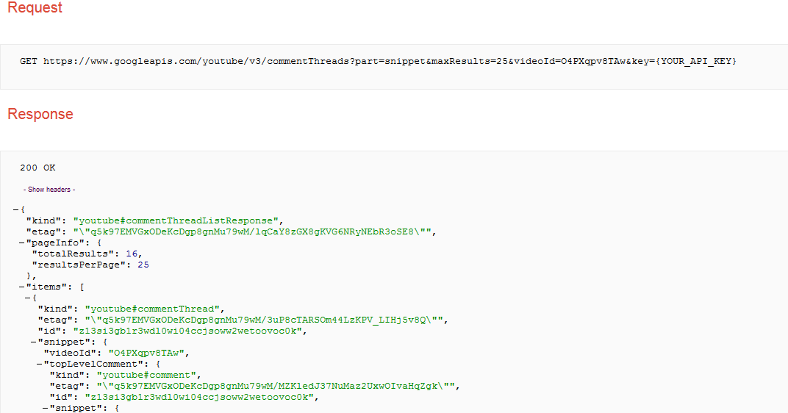
Collect and Store Data into the Data Lake
You know there is value in your
Organization’s YouTube channel,
but you don’t know what exactly
that might be.
You extract the API output weekly
& load the data into your
Hadoop Data lake.
Notes:
Common use case of Hadoop is collect output from another system, and store it as is because you don’t know how you want to analyze it yet.
You don’t know what parts of the JSON output you will need. This data is schema-less which means we don’t have to apply any logic at write-time as we would normally with a relational database management system.

Slide 12
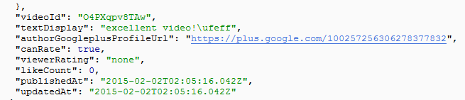

Apply a Schema on Read/Query
When we want to perform analysis on the data, we add a schema when the data are read.
This will create a table of data, like a relational table.
videoId | likes | text | pub_date
O4PXqpv8TAw | 0 | excellent video!\ufeff | 2015-02-02T02:05:16.042Z
… | … | … | …
Notes:
When we want to perform analysis on our data, we apply a schema as it is read to that it can be placed in a tabular form for analysis.
You don’t have to define a full schema to all the data – only the data you care about.
Once the schema is applied we can further process the data in tabular format.

Slide 13

Analyze Your Data
videoId | likes | text | pub_date
O4PXqpv8TAw | 0 | excellent video!\ufeff | 2015-02-02T02:05:16.042Z
… | … | … | …
The table is not stored. It is a program that adds schema when we execute the actual analytics.
In this case, an SQL SELECT statement, but it could be any code.
Export/ Visualize
videoId | sum(likes)
O4PXqpv8TAw | 56
V56Xqyy-2wq | 14
… | …
Notes:
When your data is in tabular format you can process it further and then visualize it.
Hadoop has tools to visualize your data, you can also export the data, provided it has been reduced to a reasonable side.
The entire process can be automated so that as new data is collected it can be processed and visualized.

Slide 14
What Exactly Is “Schema on Read”? Again?
Traditional RDBMS
You cannot write data without a table
Cannot insert data unless data fit into table’s single design
Large up-front design costs
Conceptual models
Table design
“Schema on write”
Hadoop’s
You write the data “as they are” to the Data Lake
Schema applied when data are read—multiple designs
Very little up-front design costs
Just write to disk
Apply schema when you need it
“Schema on read”

Slide 15
Hadoop Architecture

Slide 16
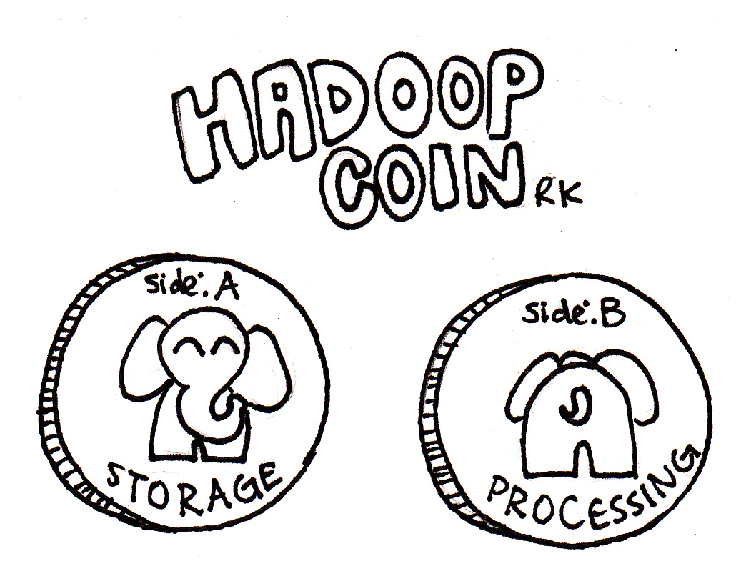
Two Essential Components of Hadoop
Distribute the data across nodes in the data lake by splitting it up. HDFS does this.
Move the compute to where the data lives. MapReduce/YARN does this.
HDFS
YARN

Slide 17


Hadoop Cluster Nodes
Master Nodes
Manages the Hadoop infrastructure
Runs one of each of these services per cluster, on a single server or many
Should run on server-class hardware
Very few of these nodes
YARN:
App Timeline Server,
Resource Manager,
History Server
HDFS:
NameNode
YARN: Node Manager
HDFS: DataNode
YARN: Node Manager
HDFS: DataNode
YARN: Node Manager
HDFS: DataNode
Worker Nodes
Store data and perform processing over it
Each node runs the same services
Runs on commodity hardware
Lots and Lots these nodes
YARN: Node Manager
HDFS: DataNode
YARN: Node Manager
HDFS: DataNode
YARN: Node Manager
HDFS: DataNode

Slide 18
HDFS
Hadoop Distributed File System

Slide 19
HDFS – Hadoop Distributed File System
Based on Google’s GFS – Used by search.
CP System: NameNode master + several DataNode workers.
Distributed data storage paradigm
A single file is divided into blocks
Blocks are spread across nodes
Blocks are written multiple times for redundancy
A
B
C
DataNode 1
DataNode 2
DataNode 3
DataNode 4
A
B
C
A
B
C

Slide 20
Example: HDFS Write
Client put file: data.csv
NameNode
That’s 4 blocks on nodes 1-4
1
2
3
1
3
2
4
3
2
DataNodes
4
3
1
4
2
1
4
5
6
Notes:
In this example we have a single namenode and 6 data nodes in our cluster.
Client makes a request to the name node to write a file.
Name node stores metadata about the file’s whereabouts (data.csv consists of 4 blocks on nodes 1-4) and instructs the client where to write the file.
The client sends its data to the data nodes. Data is written in parallel so the I/O is vastly improved over non distributed options
Each data node replicates (make a copy of its’ block) to other datanodes as instructed by the Namenode. In this example there is a replication factor of 3, so two copies are made.

Slide 21
Example: HDFS Read
Client put file: data.csv
NameNode
That’s 4 blocks on nodes 1-4
1
2
3
4
1
2
3
1
3
2
4
3
2
DataNodes
4
3
1
4
2
1
4
5
6
Notes:
In this example we have a single namenode and 6 data nodes in our cluster.
Client makes a request to the name node to read a file.
Name node knows where the data is located. The datanodes are reporting “what they have” to the name node on an interval.
The client requests the data in parallel from the data nodes.
The data in assembled in the right order by the client.

Slide 22


HDFS: Heartbeat and Block Report
“Sorry, DataNode 3, but I’m going to assume you are dead.”
NameNode
Heartbeat and block report
Heartbeat and block report
Heartbeat and block report
DataNode 1
DataNode 2
DataNode 3
DataNode 4
HDFS DataNodes send routine heartbeats and block reports to the NameNode.
This is how the NameNode knows where the blocks of a file are located.
Notes:
- If a DataNode fails to send a Heartbeat to the NameNode, that DataNode is labeled as dead
- Any data that was registered to a dead DataNode is not available to HDFS anymore
- The NameNode does not send new I/O requests to a dead DataNode, and its blocks are replicated to live DataNodes

Slide 23
Example: HDFS Failover
Client put file: data.csv
NameNode
4 blocks on nodes 1,3,4 and 5
No Heartbeat! Node 2 down!
1
2
3
4
1
2
3
1
3
2
4
3
2
DataNodes
4
3
1
4
2
1
4
5
6
Notes:
Once again with our cluster
Node 2 goes down, as the namenode has yet to see a heartbeat. Its No big deal as we have blocks 2 and 4 replicated to nodes 3/6 and 4/5 respectively.
Client requests a file. Namenode reports block from available nodes to get the file.
The rest happens as expected.

Slide 24
HDFS Commands
hdfs dfs –command [args]
Here are a few (of the almost 30) HDFS commands:
-cat: displays file content (uncompressed)
-text: just like cat but works on compressed files
-chgrp,-chmod,-chown: changes file permissions
-put,-get,-copyFromLocal,-copyToLocal: copies files from the local file system to the HDFS and vice versa
-ls, -ls -R: list files/directories
-mv,-moveFromLocal,-moveToLocal: moves files
-stat: statistical information for any given file (block size, number of blocks, file type, etc.)
Note: replacement for “Hadoop fs”
Notes:
Concerted effort to move from “hadoop fs” to “hdfs dfs”. http://hadoop.apache.org/docs/current/hadoop-project-dist/hadoop-common/FileSystemShell.html states that “hdfs dfs” is a synonym for “hadoop fs” when HDFS is being used (i.e. the “hadoop fs” command can interact with other file systems that Hadoop supports such as local FS, HFTP FS, S3 FS, and “others”) which makes sense with HDP.
Feel free to demo some of these if time allows.

Slide 25
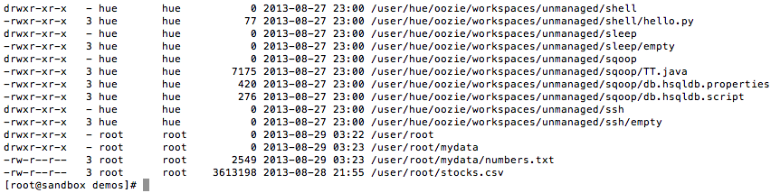
HDFS File Permissions—Like *nix Permissions
Files and directories have owners and groups
r = read
w = write
x = permission to access the contents of a directory
Notes:
- For files, the r permission is required to read the file and the w permission is required to write or append to the file
- For directories, the r permission is required to list the contents of the directory, the w permission is required to create or delete files or directories, and the x permission is required to access a child of the directory.

Slide 26
Demo: HDFS Commands
Assume the identity of the user
File system
Put files
Copy
Delete
Combine with cat
Combine with getmerge
Notes:
# need to be the cloudera user. In basic Hadoop security the current logged on user has the same permissions in HDFS
$ su cloudera
# Basic Commands
$ hdfs dfs –command
OR
$ Hadoop fs –command
# what is the current directory?
$Hadoop fs –ls
# its /user/cloudera
# make a folder
$ Hadoop fs –mkdir grades
# upload to Hadoop
$ Hadoop fs –put *.tsv grades/
# copy a file
hadoop fs -cp grades/fall2015.tsv grades/foo.tsv
# combine with cat
Hadoop fs –cat grades/*
# make a file with getmerge – a useful command when a reducer produces more than one fgile
Hadoop fs –getmerge grades/* allgrades.tsv

Slide 27
Question on HDFS Command

Slide 28
YARN (and MapReduce)
Yet Another Resource Negotiator

Slide 29
YARN – Hadoop 2.0
YARN is a job executor and resource schedule for Hadoop.
MapReduce is a distributed batch process algorithm
Hadoop v1 could old do Map-Reduce
Hadoop v2 added YARN so any distributed application could run
YARN made applications like Spark and Hive possible.
Map-Reduce is just one of the many applications which run on YARN

Slide 30
Hadoop 2 vs. Hadoop 1
Hadoop 1
Hadoop 2
Batch processing only
No high availability or failover capability
Only MapReduce applications
DataNodes and NameNodes are dependent
Applications execute and quit
Suited to a variety of distributed tasks
High availability and failover
Runs any distributed application, including MapReduce
DataNode and NameNodes (NodeManagers) are independent
Applications can remain resident

Slide 31
MapReduce Algorithm
A programming model for large-scale distributed data processing
Phases
Map → apply a transformation to a data set
Shuffle → transfer output from Mapper to Reducer nodes
Reduce → aggregate items into a single result
Combine → output of Reducer nodes into single output
Map
Shuffle
Reduce
Combine
We must supply the Mapper and Reducer functions.

Slide 32
Example MapReduce: “Total Orders by State”
Source
file
HDFS blocks each node
Mapping
Shuffle
Reduce
Combine
JAN, NY, 3
JAN, PA, 1
JAN, NJ, 2
JAN, CT, 4
FEB, PA, 1
FEB, NJ, 1
FEB, NY, 2
FEB, VT, 1
MAR, NJ, 2
MAR, NY, 1
MAR, VT, 2
MAR, PA, 3
JAN, NY, 3
JAN, PA, 1
JAN, NJ, 2
NY, 3
PA, 1
NJ, 2
CT, 4
NJ, 2 NJ, 1 NJ, 2
CT, 4 NJ, 5
JAN, CT, 4
FEB, PA, 1
FEB, NJ, 1
CT, 4
PA, 1
NJ, 1
CT, 4 NJ, 5
NY, 6
PA, 5
VT, 3
NY, 3
NY, 2
NY, 1
NY, 6
FEB, NY, 2
FEB, VT, 1
MAR, NJ, 2
NY, 2
VT, 1
NJ, 2
PA, 1 PA, 1 PA, 3
PA, 5
MAR, NY, 1
MAR, VT, 2
MAR, PA, 3
NY, 1
VT, 2
PA, 3
VT, 1 VT, 2
VT, 3
Notes:
Let’s start with a source file. This file contains the month and state and count of orders for that month/state. We would like to process this “big data” and get a count of total orders by state For example if you add up the NY orders it would be 6.
When this file is uploaded to HDFS it is broken up into blocks. The blocks are split evenly across the block size. In this example the block size chosen results in 4 blocks, conveniently one block per node. This is not always the case – just how it works out in this example.
Next we perform a mapping. The mapping phase uses the key State code to return a list of order counts. For example On the first node “NY” returns a one item list of NY,3.
Next we must move data to the reducer nodes. This is called a shuffle. The shuffle can be the most I/O intensive part of the process. In this example we have 4 reducer nodes (the same number of mappers and data nodes) data is shuffled to reducer so that each node can process its data in parallel.
In the reduce phase we take our key and apply an aggregate function to the data. For example in this case if we look at the first reducer node it will sum up the orders by key state.
At this point the map-reduce is complete and 4 files are written to HDFS (one for each reducer) we can combine these files easily to produce a single output.

Slide 33
Demo: M-R and YARN
Calculating pi
Word counts
What’s running?
What ran?
Job details
Kill a running job
Notes:
$ export MREX=/usr/lib/hadoop-mapreduce/hadoop-mapreduce-examples.jar
# estimate pi
$ yarn jar $MREX pi 1 100
# can we be more accurate?
$ yarn jar $MREX pi 1 10000
# make a file
$ echo "I love Hadoop you should love Hadoop too as Hadoop is cool" > msg.txt
# write to HDFS
$ hadoop fs –put msg.txt /user/cloudera/msg.txt
# run a wordcount
$ yarn jar $MREX wordcount /user/cloudera/msg.txt /user/cloudera/msg-out
# What happened?
$ hdfs dfs -ls msg-out
$ hdfs dfs -cat msg-out/*
$yarn application -list -appStates FINISHED
$yarn application -list
$yarn application -status application_1533052372690_0010
yarn application -kill application_1533052372690_0010
yarn application -list -appStates KILLED
yarn application -status application_1533052372690_0010

Slide 34
TODO

Slide 35
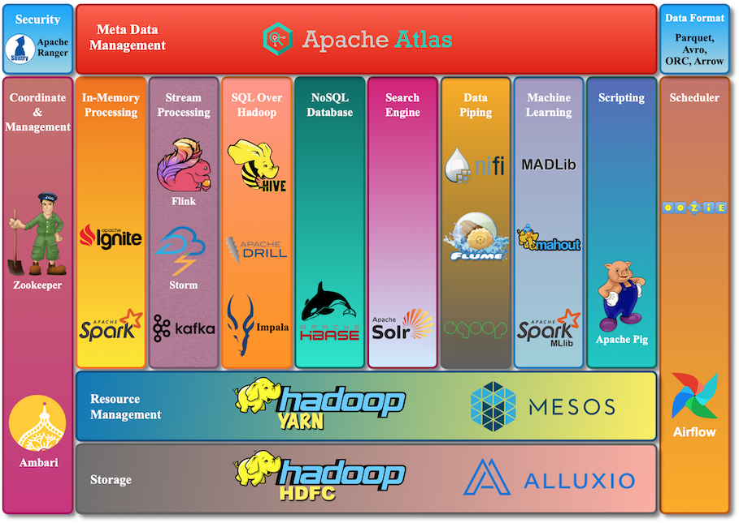
https://www.cloudduggu.com/hadoop/ecosystem/

Slide 36


An Oversimplified Version of the Hadoop Ecosystem in Action
Relational business data
Sqoop: ingest relational data
HDFS Data Lake Data stored “as is”
Pig, Spark: explore data,
transform data, add structure
Flume: ingest logs and data streams
Unstructured data (logs, social, text, etc.)
Mahout, Spark MLlib, R: mine structured data for predictive and prescriptive analytics
Hive, Impala, Spark-SQL: ad-hoc query structured data for descriptive and diagnostic analytics

Slide 37


Slide 38


Slide 40


