Slide 1
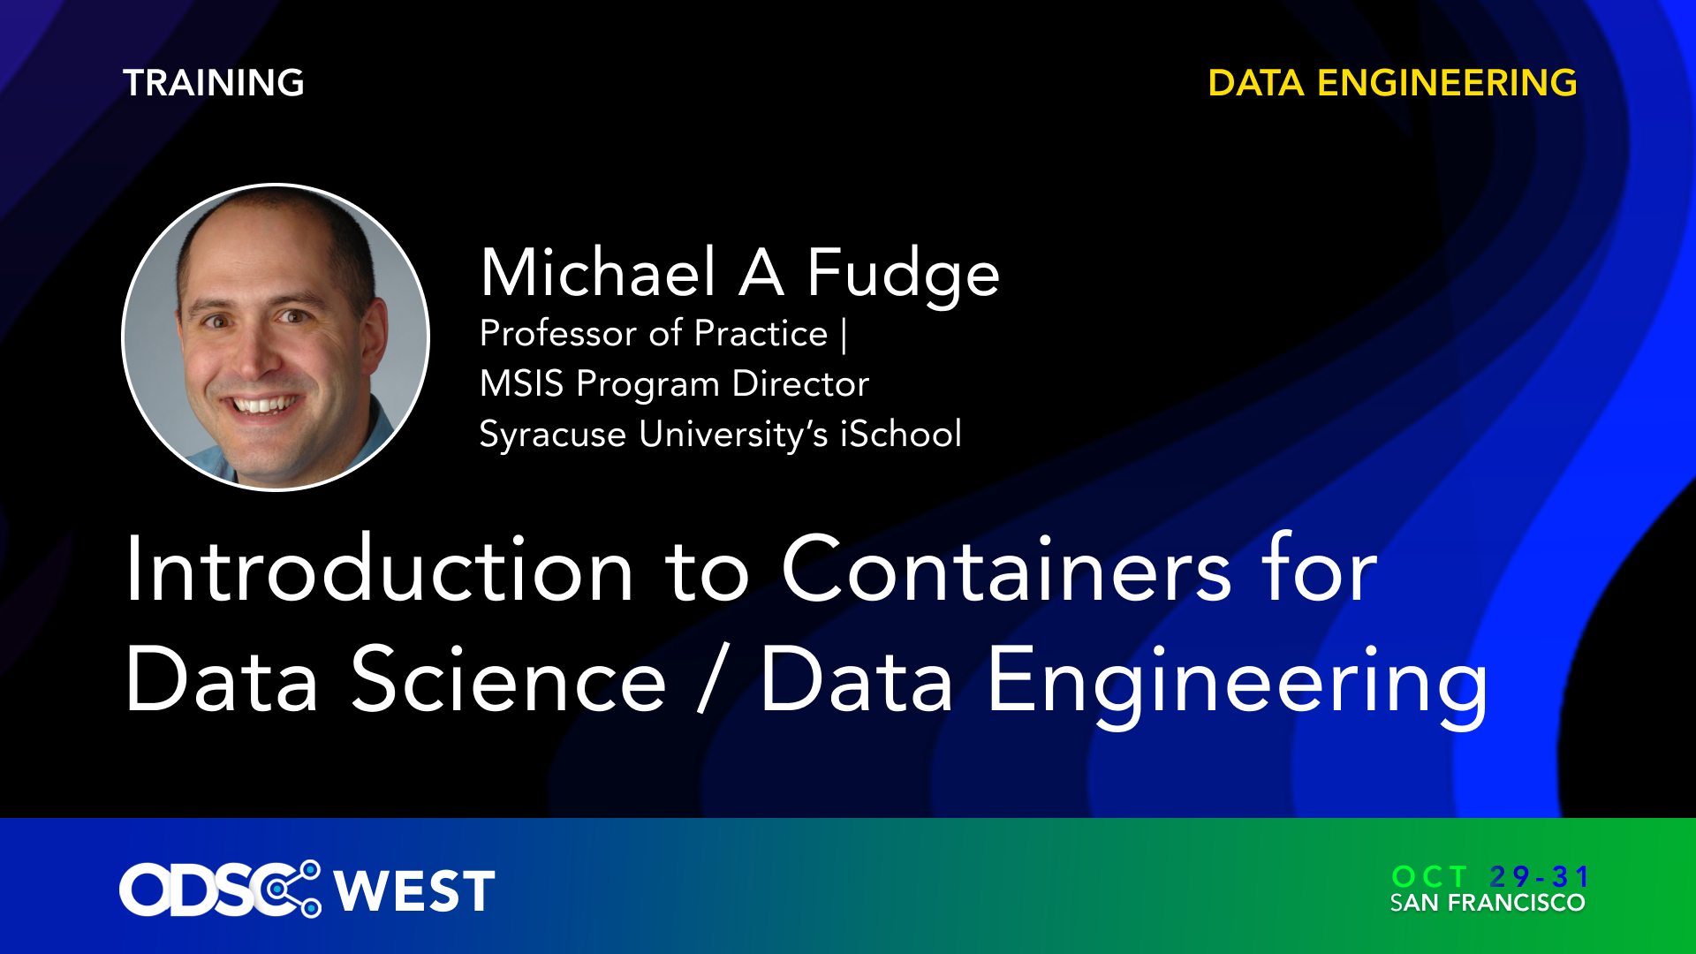

Slide 2
Introduction to Containers for Data Science and Data Engineering
Open Data Science Conference West 2024
https://github.com/mafudge/odsc24
Michael Fudge
Professor of Practice mafudge@syr.edu
Syracuse University, iSchool https://ischool.syr.edu
Apphammer
https://apphammer.co

Slide 3

Part 1: Container Essentials
Important concepts for understanding containers and docker

Slide 4
Rationale
Have you ever:
Worked on a project on more than one computer?
Shared a project with a team?
Said this: “but it works on my machine…”
Spent hours trying to deploy your project live?
If so, then containers are for YOU!

Slide 5
What is a container?
A container is a form of virtualization.
Containers virtualize the application and its dependencies.
The virtualization occurs closer to the application than the hardware.

Slide 6
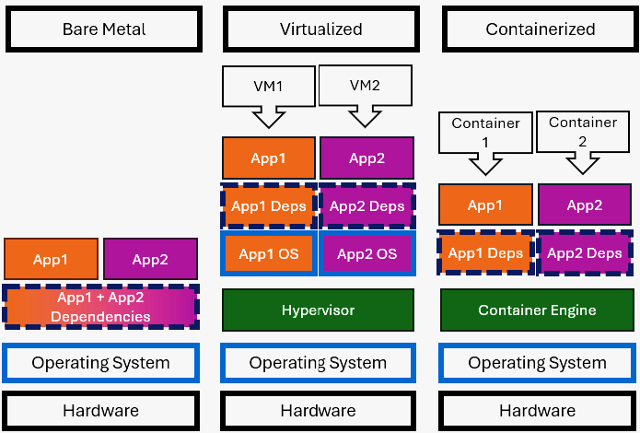
Containers, Virtualization, Bare Metal

Slide 7
Benefits of Containers
Reproducibility of work - drastically minimizes “but it works on my machine”.
Bundle the dependencies with your application.
Can mimic complex environments with external systems.
When combined with a git workflow, it can be team and cloud friendly.

Slide 8
Container Terminology
Image application + dependencies at rest, consumes disk
Tag the version / release name of the image
Container running image: consumes disk + RAM/CPU/Network
Port expose a TCP/UDP Port outside the container
Volume persistent storage for a container

Slide 9
Our first container
It always starts with a need…
Hmm. I’d like to use: https://jupyter.org/install
Rather than install all those dependencies on your computer, run it in a container!
Portability! Reproducibility!
Notes:
Commands

Slide 10
Dockerhub: finding images
Dockerhub is an example of a container registry. https://hub.docker.com
A catalog of container images in the cloud!
https://hub.docker.com/search?q=jupyter%2Fminimal-notebook
Red Hat's Quay.io is another: https://quay.io/repository/jupyter/minimal-notebook

Slide 11
Demo 1: Pulling an image
Pulling images
From Dockerhub
From Another public Image repository
Viewing downloaded images

Slide 12
Demo 1: Summary of Commands
What | Command | Example
Download image from Docker registry | docker pull <image>:<tag> | docker pull jupyter/minimal-notebook:lab-4.1.6
Download image from Another public registry | docker pull <reg>/<image>: <tag> | docker pull quay.io/jupyter/minimal-notebook:lab-4.1.6
View downloaded images + tags | docker images | docker images
Delete an image | docker image rm <image>:<tag>

Slide 13
Running an image as a container
To run the image: docker run --name <containername> -d <image>:<tag>
--name give the container a name.
-d run in the background, return to the console.

Slide 14
Demo 2: Containers!
Run the container
See running containers
View logs of running container
Stop a running container
See all containers (running and stopped)
Delete container definition

Slide 15
Demo 2: Summary of Commands
What | Command | Example
Run a container | docker run –-name <container> -d <name>:<tag> | docker run –-name jupyter -d jupyter/minimal-notebook:lab-4.1.6
List running containers | docker ps | docker ps
View output of running container | docker logs <name> | docker logs jupyter
Stop a running container | docker stop <name> | docker stop jupyter
List all containers (running and stopped) | docker ps –a | docker ps -a
Delete a container | docker rm <name> | docker rm jupyter
Notes:
Run the container
See running containers
View logs of running container
Stop a running container
See all containers (running and stopped)
Delete container definition

Slide 16
Publishing TCP/UDP Ports
What good is running an application in a container if you cannot access it?
When the container is created, we must publish the exposed the port:
-p published-port:exposed-port or
-p OUTSIDE:INSIDE
When you publish a port, you can connect to exposed application services on the published port.
For example, if 8888 is published, then http://localhost:8888

Slide 17
Demo 3: Ports
Run the container, exposing 8888
See the port is exposed
Visit http://localhost:8888
Find the key in the container output!
Login to the application!

Slide 18
Demo 3: Summary of Commands
What | Command | Example
Run a container and expose ports | docker run –-name <container> -p <pub>:<exp> -d <name>:<tag> | docker run –-name jupyter -p 8888:8888 -d quay.io/jupyter/minimal-notebook:lab-4.1.6
Notes:
Run the container
See running containers
View logs of running container
Stop a running container
See all containers (running and stopped)
Delete container definition
docker run --name jupyter -p 8888:8888 quay.io/jupyter/minimal-notebook:lab-4.1.6 -d

Slide 19
Need for volumes
Containers are ephemeral. Only what is in the image is retained between subsequent runs.
When you docker rm the changes are gone!
How does one save changes? Volumes!
-v host:image or
-v OUTSIDE:INSIDE

Slide 20
Demo 4: Volumes
In the running container save a file.
Stop and remove the container
Re-run the container
Check back into the App… file is gone. Ephemeral.
Stop and remove the container… again
Check out that local work folder
Mount that folder as a container volume
Stop and remove the container… last time

Slide 21
Demo 4: Summary of Commands
What | Command | Example
Run a container and expose ports and a volume | docker run –-name <container> -p <pub>:<exp> -d <name>:<tag> | docker run –-name jupyter -p 8888:8888 -v $PWD/work:/home/jovyan/work -d quay.io/jupyter/minimal-notebook:lab-4.1.6
List running containers | docker stop jupyter && docker rm jupyter | docker stop jupyter && docker rm jupyter

Slide 22
Orchestration with Docker Compose
Docker compose allows you to manage containers through a configuration file, in yaml format.
Makes Starting and Stopping containers easier.
Infrastructure as code:
Clear separate of Configuration –vs- Commands

Slide 23
Docker vs Docker Compose
Command
Configuration file
$ docker run
--name jupyter
-p 8888:8888
-v $PWD/work:/home/jovyan/work
-e JUPYTER_TOKEN=osdc
quay.io/jupyter/minimal-notebook:lab-4.1.6
version: "3"
services:
jupyter:
ports:
- 8888:8888
volumes:
- ./work:/home/jovyan/work
environment:
- JUPYTER_TOKEN=odsc
image: quay.io/jupyter/minimal-notebook:lab-4.1.6

Slide 24
Demo 5: Docker Compose
Start with docker compose
View running containers
Stop with docker compose

Slide 25
Demo 5: Summary of Commands
What | Command | Example
Build the configuration and start the container(s) | docker compose –f <file> up –d | docker compose –f juypter.yaml up –d
List running containers from the configuration | docker compose –f <file> ps | docker compose –d jupyter.yaml ps
Stop the running containers and remove them | docker compose -f <file> down | docker compose –d jupyter.yaml down

Slide 26

Part 2: Development with Containers
Containerizing your development pipeline

Slide 27
Simple Python ETL Pipeline
Simple data Pipeline: read file, transform it, write another file
Open part2 folder in Visual Studio Code.
Open a terminal in the part2 folder
Pipeline.py
dashboarddata.csv
companydata.csv

Slide 28
Dockerfile: Building your own image
Dockerfile explains how to build an image
FROM is the base image from a public image repository
COPY copies files into the image
RUN executes a command in the image
ENTRYPOINT defines the default command from docker run or docker compose up

Slide 29
Demo 6: Building A Custom Image
Look at the Dockerfile. No data… just code!
Look at the docker-compose.yaml File. Data in volumes.
Build the Image with docker compose
Note we don't need –f here.
What is the image name?
Run the application with docker compose

Slide 30
Demo 6: Summary of Commands
What | Command | Example
Build an image using the docker-compose file | docker compose -f <file> build | docker compose build
View images created by docker compose file | docker compose –f <file> images | docker compose images
View images with docker | docker images | docker images
Run the application | docker compose -f <file> up | docker compose up
Remove the container definitions | docker-compose -f <file> down | docker compose down

Slide 31
Useful, but not Realistic: Enter Dev Containers
This is a useful way to run your working programs
It is impracticable to implement a dev-loop this way: write→ run→ debug…
Enter the Visual Studio Code dev containers!
devcontainer.json points to an image with code + debugger
You are coding inside a running container!
Current folder is mounted as a volume!

Slide 32
Demo 7: VS Code Dev Containers
Open part2 in a dev container. It is building.
Look at the devcontainer.json.
Run code in container
Set a breakpoint and debug!

Slide 33
Demo 7: Summary of Commands
What | Command
Open a Dev Container in VS Code | Open folder >< Remote window Reopen in container Dev Container builds
Run code in Dev Container | [F5]
Set a breakpoint | [F9]
Rebuild a dev container (if you add a new dependency, for example) | >< Remote Window Rebuild Container

Slide 34
Part 3: Development with Containers and Other Container Dependencies
Use Docker Compose to orchestrate dependencies in your application

Slide 35
Overview of final pipeline
Real world pipelines require many parts.
They read from/write to databases, for example.
Loosely coupled / No direct dependencies.
Open part3 folder in Visual Studio Code.
This example uses docker-compose.yaml with the dev container.
There are other containers used in this pipeline which demonstrate typical complexity.

Slide 36
Diagram of the pipeline
MINIO (S3)
Datagen.py http://localhost:8001
companydata.csv
MINIO (S3)
Pipeline.py (Dev Container)
MINIO (S3)
companydata.csv
dashboarddata.csv
MINIO (S3)
Dashboard.py http://localhost:8002
dashboarddata.csv

Slide 37
Demo 8: Complex Pipeline
Open in Dev Container and build.
Look at all the running containers!
Run pipeline2.py, Datagen http://localhost:8001, and Dashboard http://localhost:8002
Watch the data update.
Look at the devcontainer.json. Two docker-compose files.

Slide 38

Wrap-Up!

Slide 39
Summary
Containers virtualize our applications,
bundling the dependencies with the app.
Find images for your containers on repositories
docker hub and quay.io
You can manage multiple containers with docker-compose and separate the configuration from the commands
Write code inside containers with VS Code dev containers!
Dev containers support docker compose for complex setups!

Slide 40
But Wait… There's more!
How about a containerized Spark cluster With a Jupyter front-end and Minio storage? https://github.com/mafudge/docker-spark-cluster
Query your CSV/Excel files with SQL. Drop and go! https://github.com/mafudge/local-file-drill
Chat with your PDF file, 100% on device using llama2 (dev container example) https://github.com/mafudge/chat-pdf

Slide 41
Cleaning up
You might want to reclaim some disk space after the talk
docker system prune --all --volumes

Slide 42
Introduction to Containers for Data Science and Data Engineering
Thank you For Attending!
Open Data Science Conference East 2024
https://github.com/mafudge/odsc24
Michael Fudge
Professor of Practice mafudge@syr.edu
Syracuse University, iSchool https://ischool.syr.edu

