Slide 1
SALES DEMAND FORECASTING
Retail Analytics & Prophet Time-Series Portfolio • Sample Superstore 2014–2017
Rows
9.994
Target
Sales
Periode
2014–2017
Mafud Satrio Setiono

Slide 2
02
Business Problem
Retail butuh forecast akurat untuk stok, target, dan modal kerja
Overstock /
Stockout
Stok menumpuk atau kosong di momen puncak
Target
Tidak Realistis
Target rata gagal di musim rendah Q1
Promo
Menggerus Margin
18,7% order rugi akibat diskon agresif
Solusi: dashboard interaktif + forecast Prophet (M/W) dengan interval risiko → keputusan stok & target berbasis data.

Slide 3
03
Dataset Overview
sample_superstore.csv • 2014-01-03 → 2017-12-30 • nol missing, nol duplikat
Total Sales
$2.297.201
Total Profit
$286.397
Orders
5.009
Customers
793
YoY 2014→2017
+51%
Kolom kunci:
Order Date (tanggal)
Sales (target)
Category / Region / Segment / Sub-Category / Product Name
Profit / Quantity / Discount
Kualitas: 21 kolom, 9.994 baris — siap modelling tanpa imputasi.
Catatan: distribusi right-skew (mean $230 >> median $54) + 19 order B2B raksasa dipertahankan sebagai sinyal asli.

Slide 4
04
Project Workflow
End-to-end: eksplorasi → dashboard → forecast → keputusan
1. EDA
01_EDA.ipynb
tren, musiman,
Pareto, outlier
2. Dashboard
Streamlit
KPI + 6 tab
analisis
3. Forecast
Prophet M/W
horizon 12 bln
& 24 mgg
4. Insight
Business_Insights
rekomendasi
& next step
›
›
›

Slide 5
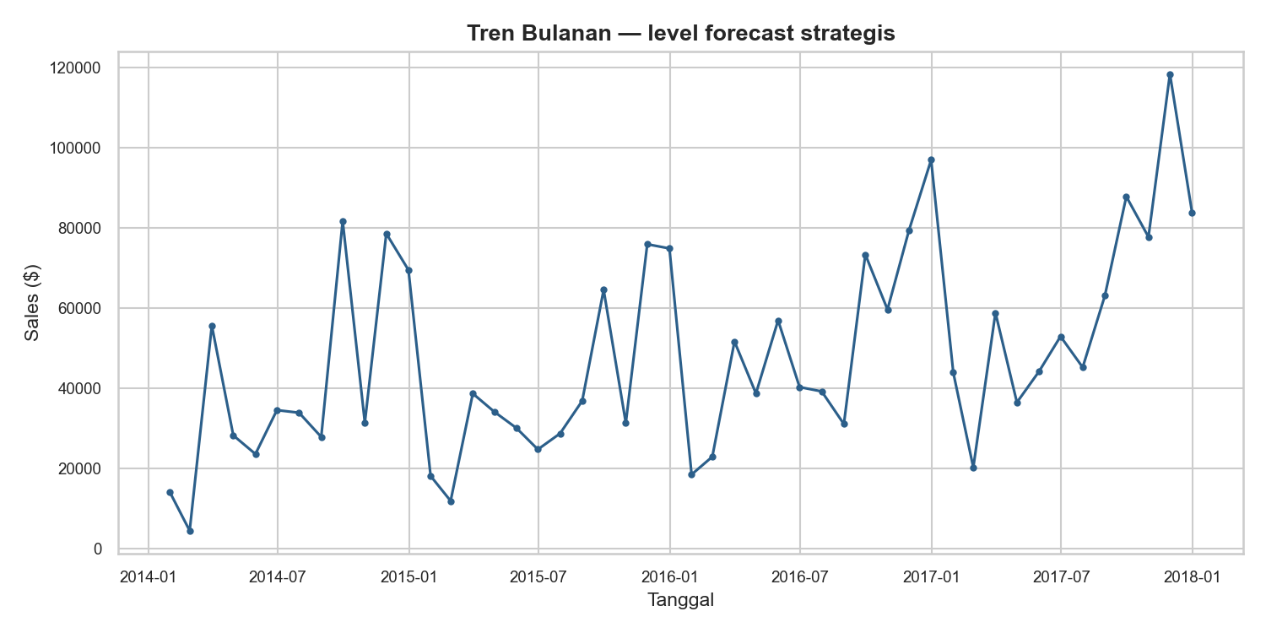
05
Sales Performance Overview
Tren bulanan: tumbuh struktural + spike Q4 berulang
KEY FINDING
Sales 2014 $484rb → 2017 $733rb (+51%); MA30 naik konsisten.
BUSINESS IMPACT
Permintaan tumbuh struktural — kapasitas & modal kerja harus ikut naik.

Slide 6
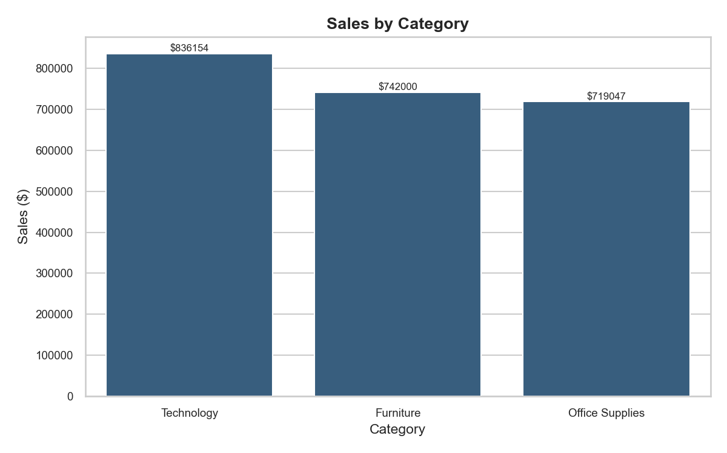
06
Sales by Category
Technology memimpin tipis — diversifikasi sehat
KEY FINDING
Technology $836rb > Furniture $742rb > Office Supplies $719rb.
BUSINESS IMPACT
Tech pendorong utama pertumbuhan; tak tergantung satu kategori.
RECOMMENDATION
Prioritaskan stok & promo Technology di periode puncak.

Slide 7
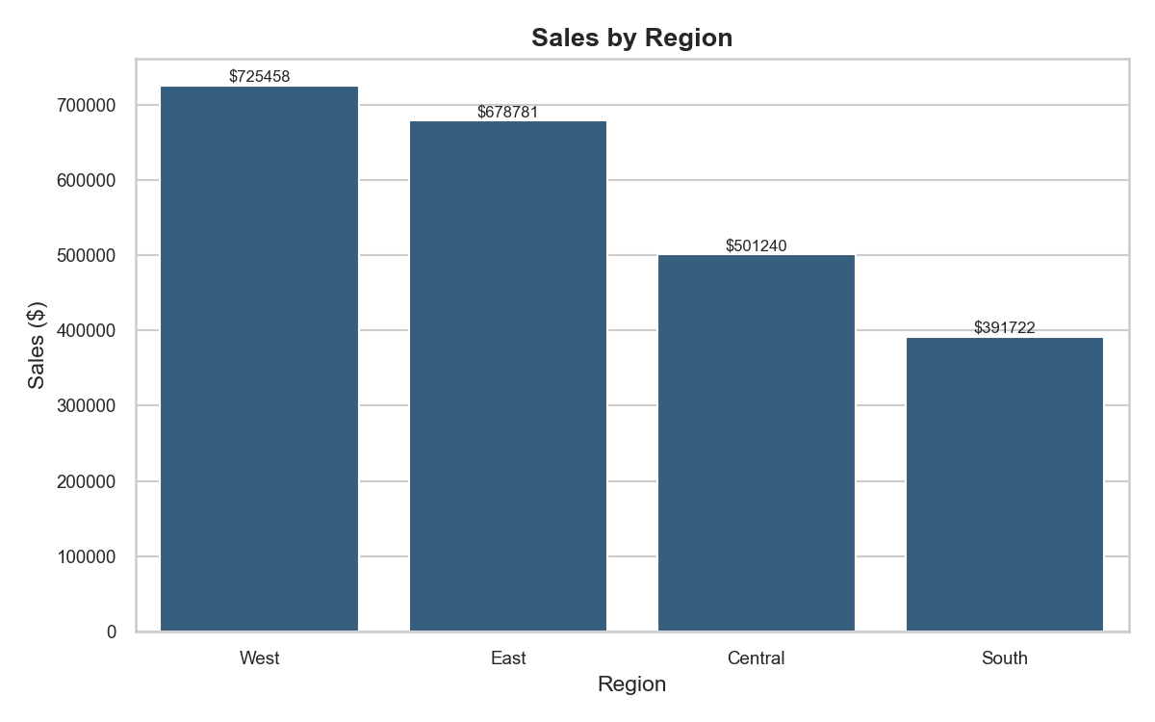
07
Sales by Region
West & East memimpin — gap distribusi jelas
KEY FINDING
West $725rb & East $679rb vs South $392rb.
BUSINESS IMPACT
Kekuatan pasar terkonsentrasi barat/timur.
RECOMMENDATION
Fokuskan armada & safety stock West/East; diagnosis South/Central.

Slide 8
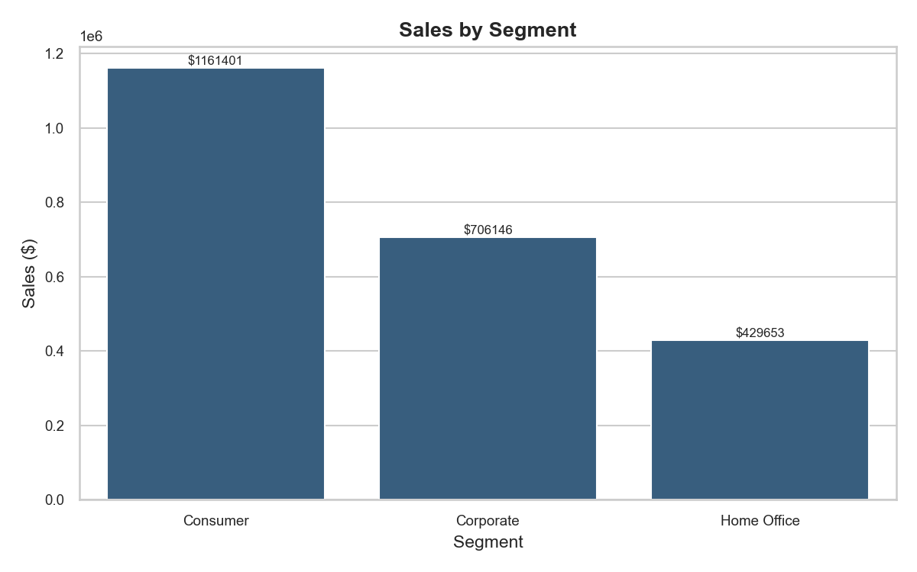
08
Sales by Segment
Consumer dominan — leverage mass-market
KEY FINDING
Consumer $1,16jt (51%) > Corporate $706rb > Home Office $430rb.
BUSINESS IMPACT
Strategi mass-market memberi dampak terbesar.
RECOMMENDATION
Kampanye Consumer massal; program B2B khusus Corporate.

Slide 9
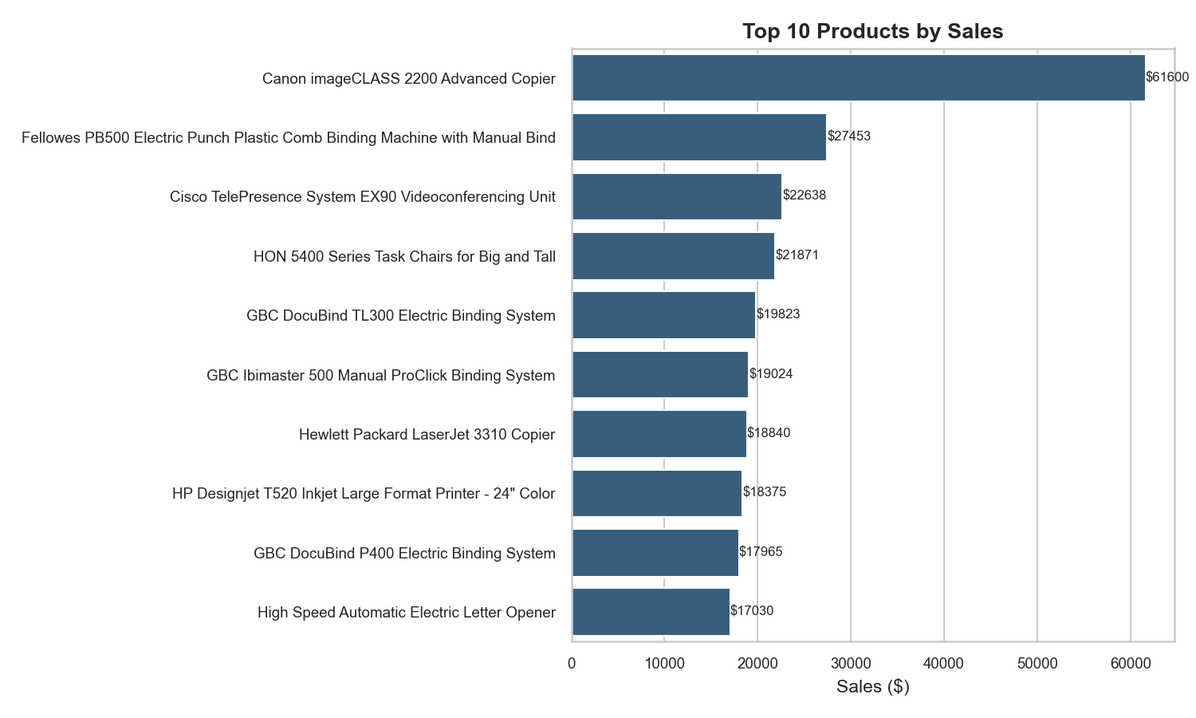
09
Top Product Performance
Hero SKU bernilai besar — satu stockout = ribuan dolar hilang
KEY FINDING
Canon imageCLASS 2200 $61,6rb top-1
hero = Phones/Chairs/Storage.
BUSINESS IMPACT
Sedikit SKU menopang mayoritas revenue (Pareto).
RECOMMENDATION
Availability + forecast per-SKU hero; safety stock ketat.

Slide 10
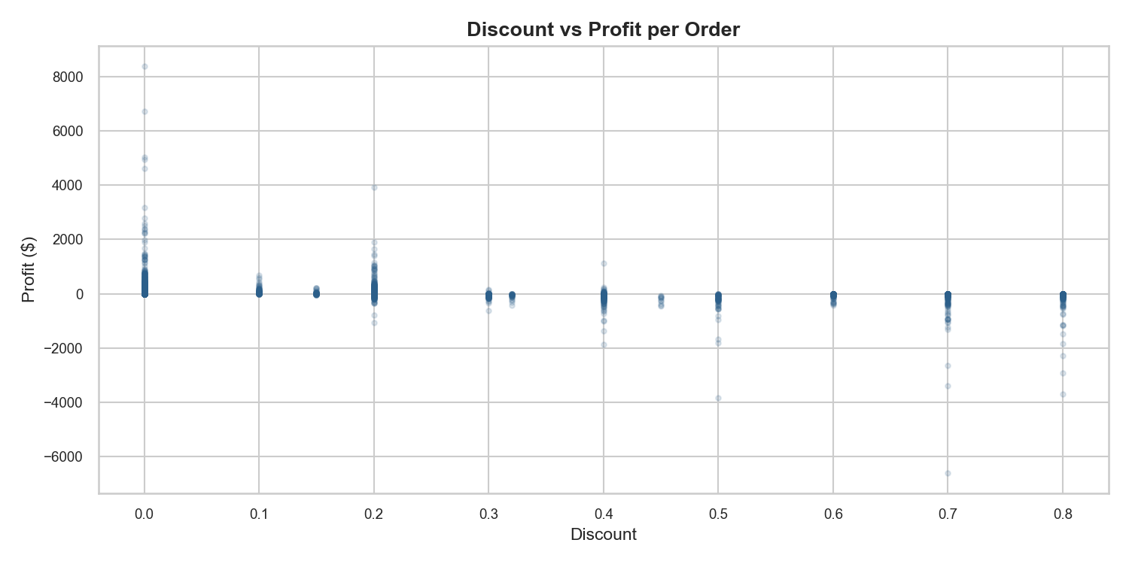
10
Profitability Analysis
Diskon menekan laba — promo butuh rem
ZONA MARGIN
● High Sales / High Profit — pertahankan & promosikan
● High Sales / Low Profit — batasi diskon, repricing
● Low Sales / Low Profit — kandidat delisting
Korelasi Discount–Profit −0,22; Furniture ekor rugi terdalam.

Slide 11
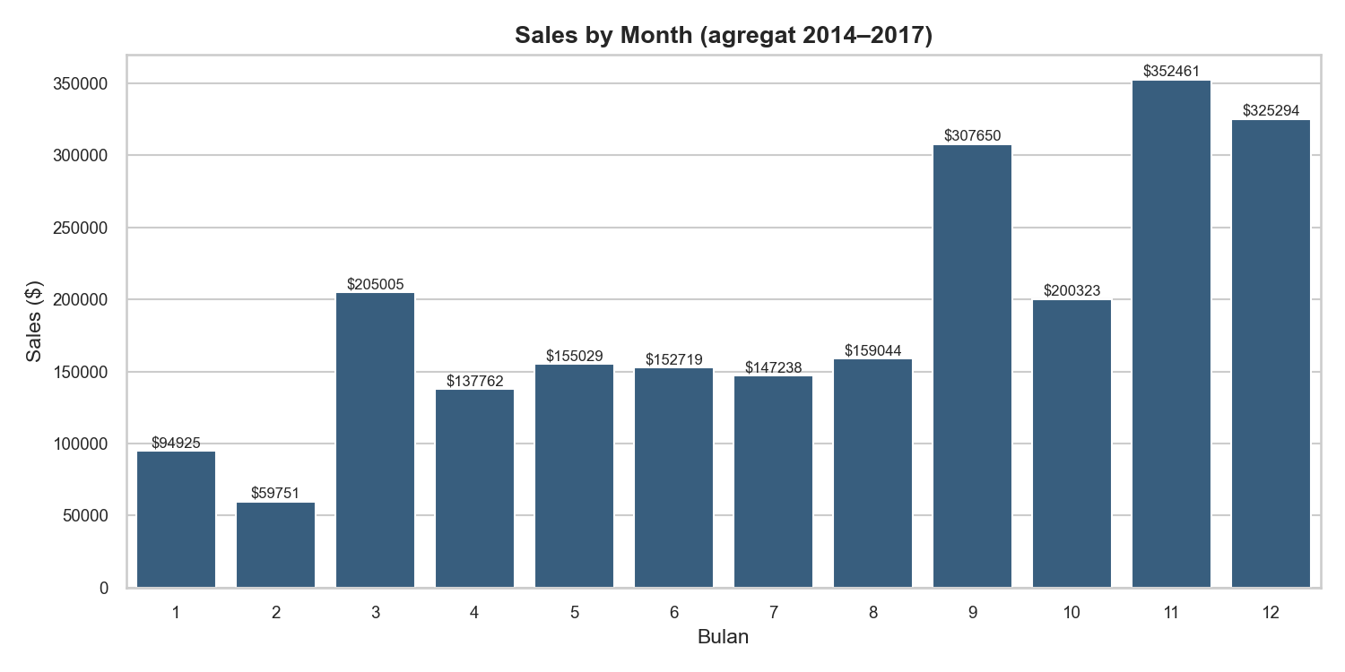
11
Seasonality — Q4 Rules
November–Desember puncak; Februari titik terendah
KEY FINDING
Q4 = 38% revenue tahunan; Nov $352rb, Feb $60rb; Rabu anomali rendah.
RECOMMENDATION
Naikkan stok Q4 (Sep–Des); just-in-time di Q1; promo di hari kuat.

Slide 12
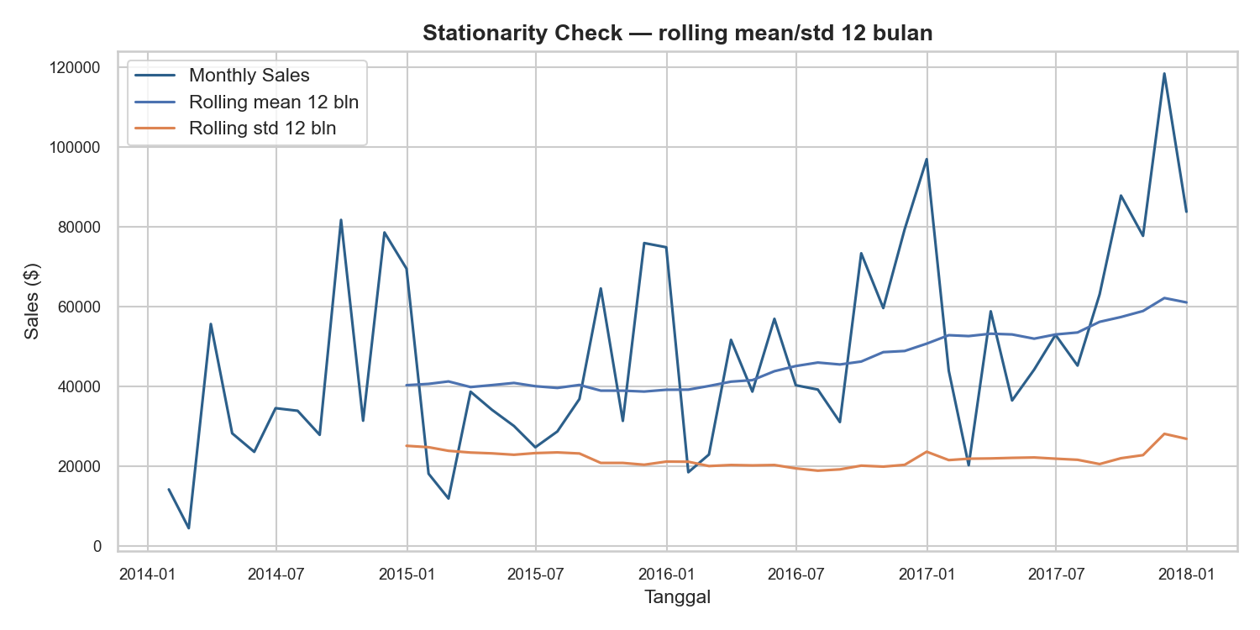
12
Prophet Forecast
Dua horizon: bulanan strategis + mingguan operasional
MENGAPA PROPHET
Tangkap trend + yearly/weekly seasonality otomatis; toleran outlier & missing dates.
CARA PAKAI
Mingguan → stok operasional (24 mgg); Bulanan → target strategis (12 bln) + interval risiko.

Slide 13
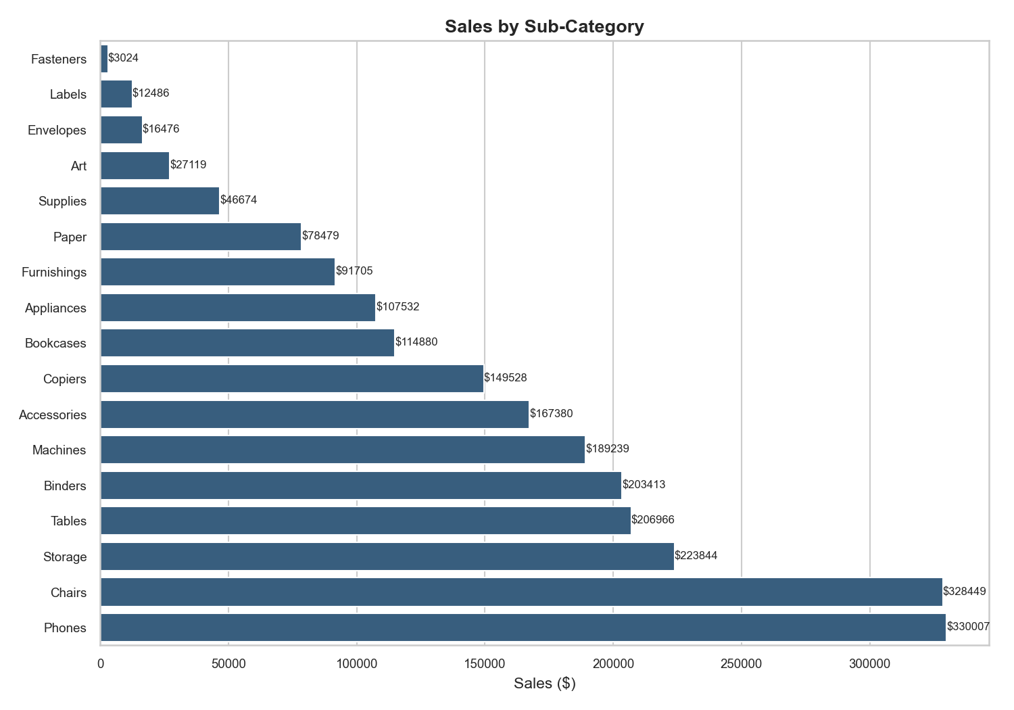
13
Streamlit Dashboard
Interaktif: KPI, filter, forecast M/W, download CSV
FITUR APP
✓ KPI: Sales, Profit, Orders, Quantity
✓ Filter tanggal + region
✓ 6 tab: Category → Top Products
✓ Forecast M/W + MAE/RMSE
✓ Download forecast CSV
✓ Business Insights siap eksekusi

Slide 14
14
Business Recommendations
Empat langkah prioritas dari data
1. Stok Q4
Naikkan inventory Sep–Des; just-in-time di Q1.
2. Fokus Tech
Stok & promo kategori Technology di puncak.
3. Kuatkan West
Armada & safety stock West/East; bedah South.
4. Jaga Margin
Batasi diskon >30%; lindungi SKU margin tebal.

Slide 15
Dari Data → Keputusan.
Forecasting menjaga stok tepat, target realistis, dan margin aman — nilai bisnis terukur.
Mafud Satrio Setiono • Data Analyst
GitHub • LinkedIn • Portfolio — QR & tautan menyusul

