Slide 1
Verification

Slide 2
Assertions
Used System Verilog Assertions to ensure nodes connected to the bus obeyed CAN protocol during transaction
Types of Assertions used include Concurrent Assertions and Immediate Assertions

Slide 3



Immediate Assertions
.

Slide 4
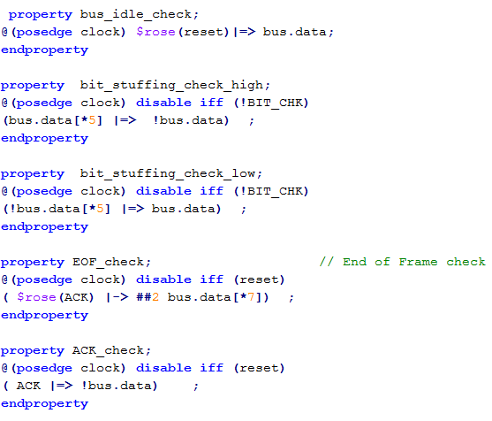
Concurrent Assertions

Slide 5
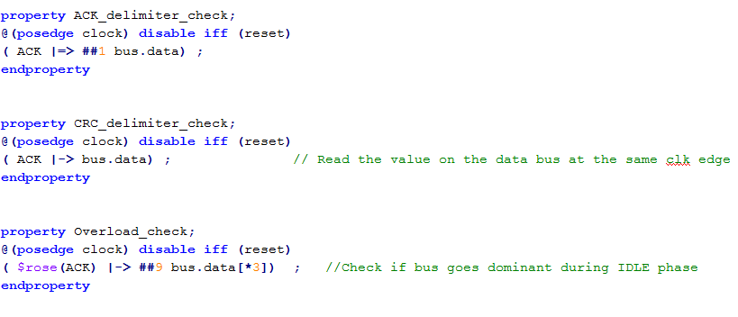
Concurrent Assertions(Cont.)

Slide 6
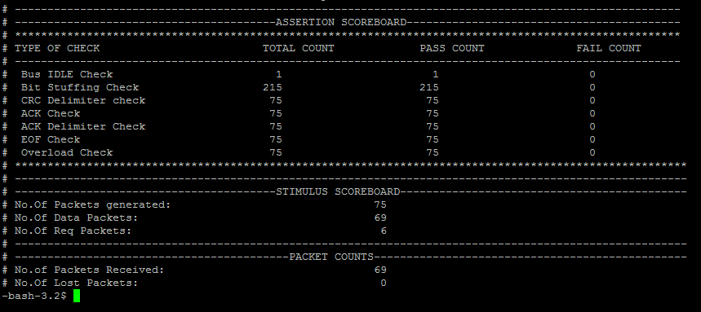
Scoreboard( Normal mode)

Slide 7
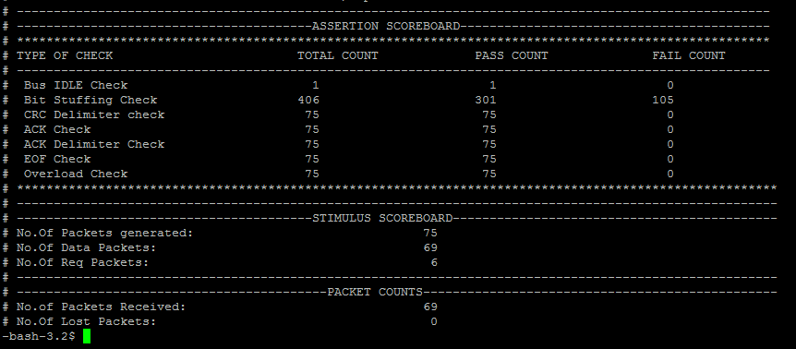
Scoreboard( Error injection mode)

