Slide 1
Ethernet MAC 10/100 Mbps
Description:
The Ethernet MAC (Media Access Control), sublevel within the Data Link Layer of the OSI reference model. This core is designed for implementation of CSMA/CD LAN(Carrier Sense Multiple Access with Collision Detection) in accordance with the IEEE 802.3 standards.
The MAC is the portion of ethernet core that handles the CSMA/CD protocol for transmission and reception of frames. It peforms Frame Data Encapsulation and Decapsulation, Frame Transmission, and Frame Reception.

Slide 2
Ομάδα 6
Ζαφείρης Δημήτρης
Καταράκης Δημήτρης
Σούτης Βασίλης

Slide 3
Introduction
The OSI model
5. Application layer
4.Transport layer
3.Network layer
2.Data link layer
1.Physical layer

Slide 4
The data link layer (layer 2)
transfers data between nodes in a WAN or in a LAN.
provides the functional and procedural means to transfer data
provides the means to detect and correct errors that may occur in the physical layer.

Slide 5
Our project: Ethernet IP Core is a 10/100 Media Access Controller (MAC) .
includes verilog code for the RTL core , which implement the layer 2 protocol of ethernet standard.
designed to run with IEEE 802.3 standard defined by 10Mbps or IEEE 802.3u standard defined by 100Mbps.

Slide 6
Project structure
2 main verilog code directories:
1)Code for ethernet MAC IP Core
(located in ethernet\rtl\verilog)
2) Code for ethernet Mac Testbench files which are used with ethernet MAC.
(located in ethernet\bench\verilog)

Slide 7
Folders description
bin: files for simulation
log: stores log files of every simulation
out: stores output files
run: the directory where the simulation is actually run. There are 2 scripts inside. One is the init script which “clears” all the data from previous sims and the second is the script to start the simulation

Slide 8
Description of Core Modules
The module eth_top.v consists of sub modules:
eth_miim.v,
eth_registers.v
eth_maccontrol.v
eth_txethmac.v
eth_rxethmac.v
eth_wishbone.v
eth_macstatus.v
and some logic for synchronizing, multiplexing and registering outputs

Slide 9
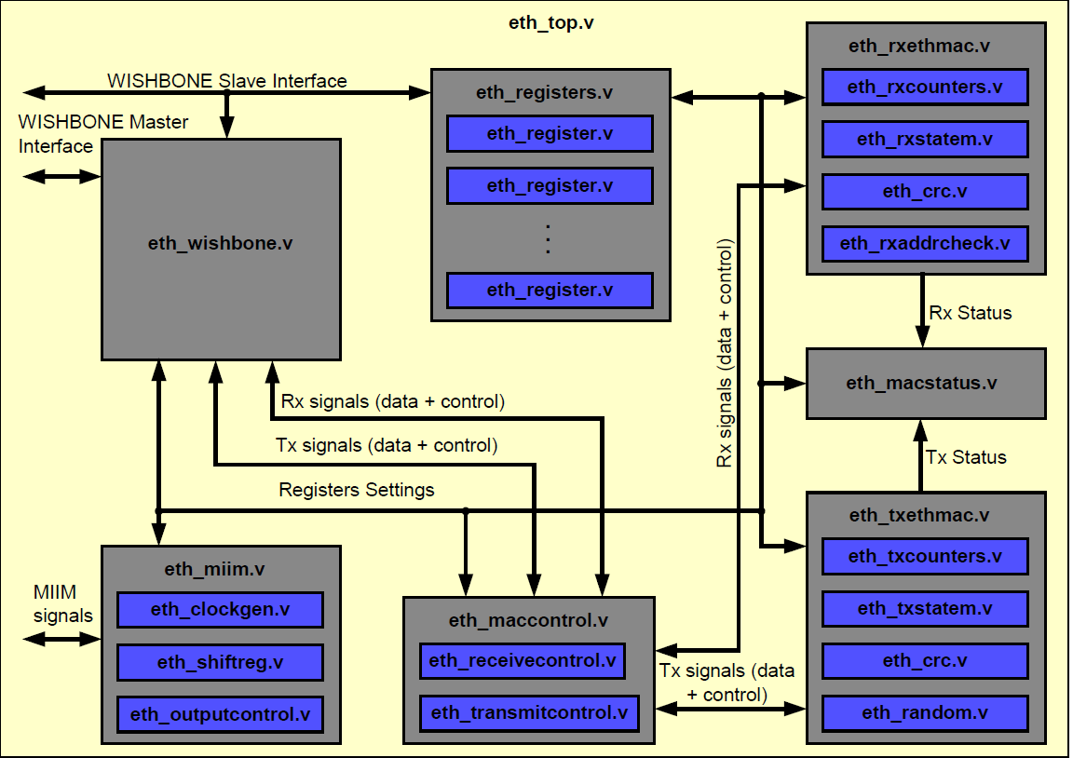
Core Modules Figure

Slide 10
Module Description
MII module (eth_miim.v) (Media Independent Interface):
is an interface to the external Ethernet PHY chip.
sets PHY’s configuration registers and reading status from it.
is consisted of two signals: clock (MDC) and bi-directional data signal (MDIO).
has several sub modules (eth_clockgen.v, eth_shiftreg.v, eth_outputcontrol.v).

Slide 11
Module Description
2. Receive module (eth_rxethmac.v):
receives data from the physical layer (cable)
assembles it to nibbles and sends to the receive module (MRxD [3:0]) together with the “data valid” marker (MRxDV).
removes the preamble and the CRC.
has four subs modules (eth_crc, eth_rxaddrcheck, eth_rxcounters, eth_rxstatem)

Slide 12
Module Description
3. Transmit module (eth_txethmac.v)
transmits data
receives signals that mark start of the data frame (TxStartFrm) and end of the data frame (TxEndFrm).
has four sub modules(eth_crc, eth_random, eth_txcounters, eth_txstatem )

Slide 13
Module Description
4. Control module (eth_maccontrol.v)
is in charge for data flow control
has 2 sub modules( eth_transmitcontrol, eth_receivecontrol )

Slide 14
Module Description
5. Status module (eth_macstatus.v)
monitors the Ethernet MAC operations
writes a status to the related buffer descriptor

Slide 15
Module Description
6. Registers module (eth_registers.v)
contains one single register.
width and value are defined with two parameters:
• WIDTH
• RESET_VALUE.

Slide 16
Module Description
7.WISHBONE interface mod.(eth_wishbone.v)
is the interface between the Ethernet Core and other devices (memory,host).
Two WISHBONE interfaces (slave and master)
Contains buffer descriptors (in the internal RAM).
Contains receive and transmit FIFO.
Contains synchronization logic for signals that spread through different clock domains.

Slide 17
Module Description
7.WISHBONE interface module
Master interface is used for storing the received data frames to the memory and loading the data that needs to be sent from the memory to the Ethernet core.
Ethernet registers and buffer descriptors (BD) are all accessed through the same WISHBONE Slave Interface.
Interface is WISHBONE Revision B.2 and B.3 compatible (selectable with a define ETH_WISHBONE_B3 in the eth_defines.v file).

Slide 18
Ports and Signals
Three types of signals to connect to media:
WISHBONE signals to connect to the Host Interface.
MII Management signals to connect to the PHY
Reset signals (for resetting different parts of the Ethernet IP Core

Slide 19
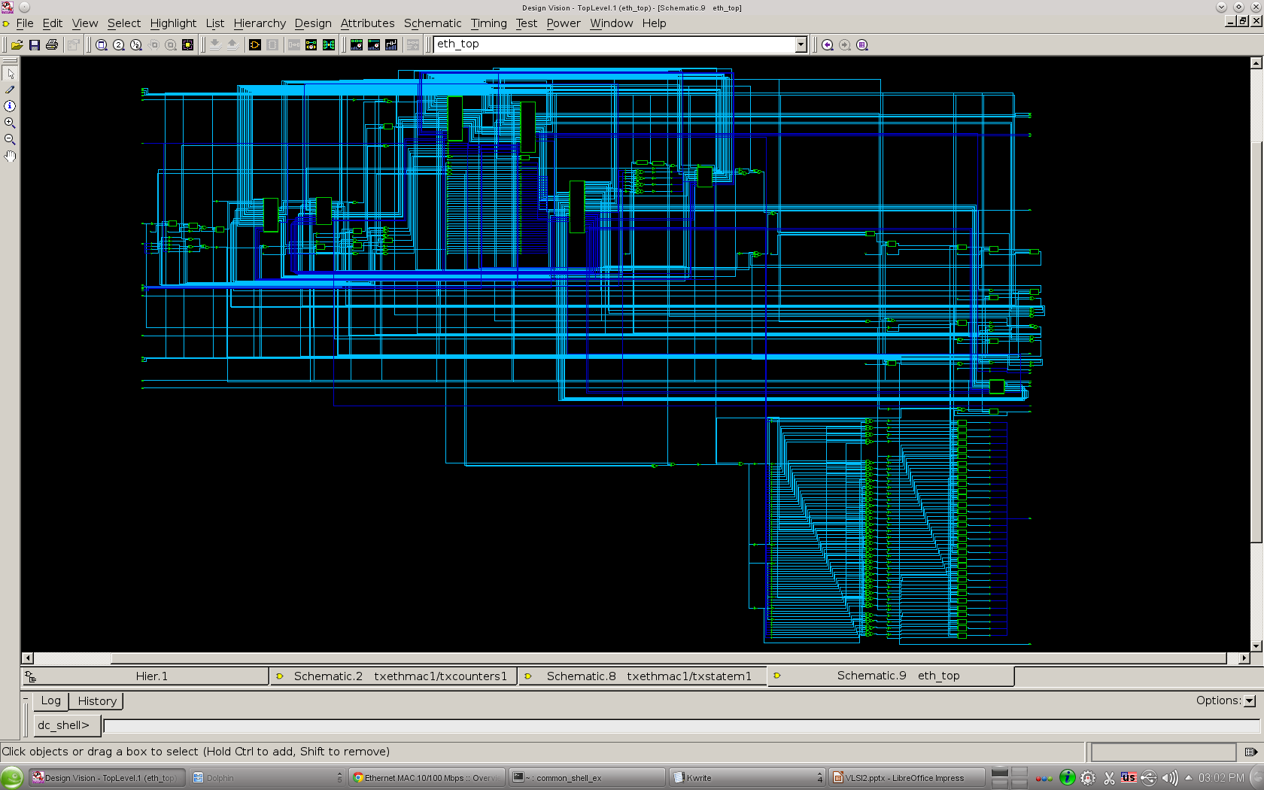
Image of top level

Slide 20
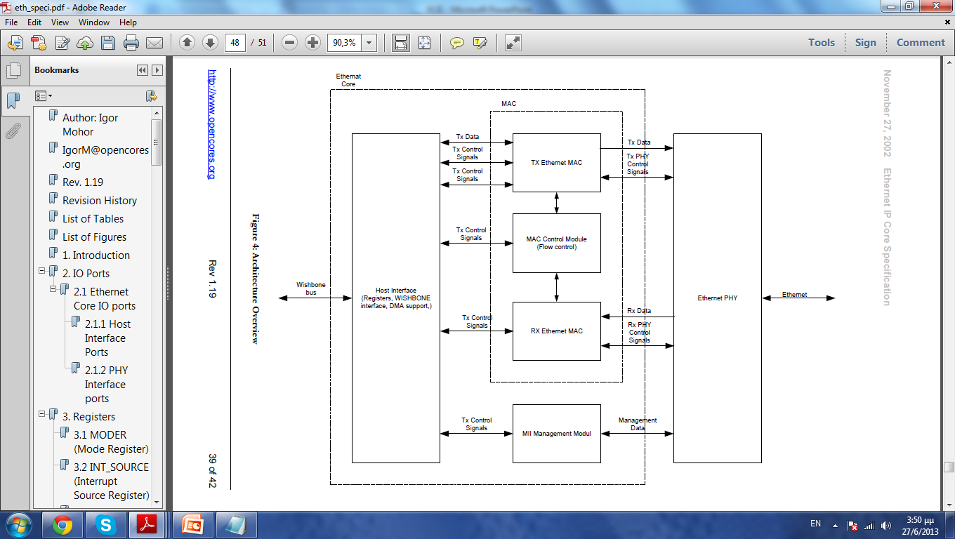
Ethernet Core

