Slide 1
Marshall Data Analytics Competition
Team Members: Xueying Wang, Ying Tu, Manqi Wang and Zikun Tian

Slide 2
Contents
Process
Forecast
Solution
Optional Exploration Areas

Slide 3
Forecast Process
1. Transfer Time Series Data into Supervised Learning Data
Time | Revenue | CustomerCounts
1/11/2016 | $488.11 | 145
1/12/2016 | $657.57 | 182
1/13/2016 | $598.10 | 164
1/14/2016 | $660.52 | 191
1/19/2016 | $929.59 | 255
1/20/2016 | $681.33 | 201
1/21/2016 | $715.66 | 198
Supervised Learning Data
Add external variables

Slide 4
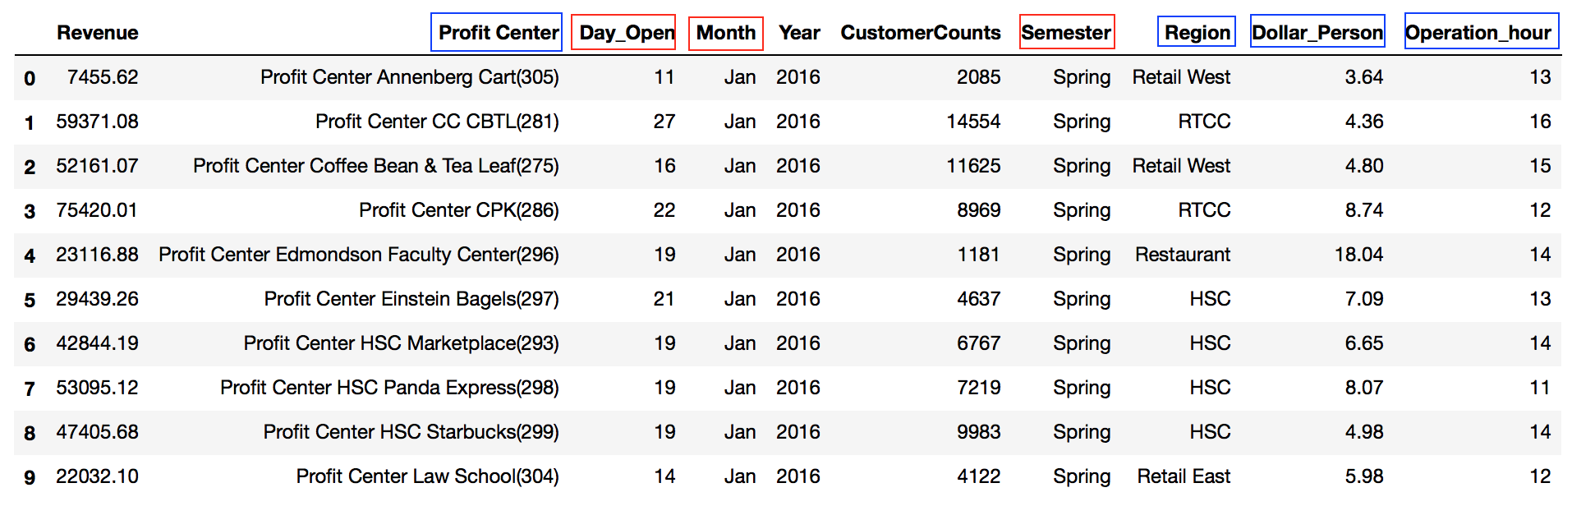
Forecast Process
Supervised Learning Data:
---- seasonality ---- profit center

Slide 5
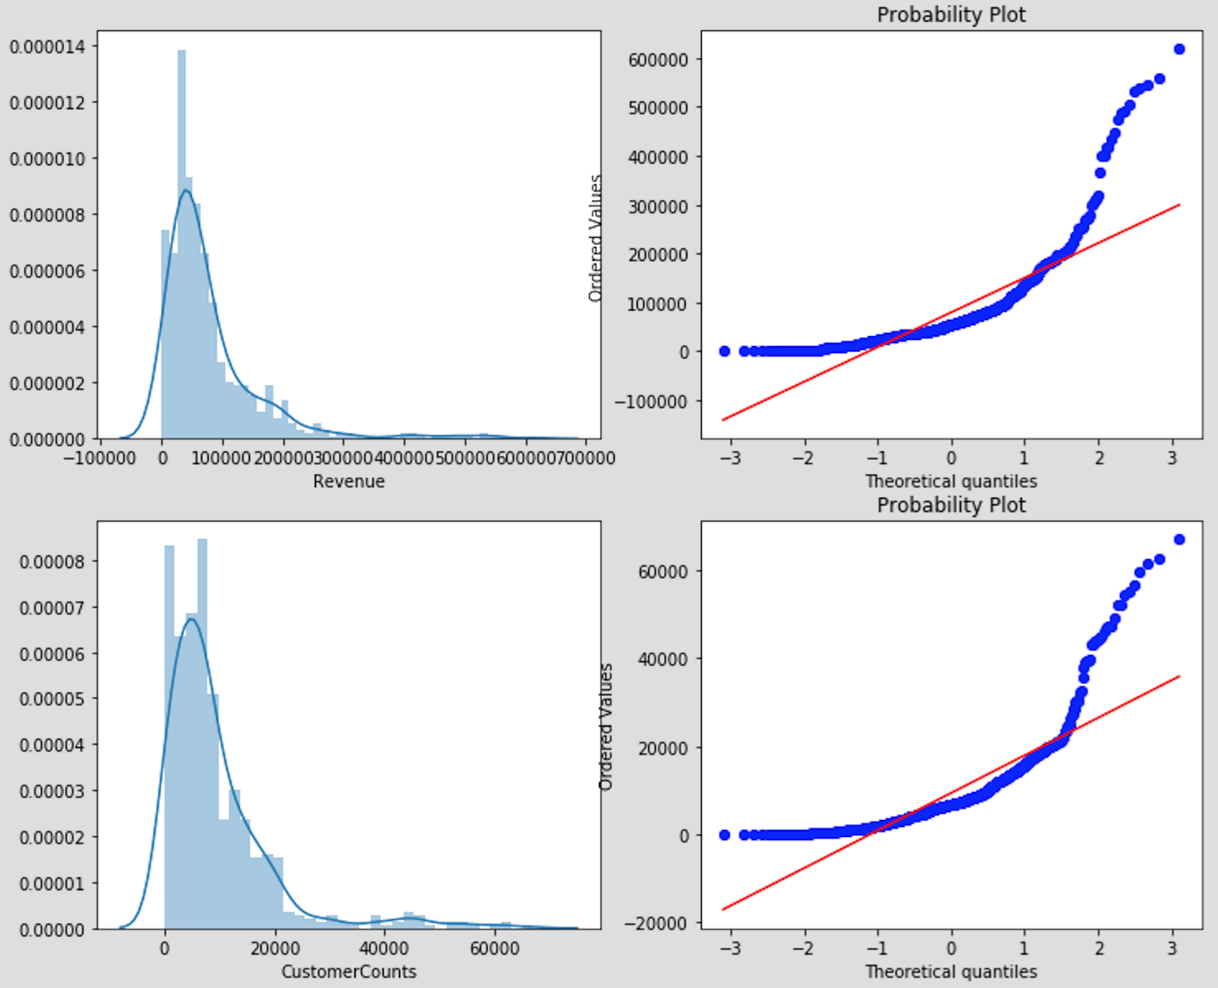
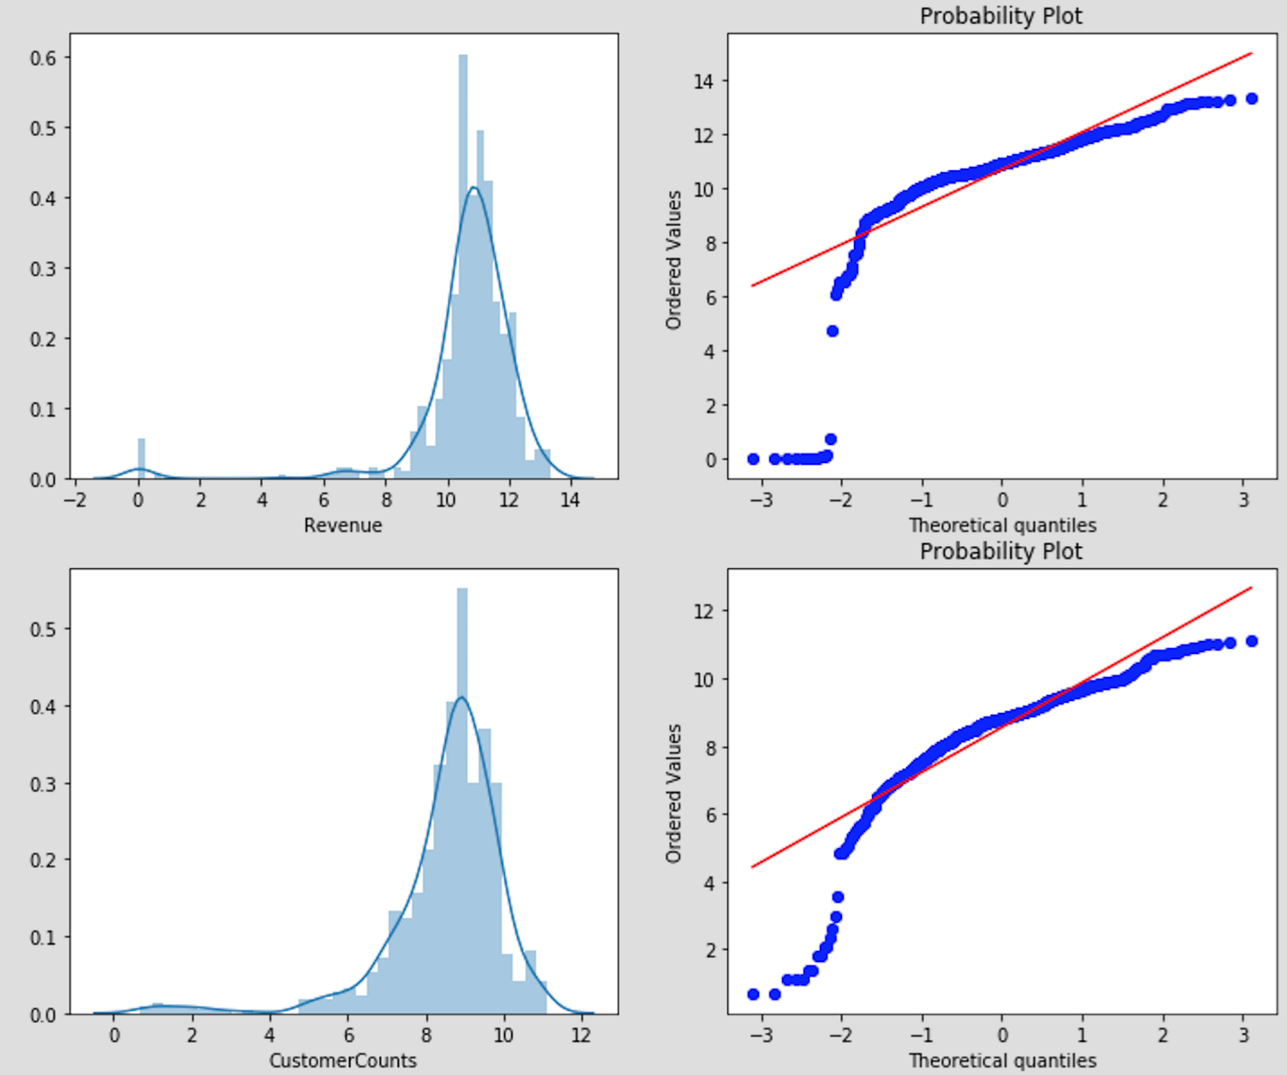
Data Preprocessing
1. Transfer Original Data into log(x+1) form to get better Gaussian Distribution
Original data
log(x+1) form data

Slide 6
Data Preprocessing
1. Transfer Original Data into log(x+1) form to get Gaussian Distribution
2. Use One-hot Encoding to convert categorical variables into dummy variables
3. Compute correlation matrix, drop features which are highly correlated with each other

Slide 7
Model ---- rIDGE regression
Predicted
Revenue
Days open
Operation hour
Other features
True
value
Predicted
value
l2 regularization

Slide 8
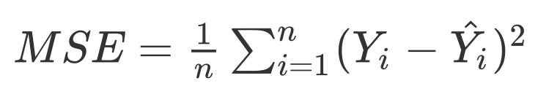
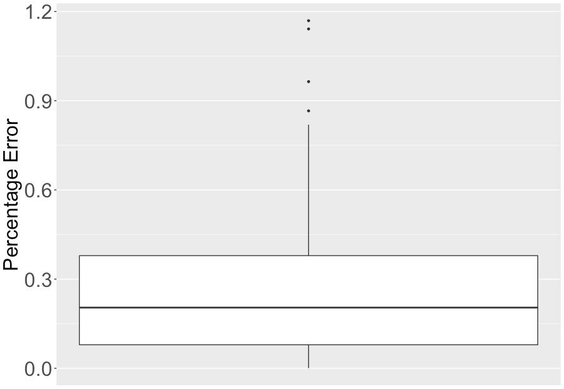

Predicted Counts (Percentage ERROR)
Mean Squared Error = 0.4342

Slide 9
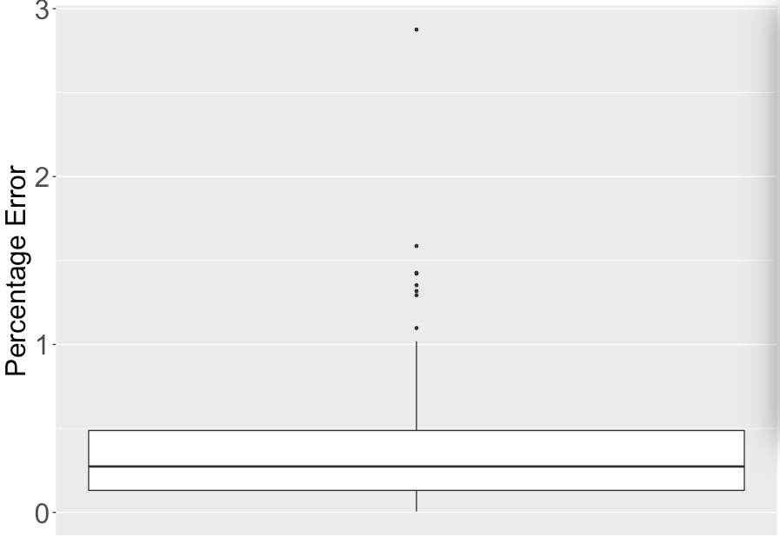
Predicted Revenue(Percentage ERROR)
Mean Squared Error = 0.2406
Notes:
Boxbplot for Percentage error （total）

Slide 10
Variables may cause inaccuracy
Lacking of information in # days opening per month in 2018
Some given revenue don’t match well with customer counts value
The model will predict better if we have more historical sales data
Notes:
Currently, we put operating hours for 2018 based on the average of hours in 2016,2017.
We found out some outliner extremely small. However, while building the model, we assume the data we are given at the beginning are all correct so that we didn’t remove outliners in the data preprocessing.
Since we only have data in 2016 and 2017.
Let’s recall the plot of distribution of sales data,

Slide 11
Forecast - Areas of Promise
Notes:
Moving to forecast trend in 2018.
lets look at an example of California pizza kitchen which showed our model learned seasonality of past trend.
Red line showed our forecast in 2018, and we can see Revenue and customer counts are pretty consistent.
And we successfully forecast 2 peak in April and Oct which we called them midterm month.
It can be regarded as a case showed area of promise,
and the reason behind maybe because the the contract of operational hours make it more effective in peak hours throughout a day
With more labor to serve more customer

Slide 12
Forecast - Areas of Promise
Notes:
CPK is not the only case, we see the same trend in profit center Law school
It shows the peak at April and Sep to Oct which is consistent with the occurrence of midterms
The longer time students stay at school, the more revenue it will showed in dining.
So the suggestion we give for maximizing these kind of effect would be:
Extend the operational hours in midterm months, like March, April, Sep and Oct
More labor at peak hours to increase the efficiency in order to serve more students at same time, and reduce their waiting time
Prepared more grab and go product

Slide 13
Forecast - Areas of Increase Risk
Notes:
For area of increased risk, we take example like Lemonade
We see the consistent trend for revenue and cc which indicates the decrease in 2018 compare to previous 2 years
And the reason we analyze would be new restaurants in University Village like cava become the key competitors since it can be the perfect replacement of lemonade
Which provide same type of food but healthier food with lower price.
Lemonade, new center in UV and 同类别产品的出现, healthy food like cava, transfer of customer behavior, lower price
→ Panda, cc gradually decrease in new semester months. Same menu, people get tired of
Food truck

Slide 14
Forecast - Areas of Increase Risk
Notes:
Same situation may also showed in Panda express, the customer counts in new semester months showed decrease sign
And the reason behind maybe because customers get tired of same menu
so instead they go for something new, like food truck or new restaurant at figuora.
Since we see the transfer of customer behavior, thus the advice we give would be
Develop new product with diverse flavor and healthier element
Provide promotion that lower the price or try sample session to attract customer back
Contract the time that not many customers come to reduce variable cost

Slide 15
Optional Exploration Areas
ID | Unit Cost | Revenue16 | Revenue17 | Margin16 | Margin17
2989 | 0.99 | 130942.74 | 167910.01 | 50.23% | 50.23%
368 | 1.42 | 217452.21 | 179485.13 | 52.49% | 52.49%
98 | 0.67 | 112132.77 | 81851.89 | 64.51% | 64.52%
993 | 0.19 | 33583.13 | 28148.25 | 80.78% | 80.79%
153 | 0.89 | 38391.27 | 39417.40 | 52.85% | 53.56%
… | … | … | … | .. | …
Q1: General statistic models are not precise in this case.
Q2: lack of data for Cost
Break Even Point : Revenue = Labor Cost + Other Cost

Slide 16
Thanks for listening !

Slide 17
ApPENDIX: One-hot encoding
Month_ Jan | Month_Feb | Month_Mar | … | Month_Dec
1 | 0 | 0 |  | 0
0 | 1 | 0 |  | 0
0 | 0 | 1 |  | 0
0 | 0 | 0 |  | 1
Month
Jan
Feb
Mar
…
Dec

