Slide 2
Model qualifier
Model provider
Certify model accuracy
HW Design
Accurate model
Tier 2 supplier
HW
Tool provider
Tier 1 supplier
Basic SW
Integrated tool chain
OEM

Slide 3

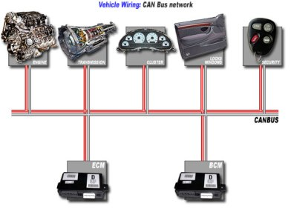
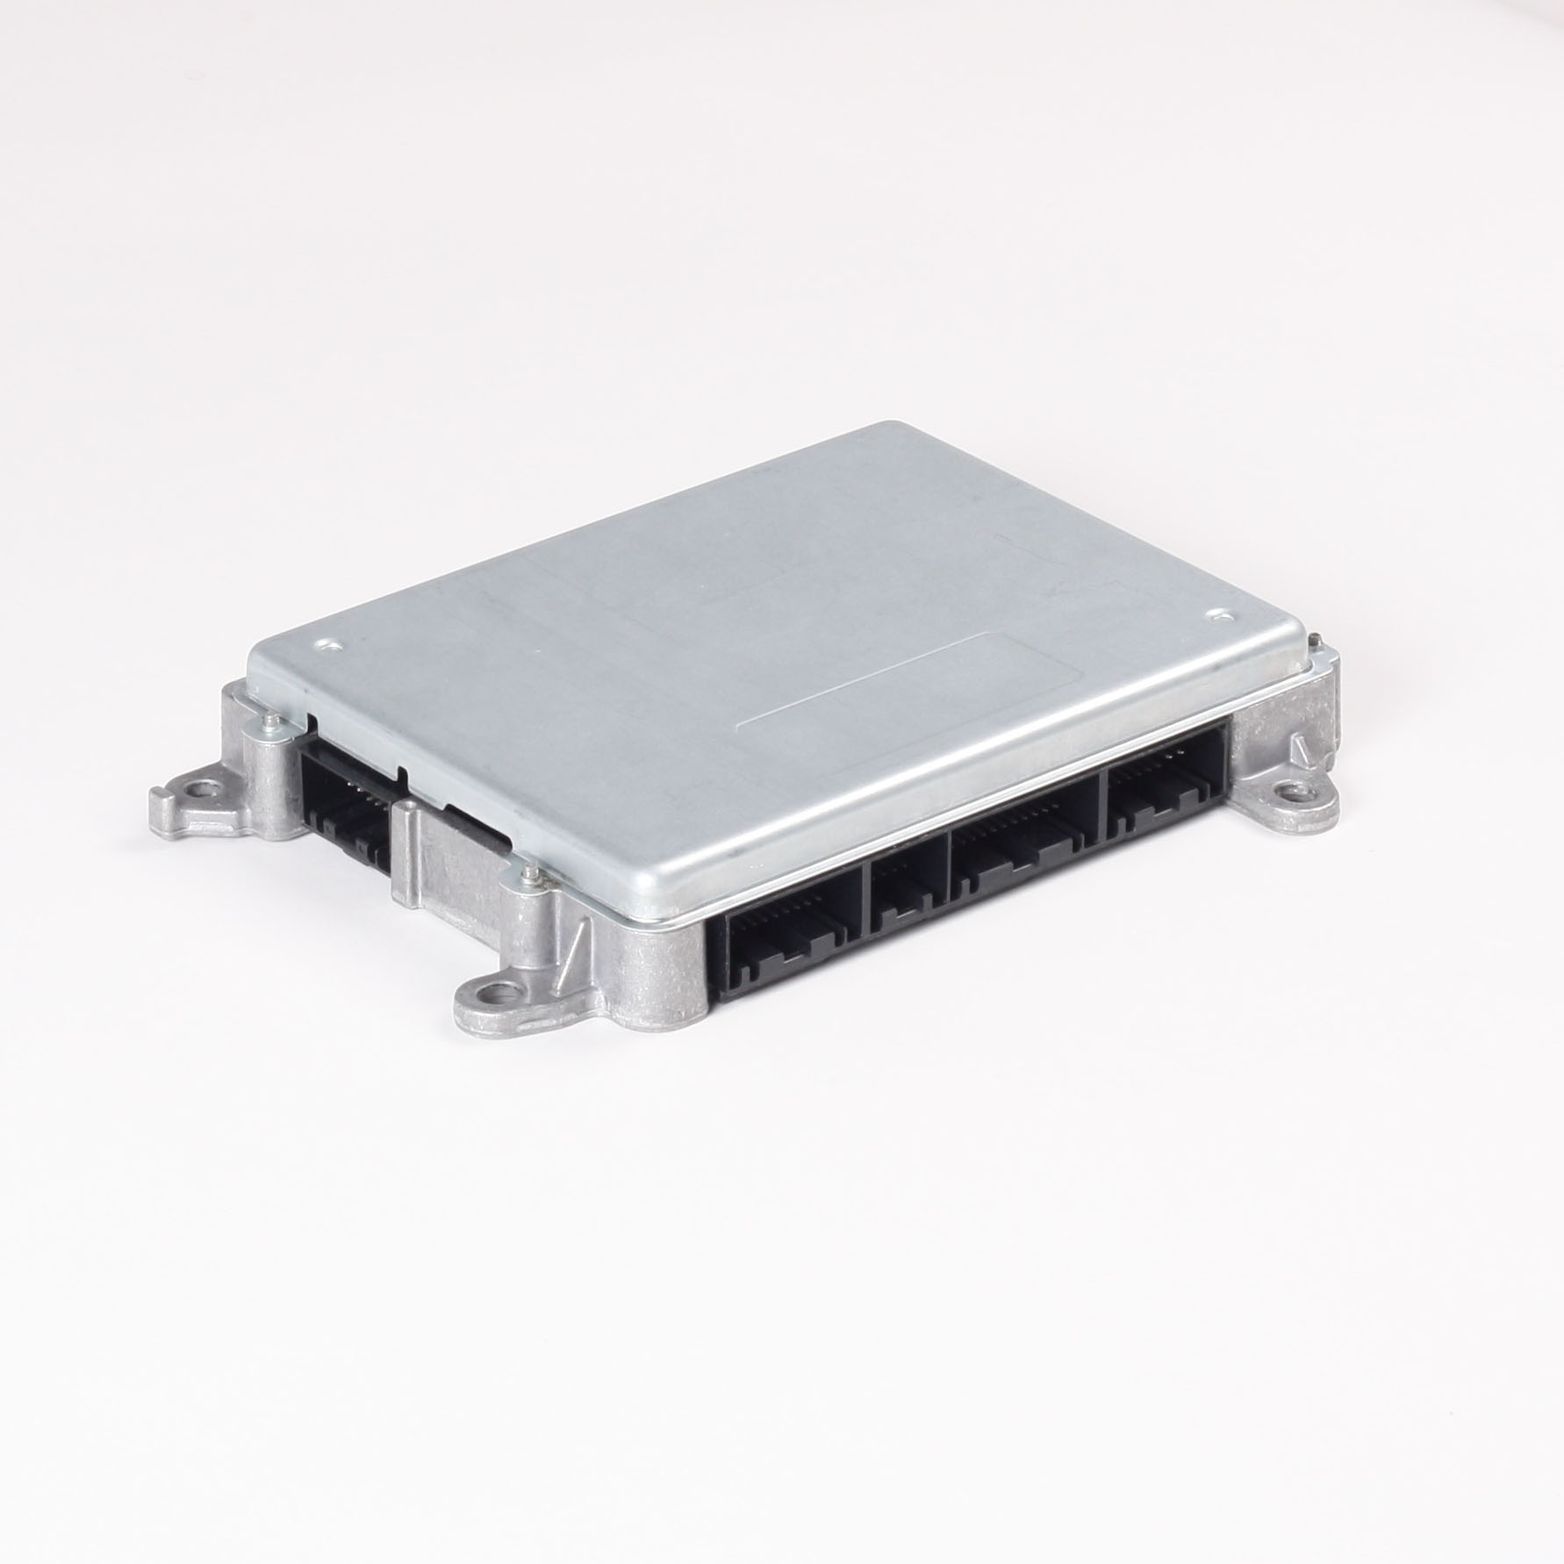
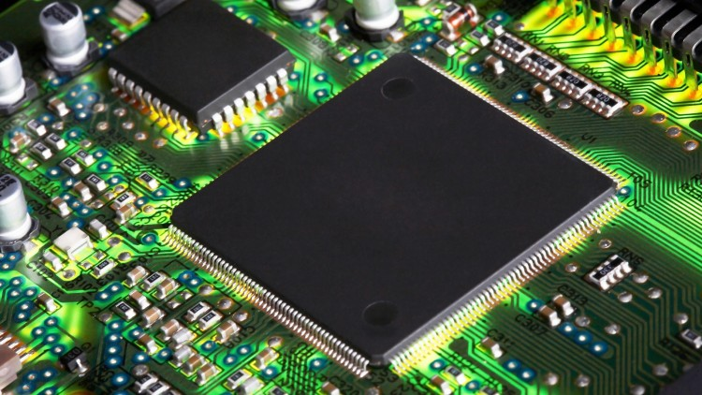
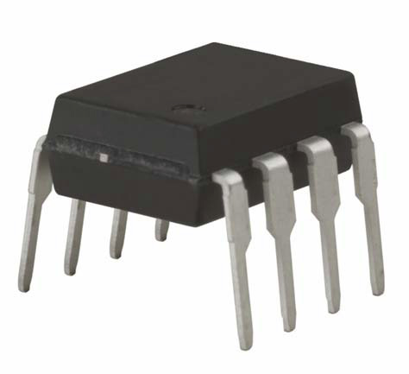
Virtual Functional and Performance Validation
Virtual Functional and Performance Verification
Vehicle
Virtual Control SW Development, Integration, Testing
Sub-System
Virtual MW Qualification/Integration
ECU
Virtual Low Level SW Development and Testing
MCU
Peripherals

Slide 4
 | Business related | Organization related | Technical
Impediments
Enablers
No adoption
Lack of resources
Recognized technical issues
Complexity/variance
Interoperability
Scale
Etc.
No demand
Culture (conservatism, HW centric)
A
B
Solving A affects B
No global strategy
A
B
A and B strongly related
Improved supplier network
Better Transparency
Clear Value proposition
Properly scoped use cases
Suitable scope
Concept of Customer Value
Technical solutions
Broader use of standards
Etc.
Clear stakeholder landscape
Map to strategic goals

