Slide 1

Big Data Analysis of: SF Crime Data
Team 5 member:
YUQING ZHAO
QIANQIAN GUO
JIEMING SHA

Slide 2
Content
Background
Results & Discussion
Problems
Methods

Slide 3
Background
Why we are doing this

Slide 4
Tasks
T1:Counts the number of crimes for different category.
T2:Counts the number of crimes for different district, and visualize your results
T3:Count the number of crimes each "Sunday" at "SF downtown".
T4:Analysis the number of crime in each month of 2015, 2016, 2017, 2018.

Slide 5
Tasks
T5:Analysis the number of crime w.r.t the hour in certian day like 2015/12/15, 2016/12/15, 2017/12/15.
T6:find out the crime event w.r.t category and time (hour) from the result of step 1
T7:For different category of crime, find the percentage of resolution.
T8: visualize the spatial distribution of crimes and run a kmeans clustering algorithm (please use Spark ML kmeans

Slide 6
Results & Discussion
Here are our result towards this tasks

Slide 7
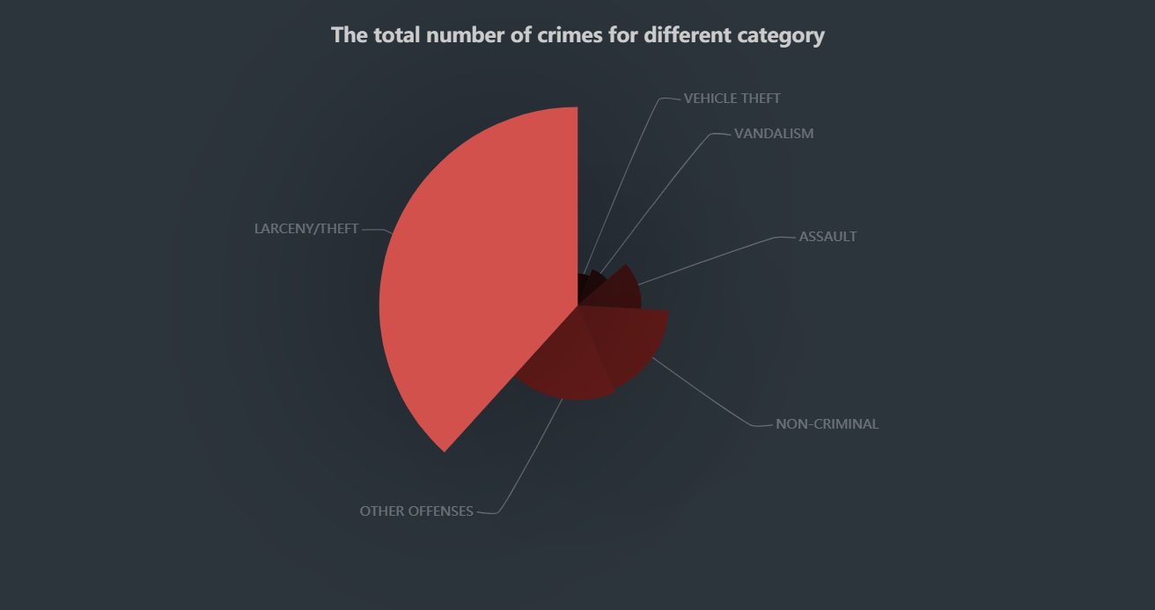
results
probable cause
advice to visitor
advice to local resident
advice to the police government

Slide 8
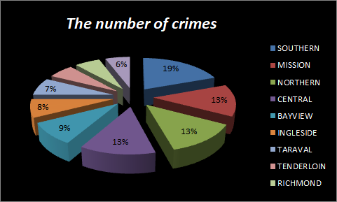
results
probable cause
advice to visitor
advice to local resident
advice to the police government

Slide 9
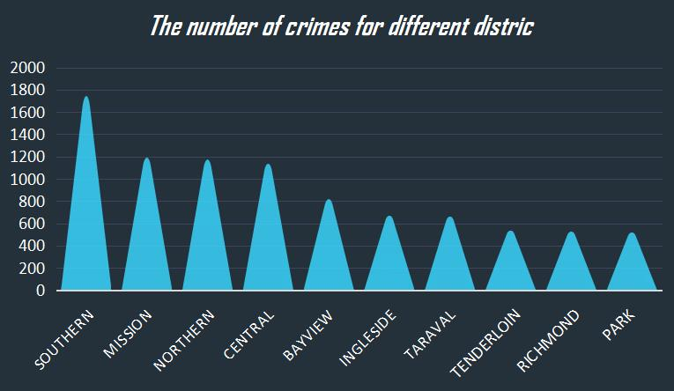
results
probable cause
advice to visitor
advice to local resident
advice to the police government

Slide 10
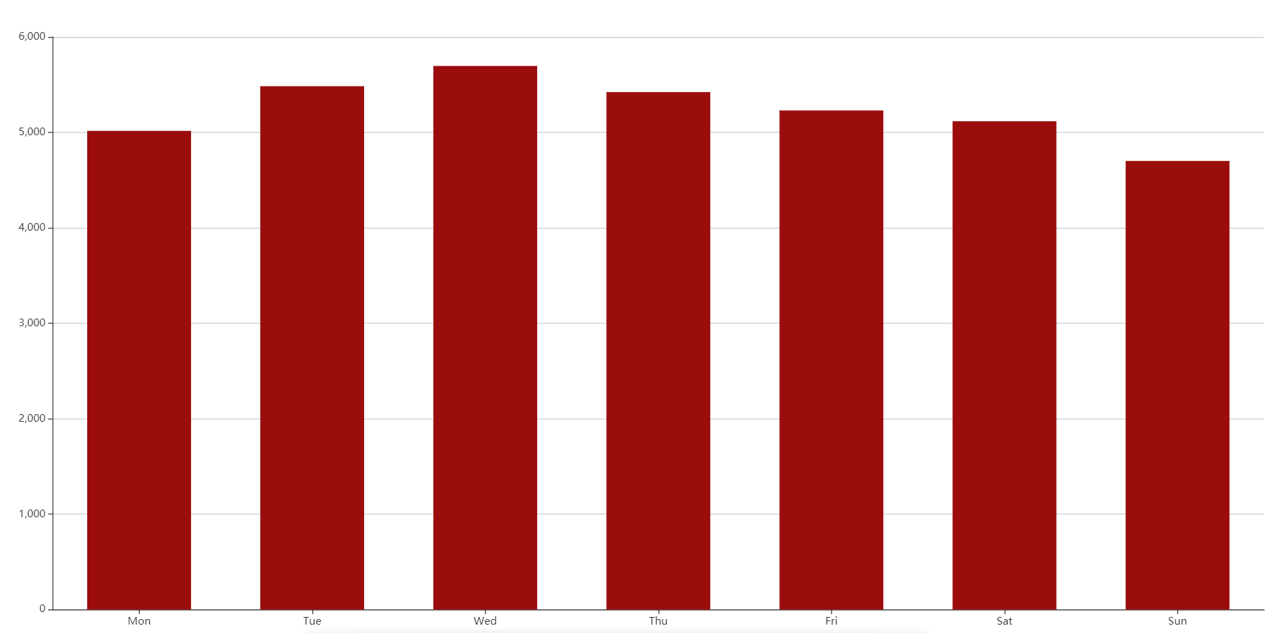
Fluctuation of crimes amount on Sunday downtown
results
probable cause
advice to visitor
advice to local resident
advice to the police government

Slide 11
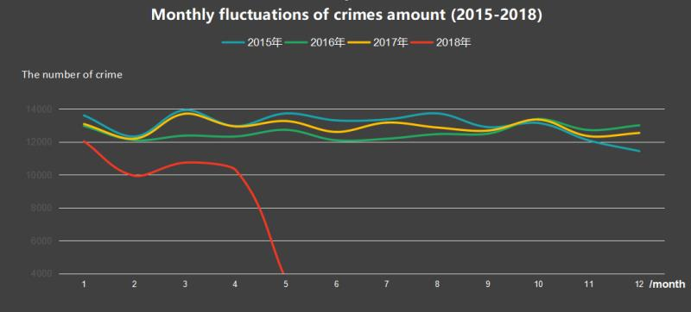
results
probable cause
advice to visitor
advice to local resident
advice to the police government

Slide 12
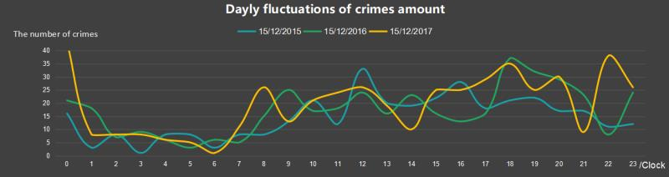
results
probable cause
advice to visitor
advice to local resident
advice to the police government

Slide 13
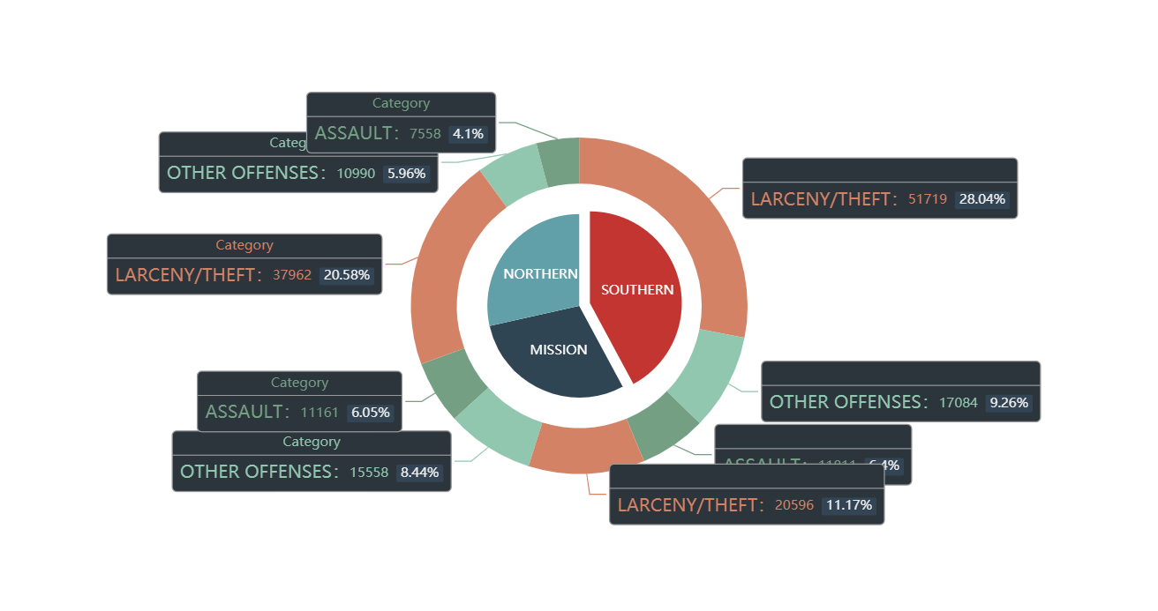
Top 3 Crimes in Top 3 Areas
results
probable cause
advice to visitor
advice to local resident
advice to the police government

Slide 14
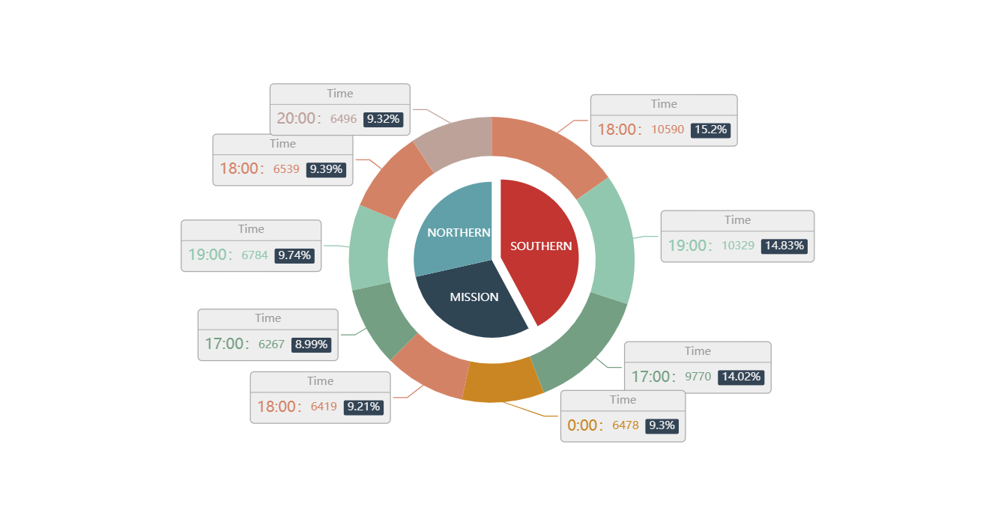
Top 3 Time for Crimes in Top 3 Areas
results
probable cause
advice to visitor
advice to local resident
advice to the police government

Slide 15
Problems we met with
To define ‘SF downtown' in code
searched the longitude and latitude
=DATE(RIGHT(E2,4),LEFT(E2,2),MID(E2,4,2))
connect wifi in the campus
Problems
To
solve
To select month out of the original data.
(month-day-year)
Methods
uploading the fixed data

Slide 16
Thank You

