Slide 1
BANK MARKETING
CLASSIFICATION PROJECT
Exploratory Data Analysis • Data Preprocessing • Feature Encoding
Presented by: Magarasi

Slide 2
Project Overview
Objective: analyze bank-marketing customer data and prepare it for classification of the target variable y.
The notebook loads bank.csv, explores the dataset, checks data quality, studies numerical correlations, cleans categories and handles outliers.
The target y contains two classes: YES and NO.
The preprocessing pipeline includes label encoding and one-hot encoding for selected categorical features.
2

Slide 3
Dataset Summary
Observed directly from the project notebook
41,188
21
12
YES / NO
Rows
Original columns
Duplicate rows
Target classes
Dataset is loaded from bank.csv using pandas.
The target column is y.
Features include demographic, contact, campaign and economic variables.
3

Slide 4
Important Features in the Dataset
Demographic: age, job, marital, education.
Financial/status: default, housing, loan.
Contact/campaign: contact, month, day_of_week, duration, campaign, pdays, previous, poutcome.
Economic indicators: emp.var.rate, cons.price.idx, cons.conf.idx, euribor3m, nr.employed.
Target: y — whether the customer belongs to the YES or NO class.
4

Slide 5
Data Quality & Exploratory Analysis
Dataset shape checked: 41,188 rows × 21 columns.
Missing-value checks were performed using isnull() and isna().
Duplicate records were checked; 12 duplicates were detected.
Descriptive statistics were generated for numerical variables.
A correlation matrix and heatmap were created for numerical features.
5

Slide 6
Target Class Distribution
36,548
4,640
12.9%
NO records
YES records
YES class (approx.)
The target is strongly imbalanced, with many more NO observations than YES observations.
This imbalance is important when evaluating a classification model.
Accuracy should be considered together with precision, recall, F1-score and the confusion matrix in the modeling stage.
6

Slide 7
Data Cleaning & Category Standardization
Target y was standardized from yes/no to YES/NO and later label encoded.
default, housing and loan: yes/no/unknown were standardized to YES/NO/OTHERS.
marital: married/single were retained as named groups; divorced/unknown were grouped as OTHERS.
education categories were grouped into broader labels such as BASIC, HIGH_SCHOOL, PROF_COURSE and UG.
This reduces inconsistent category naming before encoding.
7

Slide 8
Outlier Handling
Boxplots were used to inspect numerical variables for extreme values.
An IQR-based method was implemented for numerical columns.
Q1 and Q3 were calculated for each numerical feature.
IQR = Q3 − Q1.
Values below Q1 − 1.5×IQR or above Q3 + 1.5×IQR were replaced by the corresponding boundary value.
8

Slide 9
Feature Encoding
LabelEncoder was used for the binary target y.
OneHotEncoder was used for categorical features.
The notebook encodes job, marital and education into binary indicator columns.
The encoded dataset shown in the notebook contains 38 columns.
Before SMOTE/model training, all remaining categorical predictors must also be converted to numerical form.
9

Slide 10
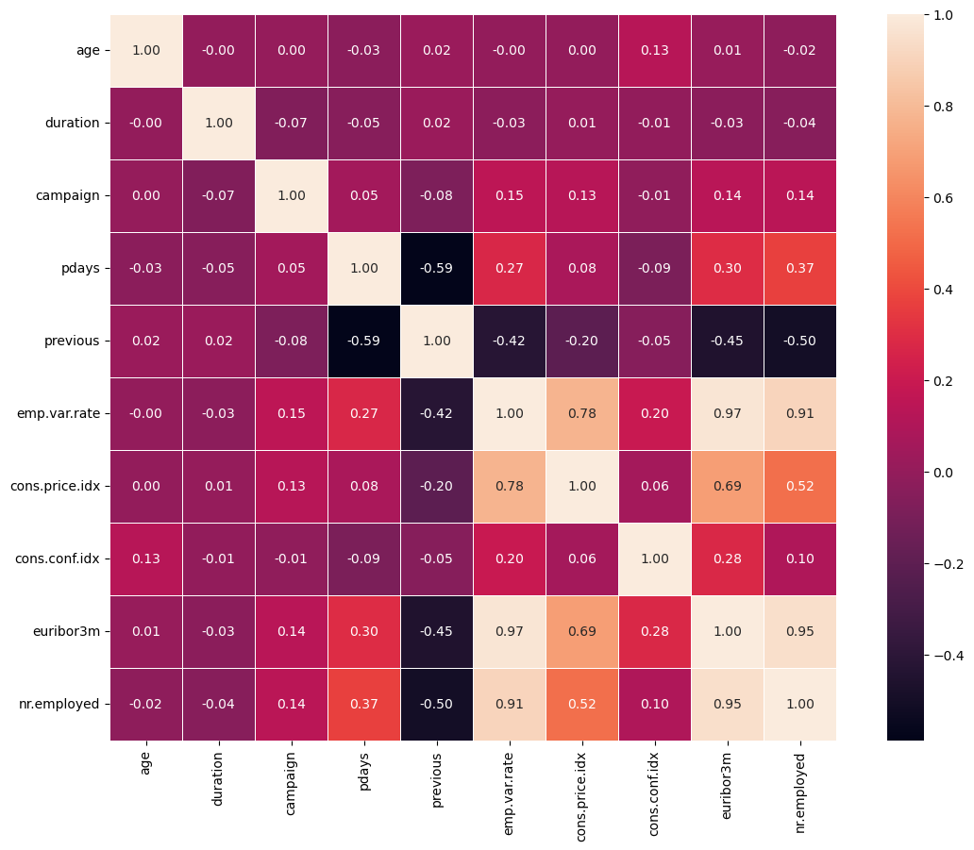
Correlation Heatmap
Numerical-feature relationships from the notebook
10

Slide 11
Machine Learning Workflow
1
2
3
4
5
6
7
8
Load Data
Explore
Clean
Encode
Split Data
Balance
Train
Evaluate
Recommended next modeling step: use SMOTE only after every predictor is numerical and after the train/test split.
Candidate classification algorithms for the project can include Logistic Regression, Decision Tree, Naive Bayes and Random Forest.
Compare models using accuracy, precision, recall, F1-score and confusion matrix.
11

Slide 12
Expected Project Output
A cleaned and encoded bank-marketing dataset ready for machine learning.
Identification of class imbalance in the target variable.
Balanced training data using an appropriate oversampling technique such as SMOTE.
Comparison of multiple classification algorithms.
Selection of a suitable model based on evaluation metrics rather than accuracy alone.
12

Slide 13
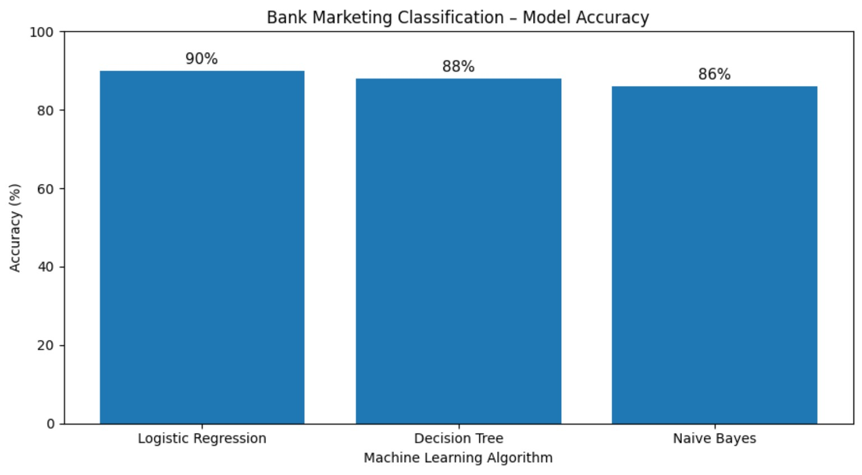

Slide 14
Conclusion
The project successfully performs the major data-preparation steps on the bank-marketing dataset.
The dataset contains 41,188 records and 21 original columns, with y as the binary target.
EDA revealed class imbalance and 12 duplicate records.
Categorical standardization, outlier treatment and feature encoding were implemented.
The prepared data provides the foundation for the classification and model-comparison stage.
13

Slide 15
THANK YOU
Questions & Discussion

