Slide 1



Multi-UAV Collaborative Monocular SLAM
Patrik Schmuck and Margarita Chli
Vision for Robotics Lab, ETH Zurich
2017 IEEE International Conference on Robotics and Automation (ICRA)
Swarmlab Journal Club
Marina Sofia Garcia Perez
31st Oct, 2019

Slide 2
Context & motivation
Introduction
Collaborative monocular visual SLAM
Centralized architecture
1 server
1-4 agents (UAVs)
Notes:
the biggest body of the literature focusing on SLAM from a single UAV
some, collaborative is loosely used: only mapping
here, truly collaborative slam
centralized used eficiently

Slide 3
Key attributes
Introduction
Onboard visual odometry
Expensive tasks run by server
Information sharing
Robust communication
Real experiments with multiple UAVs
Notes:
Onboard visual odometry
onboard of each agent
ensures autonomy
Expensive tasks run by server
non time-critical and computationally expensive
like Place Recognition, Map Fusion, and Bundle Adjustment (BA)
Information sharing
each agent reuses info captured by others
Robust communication
wireless network
resilient to delays and message loss
Real experiments with UAVs

Slide 4
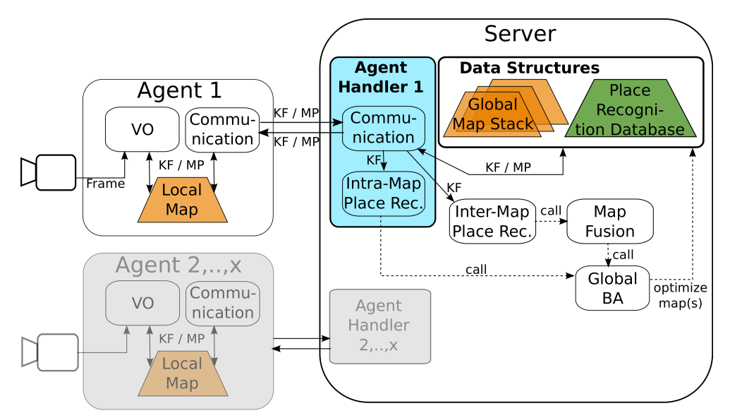
Architecture
Methodology
Notes:
Agent:
Autonomous thanks to
Visual Odometry (real time)
local map (K neighbours by server map) KeyFrame and MapPoints
Server:
ground station
non-time critical and computationally expensive tasks
Place recognition
Map Fusion
Global map optimization (bundle adjustement BA)
VISUAL ODOMETRY

Slide 5
Visual Odometry
Methodology
Underlying SLAM approach
ORB-SLAM2
Calculate movement of camera
Landmarks -> Map Points (MP)
Pose graph of Key Frames (KF)
Notes:
tracks landmarks -> stored latter as MP (K-nearest)
Pose graph as output
store when share enough MP

Slide 6
Architecture
Methodology
Notes:
AGENT HANDLERs

Slide 7
Agent Handlers
Methodology
Server/Agent
2 modules:
Communication
Intra-Map Place Recognition
Notes:
serves to interface server and agent
independent
in parrallel
Comunication: data exchange
Intra-Map Place Recognition: detects loop closures

Slide 8
Architecture
Methodology
Notes:
DATA STRUCTURES

Slide 9
Data Structures
Methodology
Map Stacks:
all complete maps
Keyframe database:
for place recognition
Notes:
MAP
complete: without the restriction of the K-nearest
4 agents -> up to 4 server map
starting system -> 1 initialized per agent
KEYFRAME:
new KF query old with same features

Slide 10
Architecture
Methodology
Notes:
COMMUNICATION

Slide 11
Communication
Methodology
ROS
Publishes KF and MP
new -> create and add
changed -> apply changes
Resilient to delays
Notes:
ROS
Publishes
bidirectional
Conflict: use server bc BA
Resilient: if the communication is cut, agents runs on VO
no crash

Slide 12
Architecture
Methodology
Notes:
PLACE RECOGNITION

Slide 13
Place Recognition
Methodology
Agent at known location?
Query for KF and loop closure
Intra-map
Inter-map
Notes:
intra:
same server map
global BA performed in that map
inter:
different server maps
map fusion

Slide 14
Architecture
Methodology
Notes:
MAP FUSION

Slide 15
Map fusion
Methodology
Pair of matching KF
Transformation between maps
BA
Delete old ones and create new map
Notes:
matching from place recognition (inter-map)

Slide 16
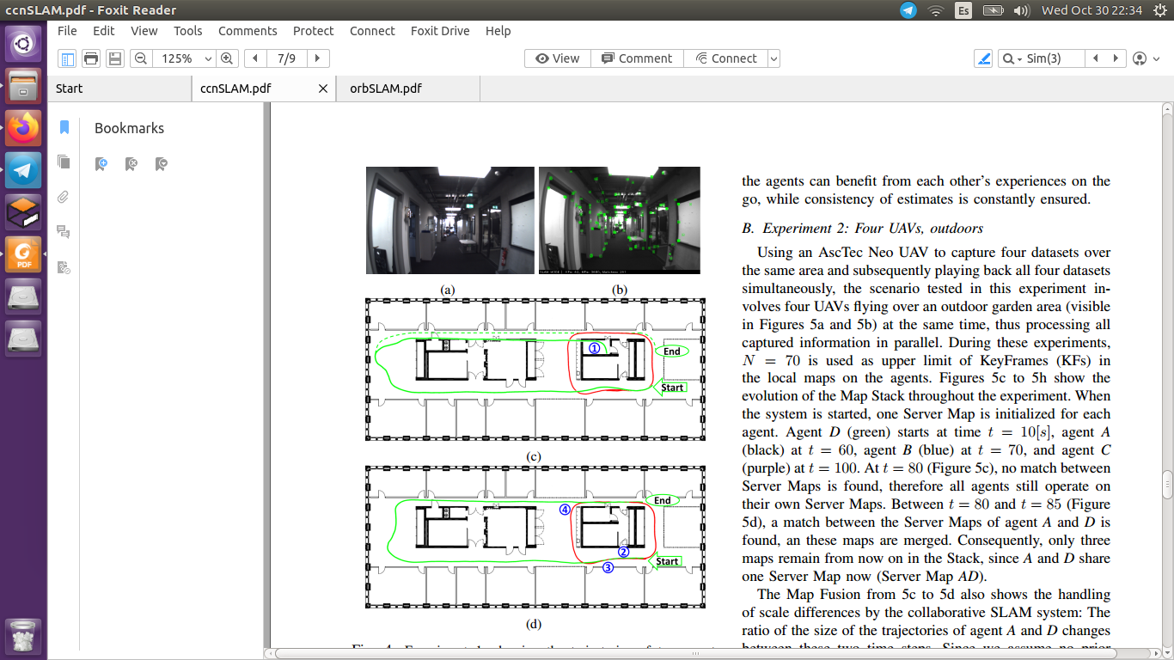
2 hand-held cameras, indoors
Experiments
Notes:
view of agent
landmarks
without using collaborative (dotted is real, collision)
collaborative. loop closure at 4. good trayectory now

Slide 17
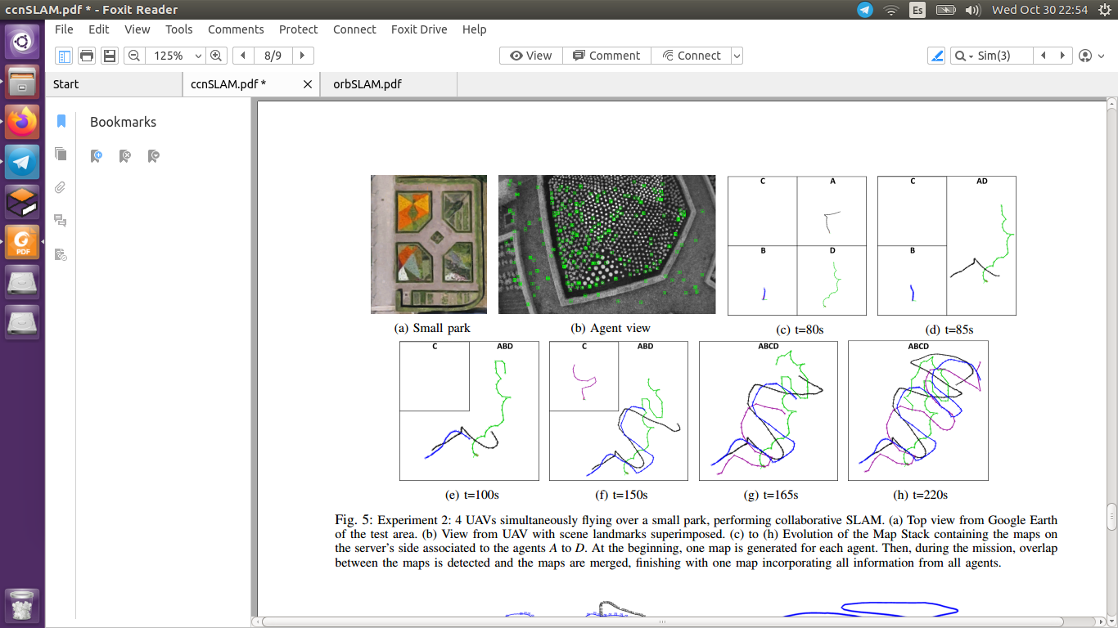
4 UAVs, outdoors
Experiments

Slide 18
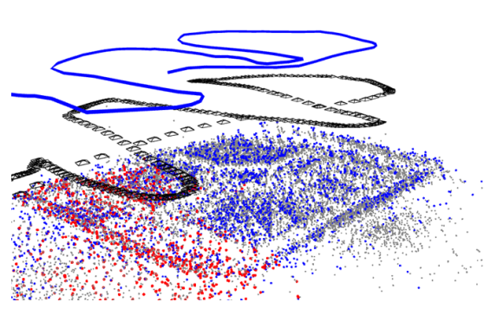
4 UAVs, outdoors
Experiments

Slide 19
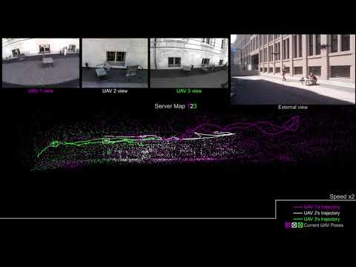
Video experiments
Experiments

Slide 20
Conclusion
Conclusion
Autonomous agents
Centralized server
Sends back information to agents
Useful and reliable in real scenarios
Negative: scaling

