Slide 1
Knowing the Graph:
does relational structure improve safety-concept probes?
Jason Boudville
Four iterations, two models, independently replicated — and a bounded answer.
Notes:
This is a story about testing an appealing hypothesis carefully enough to trust the answer — including the parts of the answer that are 'no'. (0:15)

Slide 2
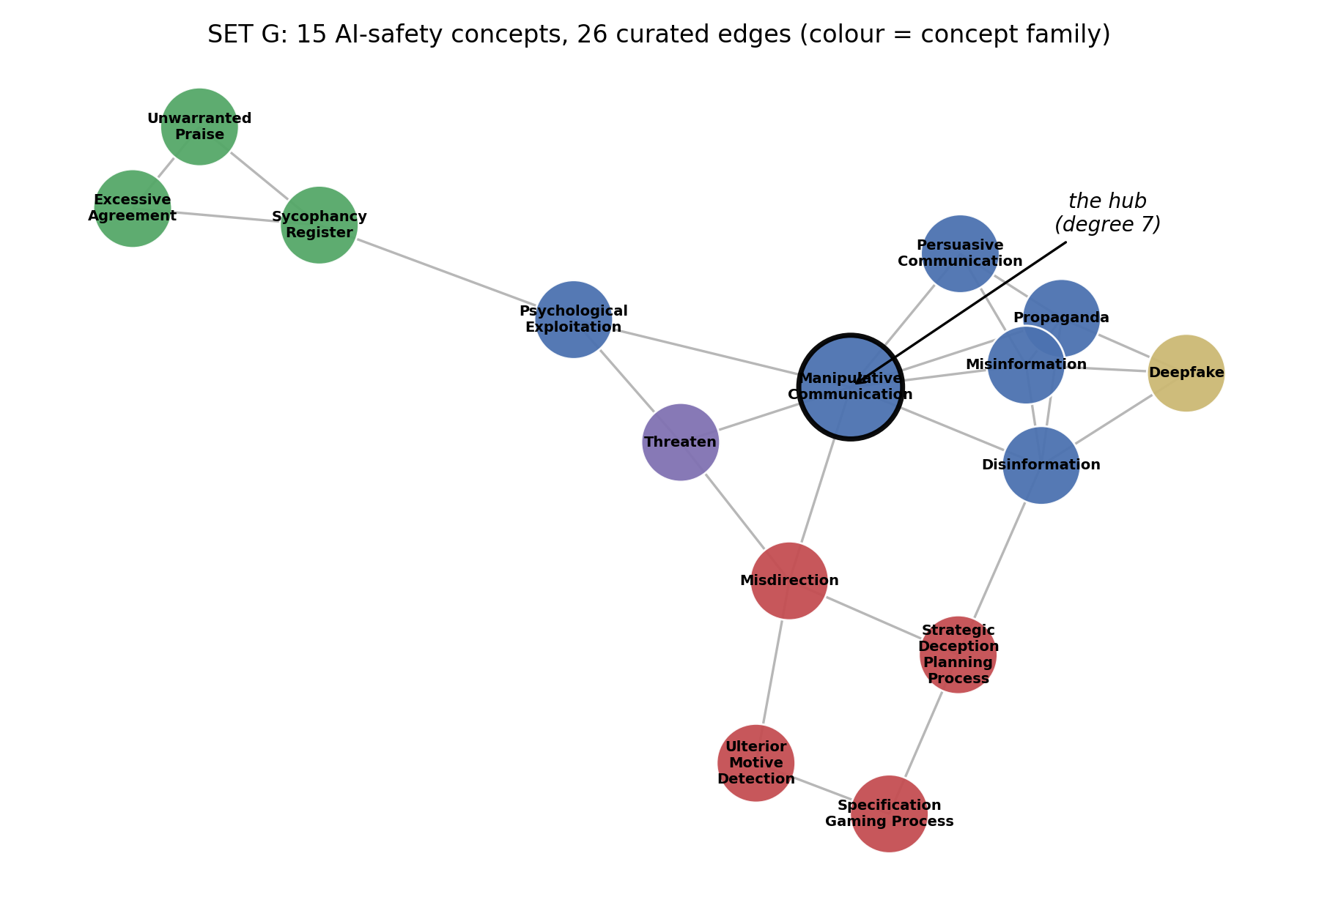
The question
1:00
The hypothesis:
Probes for related concepts should help each other —
and the benefit should scale with connectivity (alternate paths).
Like inferring a border from the neighbours' borders.
Graphs are cheap. Data is not.
Notes:
Safety monitoring wants per-concept detectors — lenses — over families of related behaviours. These concepts aren't independent: manipulation, deception, sycophancy form a graph. The hypothesis we inherited — later peer-replicated on a second model: relationship-aware training improves detection, and if two concepts are connected by many independent paths, you can triangulate their boundary even without direct data. Intuitive, testable, and if true, very useful: graphs are cheap, data is not. (1:00)

Slide 3
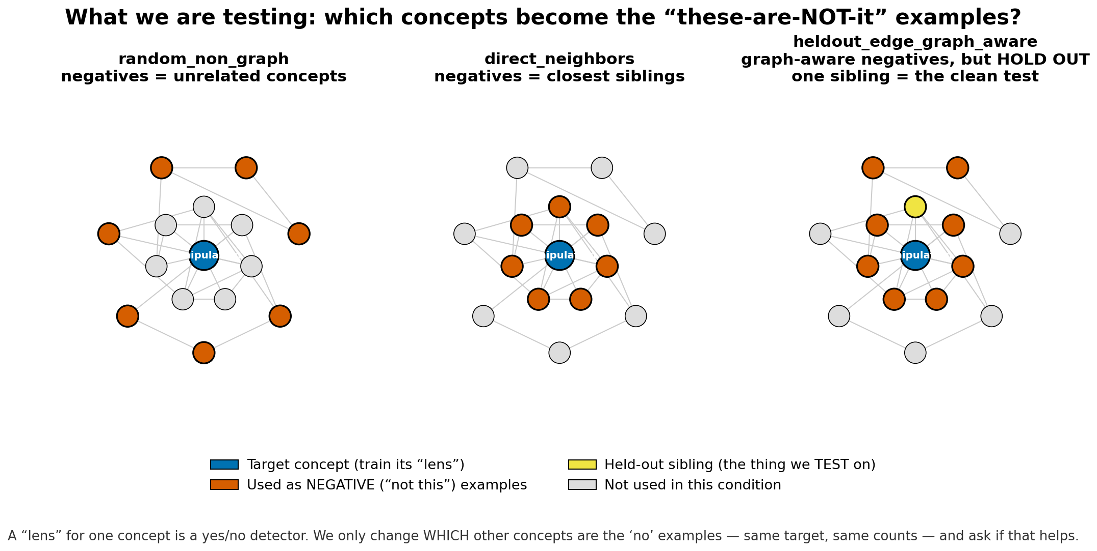
Setup in 30 seconds
0:35
15 AI-safety concepts · 26-edge curated graph
Passages in 4 surface-distinct contexts
Train on 3 contexts, test on the held-out one (OOD)
Linear probes, layer-18 residual stream
Gemma-2-9B (+ independent E4B replication) · 30 seeds
Notes:
Everything is the ARENA toolkit you know: mean-pooled residual stream, logistic regression. The one design choice to remember: out-of-distribution evaluation — train on three contexts, test on the fourth — because without it, surface vocabulary saturates everything and every probe looks perfect. (0:35)

Slide 4
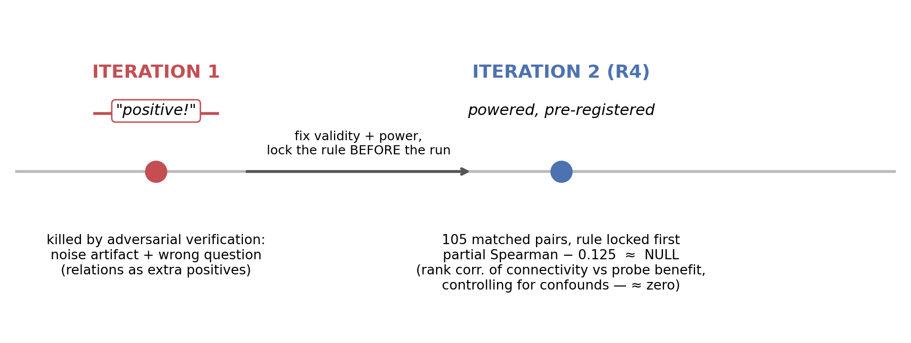
Act 1 — the honest null
1:00
Notes:
Iteration 1 looked positive — and died under adversarial verification: a noise artifact, plus we'd operationalised 'knowing the relations' as extra POSITIVE passages. Iteration 2 fixed validity and power — 105 matched pairs, decision rule locked before the run — and the answer was a clean null: connectivity does not predict probe benefit. We pre-registered, so we report it as a result, not a failure. Hold that thought, because the null gets EXPLAINED in two slides. (1:00)

Slide 5
Act 2 — the reframe that worked: relations as hard negatives
1:15
ΔF1 vs random negatives | E4B (peer replication) | Gemma-2-9B (this work)
direct-neighbour negatives | +0.057 | +0.059
graph-aware mixed | +0.043 | +0.039
held-out-edge (connectivity) | +0.008 | +0.012
Path-2 controls (Gemma-2-9B):
declared graph beats shuffled placebo graphs, p = 0.002
~⅓ of the effect is shared vocabulary
The mechanism is contrast, not coverage: train each concept's probe with its actual siblings as the negative class.
Robust: two models, two codebases, fully independent runs — same numbers.
Honest bounds: ~⅓ lexical, and the effect lives entirely in DIRECT adjacency →
Notes:
The peer replication's diagnosis: the mechanism isn't extra positives, it's hard negatives — train Manipulation's probe with its actual siblings as the negative class. That works: +0.06 F1, and the declared graph beats shuffled placebo graphs at p=0.002 — the curated edges are real confusability structure, not just 'any graph'. Two honest bounds: about a third of the effect is shared vocabulary, and — right column — the effect lives entirely in DIRECT adjacency. Same numbers, two models, two codebases, fully independent runs. (1:15)

Slide 6
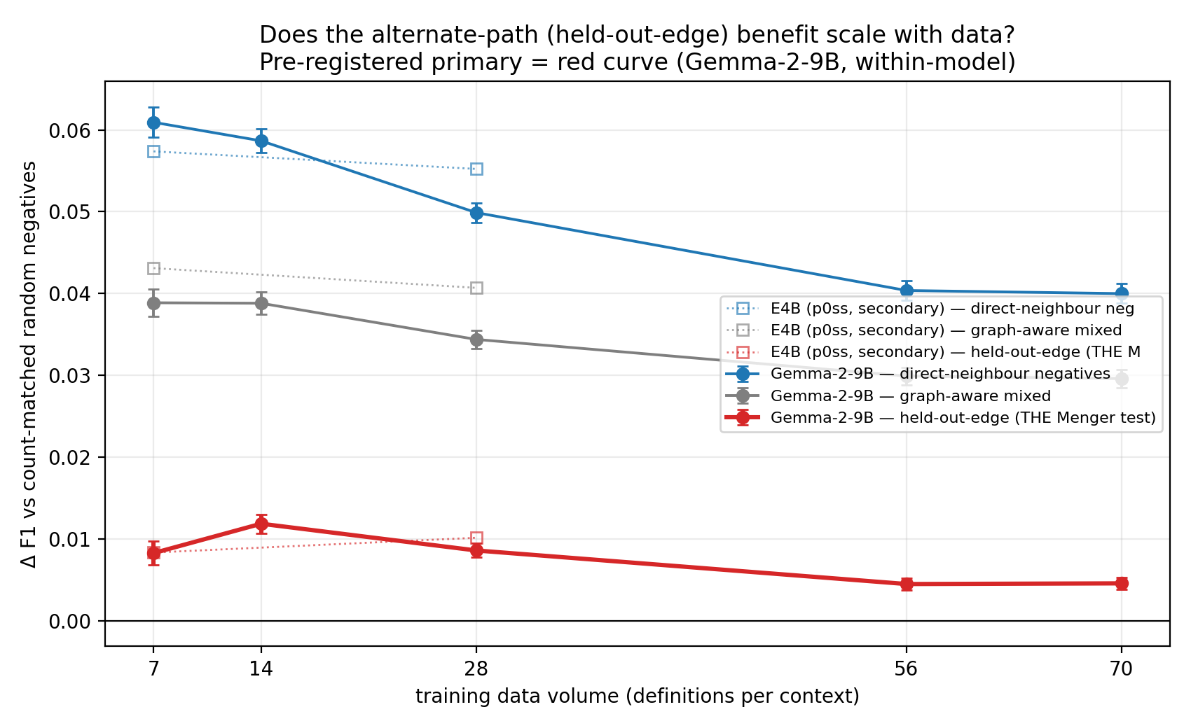
Act 3 — connectivity isolated: does it scale?
1:15
held-out-edge = train with all graph-aware negatives EXCEPT the tested sibling
If alternate paths carry signal, they should reconstruct the withheld boundary
They don't — at any volume:
10× sweep: top volume +0.005, 95% CI [−0.005, +0.014] — spans zero
Power shown: could detect 0.014; the direct effect is 3× that
VERDICT: pre-registered NULL
E4B points = peer-replication corroboration; headline trend is within-model (Gemma-2-9B)
Notes:
The clean test of CONNECTIVITY — as opposed to adjacency — is the held-out-edge condition: train with all graph-aware negatives EXCEPT the sibling you're tested against. If alternate paths carry signal, they should partially reconstruct that withheld boundary. They don't: about +0.01.
And the obvious rebuttal — 'you just need more data' — is what iteration 4 killed: we scaled to 10x under a locked pre-registration, and the line stays flat — at the top volume it's +0.005 with a confidence interval spanning zero. Say only that aloud; per-volume numbers and p-values live on the slide. And the power is shown, not asserted: the design could detect 0.014, and the direct effect — three times that size — shows the instrument works. Within-model, pre-registered: the alternate-path prediction is refuted. (1:15)

Slide 7
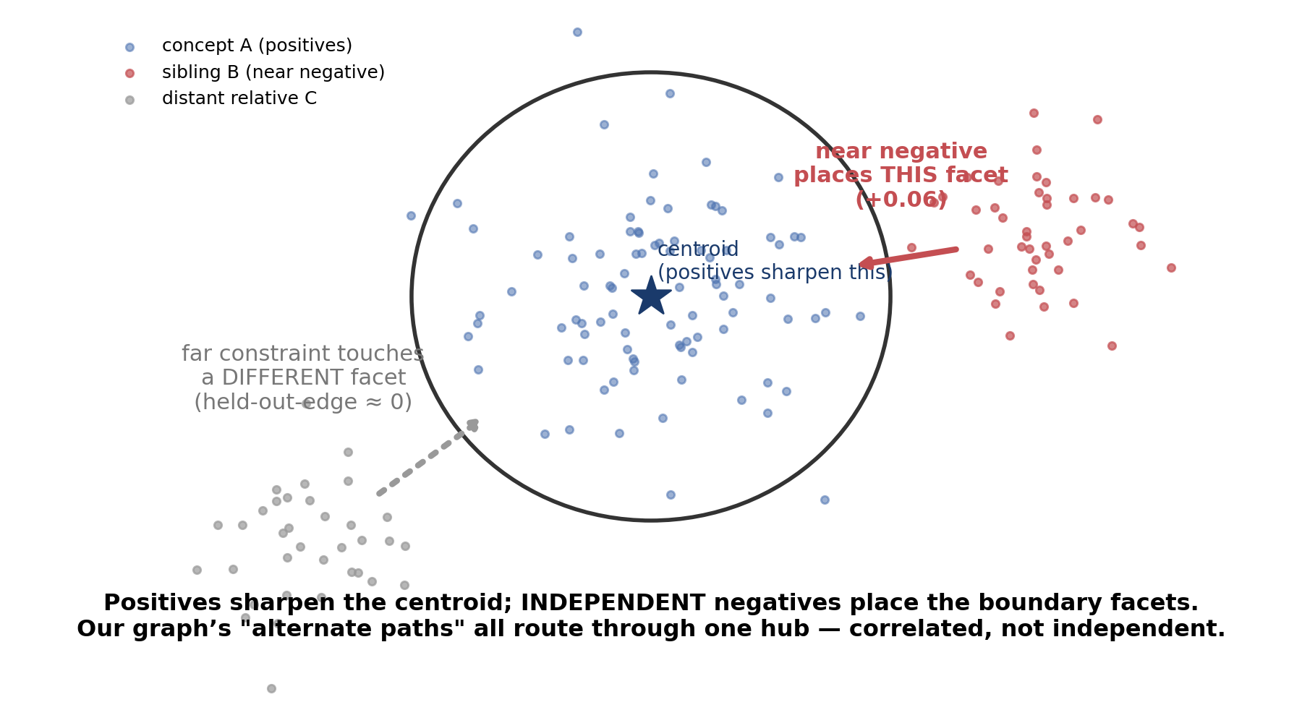
Why — the boundary-coverage picture
0:35
Notes:
One model predicts everything you've seen: a probe's boundary is set by the negatives nearest each facet. Extra positives — nothing (iterations 1-2). Sibling negatives — the facet you're tested on (+0.06). Held-out-edge — the surviving constraints face the wrong way, and in our graph the alternate paths all pass through the ManipulativeCommunication hub, so they're correlated. Menger counted paths; what matters is INDEPENDENT constraints.
Bonus beat if time allows: the direct effect itself shrinks as data grows — +0.061 at 7/context to +0.040 at 70 — so smart negatives matter most exactly when data is scarce, which is the realistic regime for long-tail safety concepts. (0:35)

Slide 8
So what — you seal exactly the faces you train against
1:00
Negative set (FPR @ 95% TPR) | neighbours | off-graph confusers | far-OOD
random | 0.19 | 0.27 | 0.18
graph siblings (cheap) | 0.05 | 0.26 | 0.19
model-mined (expensive) | 0.16 | 0.06 | 0.24
mined + cheap “other” tier | 0.15 | 0.07 | 0.00
FPR@95%TPR = false-positive rate at an operating point keeping 95% of true positives
A flat 15-probe argmax has no “none of these” — it labels a dog passage as manipulation. A cheap OTHER class fixes that completely.
Recipe: cheap tiers everywhere → audit for the gap → spend mining only on the gap (a 20-point FP cut).
Notes:
This cashes out practically. A flat 15-probe argmax has no 'none of these' — it confidently labels a dog passage as manipulation; a cheap OTHER class fixes that completely. And negative selection is a budget allocation: graph siblings seal the neighbour face for free; the cheap 'other' tier seals far-OOD; but the graph gives ~zero protection against the model's ACTUAL off-graph confusers — only model-mining seals those, a 20-point FP cut. So: cheap tiers everywhere, audit for the gap, spend mining only on the gap. (1:00)

Slide 9
What this taught me
0:45
Pre-register before powered runs — saved us twice
Adversarially verify your positives — killed a false one
A bounded answer + a mechanism beats an unbounded yes
Next:
contrast-prompted generation test · near-out-of-set rejection test (controls generated + audited) · count independent constraints, not edges
Notes:
The meta-result for this room: iteration 1's false positive would have been a fun talk and wrong. The discipline — pre-registration, adversarial verification, honest bounding — is what let two fully independent runs converge on numbers we trust. The relationships turned out to matter not as classifiers but as a map: where to look next. Thanks — questions. (0:45)

