Slide 1
Does relational structure improve linear-probe
detection of related AI-safety concepts?
Jason Boudville
Four iterations, two models, independently replicated — a bounded result.
Notes:
This talk asks whether relational structure between concepts improves linear-probe detection of related AI-safety concepts. Across four iterations — every powered run pre-registered, with independent peer replication on a second model — we reach a bounded result: relations help, but only as local hard-negative contrast; the graph's connectivity contributes no measurable benefit. (0:15)

Slide 2
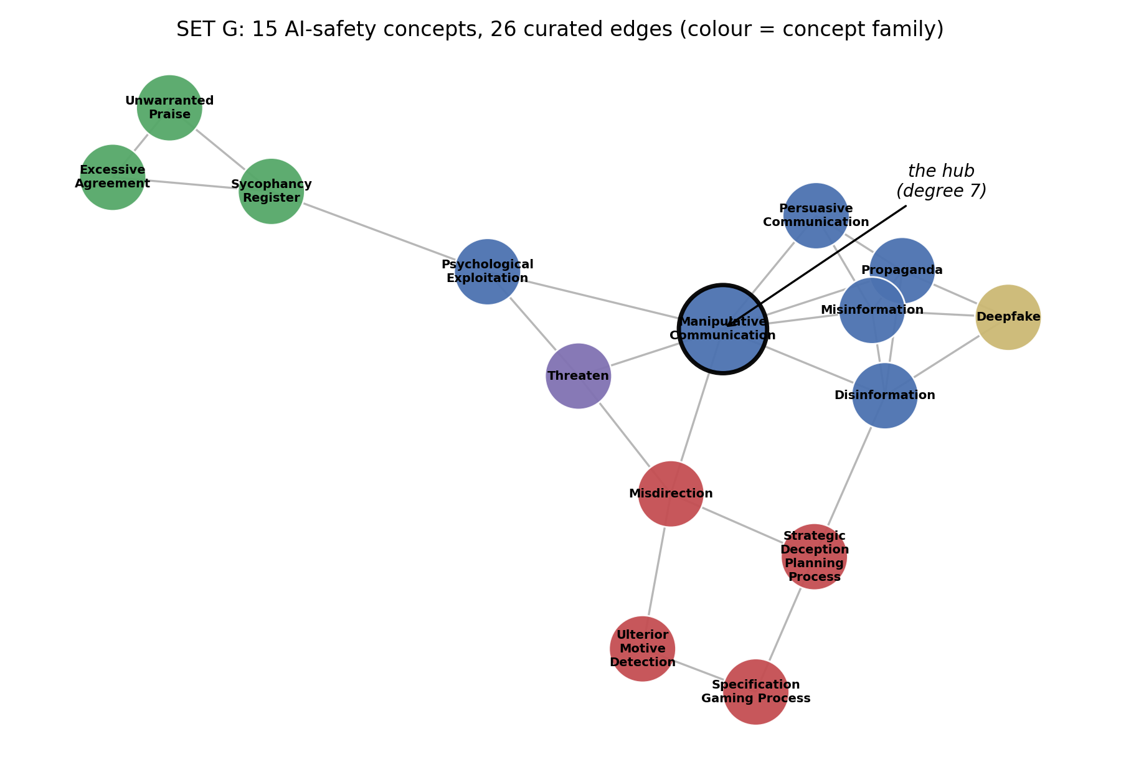
Motivation
0:55
Safety monitoring needs a detector — a lens — per behaviour of concern.
These concepts are not independent: they form a relational graph.
Hypothesis: relational structure can be exploited —
  train each lens against its relatives; use connectivity to reduce data.
Relational structure is cheap to specify; labelled data is not.
Notes:
Deployable safety monitoring requires a detector — a lens — for each behaviour of concern. These concepts are not independent: manipulation, deception, and sycophancy form a graph of overlapping, related categories. The hypothesis under test is that this relational structure can be exploited — that training each lens against its relatives, and exploiting connectivity between concepts, improves detection and reduces the data required. The appeal is straightforward: relational structure is inexpensive to specify, whereas labelled data is costly. (0:55)

Slide 3
The HatCat programme and the relational hypothesis
1:15
HatCat — an interpretability programme building a navigable, interpretable map of the concepts a model represents.
Not a single probe — an atlas of per-concept lenses, connected by a relational graph.
Premise: relational knowledge improves —
  · discrimination (training against neighbouring concepts)
  · coverage efficiency (the graph indicates where to probe; connectivity reaches
  concepts lacking direct data)
This capstone evaluates the sharpest, most falsifiable form of that premise:
does the graph measurably help, and does connectivity scale?
Notes:
The hypothesis originates in HatCat, an interpretability programme whose objective is a navigable, interpretable map of the concepts a model represents — not a single probe, but an atlas of per-concept lenses connected by a relational graph. HatCat's central premise is that relational knowledge improves both discrimination, through training against neighbouring concepts, and coverage efficiency, since the graph indicates where to probe and connectivity provides access to concepts that lack direct data. This capstone evaluates the sharpest, most falsifiable form of that premise: does relational structure measurably improve a linear probe, and does the benefit scale with graph connectivity? (1:15)

Slide 4
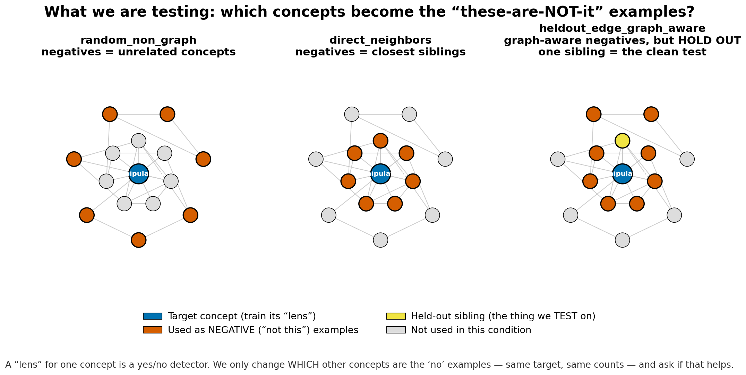
Experimental setup
0:30
15 AI-safety concepts · curated 26-edge graph
4 surface-distinct contexts per concept
Out-of-distribution: train on 3 contexts, test on the held-out 1
Layer-18 mean-pooled residual stream · logistic-regression probes
Gemma-2-9B (+ Gemma-4-E4B peer replication) · 30 seeds
Notes:
The setup follows standard interpretability practice: the mean-pooled residual stream at layer 18 of Gemma-2-9B, logistic-regression probes, 30 seeds, over 15 concepts and a curated 26-edge graph. The critical design decision is out-of-distribution evaluation. Passages are generated across four surface-distinct contexts; probes are trained on three and tested on the held-out fourth. Without this control, surface vocabulary saturates discrimination to near-perfect accuracy and the experiment retains no headroom. (0:30)

Slide 5
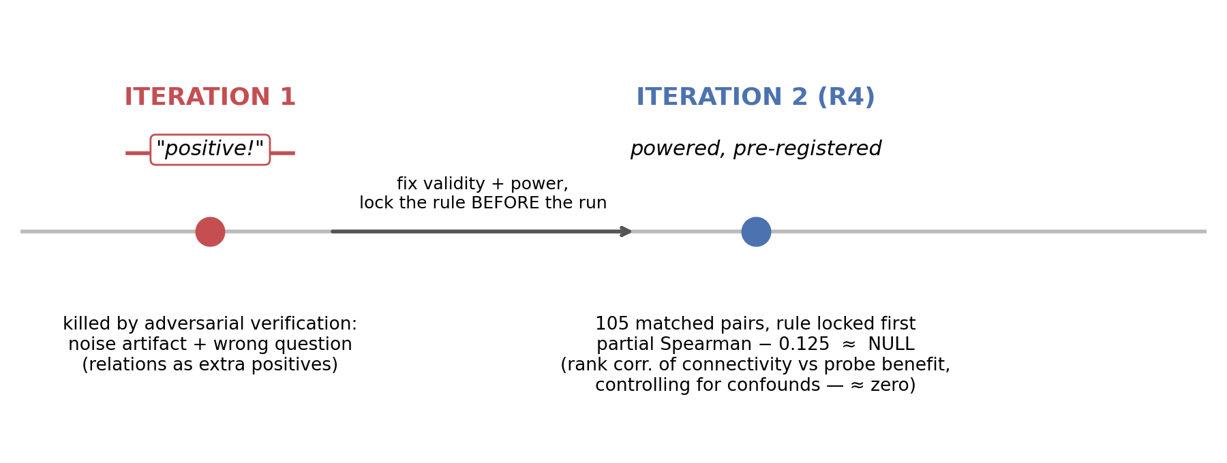
Iterations 1–2: a powered, pre-registered null
1:00
Notes:
Iteration 1 initially indicated a positive effect. Adversarial verification identified it as a noise artifact, compounded by a mis-specification: relational knowledge had been operationalised as additional positive examples rather than as contrastive structure. The design was rebuilt. Iteration 2 was a pair-matched, powered test over 105 pairs, with the decision rule fixed in advance. It returned a clean null — a partial Spearman correlation of minus 0.125 between connectivity and probe benefit. Because the analysis was pre-registered, the null is reported as a result. It is subsequently explained, rather than merely recorded. (1:00)

Slide 6
Iteration 3: relations as hard negatives
1:10
ΔF1 vs random negatives | E4B (peer replication) | Gemma-2-9B (this work)
direct-neighbour negatives | +0.057 | +0.059
graph-aware mixed | +0.043 | +0.039
held-out-edge (connectivity) | +0.008 | +0.012
Path-2 controls (Gemma-2-9B):
curated graph beats placebo permutations, p = 0.002
~⅓ of the effect is shared vocabulary (upper bound)
Mechanism: contrast, not coverage — each probe is trained against its graph siblings as negatives.
Replicated across two models and two codebases.
Bounds: ~⅓ lexical; the benefit is confined to DIRECT adjacency.
Notes:
The correct operationalisation uses related concepts as hard negatives rather than additional positives — contrast, not coverage. Training each concept's probe against its graph siblings improves discrimination by approximately 0.06 F1. A placebo-graph permutation confirms the effect is specific to the curated relationships, at p equals 0.002, rather than an artifact of any graph. Two bounds apply. Approximately one third of the effect is attributable to shared vocabulary — an upper bound, since the vocabulary regression over-controls. And the benefit is confined to direct adjacency. The pattern replicates across both models and codebases. (1:10)

Slide 7
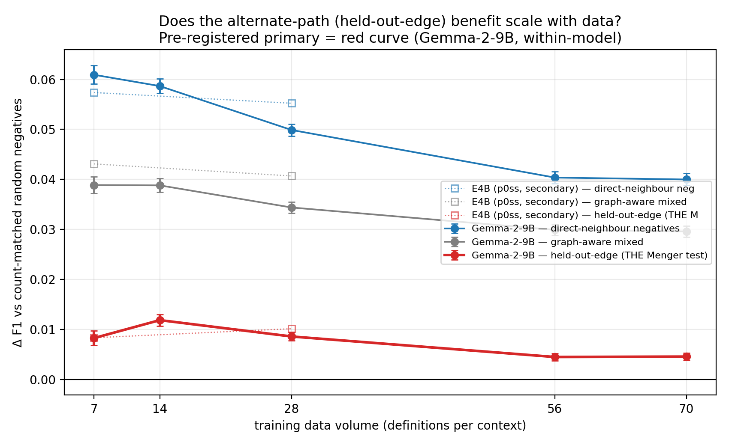
Iteration 4: does the connectivity benefit scale?
1:15
held-out-edge: graph-aware negatives EXCLUDING the evaluated sibling
(the clean alternate-path / Menger test)
Pre-registered 10× within-model scaling sweep:
top volume +0.005, 95% CI [−0.005, +0.014] — spans zero
minimum detectable effect 0.014; direct effect resolved at 3×
Result: pre-registered NULL — alternate-path prediction refuted at power
E4B = peer-replication corroboration; headline trend is within-model (Gemma-2-9B)
Notes:
The clean test of connectivity, as distinct from adjacency, is the held-out-edge condition: the probe is trained on all graph-aware negatives except the sibling against which it is evaluated. If connectivity carries transferable signal, the remaining relationships should partially reconstruct the withheld boundary. They do not — the effect is approximately 0.01. To address the possibility that this reflects insufficient data, we pre-registered a within-model scaling sweep to ten times the original volume. The held-out-edge delta does not increase; at the top volume it is 0.005, with a 95% confidence interval spanning zero. The minimum detectable effect at this power was 0.014, and the same design resolves the direct-neighbour effect at three times that magnitude. The alternate-path, or Menger, prediction is therefore refuted at adequate power. (1:15)

Slide 8
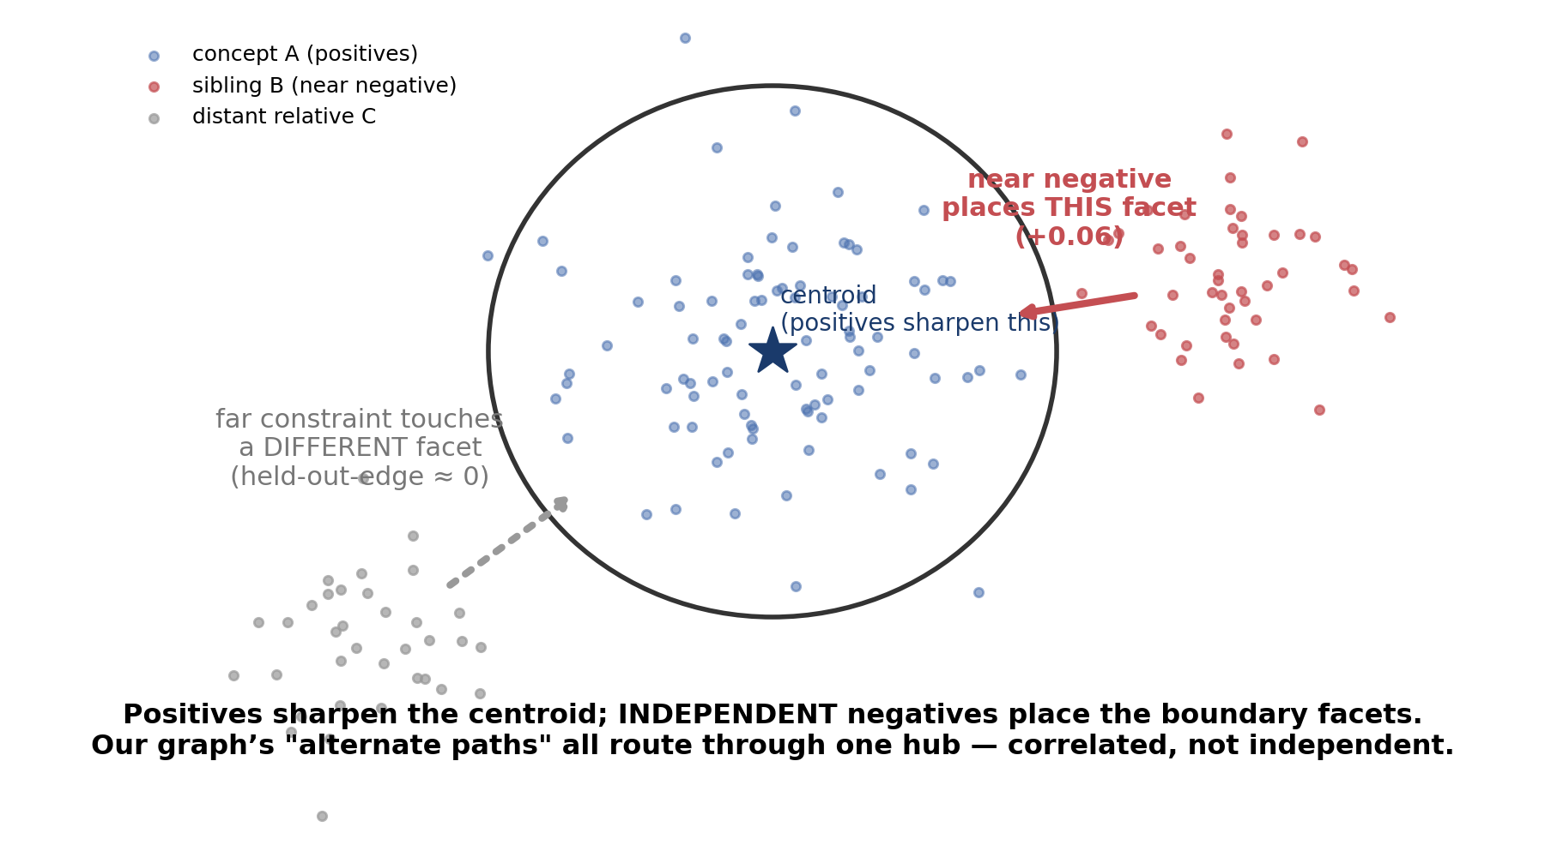
Mechanism: independent-constraint boundary coverage
0:35
Notes:
A single model accounts for the full pattern. A concept is represented as a centroid with a surrounding distribution; the probe's boundary lies at the distribution's tail. Positive examples sharpen the centroid but do not relocate the boundary; each negative constrains the boundary facet it faces. This predicts that additional positives have no effect once the centroid is well estimated, that sibling negatives improve the tested boundary, and that the benefit decreases with distance from it. The held-out-edge effect is null because, in this graph, the alternate paths route through the ManipulativeCommunication hub: the constraints are correlated rather than independent. Connectivity matters only insofar as it counts independent constraints. (0:35)

Slide 9
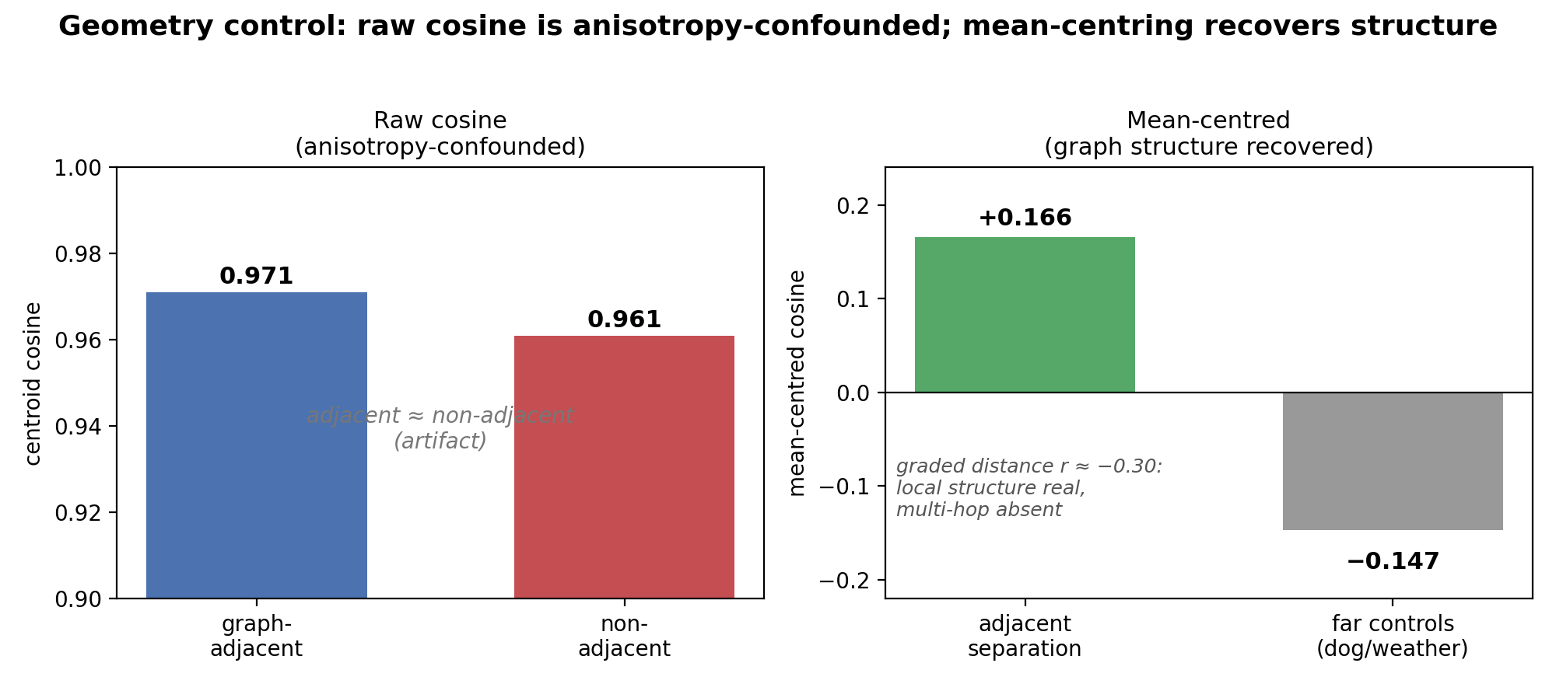
Geometry control: the anisotropy correction
0:55
Notes:
An unsupervised geometric check both corroborates the mechanism and illustrates the analysis discipline. Raw cosine similarity between concept centroids suggested near-total overlap — 0.971 for adjacent versus 0.961 for non-adjacent pairs — which would imply the graph is not represented in the model. This is an anisotropy artifact: transformer activations occupy a narrow cone, inflating all similarities. After mean-centring, the structure is recovered: adjacent pairs separate by 0.166, far-domain controls fall well outside the cluster at minus 0.147, while graded graph distance remains uncorrelated with representation. The geometry independently reproduces the probe result — local structure is real, multi-hop structure is absent — and the probe results themselves are unaffected, since a linear classifier removes the common direction. This is the second instance in which a raw metric was misleading and a control proved decisive. (0:55)

Slide 10
Deployment: rejection scaffolds and tiered negatives
0:55
FPR @ 95% TPR | neighbours | off-graph confusers | far-OOD
random | 0.19 | 0.27 | 0.18
graph siblings (cheap) | 0.05 | 0.26 | 0.19
model-mined (expensive) | 0.16 | 0.06 | 0.24
mined + cheap “other” tier | 0.15 | 0.07 | 0.00
FPR @ 95% TPR = false-positive rate at a 95%-true-positive operating point
A flat 15-way classifier has no rejection option; a coarse “other” class rejects out-of-family inputs at full recall.
Tiered recipe: inexpensive negatives throughout → audit the off-graph gap → mine only that gap (20-point FP reduction).
Notes:
The findings yield a practical recipe. A flat 15-way classifier has no rejection option and assigns every out-of-domain input to some concept; a coarse 'other' class rejects out-of-family inputs at full recall with no false rejection of genuine concepts. With negative count held fixed, false-positive rate at a 95%-true-positive operating point shows that each scheme seals only the faces it trains against. Graph siblings seal the neighbour face but not off-graph confusers, against which they perform no better than random. Model-mined confusers seal that face — a 20-point reduction — but not the others. And a cheap 'other' tier seals the far-out-of-distribution face entirely. The recommended pipeline is therefore tiered: inexpensive negatives throughout, an audit to locate the off-graph gap, and expensive mining applied only to that gap. Calibration drift is a material failure mode: operating points set on training data degrade substantially under distribution shift. (0:55)

Slide 11
Conclusions and future work
0:50
Relational structure helps only as local hard-negative contrast (~0.06 F1, ~⅓ lexical, two models).
The graph's connectivity contributes no measurable benefit at any data volume tested.
Pre-registration and adversarial verification were each decisive — twice a raw signal was misleading.
The relational structure is a map of where to extend coverage, not a classifier —
  the cartographic objective of HatCat.
Future work: contrast-prompted generation · near-but-out-of-set rejection test · counting independent constraints.
Notes:
In summary: relational structure improves safety-concept probes only as local hard-negative contrast — approximately 0.06 F1, roughly one third lexical, replicated across two models — while the graph's connectivity contributes no measurable benefit at any data volume tested. Methodologically, pre-registration and adversarial verification were each decisive: on two occasions a raw signal was misleading and was identified by a control. Finally, the relational structure is better understood not as a classifier but as a map of where to extend coverage — which is the cartographic objective of the HatCat programme. Future work includes contrast-prompted generation, a near-but-out-of-set rejection test, and a connectivity test that counts independent constraints rather than raw edges. (0:50)

