Slide 1
Does relational structure improve
safety-concept probes?
Jason Boudville
Four iterations, two models, independently replicated — and a bounded answer.
Notes:
Here's the short version, so you know where we're headed. We took an idea that sounds obviously true, and we tested it hard enough to trust the answer — including the part of the answer that turned out to be no. (0:15)

Slide 2
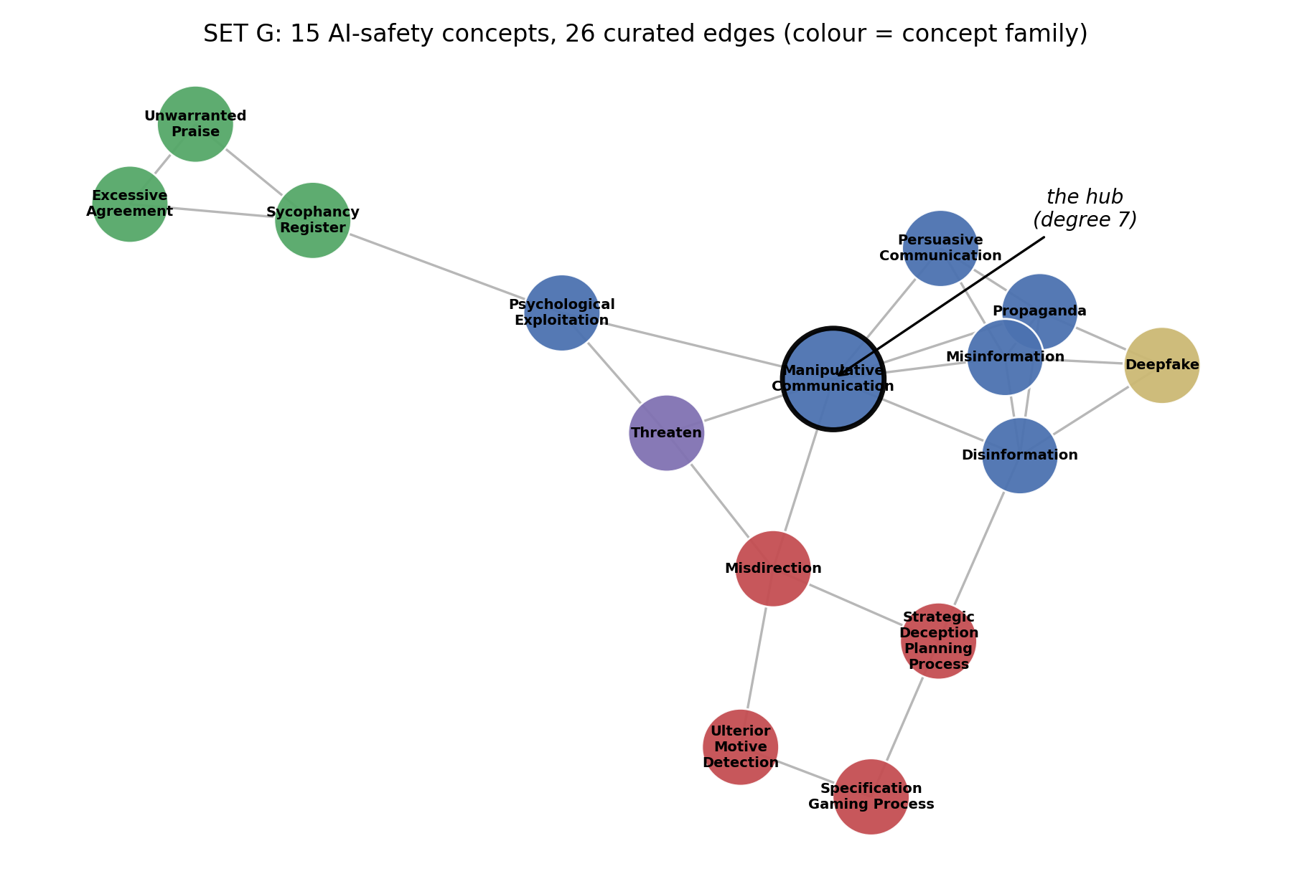
The question
0:55
The hypothesis:
Probes for related concepts should help each other —
and the benefit should scale with connectivity (alternate paths).
Like inferring a border from the neighbours' borders.
Graphs are cheap. Data is not.
Notes:
Safety monitoring wants a detector for each behaviour we care about — a lens for manipulation, one for deception, one for sycophancy. But these concepts aren't strangers to each other. They overlap, they blur at the edges, they form a graph. So here's the idea: you lean on that graph. You train each lens against its relatives. And where two concepts are joined by lots of independent paths, you pin the boundary between them without ever showing the probe that boundary directly. It's the appealing kind of idea. Structure is free. Data isn't. (0:55)

Slide 3
The bigger picture — HatCat
1:15
HatCat — an interpretability programme building a navigable map of the concepts a model represents.
Not one probe — an atlas of per-concept “lenses,” wired together by a relational graph.
The bet: know how concepts relate →
  · train better lenses (each against its neighbours)
  · cover the space more cheaply — the graph says where to look,
  the connections reach concepts you have no direct data for.
Our capstone tests the sharpest, most falsifiable slice of that bet:
Does the graph actually help — and does connectivity scale?
Notes:
A word on where this comes from, because it's the whole reason the question matters. It isn't ours. It sits inside a programme called HatCat — an attempt to build something like a map of the concepts a model carries in its head. Not one detector bolted on the side, but a whole atlas of them: a lens per concept, and a graph wiring the related ones together. The bet is simple, and ambitious. Know how the concepts relate, and you can build better detectors — you train each one against its neighbours. And you cover the space more cheaply. The graph tells you where to look. The connections let you reach concepts you've got no direct data for. That last part — reaching a concept through its connections — is the boldest claim. It's the one we set out to test, in its sharpest, most falsifiable form. Does the graph actually earn its keep? And does the connectivity scale? (1:15)

Slide 4
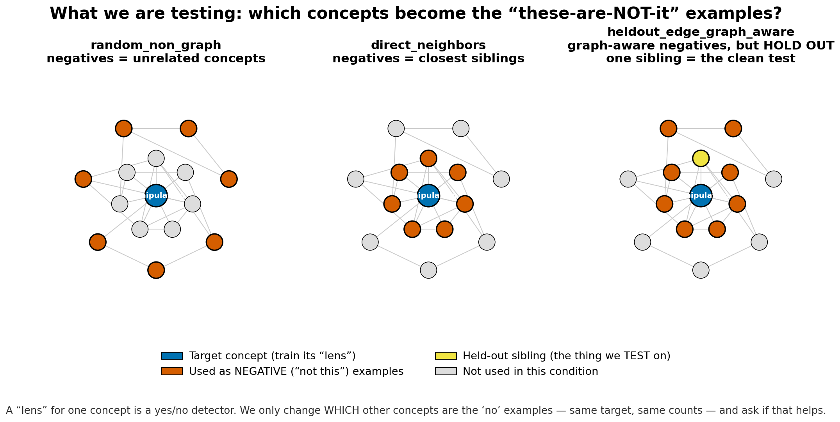
Setup in 30 seconds
0:30
15 AI-safety concepts · 26-edge curated graph
Passages in 4 surface-distinct contexts
Train on 3 contexts, test on the held-out one (OOD)
Linear probes, layer-18 residual stream
Gemma-2-9B (+ independent E4B replication) · 30 seeds
Notes:
Thirty seconds of setup, all of it the ARENA toolkit. Mean-pooled residual stream, logistic regression on top. The one choice that matters: we always test out of distribution — train the probe in three settings, test it in a fourth it's never seen. Skip that and surface vocabulary does all the work, every probe scores perfect, and you've measured nothing. (0:30)

Slide 5
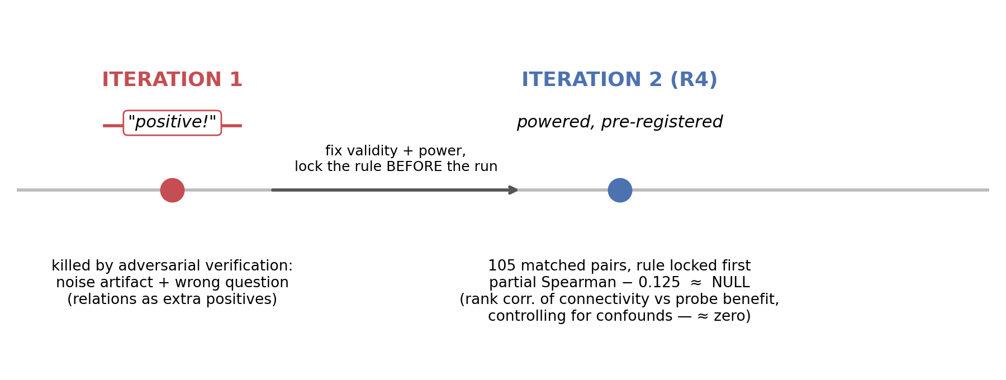
Act 1 — the honest null
1:00
Notes:
Iteration one looked positive. It was wrong. We pulled it apart and found noise, not signal — and worse, we'd asked the wrong question, feeding the probe more examples of each concept instead of teaching it the boundary. So we rebuilt it properly. Iteration two: a hundred and five matched pairs, powered, the decision rule locked before we looked. The answer came back a clean null — connectivity does not predict how much a probe improves. Because we'd pre-registered, there was nowhere to hide it and no reason to. Hold onto that null. A few slides from now it stops being a disappointment and becomes the point. (1:00)

Slide 6
Act 2 — the reframe that worked: relations as hard negatives
1:10
ΔF1 vs random negatives | E4B (peer replication) | Gemma-2-9B (this work)
direct-neighbour negatives | +0.057 | +0.059
graph-aware mixed | +0.043 | +0.039
held-out-edge (connectivity) | +0.008 | +0.012
Path-2 controls (Gemma-2-9B):
declared graph beats shuffled placebo graphs, p = 0.002
~⅓ of the effect is shared vocabulary
The mechanism is contrast, not coverage: train each concept's probe with its actual siblings as the negative class.
Robust: two models, two codebases, fully independent runs — same numbers.
Honest bounds: ~⅓ lexical, and the effect lives entirely in DIRECT adjacency →
Notes:
Here's what we'd missed. The fix isn't more examples of a concept — it's the right negatives. Train manipulation's probe against its actual siblings, the concepts it keeps getting confused with, and discrimination jumps about six points of F1. And the graph earns its keep: shuffle the edges into a fake graph and the effect vanishes — p of nought-point-zero-zero-two — so these particular relationships are real, not just any old structure. Two honest caveats, because that's the job. About a third of the lift is shared vocabulary, not deep structure. And — this is the column on the right — all of it lives in direct neighbours. Same numbers, two models, two codebases, run independently. (1:10)

Slide 7
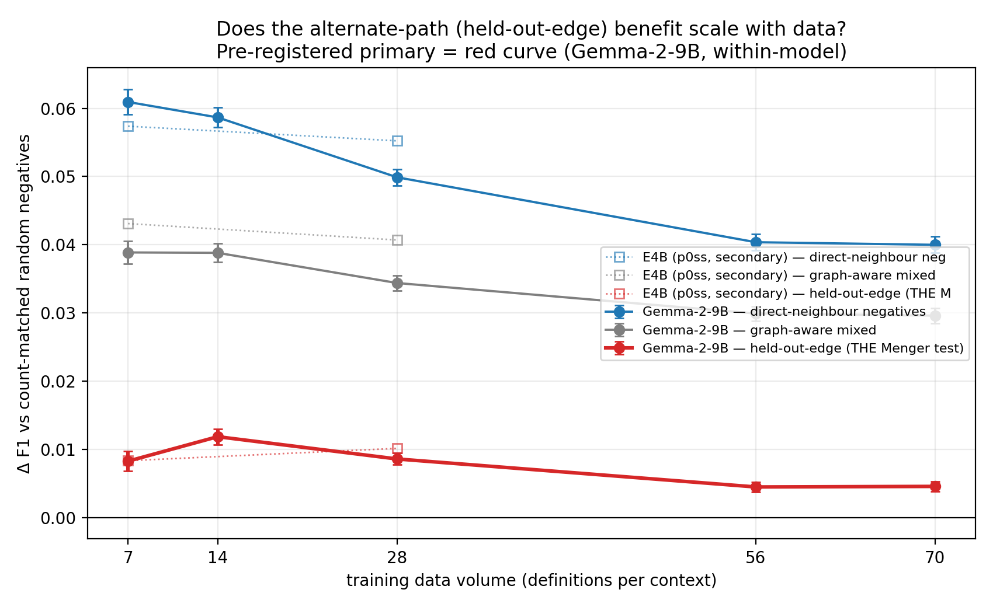
Act 3 — connectivity isolated: the pre-registered NULL
1:15
held-out-edge = train with all graph-aware negatives EXCEPT the tested sibling
If alternate paths carry signal, they should reconstruct the withheld boundary
They don't — at any volume:
10× sweep: top volume +0.005, 95% CI [−0.005, +0.014] — spans zero
Power shown: could detect 0.014; the direct effect is 3× that
VERDICT: pre-registered NULL
E4B points = peer-replication corroboration; headline trend is within-model (Gemma-2-9B)
Notes:
Now the clean test of connectivity, separated from mere adjacency. Train with all the graph's negatives except the very sibling you're being tested on. If the graph's deeper structure carries anything, those other relationships should reconstruct the boundary you held back. They don't — about a hundredth of a point. And the obvious comeback is 'you just didn't have enough data.' So we settled it. We bought ten times the data, pre-registered, one model start to finish. The line didn't move. At the top volume it's five-thousandths of a point, with a confidence interval sitting squarely across zero — say just that. And before anyone asks whether we had the power to see an effect: the design could catch one of fourteen-thousandths, and it picks up the direct effect — three times that — without breaking a sweat. The instrument works. The thing we were testing just isn't there. (1:15)

Slide 8
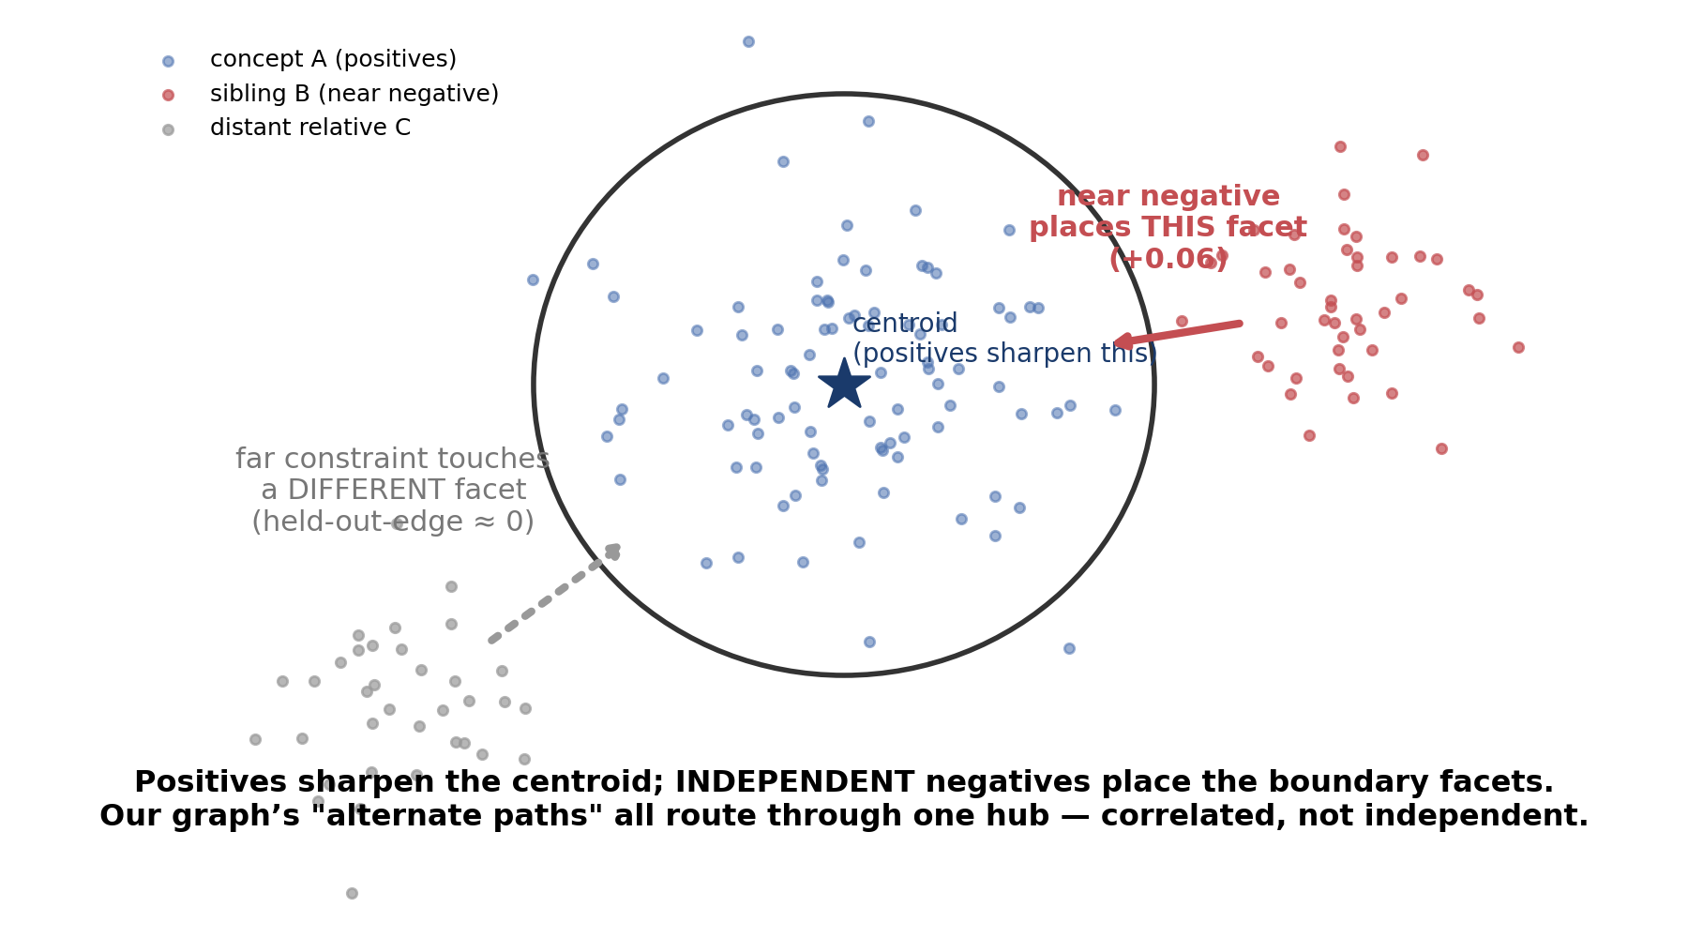
Why — the boundary-coverage picture
0:35
Notes:
One picture explains all of it. A probe's boundary is set by whichever negative sits closest to it. More examples of the concept — nothing; the centre's already sharp. A sibling negative — it leans right on the face you're testing, so it helps. And the held-out-edge stays at zero because in our graph the alternate routes run back through the same hub — manipulation — so those paths aren't independent. They're the same information wearing different hats. Menger counted paths. What a boundary actually needs is independent constraints. (0:35)

Slide 9
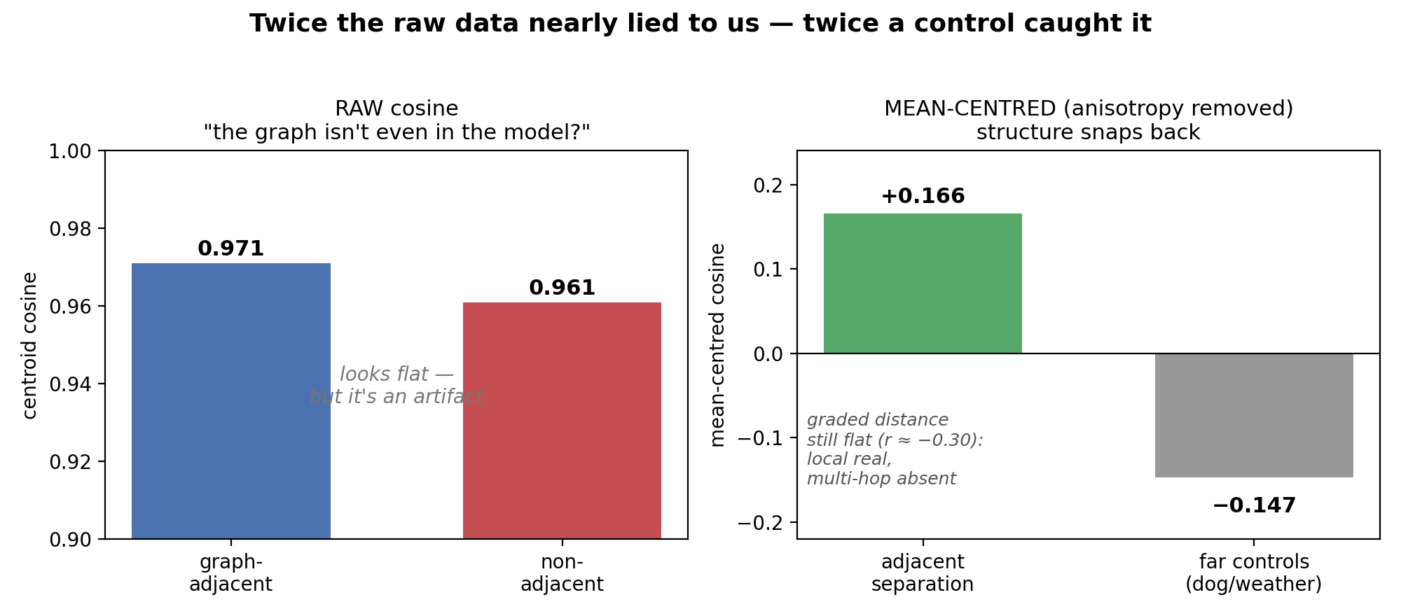
A second time we nearly fooled ourselves
0:55
Notes:
Quick aside, because it's the kind of thing that should make you trust the rest. When we looked at the raw geometry — just the cosine between concept clusters — it said everything overlapped. Adjacent concepts at point-nine-seven, non-adjacent at point-nine-six. For a moment it looked like the graph wasn't even in the model. But that flatness is an artifact: transformer activations get squashed into a narrow cone, so everything looks similar to everything. Subtract that out, and the structure snaps back — related concepts pull apart, and far-away ones, dogs and weather, fall right outside the cluster. Same story the probes told: the local structure is real, the long-range structure isn't. That's twice now the raw data nearly lied to us, and twice a control caught it. That's the job. (0:55)

Slide 10
So what — you seal exactly the faces you train against
0:55
Negative set (FPR @ 95% TPR) | neighbours | off-graph confusers | far-OOD
random | 0.19 | 0.27 | 0.18
graph siblings (cheap) | 0.05 | 0.26 | 0.19
model-mined (expensive) | 0.16 | 0.06 | 0.24
mined + cheap “other” tier | 0.15 | 0.07 | 0.00
FPR@95%TPR = false-positive rate at an operating point keeping 95% of true positives
A flat 15-probe argmax has no “none of these” — it labels a dog passage as manipulation. A cheap OTHER class fixes that completely.
Recipe: cheap tiers everywhere → audit for the gap → spend mining only on the gap (a 20-point FP cut).
Notes:
This pays off in something you can actually build. A flat fifteen-way probe has no 'none of these' — show it a passage about a dog and it'll still confidently call it manipulation. Add one cheap reject class and that problem's gone. After that, picking negatives is just budget. Graph siblings seal the neighbour face for nothing. A cheap 'other' tier seals the far-away stuff completely. But the graph gives you almost no protection against the model's real confusers — the ones it actually trips on — and only the expensive option, mining the model's own confusions, seals those: a twenty-point cut in false positives. So: cheap everywhere, find the gap, spend the expensive money only on the gap. (0:55)

Slide 11
What this taught me
0:50
Twice the data nearly fooled us — both times the discipline caught it.
Pre-register before powered runs — saved us twice
Adversarially verify your positives — killed a false one
A bounded answer + a mechanism beats an unbounded yes
The relationships weren't a classifier. They're a map — of where to look next.
(which is exactly what HatCat set out to build)
Notes:
What I'll take from this. Twice the data nearly fooled us — iteration one's noise, then the geometry artifact — and both times the discipline caught it: pre-register, try to kill your own positives, bound what you claim. That's the only reason I can stand here and trust these numbers. And the relationships — HatCat's whole bet? They turned out not to be a way of telling concepts apart at all. They're a map — of where to look next. Which is exactly what HatCat set out to build. Thanks. Happy to take questions. (0:50)

