Slide 1
Introduction to Unix
Command Line Interface

Slide 2
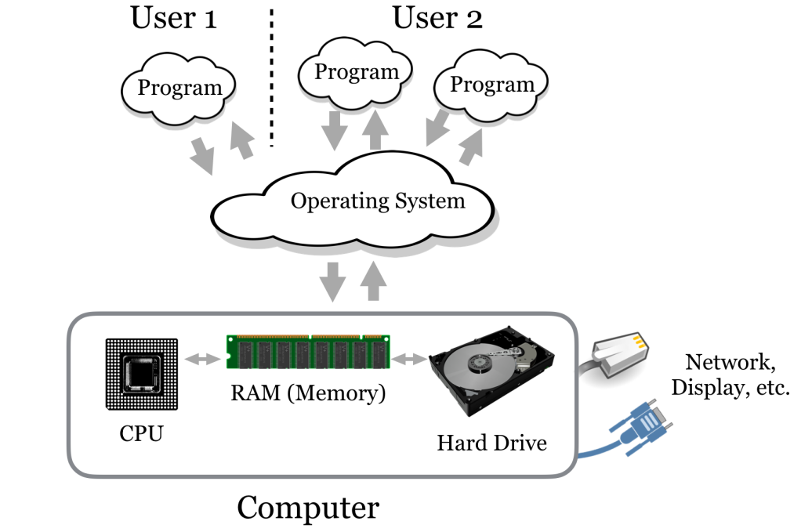
Introduction

Slide 3
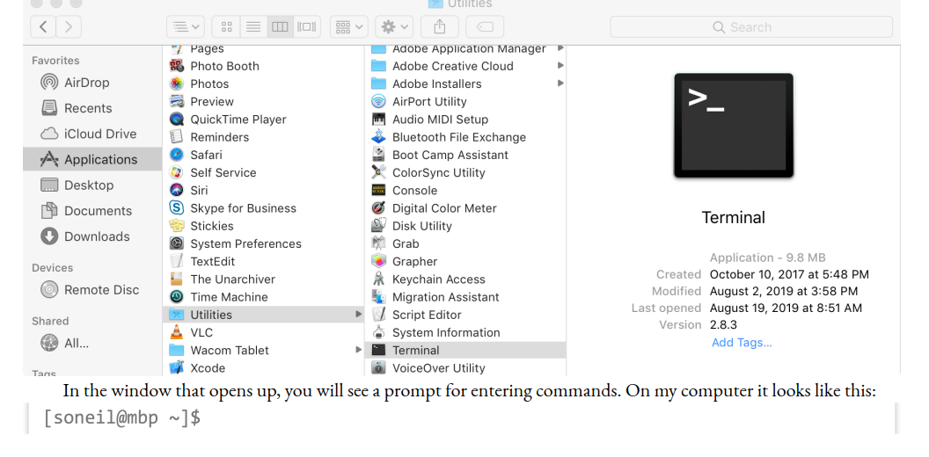

Terminal
Login into Unix Environment
Exit from Environment
Exit from Environment
Then close the window

Slide 4

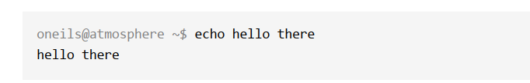
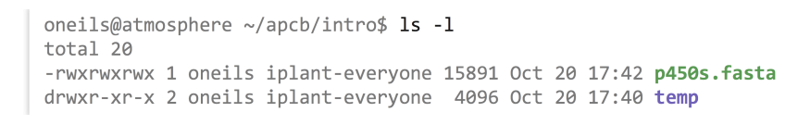
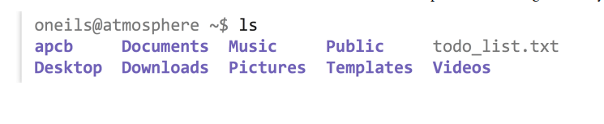

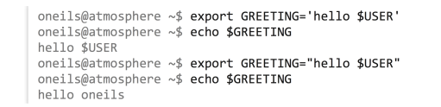

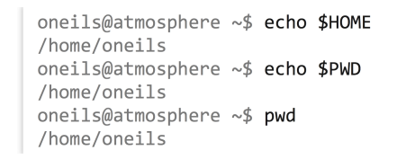
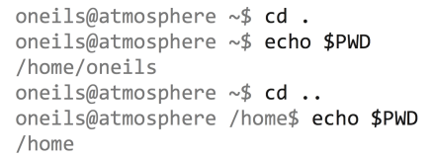

Environment Variables
Command Line Interface
Files & Folders
CLI : Ex5
CLI : Ex1
CLI : Ex6
CLI : Ex2
CLI : Ex7
CLI : Ex3
CLI : Ex8
CLI : Ex4
Refer Page : 17 to 29 / Book : Computational Biology

Slide 5
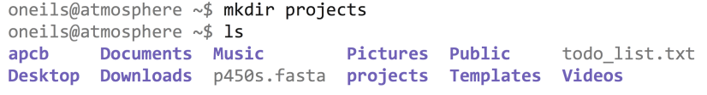



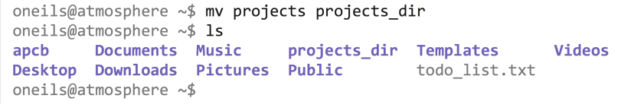
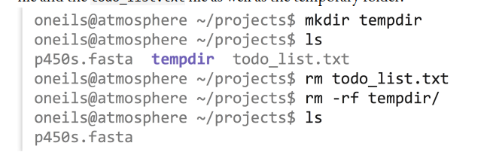
Command Line Interface : Working with Files & Folders
Working with Files
CLI : Ex20
CLI : Ex10
CLI : Ex21
CLI : Ex11
CLI : Ex11
CLI : Ex22
CLI : Ex23
CLI : Ex24
Refer Page : 30 to 31 / Book : Computational Biology

Slide 6

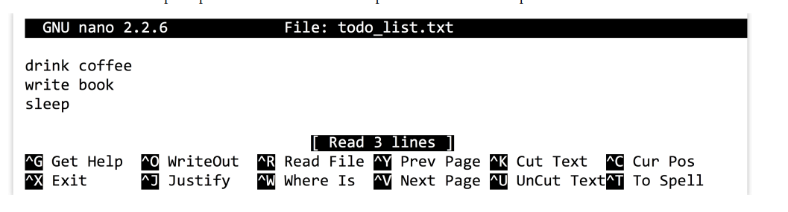
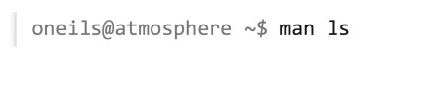
Editing a File (text)
Getting Help on a Command
Refer Page : 32 to 33 / Book : Computational Biology

Slide 7
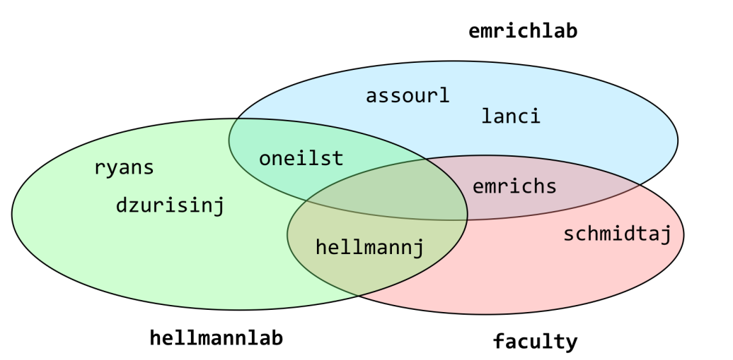
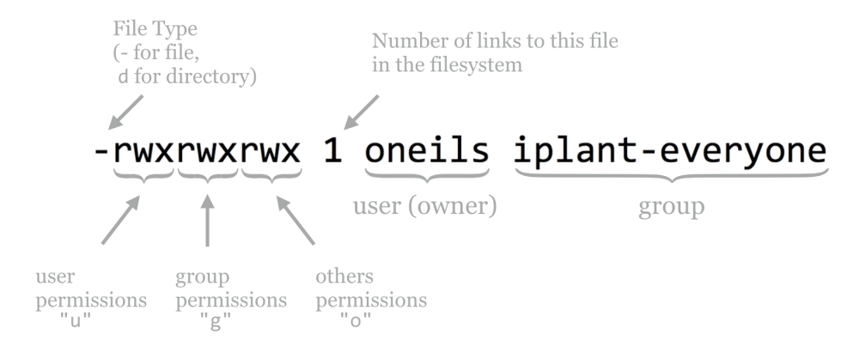
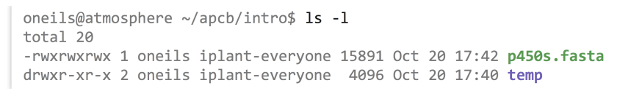
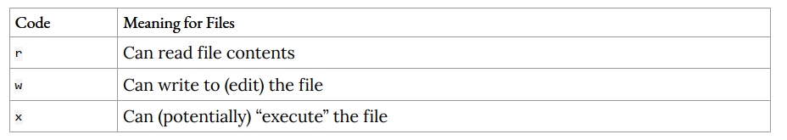
File Permission & Executable
Refer Page : 37 to 39 / Book : Computational Biology

Slide 8
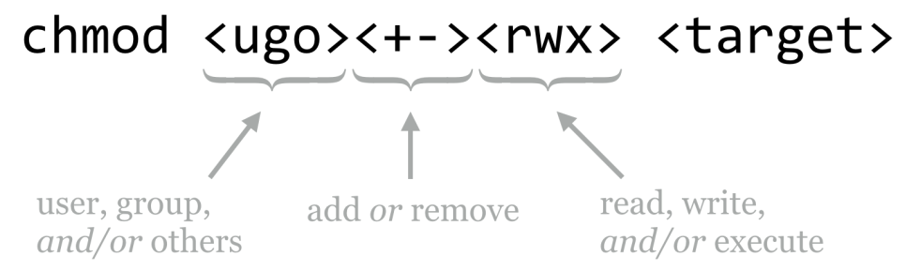
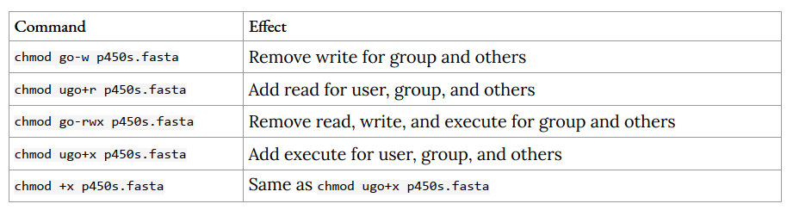
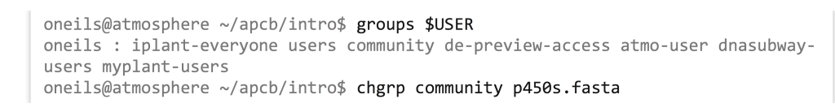
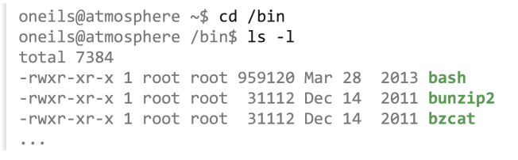
File Permission & Executable
Refer Page : 37 to 39 / Book : Computational Biology

Slide 9
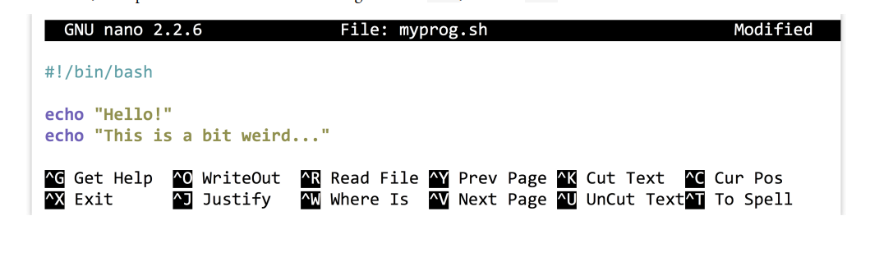
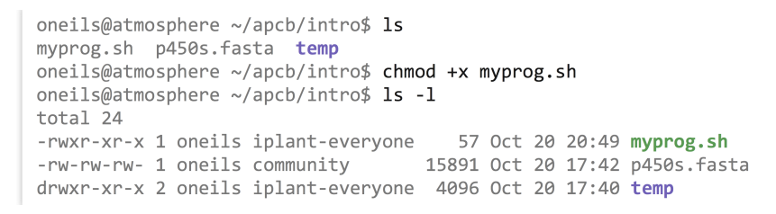
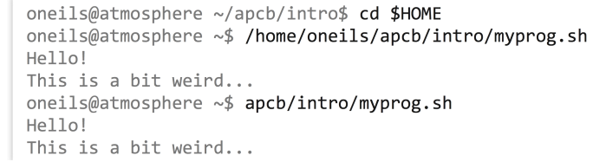
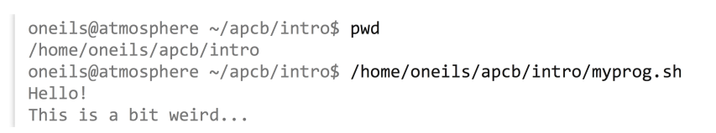

Making a File Executable
CLI : Ex30
CLI : Ex31
CLI : Ex34
CLI : Ex32
CLI : Ex33

