Slide 1

Kakeibo (かけいぼ)
Personal Finance Tracker
AIE1F Frontend Development Project · Team 3
Ho Wai Hong · Choo Yeow Hwee · Prancia Toh Wai Yee
Notes:
~30s. Introduce the team and the app name. Kakeibo is the Japanese household budgeting method.

Slide 2
PROBLEM STATEMENT
Where did my money go this month?
Who it's for
The problem
What Kakeibo does
Individuals and households who want a simple habit of recording income and spending.
Spending is spread across cash, cards and paper receipts, so it's hard to see where the money goes each month.
Log income and expenses, group them into categories, see a monthly summary, and scan receipts instead of typing.
Inspired by kakeibo (家計簿), the Japanese household budgeting method introduced by Hani Motoko in 1904.
Notes:
~1 min. Who the user is, the pain point, and what the app does about it.

Slide 3
TECHNOLOGIES
Stack, libraries and data source
React 19 + Vite
React Router v7
Context + useReducer
json-server
Fast dev server and hot reload, one-command production build
Client-side routes, protected /app area, 404 page
One shared source of truth for transactions and the logged-in user
Mock REST API from data/db.json with full CRUD, no backend to build
Yup
lucide-react · react-spinners
Vitest + Testing Library
Netlify + Functions · Veryfi
Declarative validation for the Add Category form
Consistent icons and loading indicators
Component, context and reducer tests (9 test files)
Hosting, plus a serverless proxy to Veryfi's receipt OCR API
Notes:
~1 min. For each choice, say why in one line. Data source: json-server serving data/db.json (transactions and categories).

Slide 4
HOW IT FITS TOGETHER
Architecture
React app (browser)
Routes → Pages → Components
AuthContext: logged-in user
TransactionContext: useReducer for transactions, categories, filters
Forms: controlled inputs
json-server (mock REST API)
/transactions · /categories from data/db.json
fetch GET / POST / PUT / DELETE
Netlify Function
/api/receipt/parse
API keys stay on the server
Veryfi OCR
Merchant, total and date from a receipt photo
receipt image
Notes:
~45s. The browser never sees the Veryfi keys: the Netlify Function adds them server-side.

Slide 5
PROJECT REQUIREMENTS
How Kakeibo meets each requirement
Requirement | How we met it
Built with Vite | Vite 8: npm run dev / npm run build | ✓
Functional components + hooks | No class components; useState, useReducer, useContext, useMemo, custom useAuth | ✓
Sensibly scoped components | 12 components + 8 pages, e.g. TransactionList → TransactionItem (transaction, onDelete) | ✓
≥ 2 routes with navigation | 8 routes incl. /login, /app/dashboard, /app/transactions, /app/categories; sidebar NavLinks | ✓
Shared state | useReducer in TransactionContext; AuthContext for the user; useState for form fields | ✓
Fetch data + loading / error | json-server REST API; FETCH_START / SUCCESS / ERROR; Spinner and error messages | ✓
Controlled form to create | New Transaction form; Add Category form with Yup validation | ✓
Read + Delete | Transactions table and category grid, delete with confirmation | ✓
Deployed to a public URL | Netlify: <add deployed URL> | TBC
Notes:
~1 min. Don't read every row; point out the component split, the reducer and the loading/error handling.

Slide 6
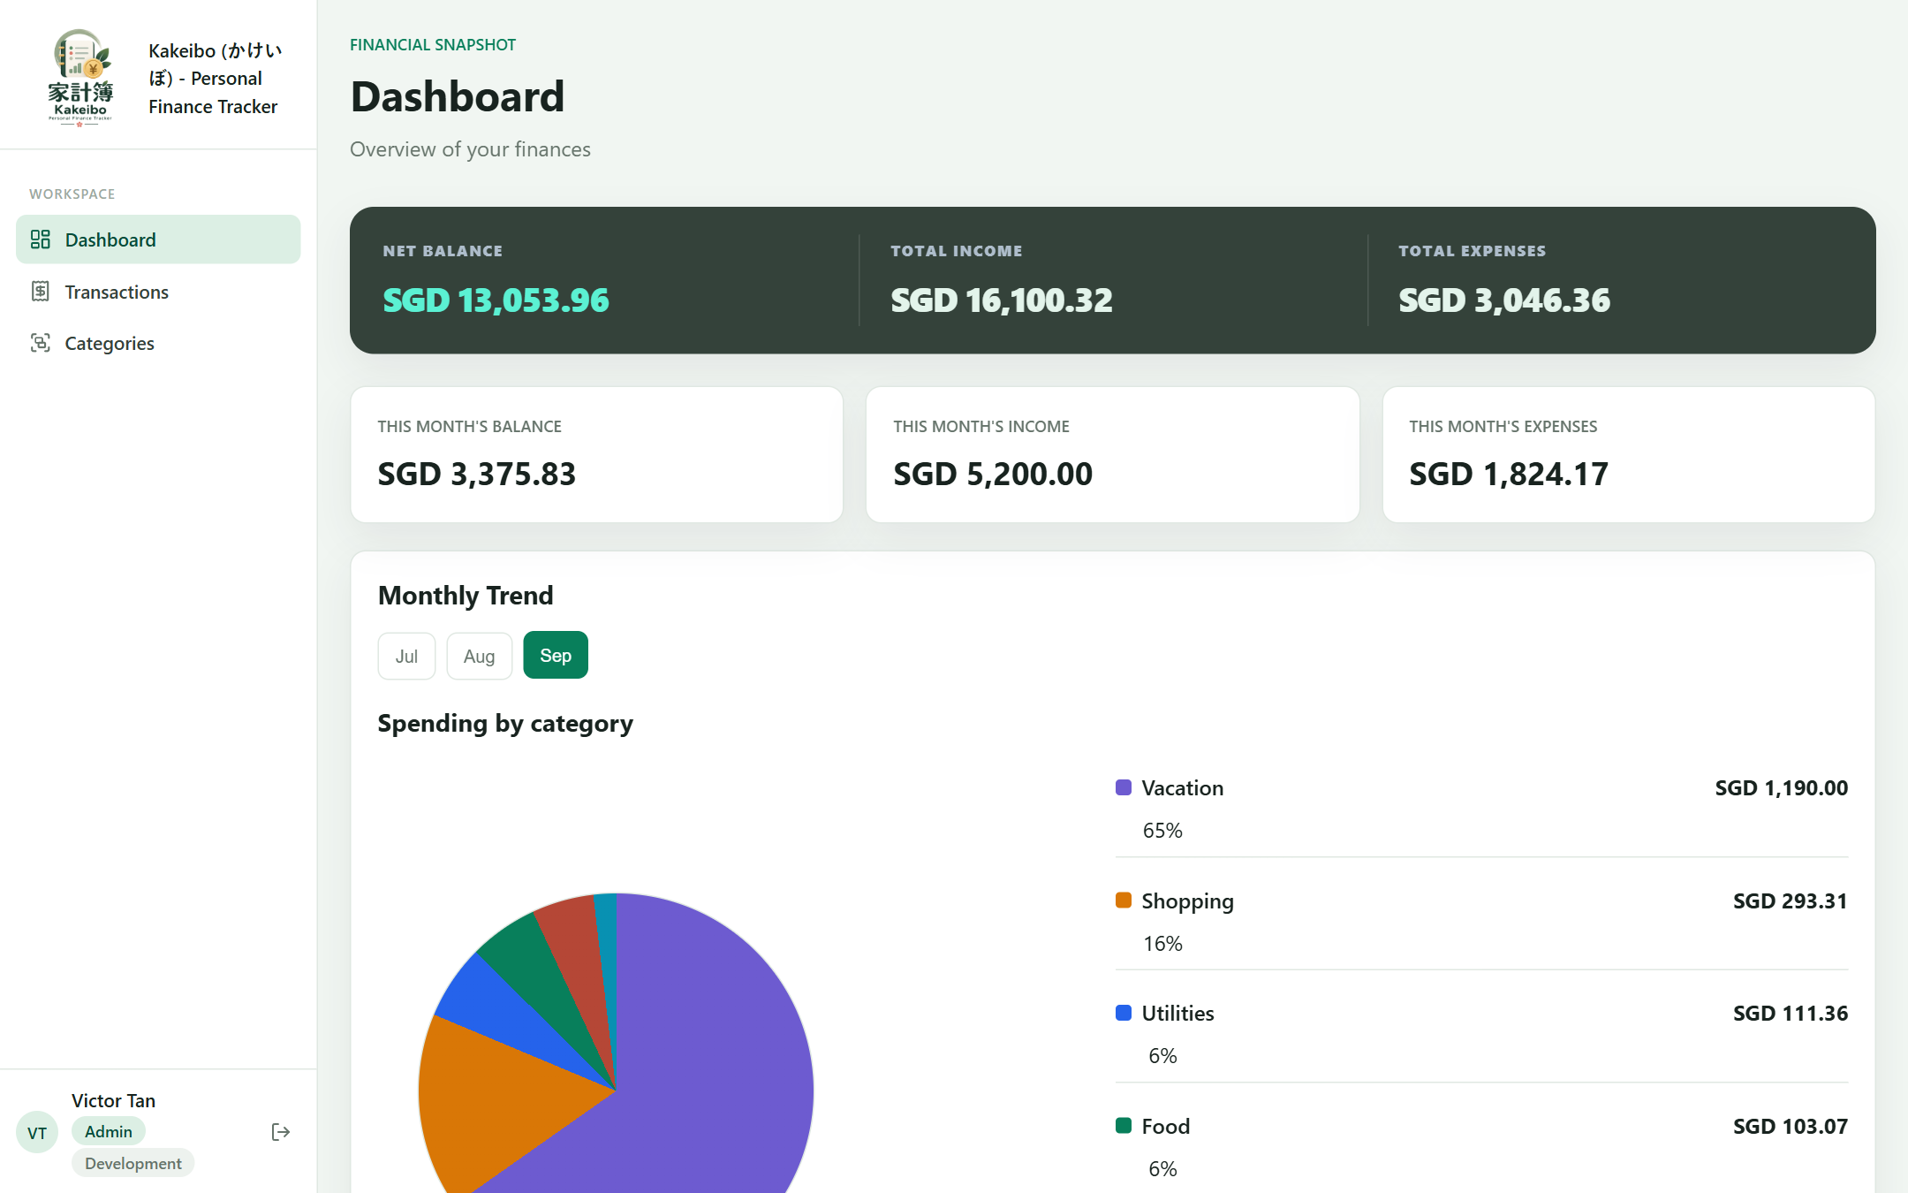
SCREENSHOT · DASHBOARD
See the month at a glance
Summary cards
Net balance, income and expenses, all-time and this month
Monthly trend
Switch between months
Spending by category
Pie chart with amounts and percentages
Derived state
Everything is calculated from the shared TransactionContext
Notes:
~30s.

Slide 7
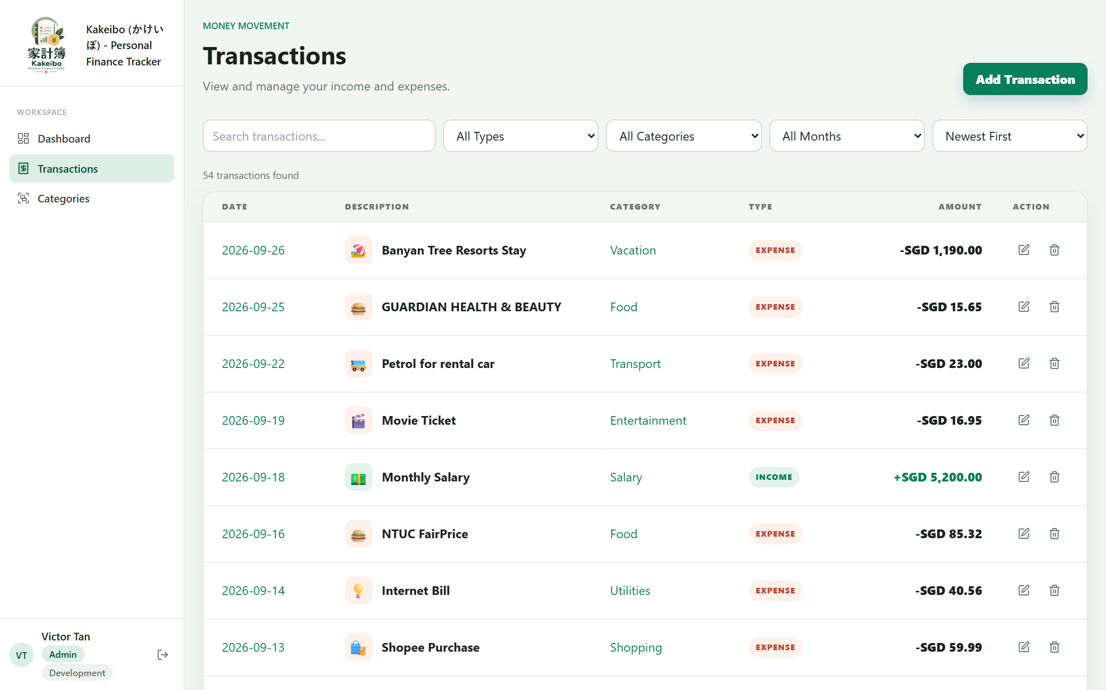
SCREENSHOT · READ + DELETE
Transactions
Read
All transactions in one table, with a live count
Search, filter, sort
By text, type, category and month; newest/oldest/amount
Edit and delete
Per-row actions; delete asks for confirmation first
Components
TransactionList → TransactionItem via props
Notes:
~30s.

Slide 8
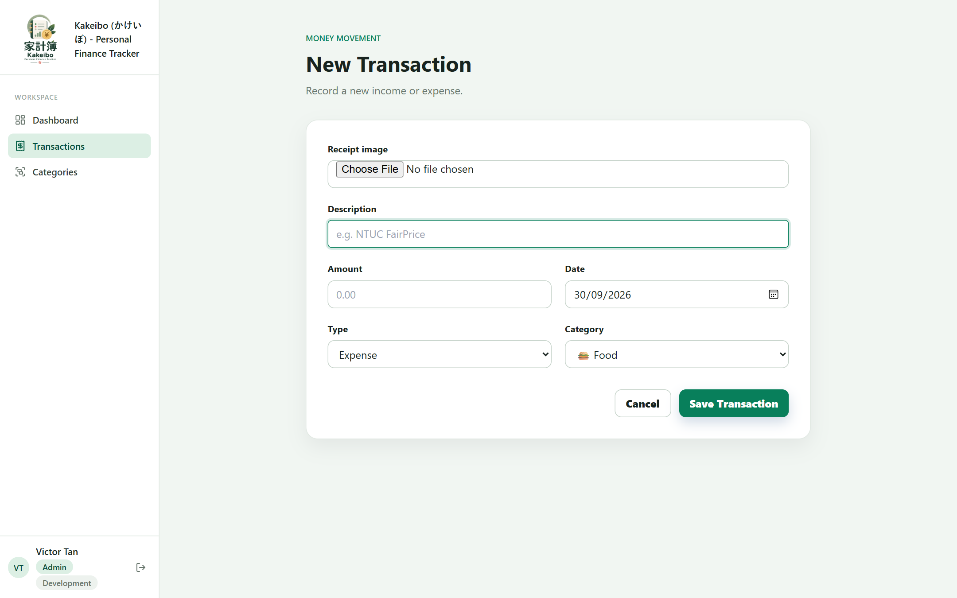
SCREENSHOT · CREATE
New transaction
Controlled inputs
Every field is held in React state
Validation
Description required, amount > 0, category required
Receipt scan
Upload a photo and Veryfi fills in merchant, total and date
User stays in control
Nothing is saved until the form is submitted
Notes:
~30s.

Slide 9
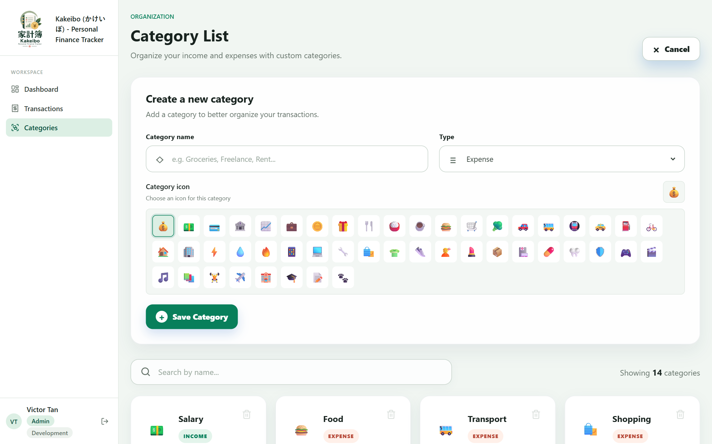
SCREENSHOT · CATEGORIES
Custom categories
Add
Name, type and icon, validated with Yup
Search
Filter categories by name
Safe delete
A category can't be deleted while transactions still use it
Notes:
~30s.

Slide 10
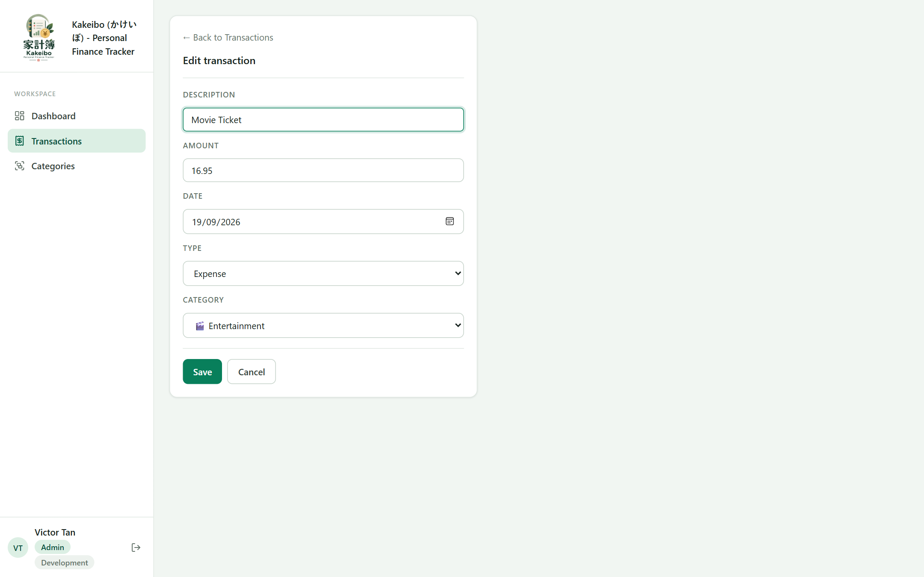
BEYOND THE REQUIREMENTS
Bonus features
Edit a transaction (Update): /app/transactions/:id/edit
Search, filter and sort transactions
Receipt scanning with Veryfi OCR, via a Netlify Function
Login with protected routes and user roles
Dashboard summary and spending-by-category chart
Automated tests with Vitest + Testing Library
Notes:
~45s.

Slide 11
LIVE DEMO
Let's see it working
1
Log in (victor@team3.io)
2
Dashboard: this month's balance and spending
3
Add a transaction by scanning a receipt
4
Find it with search, edit it, then delete it
5
Add a category, then try deleting one that's in use
6
Refresh a deep link on the deployed Netlify site
Notes:
~3–4 min. Have the site open and logged out beforehand, and a receipt photo (under 4 MB) ready.

Slide 12
CHALLENGES
What was hard, and how we solved it
Server code on a static host
The receipt API needed Node. We moved it to a Netlify Function; the 6 MB request limit capped images at 4 MB.
Keeping API keys secret
Veryfi keys live only in server-side environment variables; .env is git-ignored.
Avoiding double charges
A timed-out scan could be retried and billed twice. An Idempotency-Key from the image hash prevents that.
Three branches, one codebase
Merging feature branches into develop caused conflicts, e.g. json-server port in package.json and .env.
UI in sync after every change
One reducer is the single source of truth; filtered lists are derived with useMemo.
Notes:
~1.25 min. Pick two or three to talk about; the slide covers the rest.

Slide 13
LEARNINGS
What each of us took away
HW
Ho Wai Hong
CY
Choo Yeow Hwee
PT
Prancia Toh Wai Yee
Calling a third-party API securely through a server-side proxy
Serverless limits: payload size and timeouts
Git branching, merging develop and resolving conflicts
<learning 1>
<learning 2>
<learning 3>
<learning 1>
<learning 2>
<learning 3>
Notes:
~1.5 min, about 30s each. Each member presents their own column.

