Slide 1

Exploratory Data Analysis
G2M Case Study – XYZ Cab Industry Analysis
Magdalena Ivanova | 18-September-2025

Slide 2

Agenda
Executive Summary
Client & Problem Statement
Dataset & Preparation
Hypothesis-Driven Analysis (EDA)
Key Insights & Recommendation

Slide 3
Background – Case study
XYZ, a private firm, is evaluating an investment in the U.S. cab market. Two companies were analyzed: Yellow Cab and Pink Cab.
This presentation uses cab industry data from 2016–2018 to test key hypotheses on market share, profitability, customer segments, payment modes, city penetration, and forecasting.
Objective: Recommend the stronger investment opportunity for XYZ based on data-driven insights.

Slide 4
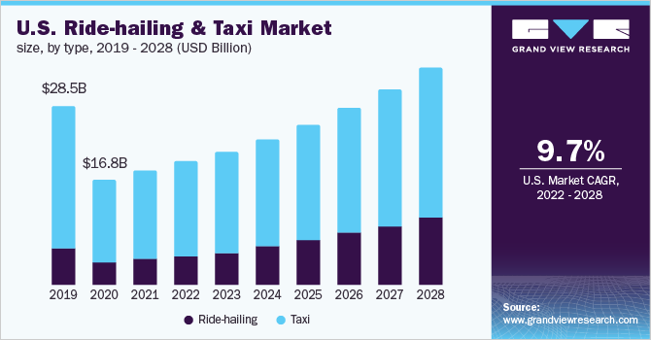
The Client & Problem Statement
XYZ, a private firm, seeks entry into the U.S. cab market, which has grown rapidly but remains fragmented.
The decision: Which company, Yellow Cab or Pink Cab, is the stronger long-term investment?
Key factors assessed: profitability, customer retention, demographics, geographic penetration, and growth outlook.

Slide 5
Dataset Overview
Period: Jan 2016 – Dec 2018
4 datasets merged into Master (~355K records)
Enables analysis across: transactions, demographics, geography, profitability
Dataset | Description | Records | Key Fields
Cab_Data | Transaction details: fare charged, cost of trip | ~359,000 | ‘Transaction ID’, ‘Price Charged’, ‘Cost of Trip’, ‘City’
Customer_ID | Customer demographics (age, gender, income) | ~49,000 | ‘Customer ID’, Age, ‘Income’
Transaction_ID | Maps transactions to customers & payment modes | ~440,000 | ‘Transaction ID’, ‘Customer ID’, ‘Payment Mode’
City | U.S. cities with population & cab users | 20 | ‘City’, ‘Users’

Slide 6
Data Intake & Preparation
The datasets were cleaned and prepared before analysis:
Removed duplicate entries across transactions.
Checked for missing values and handled them appropriately.
Derived new fields: Revenue = Price Charged, Profit = Revenue – Cost, Margin% = Profit ÷ Revenue.
Merged files using Transaction_ID, Customer_ID, and City as keys.
Final outcome: A structured master dataset suitable for analysis.
Raw Data
Cleaning
Master Dataset

Slide 7
Data Relationships
The data sources are linked as follows:
Cab_Data provides transaction-level details.
Transaction_ID maps each trip to a customer.
Customer_ID provides demographics for each customer.
City.csv provides city-level context (population, cab users).
This relational structure enables analysis across customer behavior, city coverage, and profitability.
Customer_ID
City
1
1
Many
Many
Transaction_ID
Cab_Data
Many
1

Slide 8
Hypotheses to Test
I investigated several hypotheses to understand the market:
H1: Yellow Cab holds larger market share across time and cities.
H2: Margin rises with customer count (monthly correlation).
H3: There is monthly seasonality (peaks mid-year, troughs in Feb).
H4: Higher-income and 25–44 age segments contribute more revenue.
H5: Card payments dominate and are associated with slightly higher average revenue per trip.
H6: Penetration (Users/Population) relates to revenue concentration (NY, CHI, DC, LA, BOS).

Slide 9
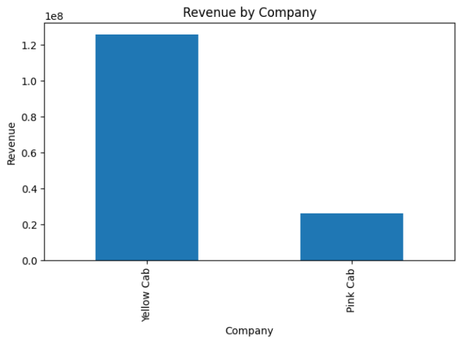
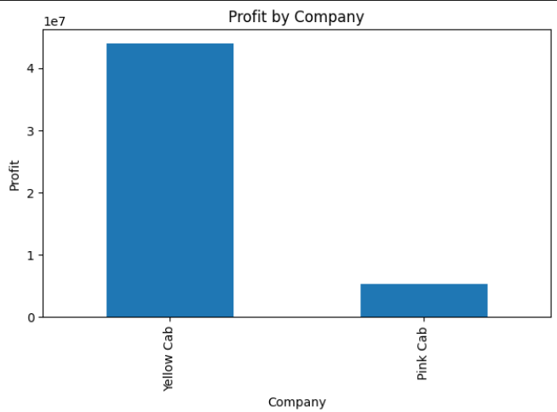
Company Performance
Yellow Cab consistently generates higher revenue and profit across the 2016–2018 period.
This indicates stronger operational efficiency and broader market share compared to Pink Cab.

Slide 10
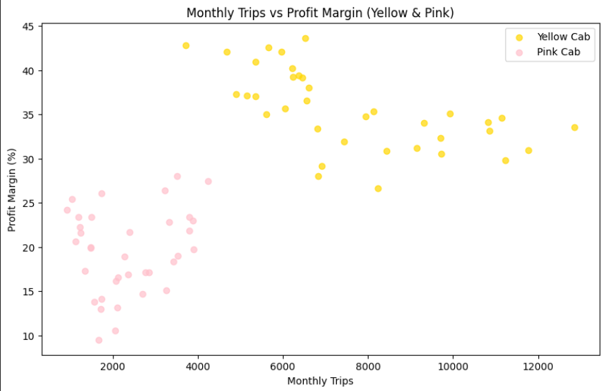
Profit Margin vs Customer Count
Yellow Cab shows higher margins (30–40%) with more trips, proving strong economies of scale.
Pink Cab stays at lower margins (10–25%), even with higher volumes.
Growth in customers translates into sustained profitability for Yellow Cab.

Slide 11
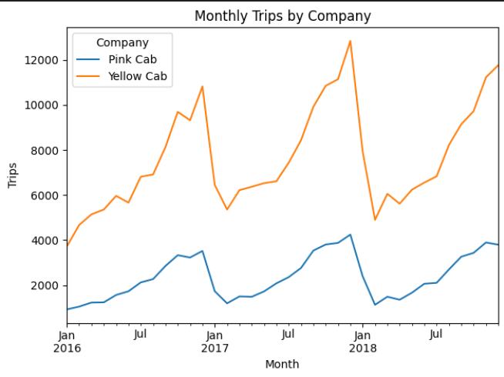
Seasonality trends- Monthly Trips by Company
Yellow Cab consistently achieves 3× the trips of Pink Cab, confirming a much larger market share.
Both companies show clear seasonal patterns: demand peaks mid-year and early year, with sharp dips around February.
Yellow Cab’s growth trajectory is steeper, showing rising demand over the 2016–2018 period.

Slide 12
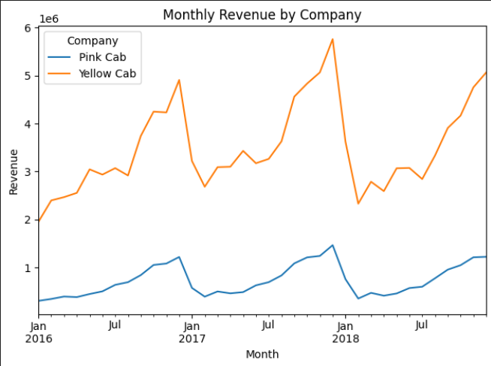
Seasonality trends - Monthly Revenue by Company
Yellow Cab generates significantly higher revenue, consistently outpacing Pink Cab each month.
Seasonal peaks in revenue align with trip spikes, reflecting strong, recurring demand cycles.
Revenue growth over time is much stronger for Yellow Cab, while Pink Cab remains stagnant at lower levels.

Slide 13
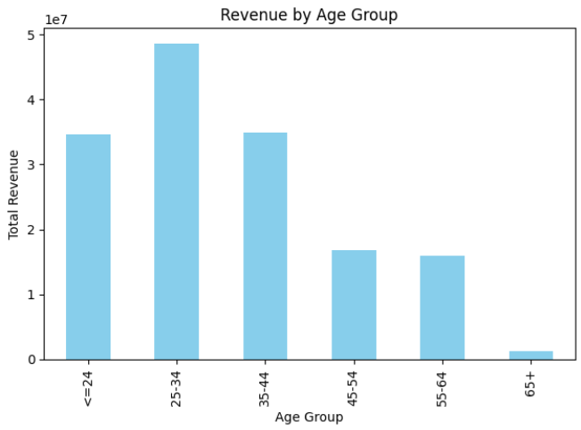
Customer Segmentation: Age
The 25–34 age group generates the highest revenue, followed by 35–44 and ≤24.
Revenue contribution drops steadily after age 45, with very limited demand among seniors (65+).
Younger and middle-aged adults are therefore the core customer base for cab services.

Slide 14
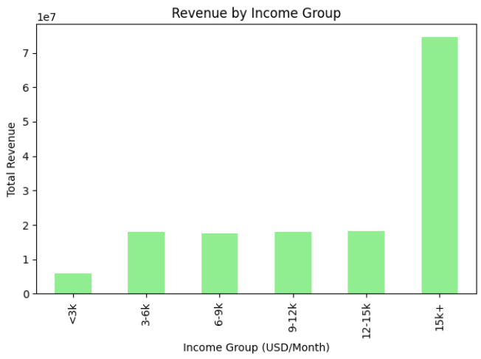
Customer Segmentation: Income
Customers earning USD 15k+ per month contribute the majority of total revenue.
Lower and middle income groups (<15k) are relatively balanced but far behind in total revenue share.
Indicates that affluent customers drive cab profitability, though broad participation exists across all income levels.

Slide 15
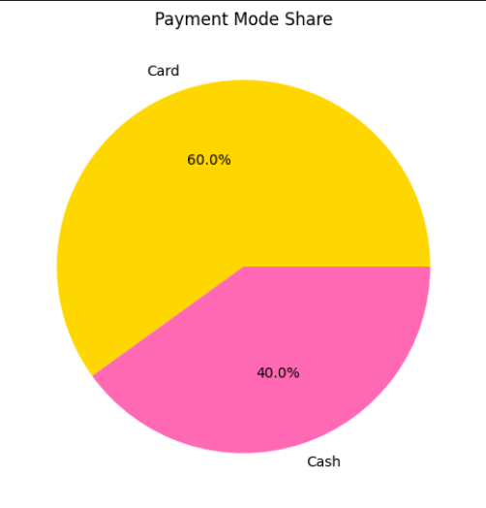
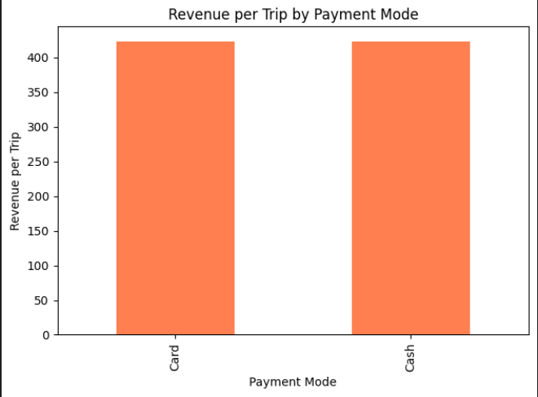
Payment Mode Preferences (Overall)
Card payments dominate at 60% of total rides.
Card trips generate slightly higher average revenue per trip compared to cash.
Indicates a strong shift toward digital payments across the market.

Slide 16
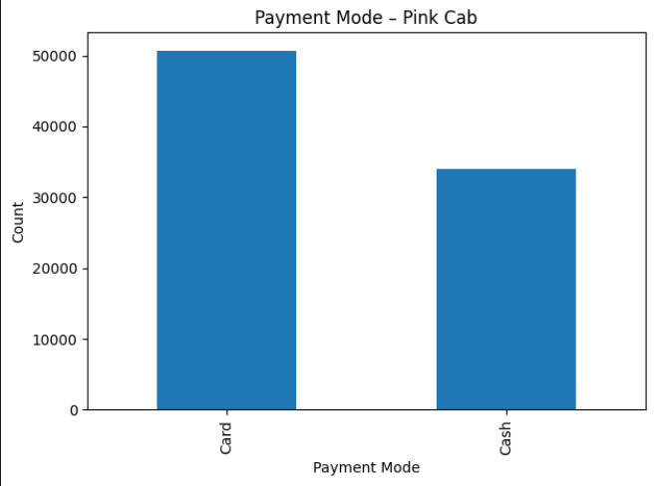
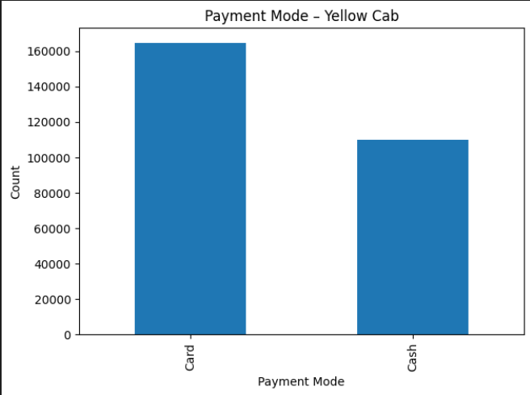
Payment Mode by Company
Both companies show higher usage of card payments.
Yellow Cab has a stronger card preference (≈60%+ card vs 40% cash).
Pink Cab also skews toward cards, but with a smaller share.
Digital adoption is a consistent trend, with Yellow Cab leading.

Slide 17
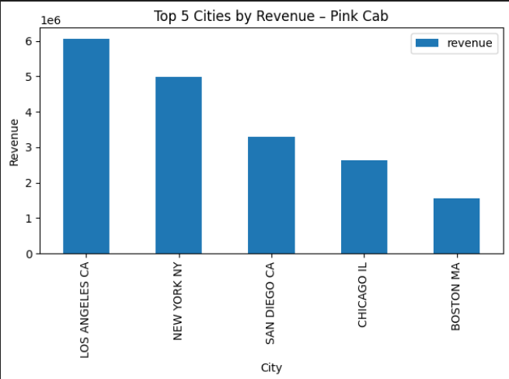
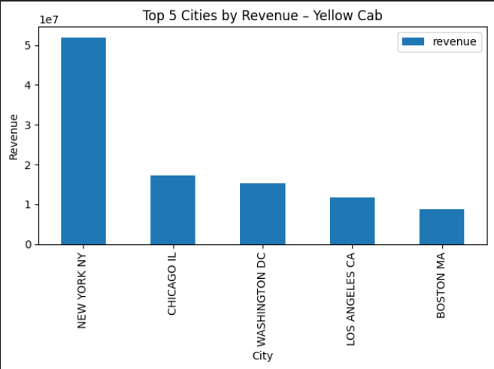
Top Cities by Revenue (Pink vs Yellow Cab)
Pink Cab revenue is concentrated in Los Angeles, New York, San Diego, Chicago, and Boston, but total levels remain modest.
Yellow Cab dominates in New York, followed by Chicago, Washington DC, LA, and Boston.
Yellow Cab captures significantly larger absolute revenue in top cities, confirming stronger market dominance.

Slide 18
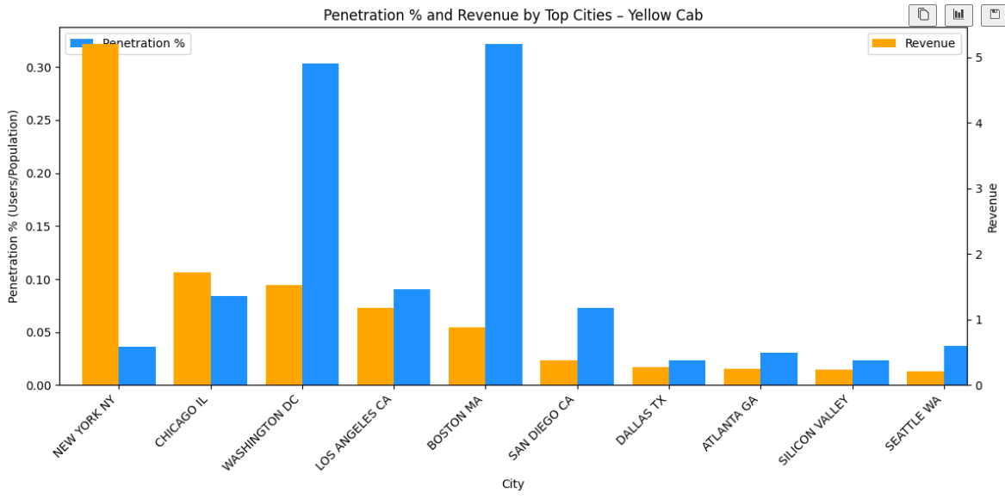
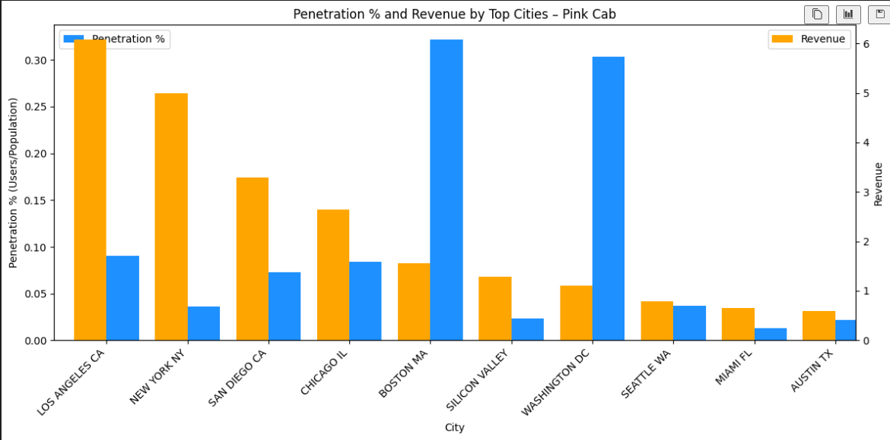
Penetration vs Revenue (City-Level Comparison)
Revenue is strongly linked to penetration (users ÷ population).
High-revenue cities like New York, LA, DC, and Boston also show higher penetration.
Yellow Cab achieves better penetration in high-value cities, reinforcing its leadership in both scale and profitability.

Slide 19
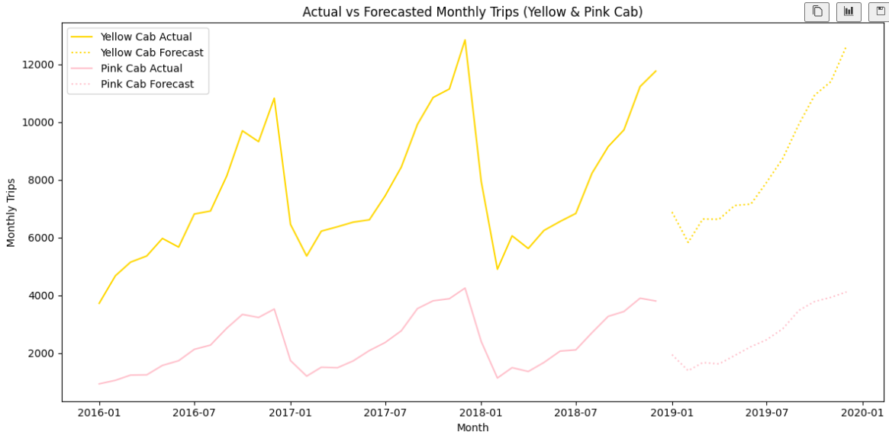
Forecasting (2019)
Both companies face a decline in 2019.
Yellow Cab: Trips stabilize at 6k–12k/month, decline ≈ –1.8%.
Pink Cab: Stays much lower at 2k–4k/month, decline ≈ –3.1%.
The forecast reinforces Yellow Cab’s larger scale and greater resilience, even under slowing market conditions.

Slide 20
Key Insights & Recommendation
Strengths (Why Yellow Cab)
Risks (What to Monitor)
Opportunities (Growth Levers)
~3× more trips & ~5× revenue vs. Pink (2016–2018)
Higher profit margins, scales better with demand
Stronger city presence (NYC, Chicago, DC, LA, Boston)
Broader customer base (age, income, payment mix)
Margin variability across cities
Seasonal dips (February troughs)
Payment mix differences (cash-heavy cities)
Optimize pricing in high-demand cities
Deepen loyalty in 25–44 age group
Expand digital adoption (card payments)
Target senior customers where Yellow already has reach
Recommendation: Invest in Yellow Cab – stronger scale, higher profitability, broader reach, and greater resilience compared to Pink Cab.

Slide 21
Thank You

