Slide 1

JAVA-BASICS
Team Papaya
Teamwork Project
Software University
SoftUniBreaker-the game

Slide 2
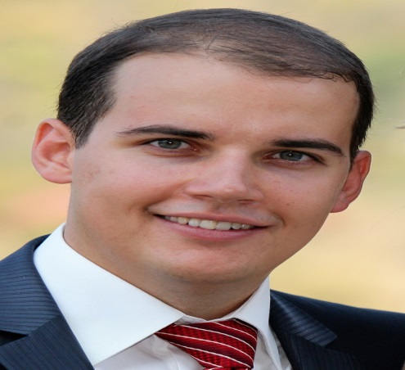
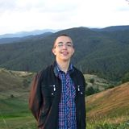
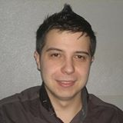
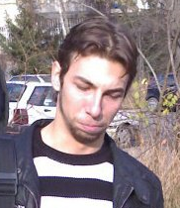
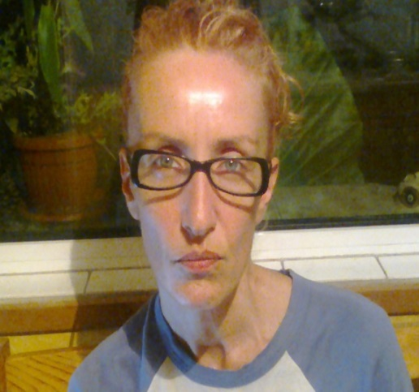
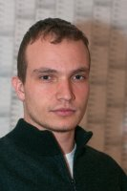

Team PAPAYA
Borislav Totev
Salih Alishov
Teodor Penev
Magdalena Petrova
Stoyan Petrov
KostadinStefanov

Slide 3
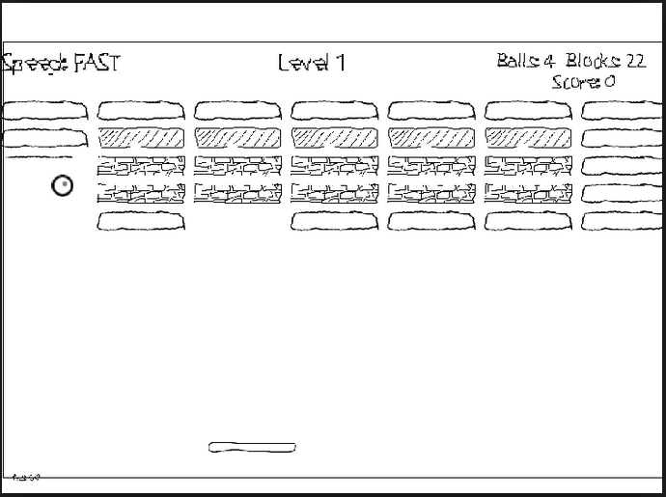

The idea – to create one old well-know game
The aim of the game - woven brain cell (paddle) send brain momentum in the form of shot (ball) and with it’s help pass levels in SoftUni when smashing courses.

Slide 4



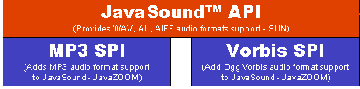
What we did?
1. Ideas gathering - whole PAPAYA team
2. Git Repository - Kostadin
3. First basic version - whole PAPAYA team
4. Levels - Borislav, Salih
5. MusicPlayer - Stoyan, Teodor
6. Ranking - Salih, Borislav
7. Ranking Rows - Borislav, Magdalena
8. TotalPoints - Kostadin, Stoyan, Borislav
9. Different design on each level - Magdalena, Teodor
10. Testing - whole PAPAYA team
11. Presentation - Stoyan, Kostadin, Borislav
What we use?

Slide 5
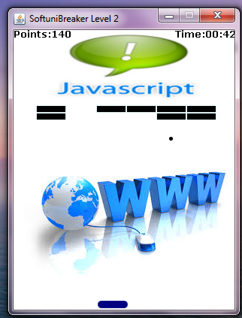
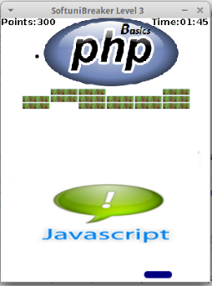
Demo

Slide 6

Thanks!!!

