Slide 1
Mental Health App
Магдалена Петрушевска, 181541

Slide 2
This project is designed for the purpose of the course Implementation of Free and Open Source Systems under the Faculty of Computer Science and Engineering, UKIM 2021/2022
The goal was to create an example site using the FastAPI development framework in Python
Topic : Mental Health App
Link to GitLab repo

Slide 3
GOAL OF THIS APP
This mental health app aims to help their users easily cope with stress, low mood, depression, and anxiety.
It offers 3 main features (Forum, Mood diary and Medication reminder) for improving mental health of users.
Мental health forum allows users to share posts through which they can share their problems, help each other in times of crisis, to share experiences, etc. Every user will be able to start a new forum topic. Anyone can write a comment on that topic. The one who creates the theme can delete it, edit it. The user can give thumbs up on the comment he likes. Anyone who has written the comment can delete it, edit it.
Mood diary allows the user to track his mood constantly by adding on daily basis the record of how does he feels and also can describes the reason why he feels that way. The user has the opportunity to export an pdf document containig the mood history of the user.
Medication reminder as app feature is designed to be used by users that have the need of taking medication on regular basis. This feature allows users to receive SMS messages at the scheduled time. That way they can be sure they never forgot to take appropriate medication.

Slide 4
TECHNOLOGIES USED TO BUILD THE APP
FastAPI
React
PostgreSQL
Twilio
JWT
PyFPDF
Backend
Frontend
Database
Modern, fast web framework for building APIs with Python
JavaScript library for building user interfaces.
Powerful, open source object-relational database system
Communication APIs for SMS
Authentication
PDF documents generation
Works in the background to bridge the gap between web based applications and telephones
Open standard used to share security information between two parties
Library for PDF document generation under Python

Slide 5
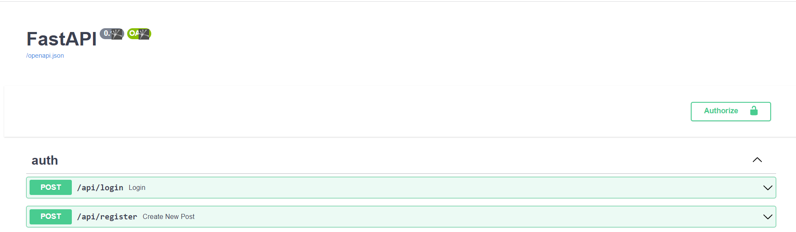
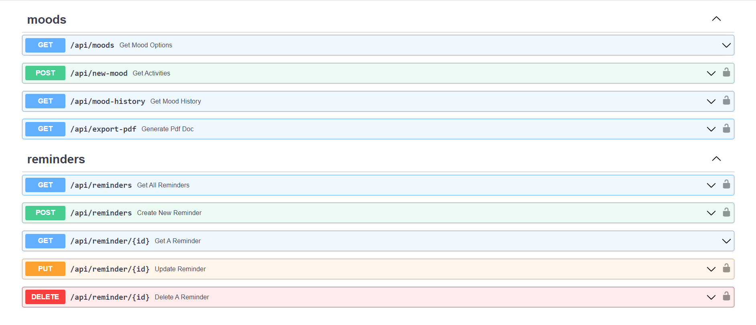
Interactive FastAPI docs

Slide 6
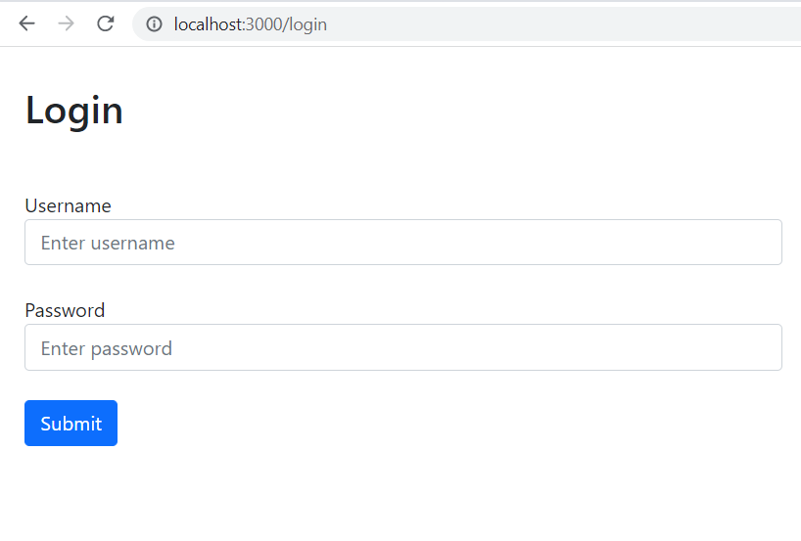
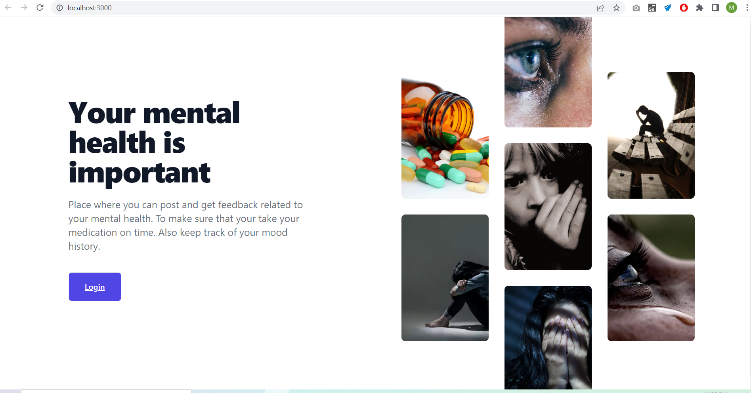
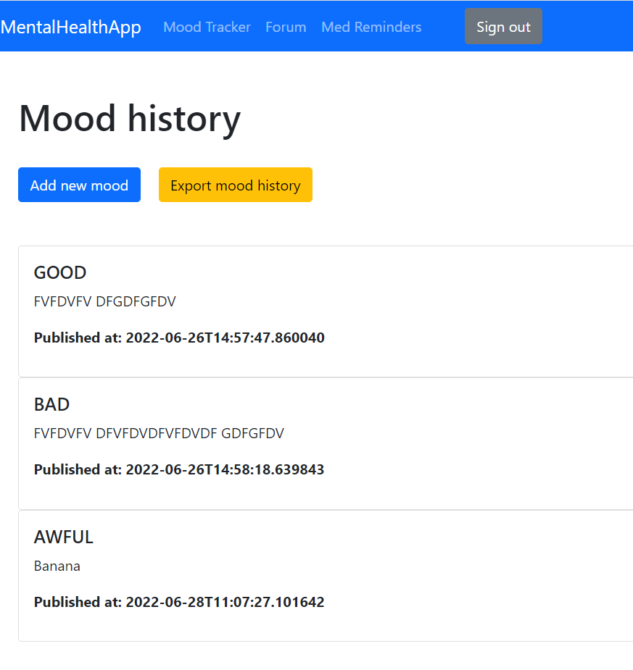
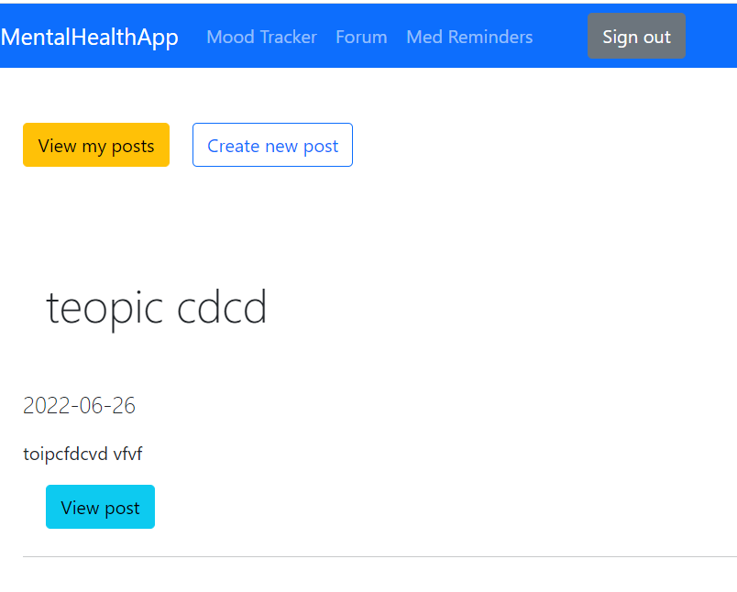
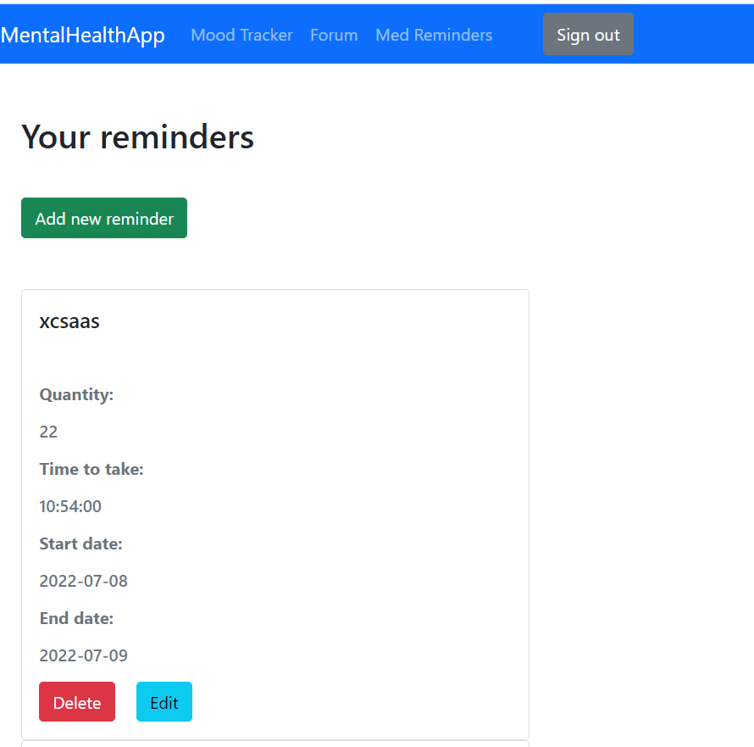
USER INTERFACE

Slide 7
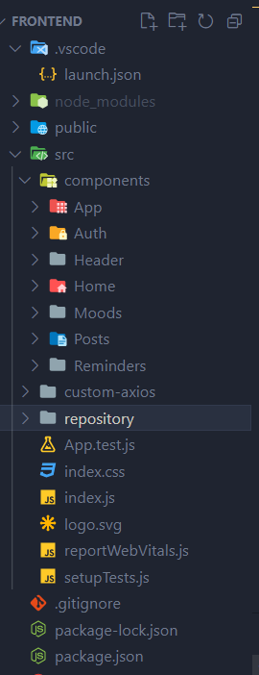
STUCTURE OF THE FRONTEND APP
COMPONENTS
Different user interfaces are grouped as separate components. The name of the component itself describes the purpose of its use
AXIOS
Here Axios is used to makes it easy to send asynchronous HTTP requests to REST endpoints and perform CRUD operations
BOOTSTRAP
Is used to give a user interface a better look

Slide 8
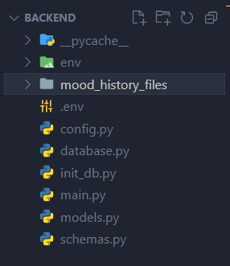
STUCTURE OF THE BACKEND APP
The env directory creates a folder which contains all the necessary executables to use the packages that a Python project would need.
The mood_history_files directory is used to store on the server the generated mood history files from its users.
The .env file is used to configure some environmental variables needed to implement integration with Twilio.
Database.py file is used to configure the database to be used for storing data. Additionally using file init_db.py we create the needed tables in the database.
Main.py is the file where the entire backend logic lies.
Our models are kept in models.py. And the DTO classes are kept in schemas.py.

