Slide 1

Detecting Spectre vulnerabilities in OpenSSL libraries using static analysis techniques
Master’s Thesis in
Artificial Intelligence & Cybersecurity
Candidate:
Magdalena M. Solitro
Supervisor:
Prof. Maria Elisabeth Oswald
Co-supervisor:
Prof. Agostino Dovier

Slide 2

Abstract
Main topics:
  Overview on the foundations of static analysis;
  In-depth study of Spectre attacks and its variants;
  Examination OpenSSL's implementation of a symmetric cipher (AES) with different static analysers;
  Comparison between the results of different static analysers.
Goal: compare different static analysis tools to detect Spectre

Slide 3


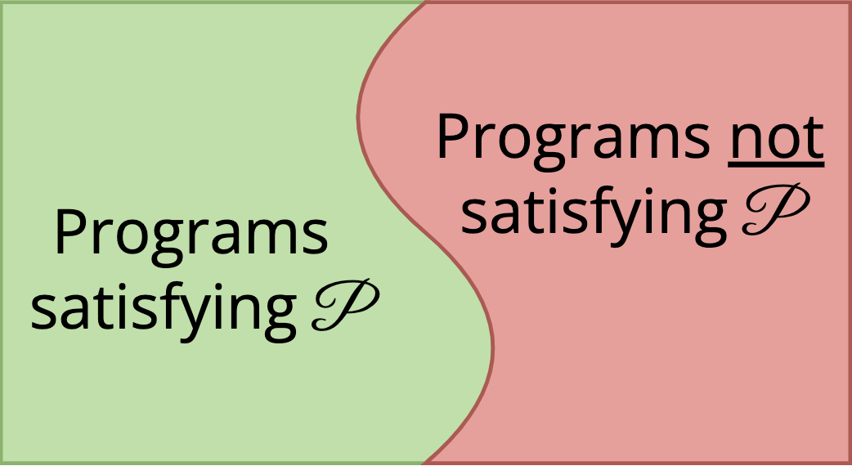

Static Analysis
Static analysis: automated analysis of a program’s source code to verify whether it satisfies certain properties.
Sound, incomplete analysis
  Efficient, but not perfect (Halting Problem, Rice’s Theorem)
= programs detected
by static analyser
Unsound, complete analysis

Slide 4

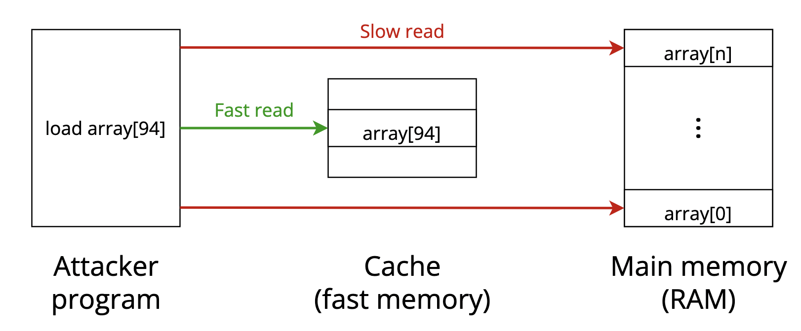
Spectre
Spectre: a class of side-channel attacks that exploits speculative execution to read protected memory addresses.
Speculative execution: optimisation technique where the CPU tries to predict what branch of a conditional statement is going to be executed and loads the needed data in advance.
Example: Spectre v1
int restrictedAccess(size_t x){
  if(x < array_size){
  return array[x];
  } else {
  printf(“Illegal access!”)
  }
}
array
secret region
0 1 2 … N

Slide 5
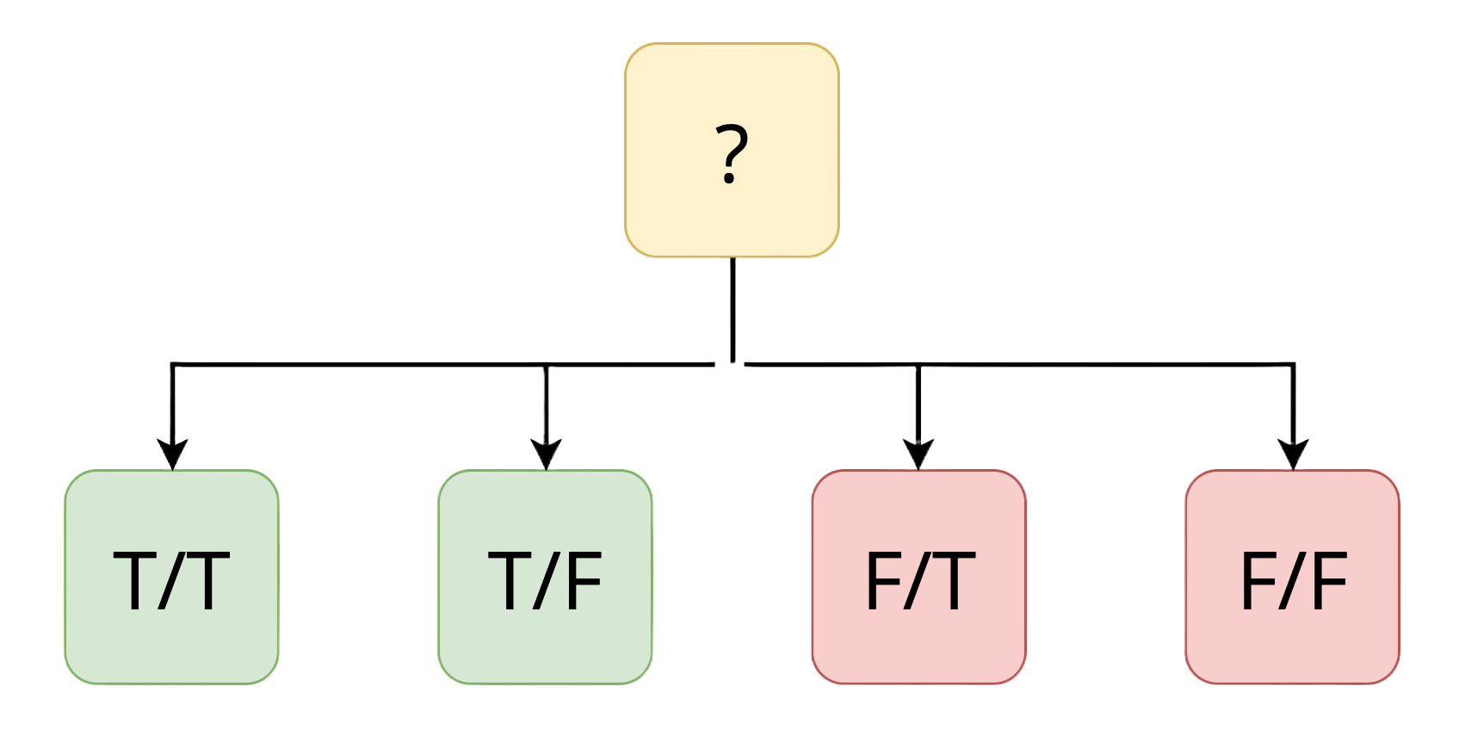

Verification tools to detect Spectre
KLEESpectre:
  Leverages on speculative symbolic execution
FastSpec:
  Employs deep learning techniques (Generative Adversarial Networks, BERT)
int restrictedAccess(size_t x){
  if(x < secret_size){
  return secret[x];
  } else {
  printf(“Illegal access!”)
  }
}
Both are limited to detect Spectre v1
Condition true
Prediction correct
Condition true
Prediction wrong
Condition false
Prediction correct
Condition false
Prediction wrong

Slide 6
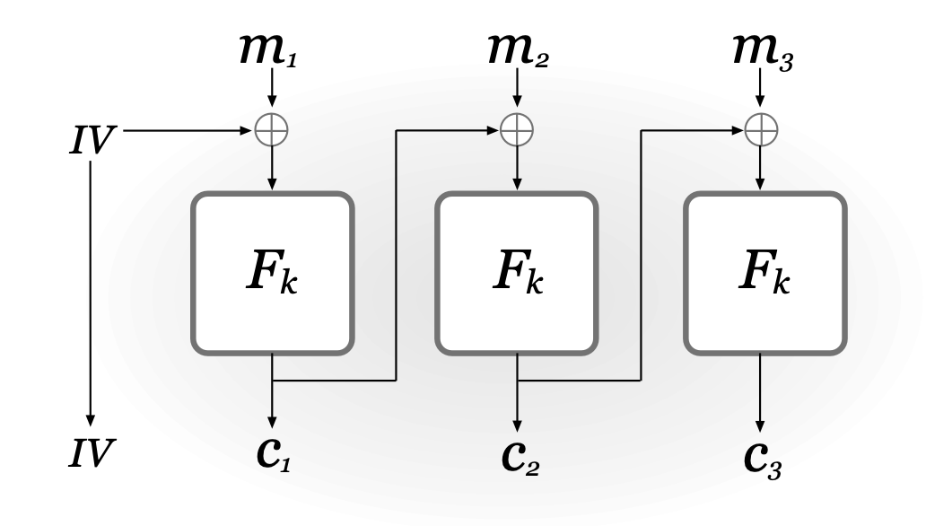
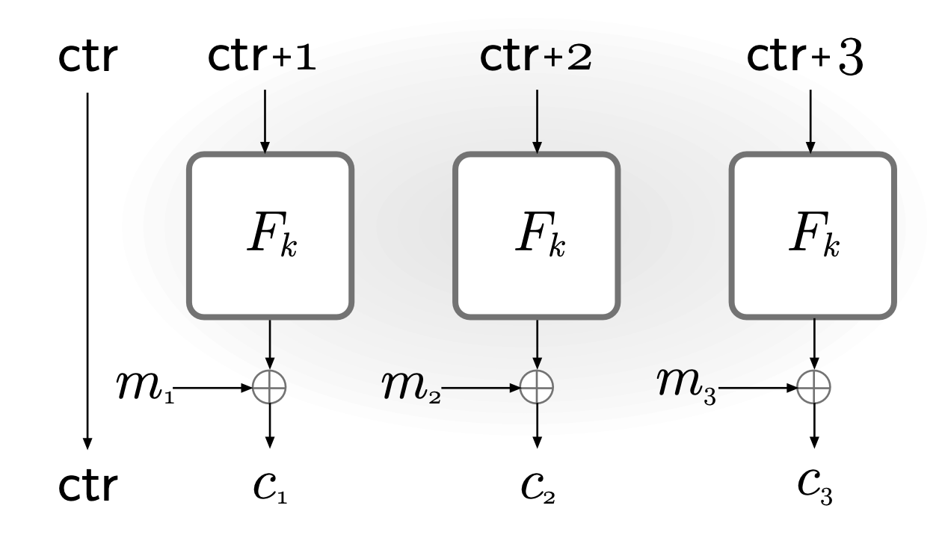
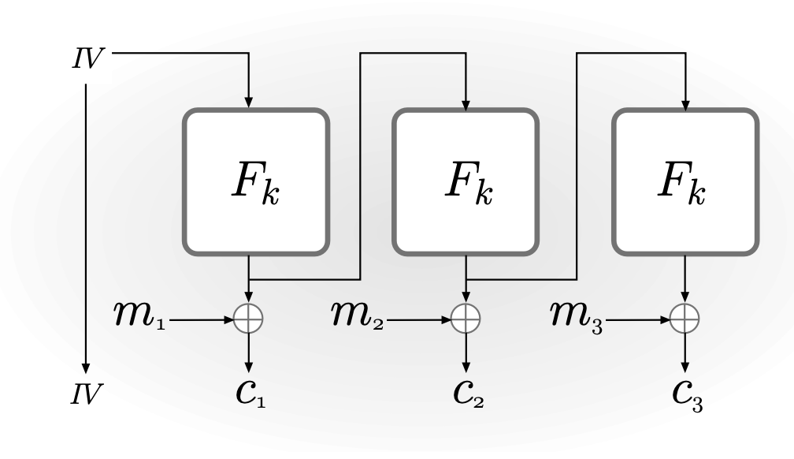
The target: AES modes of operation
AES (Advanced Encryption Standard): standard block cipher for symmetric encryption established by the U.S. National Institute of Standards and Technology (NIST) in 2001.
CBC mode
CTR mode
OFB mode
(image source: “Introduction to Modern Cryptography” by Katz and Lindell)
where Fk = AES routine

Slide 7
KLEESpectre: Results
Detected 6 alleged vulnerabilities:
  1/6 is a potential Spectre vulnerability (in CBC mode of operation);
  5/6 are false positives.
Why false positives? In LLVM bitcode, branches and cycles are the same…
High-level code
(C code)
if (x<0){ … }
else { … }
while (x<0){ … }
Low-level code
(LLVM bitcode)
br i1 x<0, label L1, label L2

Slide 8
FastSpec: Results
6 alleged vulnerabilities, but the results are difficult to interpret:
  3/6 alleged vulnerabilities are false positives;
  3/6 alleged vulnerabilities presented jump instructions, but with an illegal syntax;
  no annotations link the Assembly code to the source code;
  some tokens of the code are masked for efficiency purposes.
<label> = label identifying a specific piece of code
<imm> = immediate values
<UNK> = out-of-vocabulary tokens
        Legal syntax: jmp <label>
Syntax found in FastSpec: jmp movl <imm>, <imm>(%rbp)

Slide 9

Conclusions
Initial goal: compare the results of different static analysers.
KLEESpectre outperforms FastSpec:
  The output is clear to read
  Easy to link LLVM bitcode snippets to source code
  Reasonable results
Future work:
  Run a Spectre attack on the alleged vulnerability, to see whether the it is actually exploitable.
  Verify presence of other Spectre variants with different tools, or by extending existing tools.

Slide 10

Thank you for your attention!

