Slide 1

Detecting Spectre vulnerabilities in OpenSSL libraries using static analysis techniques
Master’s Thesis in
Artificial Intelligence & Cybersecurity
Candidate:
Magdalena M. Solitro
Supervisor:
Prof. Maria Elisabeth Oswald
Co-supervisor:
Prof. Agostino Dovier

Slide 2
Abstract
Main topics:
  Overview on the foundations of static analysis;
  In-depth study of Spectre attacks and its variants;
  Examination OpenSSL's implementation of a symmetric cipher (AES) with different static analysers;
  Comparison the results of different static analysers.
Funding: KWF (grant number KWF-3520 | 31870 | 45842)

Slide 3
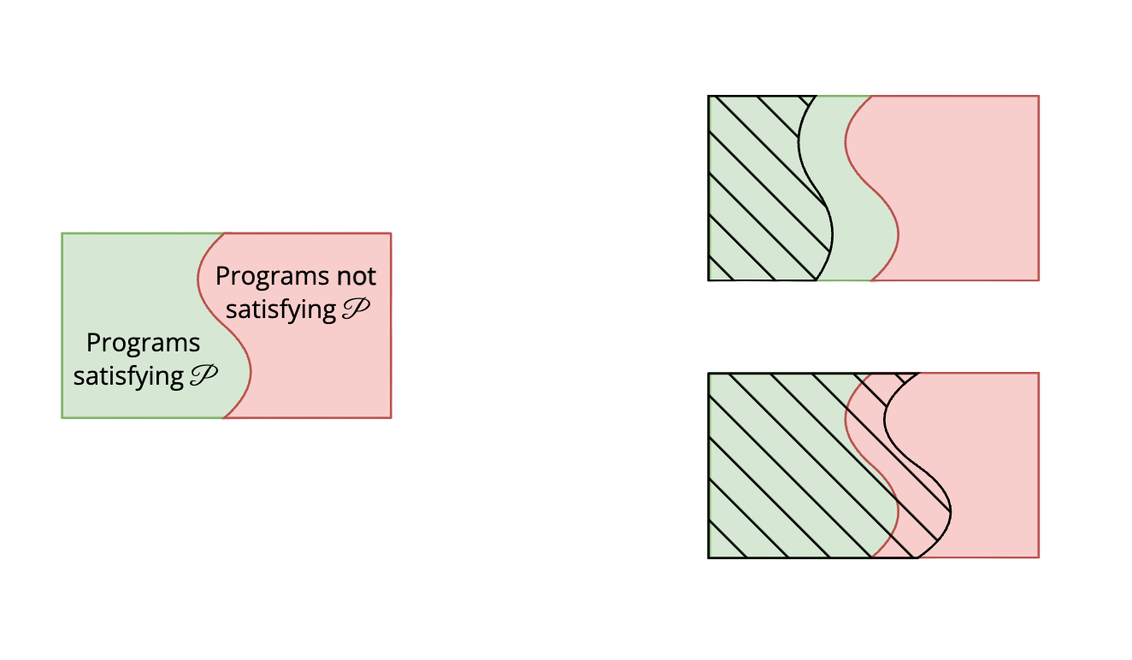

Static Analysis
Static analysis: automated analysis of a program’s source code to verify whether it satisfies certain properties.
Sound, incomplete analysis
  Efficient, but not perfect (Halting Problem, Rice’s Theorem)
= programs detected
by static analyser
Unsound, complete analysis

Slide 4

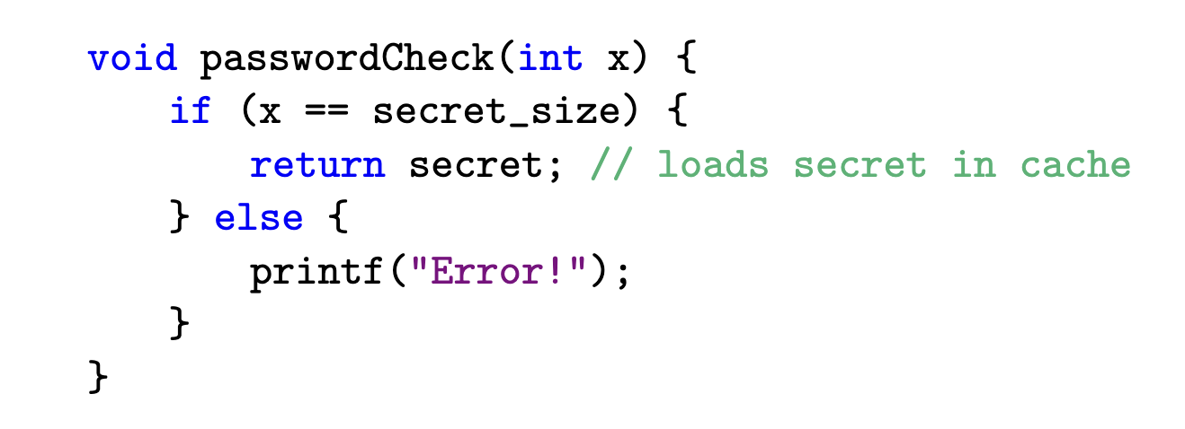
Spectre
Spectre: a class of side-channel attacks that exploits speculative execution to read protected memory addresses.
Speculative execution: optimisation technique where the CPU tries to predict what branch of a conditional statement is going to be executed and loads the needed data in advance
Example: Spectre v1

Slide 5
Verification tools to detect Spectre
KLEESpectre:
    Leverages on speculative symbolic execution and taint analysis
    Inspects LLVM bitcode
FastSpec:
    Employs deep learning techniques (Generative Adversarial Networks, BERT)
    Inspects Assembly code (AT&T syntax)

Slide 6
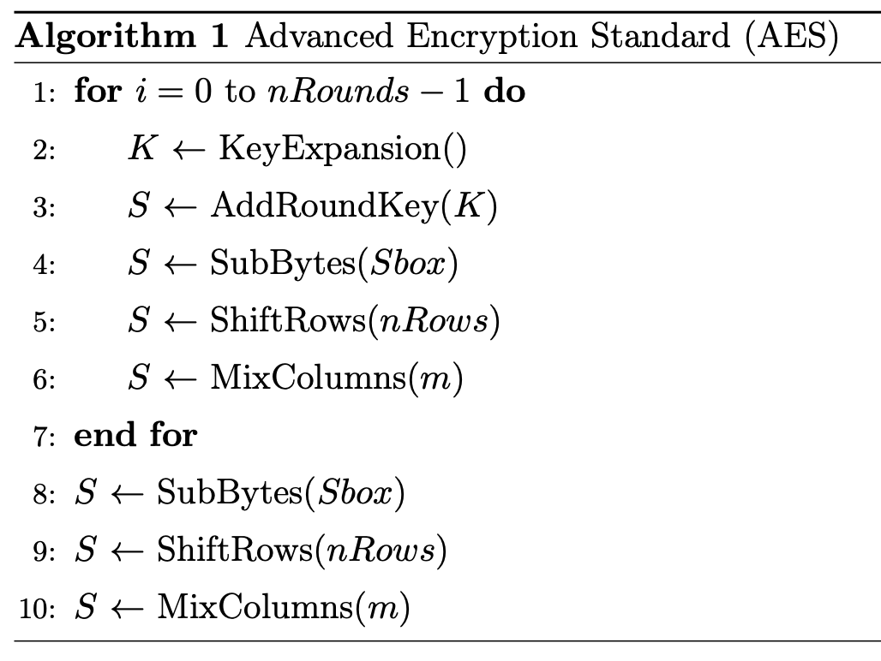
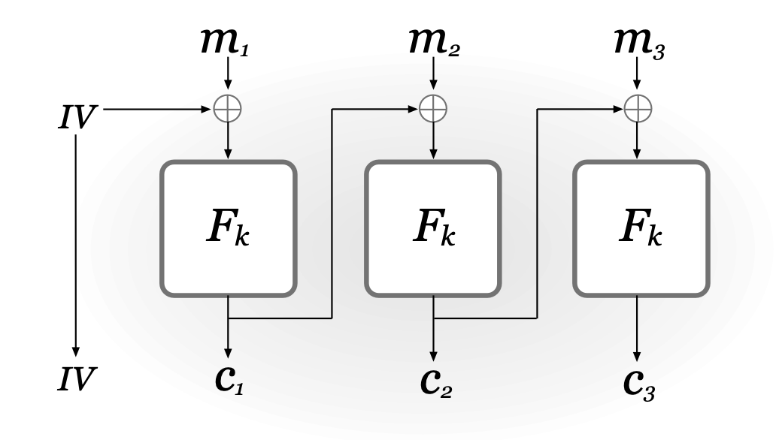
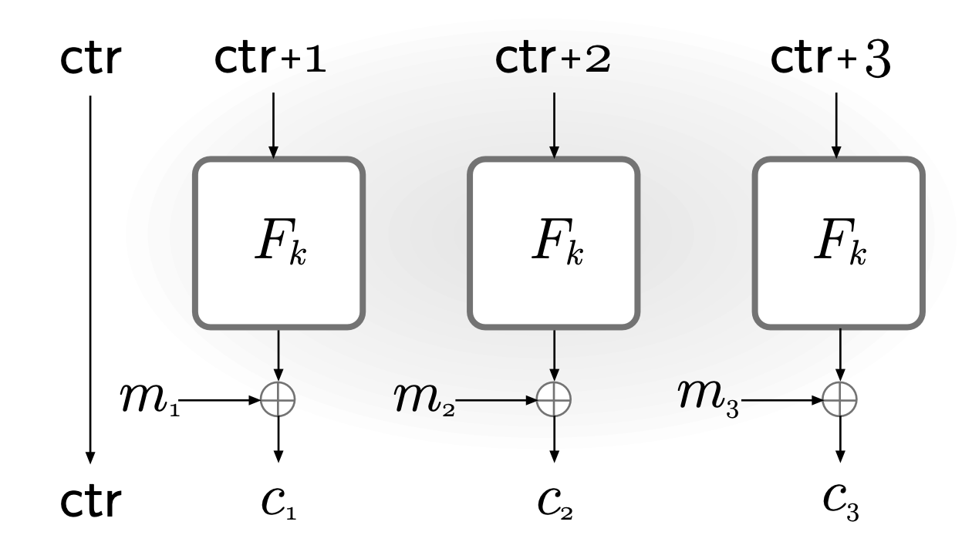
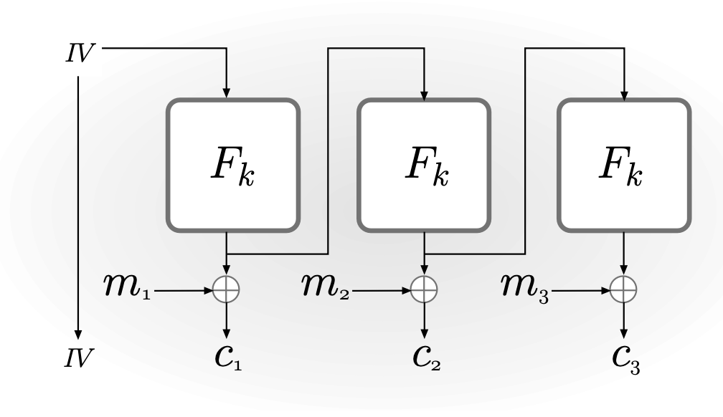
The target: AES modes of operation
AES (Advanced Encryption Standard): standard block cipher for symmetric encryption established by the U.S. National Institute of Standards and Technology (NIST) in 2001.
OpenSSL: popular open-source software library used to ensure secure communication over the network.
CBC mode
CTR mode
OFB mode

Slide 7
KLEESpectre: Results
Detected 6 alleged vulnerabilities:
  1/6 is a potential Spectre vulnerability;
  5/6 are false positives.
Why false positives? LLVM bitcode translates both conditional statements and cycles with a branch instruction, but only the former can be subject to a Spectre attack!

Slide 8
FastSpec: Results
6 alleged vulnerabilities, but the results are difficult to interpret:
  3/6 alleged vulnerabilities are false positives;
  3/6 alleged vulnerabilities presented jump instructions, but with an illegal syntax;
  no annotations link the Assembly code to the source code;
  some tokens of the code are masked for efficiency purposes.

Slide 9
Conclusions
KLEESpectre outperforms FastSpec:
  The output is clear to read
  Easy to link LLVM bitcode snippets to source code
  Reasonable results

