Slide 1
MY APP STORY
AQUA
An idea can become
a website or an app
Laundromats LLC
Church presentation
September 2026
How I built a business website and the Aqua Laundromats Scheduler with AI help, curiosity, and a lot of testing
Built by Mak
Notes:
I am not presenting myself as a software engineer. I am sharing how I took a real business problem, learned as I went, and used AI as a helper to build both a business website and a scheduling app. The main lesson is that an idea can become something useful when we keep asking clear questions.

Slide 2
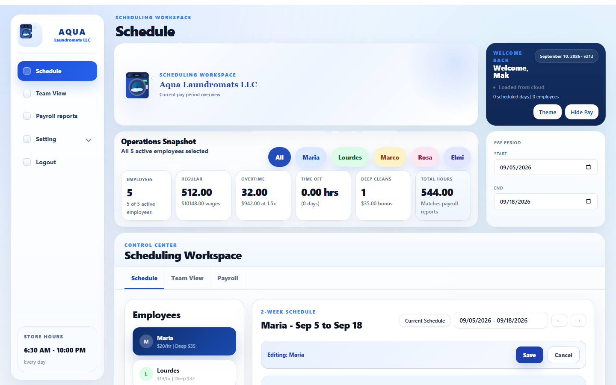
The problem at work
A schedule needs to be clear, current, and trusted
I started with ordinary problems:
• People need to know when they work.
• Time off and schedule changes must stay visible.
• Payroll needs the right hours for the right pay period.
That was enough to begin. I did not start with code. I started with a problem I understood.
Aqua Laundromats Scheduler
02
Notes:
This is the kind of real-world issue that started the project. I knew the day-to-day work, the people, and the questions that a schedule needed to answer. That knowledge mattered before any technology did.

Slide 3
The first questions
My design came from the work, not from a template
1
What repeats every week?
Schedules, time off, deep cleans, and payroll hours.
2
Who needs to use it?
Owners need the full picture. Managers need the schedule.
3
What must never happen?
A person’s time off or hours should not disappear.
Those questions became the app’s features and its safety checks.
Aqua Laundromats Scheduler
03
Notes:
This is what I mean when I say I started thinking like an engineer. I was not memorizing code. I was turning a vague idea into questions that could be answered, built, and tested.

Slide 4
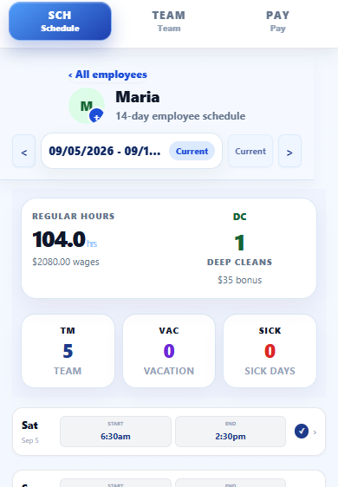
Obstacles that changed the app
Every difficult moment gave me a better question to ask
Phone screens felt crowded
I redesigned the mobile experience for quick edits.
The app improved because I used it, noticed problems, and kept asking for a better version.
A cloud save can fail
The app now says whether it saved to cloud or only locally.
Dates can be confusing
The pay period stays visible so I know which two weeks I am editing.
Different people need different access
Owner and manager roles protect sensitive information.
Aqua Laundromats Scheduler
04
Notes:
The first version did not have to be perfect. I found problems by actually using it. The goal was never to hide mistakes. The goal was to see them, understand them, and improve the app.

Slide 5
How AI helped me
I could describe the work in normal words
WHAT I COULD SAY
WHAT AI COULD HELP WITH
“I need a button that takes me back to the current schedule.”
• Suggest a design.
• Write a first version of code.
• Explain tradeoffs and help create tests.
I could explain the business problem without knowing the technical words.
AI did not replace my judgment. I still had to decide what was useful, test it, and ask the next question.
Aqua Laundromats Scheduler
05
Notes:
The biggest help was that I could start in plain language. I did not need to know the right technical word first. AI could help turn my description into a plan, then I could review and test it.

Slide 6
How the project stayed connected
GitHub kept the shared project in one place, so both AI tools could inspect the same work.
MY IDEAS + DECISIONS
I bring the problem, choose what matters, and test the result.
↓
GITHUB
ChatGPT
Claude
↔
↔
Plans, explanations,
and first drafts
Shared app code
Saved changes
Test history
Code review, testing,
and improvements
Both tools can inspect the same project state through GitHub when I share the repository.
GitHub stores the project, not our private chats. I still provide the goal and context.
Aqua Laundromats Scheduler
06
Notes:
This is the simplest picture of how I worked. GitHub was the shared home for the project files, saved changes, and test history. When I shared the repository, either AI tool could inspect the same state of the app and help from there. But GitHub did not automatically share private conversations, so I still needed to describe the goal and give context.

Slide 7
GitHub gave the project a memory
Every update had a name, a history, and a way to review what changed
PROJECT HISTORY
GitHub helped me keep a record of the work.
c6c322f Refine desktop Aqua brand lockup v213
b3fd35b Rebrand app as Aqua Laundromats LLC v212
734b8f5 Hide mobile sheets on desktop v211
7549e13 Improve desktop Team week summaries v210
• I could see what changed.
• I could test before publishing.
• I could move forward without guessing.
That made the project feel less scary. I had a history to look back at.
Aqua Laundromats Scheduler
07
Notes:
GitHub is like a notebook for the project. It keeps versions of the work. When I make a change, I can name it, test it, and understand what happened later.

Slide 8
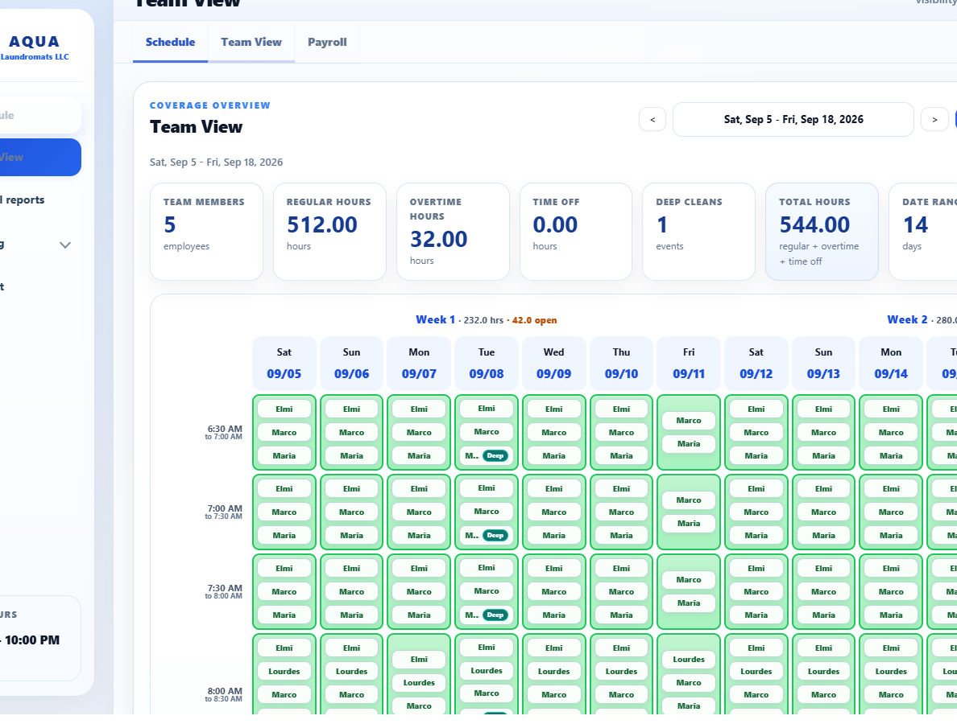
Security and trust
A useful app has to protect people’s information and their work
Access
Owners and managers do not see the same information.
Cloud data
Firebase rules help control who can read and write.
Backups
The app can keep a safer copy before a restore.
Visible status
A clear message shows whether a save reached the cloud.
Aqua Laundromats Scheduler
08
Notes:
Security is not only a technical word. It means people can trust the app with their work. We thought about who should see pay information, what happens when the internet has a problem, and how to reduce the risk of lost changes.

Slide 9
Thinking like an engineer
I am still learning code, but I learned how to ask better questions
What could break?
Who could be affected?
How can I test the fix?
What happens on a phone or weak internet?
That habit helps whether I am building an app, planning an event, or solving a problem at work.
Aqua Laundromats Scheduler
09
Notes:
I do not know everything about software. But I have learned to pause and ask what could go wrong, who it affects, and how I can verify the answer. That is a skill kids can use in any field.

Slide 10
Your idea might start with
a problem you already know.
IDEA
Ask a clear question.
Learn as you go.
Keep improving.
Look around school, home, church, or your neighborhood. Notice something confusing, slow, or frustrating. That can be the beginning of a project.
AI can help you begin. Your ideas give it direction.
Thank you
Aqua Laundromats Scheduler
10
Notes:
My final message is simple: you do not have to wait until you know everything. Start with a problem you care about. Ask a clear question. Learn one step at a time, and ask for help when you need it.

