Slide 1
Spring Framework
A Dependency Injection Framework, and much more

Slide 2
What is Spring Framework?
Dependency Injection Framework
Makes working with different JEE Standards Easier
Actas as glue between different frameworks

Slide 3
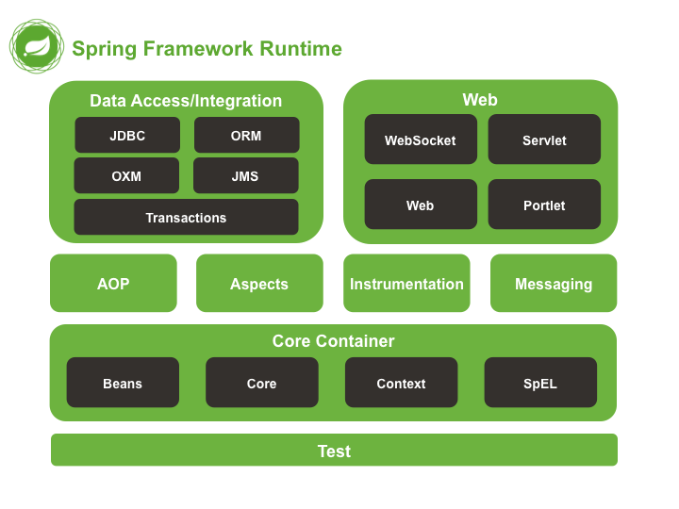
Main modules

Slide 4
Dependency Injection
“Don’t call us, we’ll call you”
Spring manages the lifecycle of your objects
You provide a map of how the application is wired together
Makes testing easier
Allows Spring to enhance your classes, with transaction management or other functionality

Slide 5
ApplicationContext
The ApplicationContext is the heart of your spring application
It contains instructions of how objects are mapped together
Can be XML-based, annotation based, java-based or groovy-based
The application-context must be instantiated by your application, either directly or indirectly
All beans which are part of the application-context has access to it
Dependencies can be injected using constructors, fields or setters

Slide 6
XML-based Dependency Injection
Was the only form of DI in early versions of Spring
Is more or less considered legacy, not recommended for new projects
Instantiated using new ClassPathXmlApplicationContext("services.xml", "daos.xml")

Slide 7
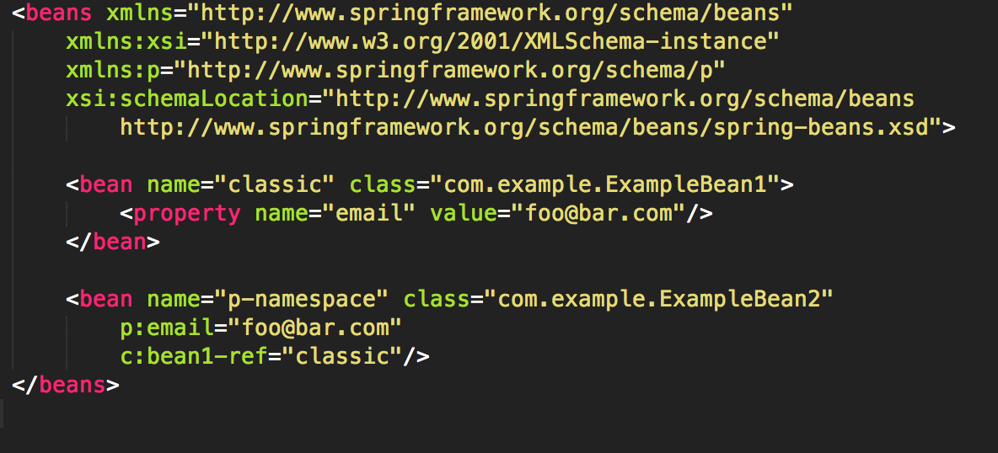
Example XML context

Slide 8
Annotation-based context
Uses annotations on your classes, fields, setters, constructor and methods to wire objects together
Created using new AnnotationConfigApplicationContext();
@Component or @Service on class defines that class as spring managed
@Autowired on fields, setters or methods instructs spring to inject an object of the correct type
Constructors do not need the @Autowired constructor, all referenced spring objects are injected if the object is spring managed
@PostConstruct and @PreDestroy can be used for initialization after all wiring is done

Slide 9
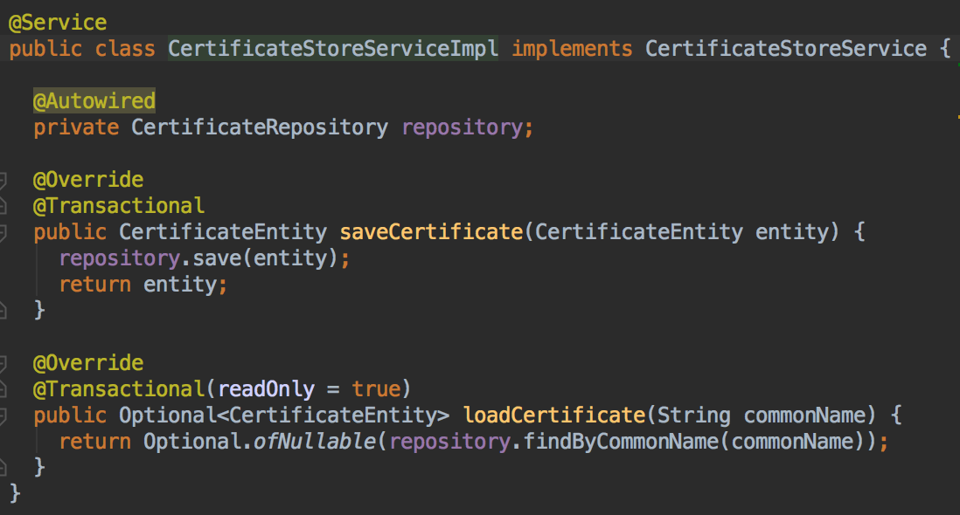
Example @Annotation-config

Slide 10
Java-based context
Annotate one or more classes with @Configuration
Annotate one or more methods in these classes with @Bean
The methods will be called by spring when creating managed objects
Also created using new AnnotationConfigApplicationContext();
Used if you want one centralized location for your context
Can also be used to initialize third party classes
Dependencies can be injected using method parameters

Slide 11
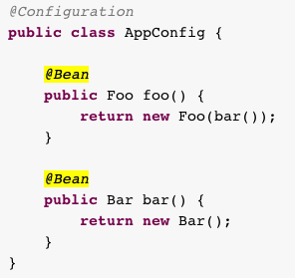
Example java context

Slide 12
Bean Scope
Beans can have different scopes
Singleton scope is default if nothing is defined. One object instance is created for the whole application
Prototype scope means that every autowired dependency gets a new instance
Session scope means one reference per web session
Request scope means one instance per user web request
Websocket scope means one instance per websocket connection
Set using the @Scope annotation

Slide 13
Resources
Use the Resource class to get external resources
Can be used by injecting the ApplicationContext and calling ctx.getResource(”classpath:files/myTemplate.txt");
Can also be injected by using the annotation @Value(”classpath:files/myTemplate.txt"
Prepend with classpath: to get resources on classpath

Slide 14
Testing
Spring has excellent test-support
Annotate your junit class with @RunWith(SpringRunner.class) and it will create a context for you
Use @ContextConfiguration to specify if you need to apply special test-configuration
Use MockMVC to mock rest endpoints
Use JdbcTestUtils to easy in testing database
Etc…

Slide 15
Spring MVC
Framework used for creating dynamic web pages
Is also used for creating rest services
Annotation based configuration
Annotate class with @Controller for building web pages
Annotate class with @RestController for rest
We will only look at rest…

Slide 16
Enable Spring MVC
You must add a class which has the @Configuration and @EnableWebMvc to enable the MVC functionality
You must also add jackson 2 to your pom.xml(it handles serializing to and from JSON)
And make sure that you have the spring-webmvc module in your pom.xml
Now MVC is enabled

Slide 17
Setup RestControllers
Create a class which has the @RestController annotation. This class will contain all your enpoints
Also create your model objects, i.e. regular POJOS which will be used to generate JSON-payloads
Create methods annotated with @RequestMapping to map a method to an URL. You can also use the more specialized versions:
@GetMapping
@PutMapping
@PostMapping
@DeleteMapping
PatchMapping

Slide 18
Example
@GetMapping("/user") public User getUser() {
GET json object User from endpoint http://localhost:8080/user
@RequestMapping(value=”/user/{user}", method=RequestMethod.GET) public User getUser(@PathVariable Long user) {
GET JSON object USER from endpoint http://localhost:8080/user/2
@PostMapping(value="/customer") public Customer createCustomer(@RequestBody Customer customer){
POST JSON object Customer to http://localhost:8080/customer

Slide 19
More fine grained control
ResponseEntity can be used if you want more control over the HTTP Status code and headers returned
@ResponseStatus can be set on exceptions to define what HTTP Status code will be returned when the exception is thrown

Slide 20
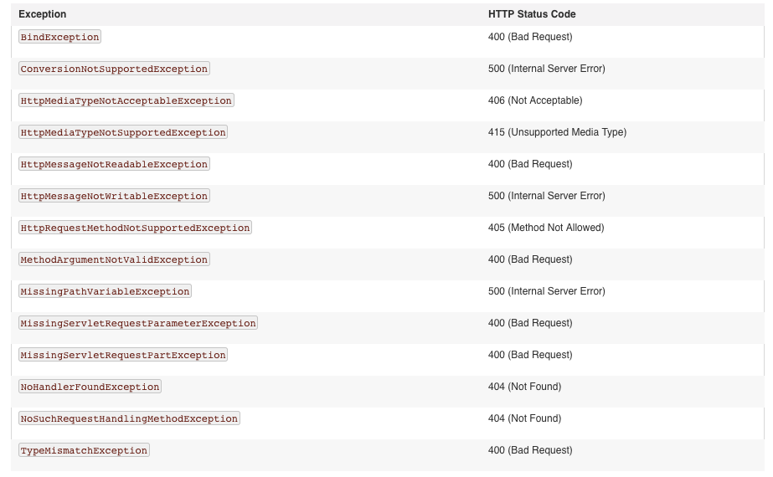
Default exception mappings

Slide 21
Time for some exercise

