Slide 1
Diffusion in Genotype Space
2

Slide 2
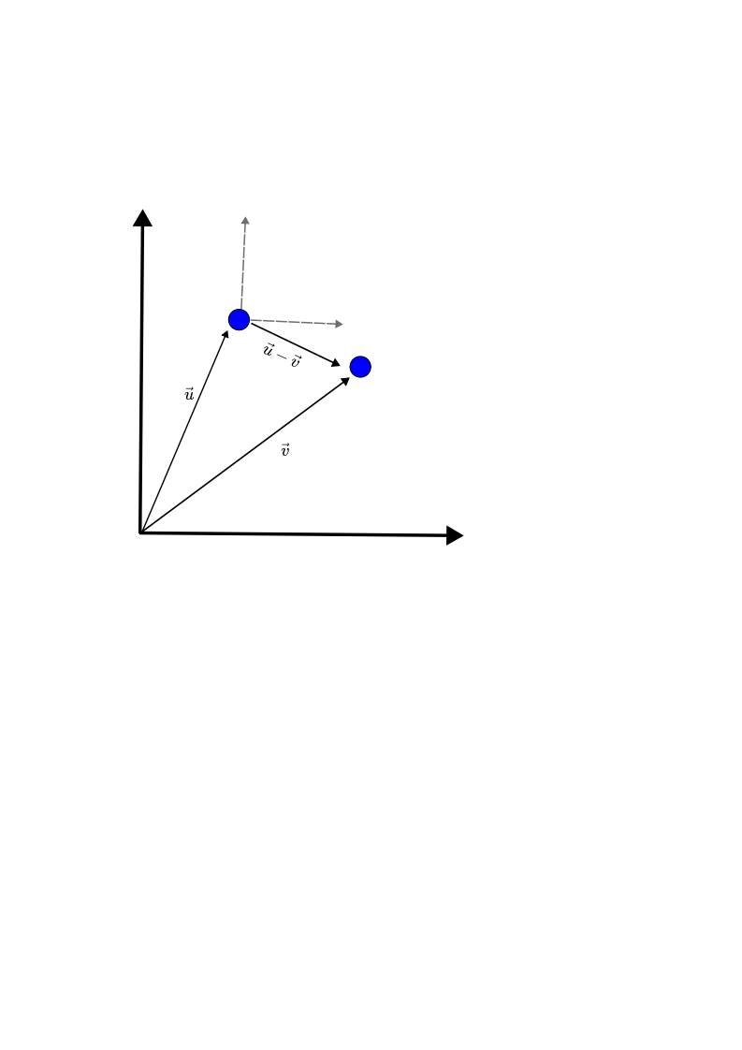
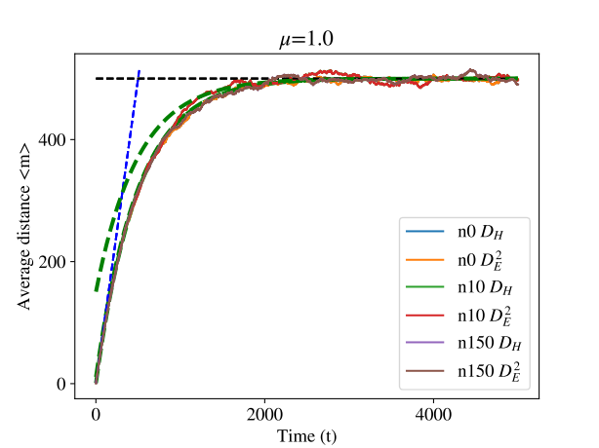
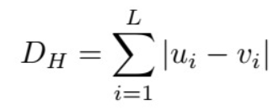
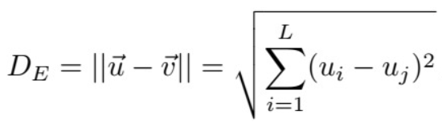
Diffusion in Genotype Space
Using this metric only shifts the origin

Slide 3
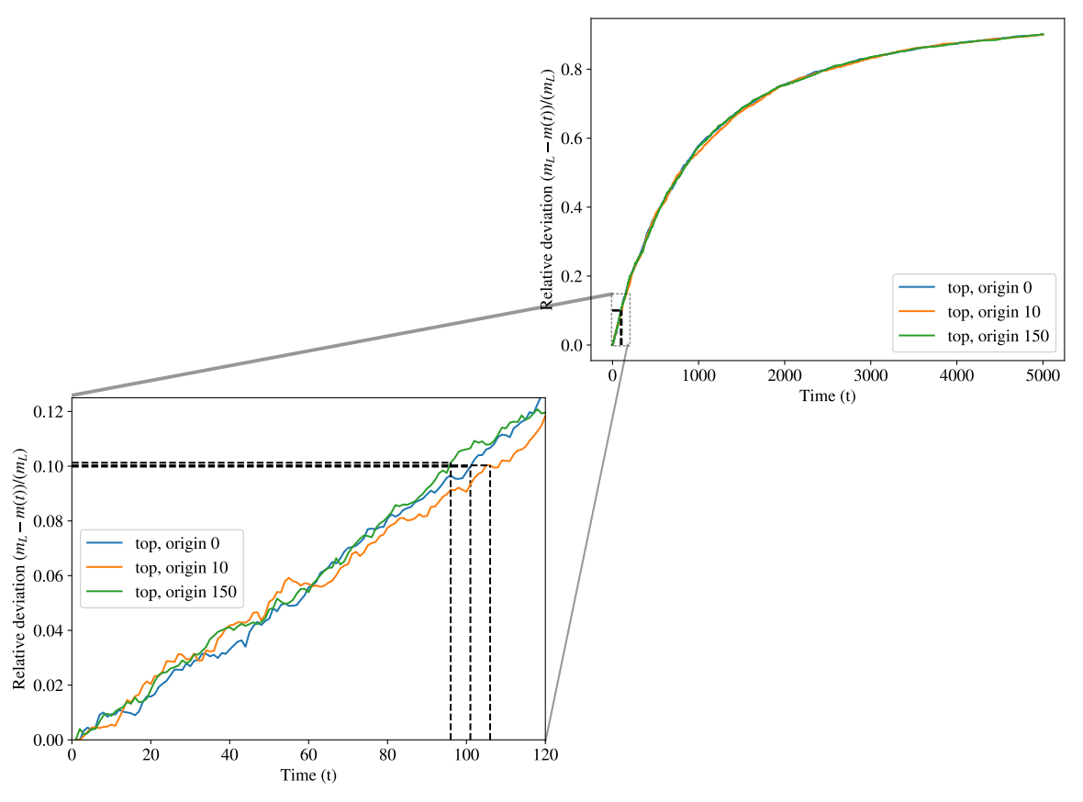

Diffusion in Genotype Space
When can we say that linear approximation is valid?
(With this new metric, different origins are pointless.)

Slide 4

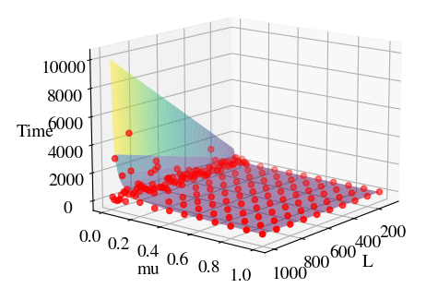
Diffusion in Genotype Space
Surface → Theoretical result
Points → Simulated
Developing m(t) to second order, one can obtain that
Simulations were carried and stopped when the mean number of mutations of the population was
then saving the value of t .

Slide 5
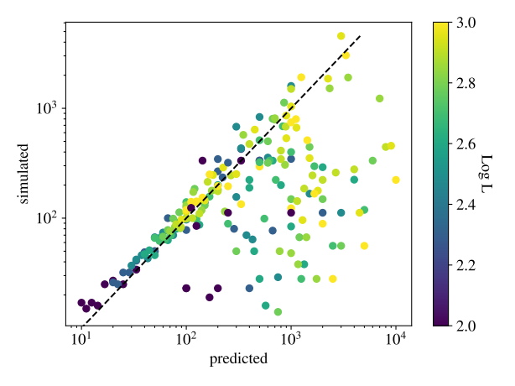
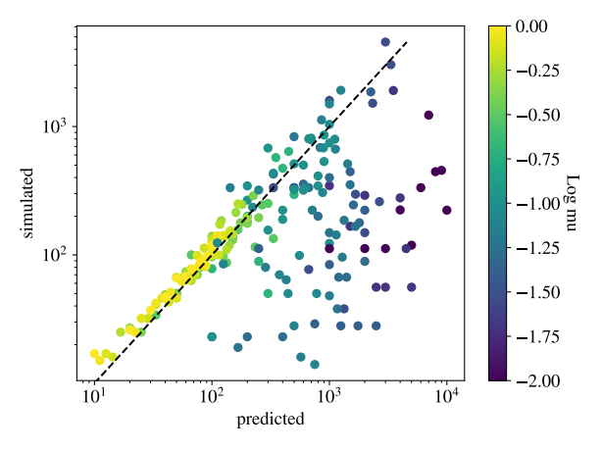
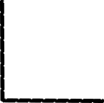
Diffusion in Genotype Space
Although we have a good agreement, prediction fails for small values of μ

Slide 6
Open questions
The upcoming phase involves the duplication of sequences with a specified probability, denoted as "p." In instances where the probability is 1-p, sequences do not duplicate but may undergo mutations.
I have a struggle deciding which implementation we want for the process.
1-) Does each sequence undergo a predetermined duplication? (my most voted)
This scenario suggests that certain sequences possess advantages for replication based on their genotype.
2-) Is the duplication of each sequence a random event (with probability p)?
In this case, the replication process appears to be a stochastic one within the population, regardless of the specific genotypes present.

