Slide 1
Diffusion in Genotype Space

Slide 2

Diffusion in Genotype Space
Origin (00000000….0)

Slide 3






Diffusion in Genotype Space
Origin (00000000….0)

Slide 4
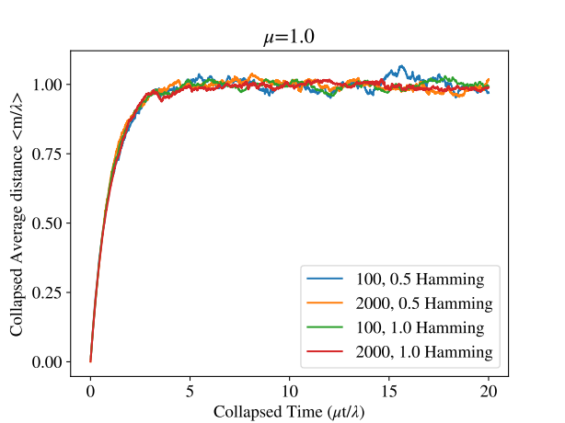
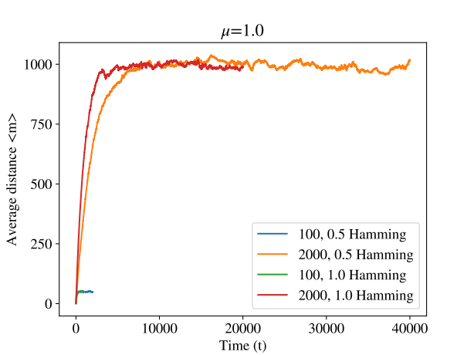
Diffusion in Genotype Space
Origin (00000000….0)

Slide 5
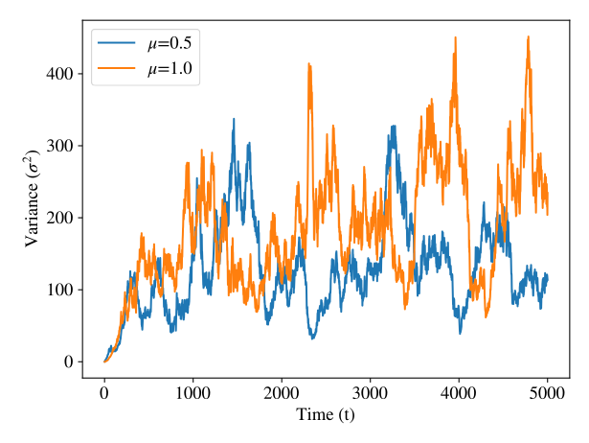
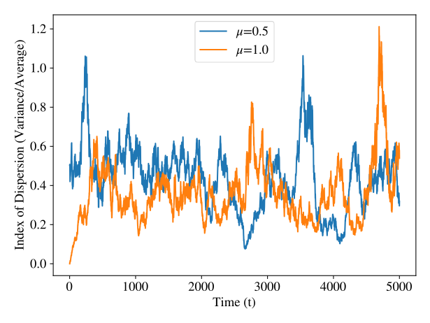
Diffusion in Genotype Space
Origin (00000000….0)

Slide 6
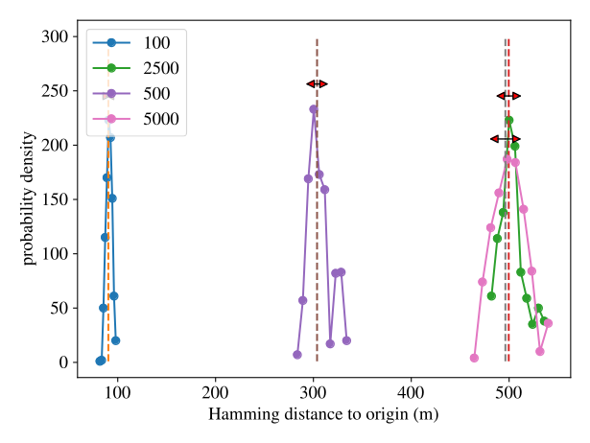
Diffusion in Genotype Space
Origin (00000000….0)

Slide 7
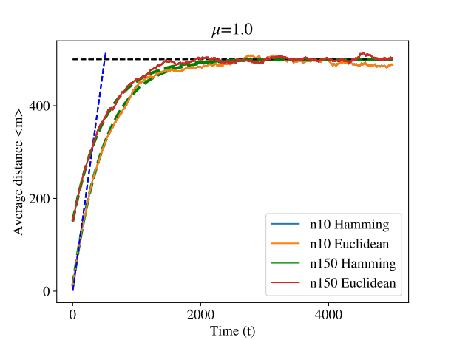
Diffusion in Genotype Space
Origin (1111100...000)

Slide 8
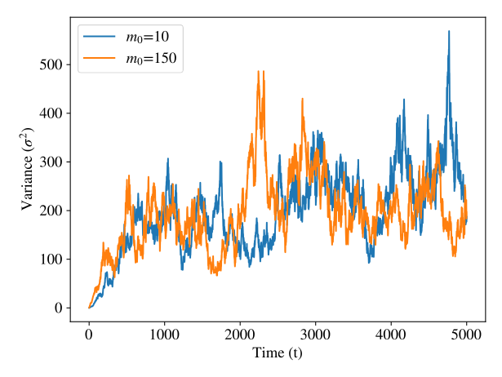
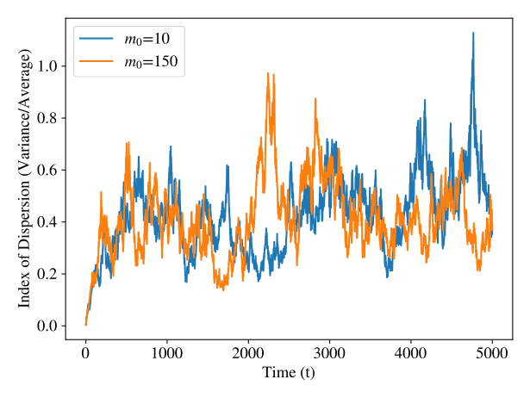
Diffusion in Genotype Space
Origin (1111100...000)

Slide 9
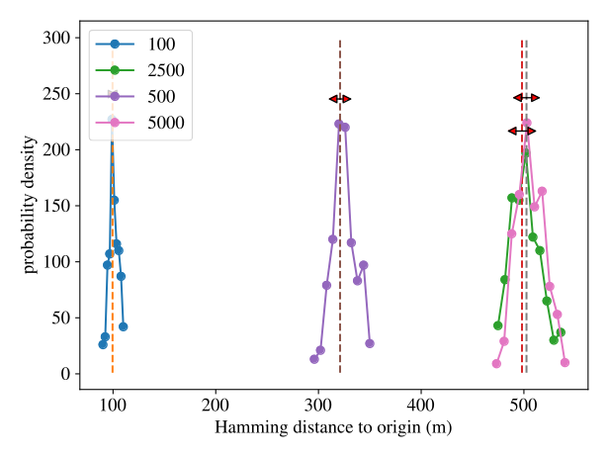
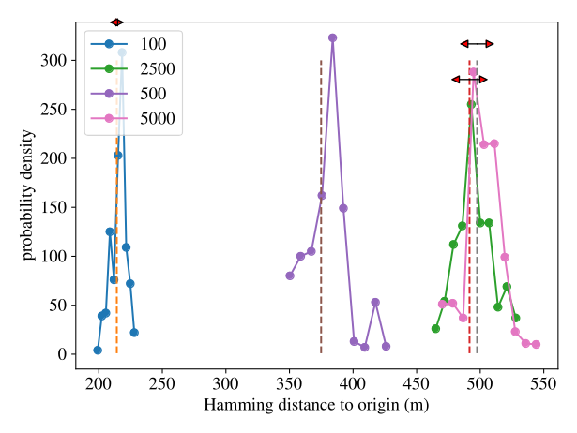
Diffusion in Genotype Space
Origin (1111100...000)

Slide 10
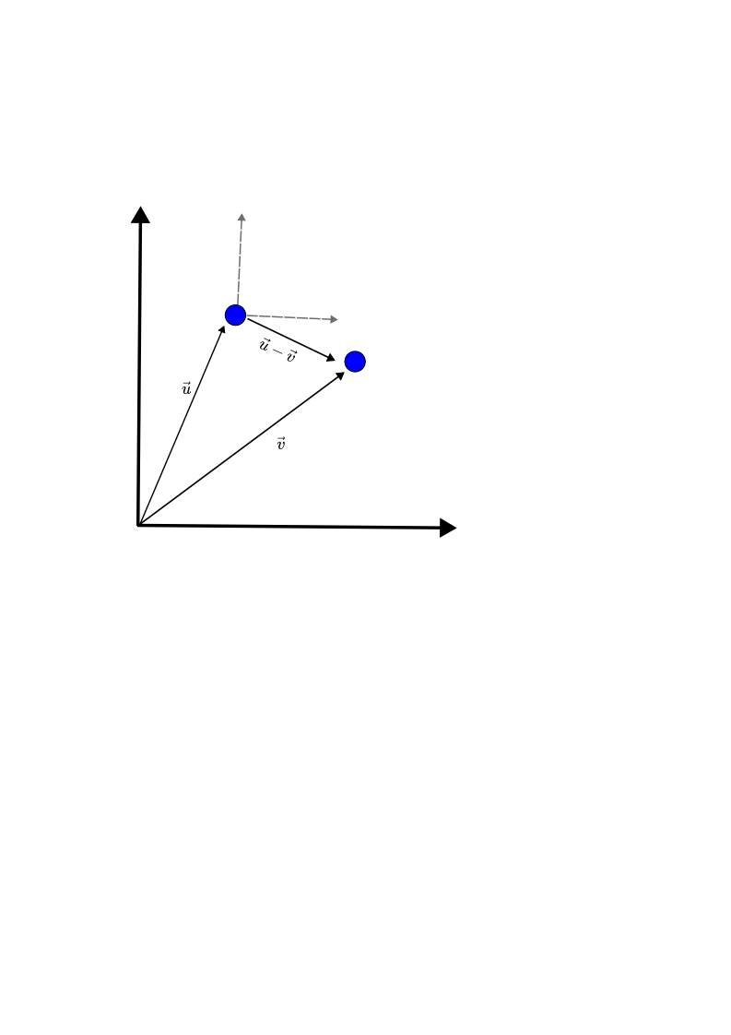
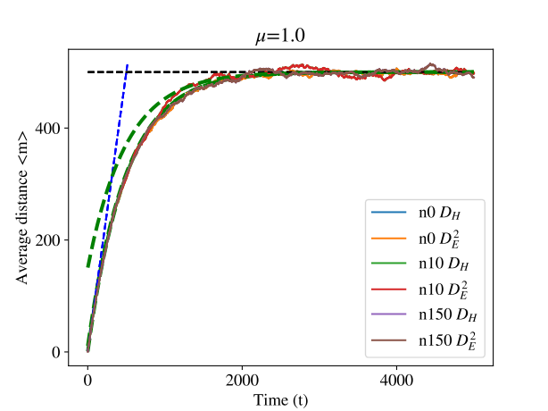
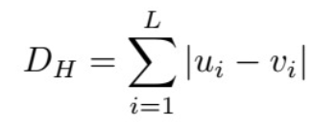
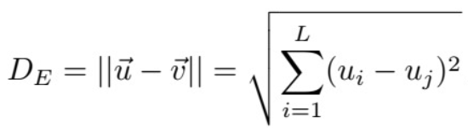
Diffusion in Genotype Space
Using this metric only shifts the origin

Slide 11
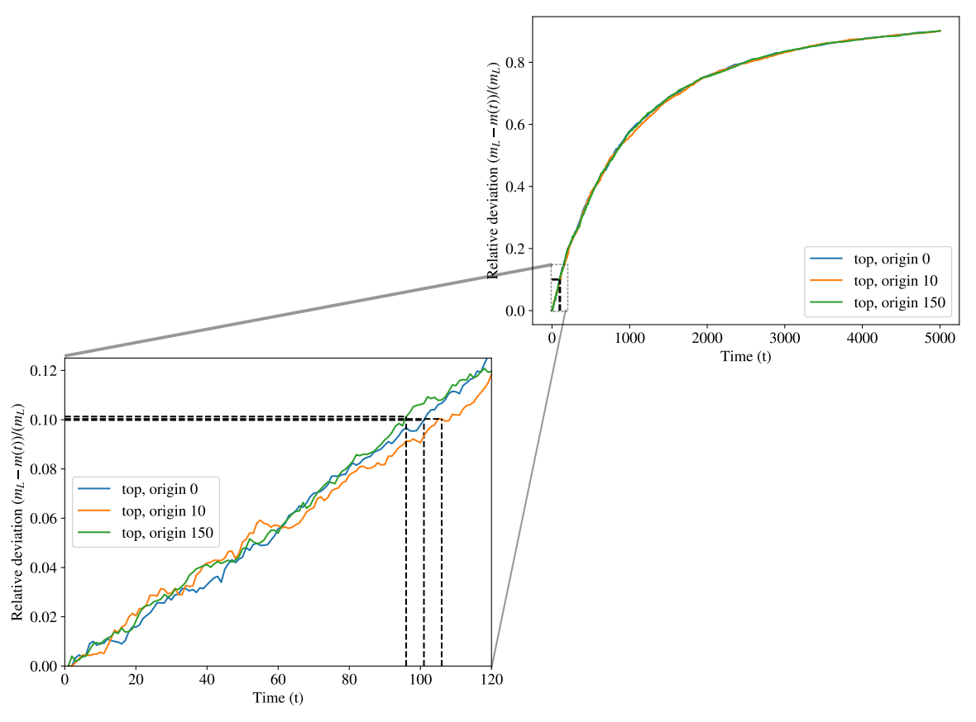

Diffusion in Genotype Space
When can we say that linear approximation is valid?
Write the approximation and when it is valid

Slide 12

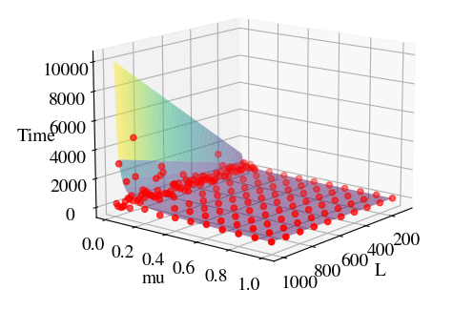
Diffusion in Genotype Space
Developing m(t) to second order, one can obtain that
Surface → theoretical result
Points → Simulated

Slide 13
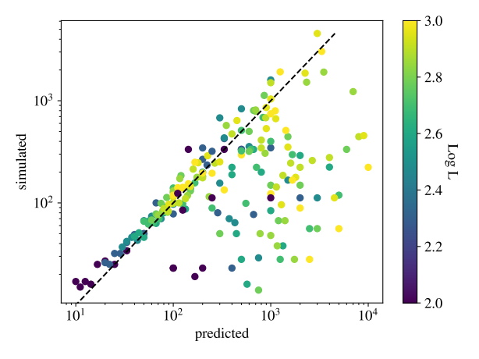
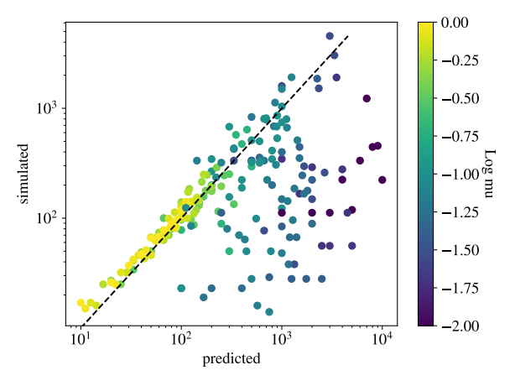

Diffusion in Genotype Space

