Slide 1
Simulation
Sequence: our_sequence_qbeta[:201] → wt
Population_0 = 3 sequences of the wt
One step is:
-for every sequence, create f (fitness) descendants, with f an int for each sequence
-for every descendant, introduce n mutations (n comes from Poisson with mean value μ*L). Mutations are created choosing a locus at random and changing the letter.
--if mutation introduces a stop-codon, then the # of descendants of genotype is f=0, in other case, f=2
Finally:
-select a number N_max of sequences at random to use for next population step
f=2
#mut = Poisson(μL)
f=0 o 2

Slide 2
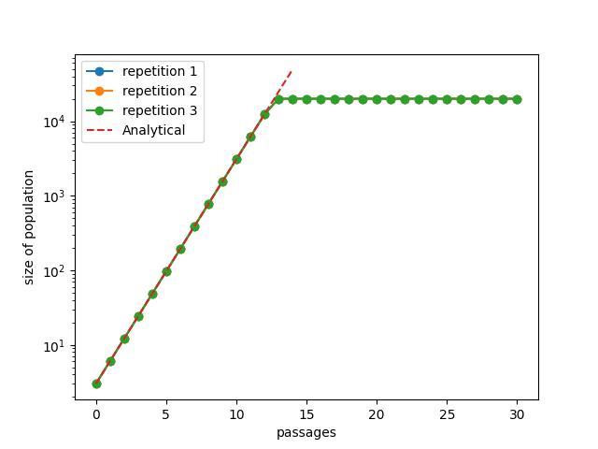
Simulation
Number of sequences at each step. No mutation rate: μ=0
N_max = 10**4

Slide 3
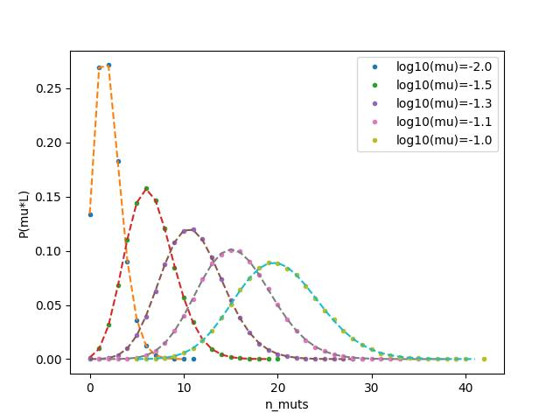
Simulation
Number of mutations generator comprobation
-Dashed are analytical Poisson distributions

Slide 4
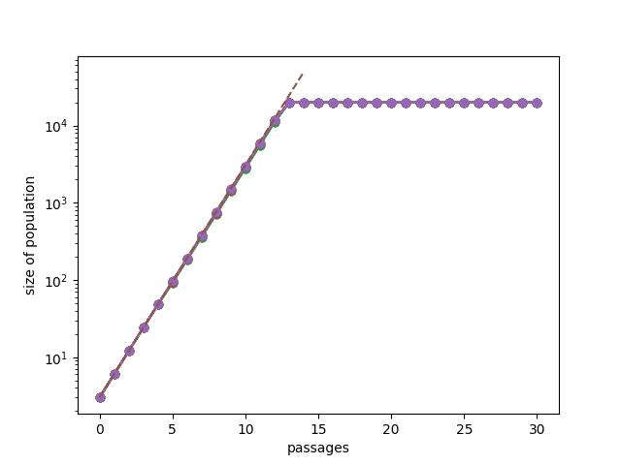
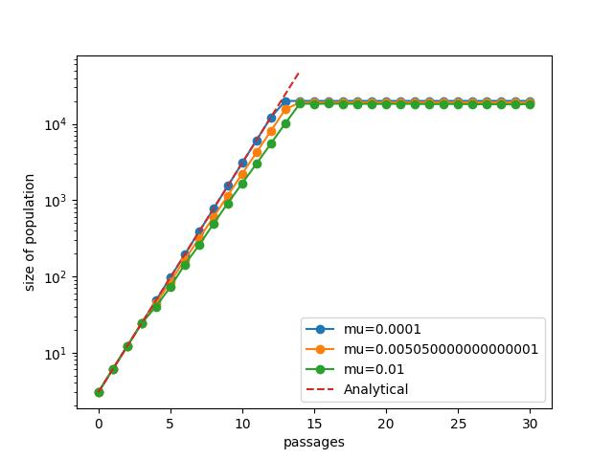
Simulation
Number of sequences at each step. Various mutation rate
N_max = 10**4
Mu=[0, 10^-3]

Slide 5
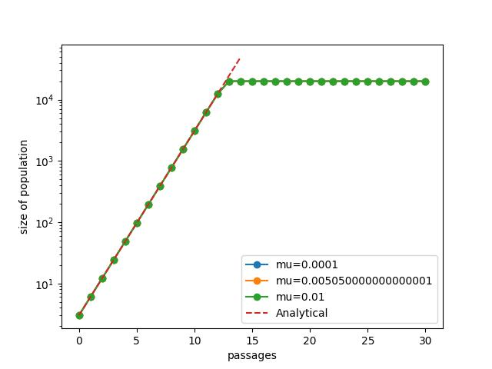
Simulation
Number of sequences at each step. Various mutation rate
N_max = 10**4
Same as previous but lethal mutations f=2
Mu=[0, 10^-3]

Slide 6
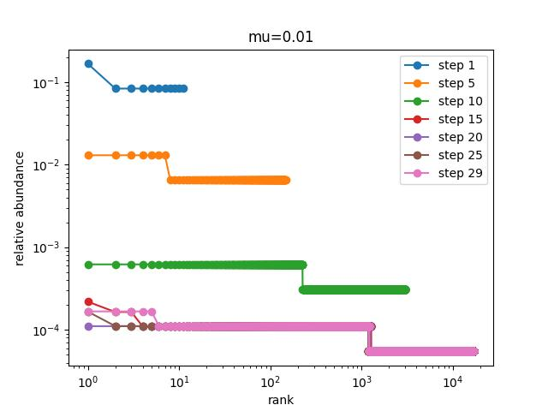
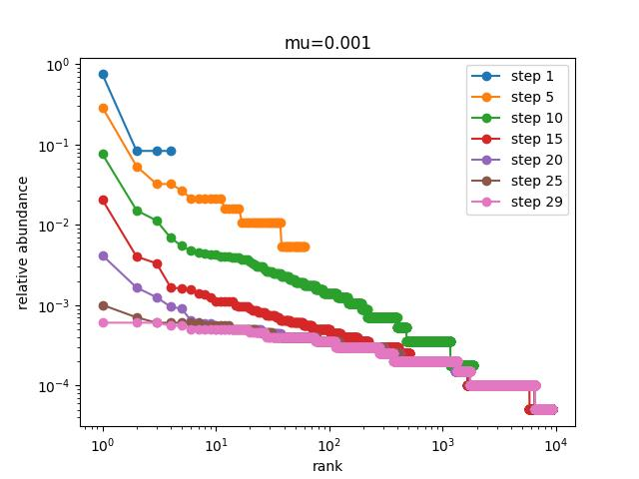
Simulation
Evolution of abundance distr with time, and mu
N_max = 10**4

Slide 7
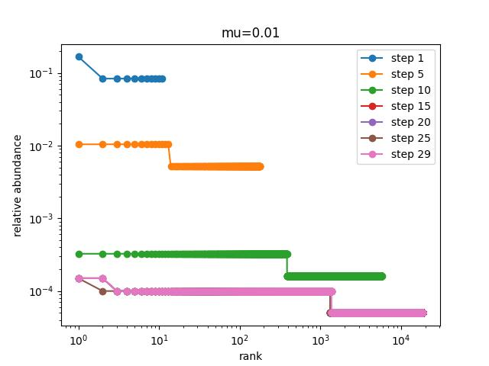
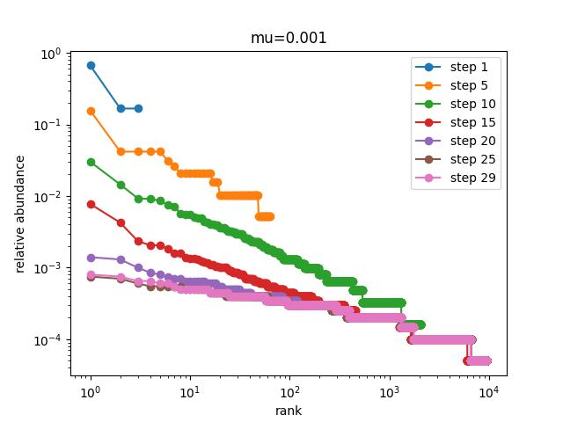
Simulation
Same as previous but without fitness selection
Evolution of abundance distr with time, and mu
N_max = 10**4

Slide 8
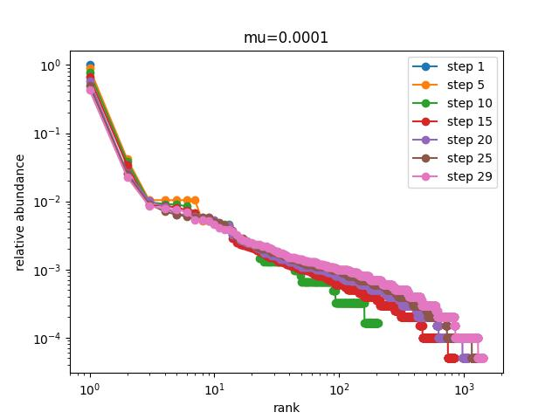
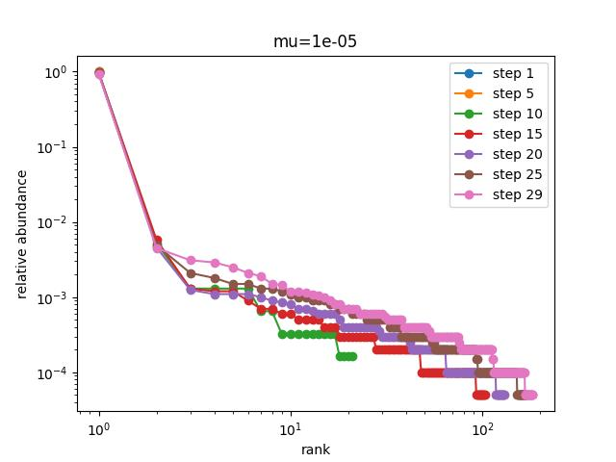
Simulation
Evolution of abundance distr with time, and mu
N_max = 10**4

Slide 9
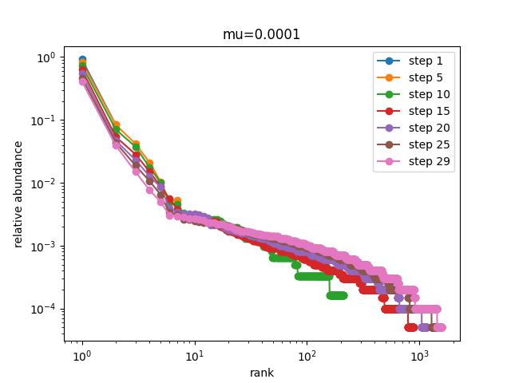
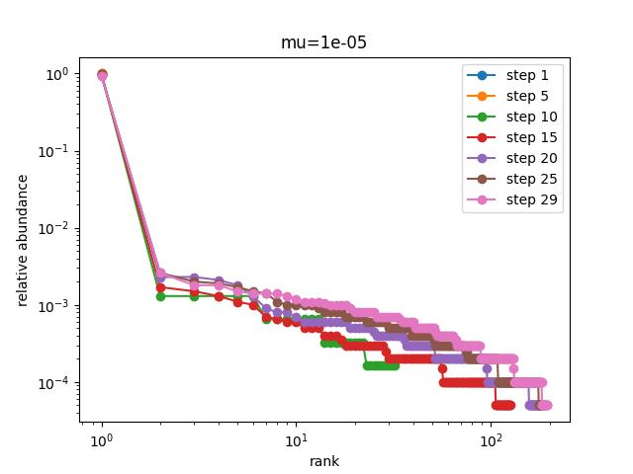
Simulation
Same as previous but without fitness selection
Evolution of abundance distr with time, and mu
N_max = 10**4

Slide 10
Algunas conclusiones?
La estructura herárquica influye màs en la forma de la distribución de abundancia vs. rank, que la distribución de fitness usada.
La tasa de mutación afecta la forma de la distribución abudancia vs. rank: altas tasas implican la separación en niveles de la curva, y bajas tasas tienden a dar una forma màs suave.
El aumento de la tasa de mutación retrasa el crecimiento de la población bajo selección

Slide 11
Proximos pasos
Si todo funciona bien, pasar a C++
Computar los population vectors y algunas propiedades, como los ángulos entre pases y respecto al origen.
Ídem computar la matriz de rotación de estos vectores y comprarla con la matrix de evolución en los papars (Manrubia, Aguirre, et al)
Poner distribuciones de fitness un poco más realistas. (Como suele ser una distribucion de fitness real, evomisa?)
Construir redes de genotipo

Slide 12
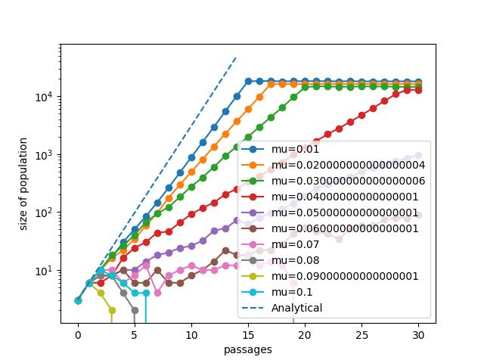
Error catastrophe

Slide 13
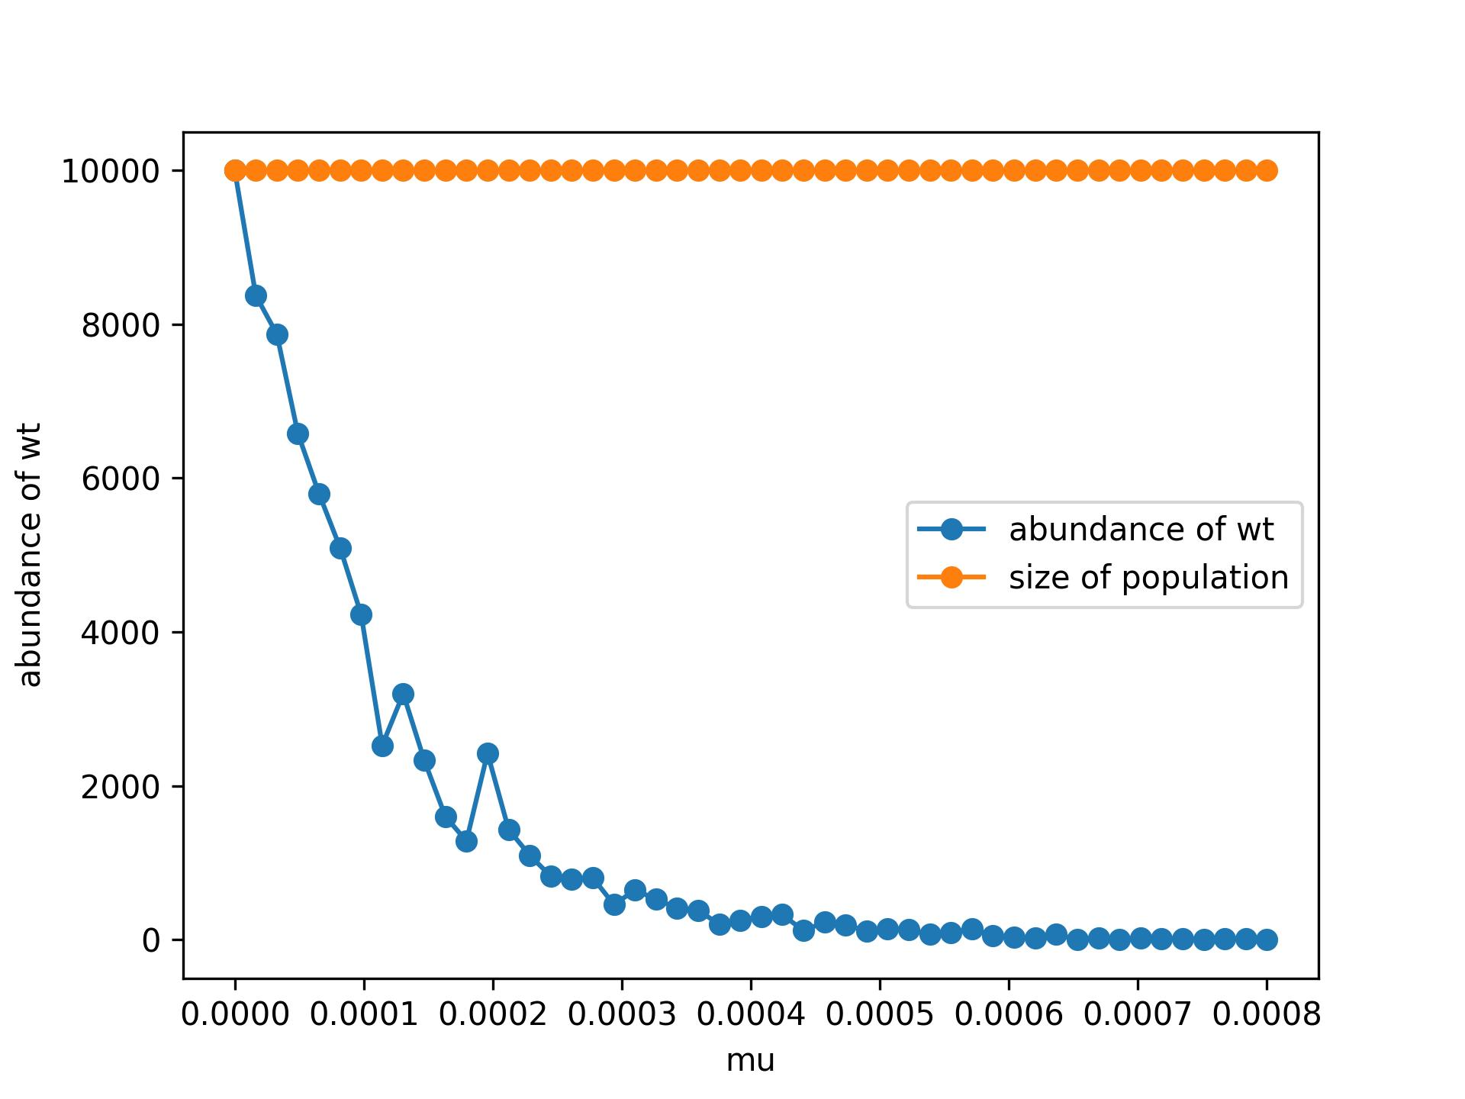
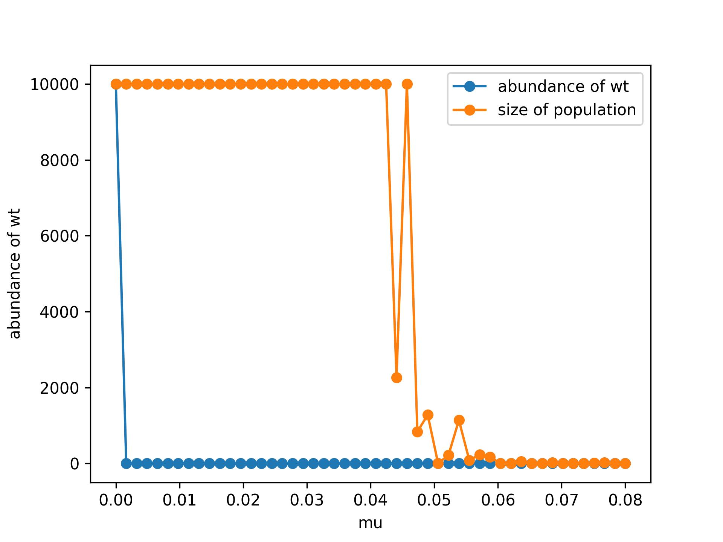
Error catastrophe
Abundance after 30 steps for different values of μ.

Slide 14
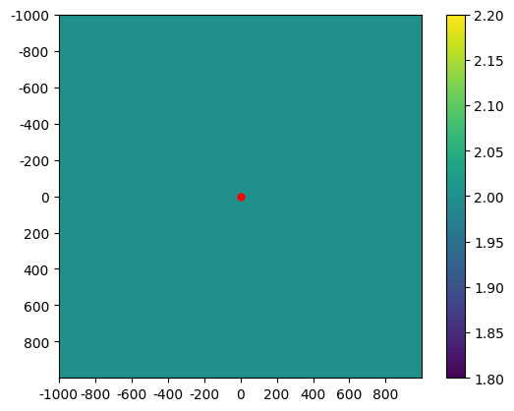
Random Walkers simulation
For t in range(t_max):
for each walker in population at t-1,
If, in its position, we have fitness_map=(f≠0),
then we create f copies of the walker and add to their position random vectors v = (±s, ±s) with s=1 .
Save those new walkers in the time-t population
In other case, nothing happens.
Re-sample the popultation in order to obtain a constant size N_max, but keeping each walker’s position’s abundance. This is for bigger than N_max populations and decreasing populations.
*distance → Euclidean 2D to origin
Create a matrix, with randomly distributed vales {0,f}. f will be the number of descendants every random walker will leave. 2D in a simple case. P is the proportion o f values in all grid.
Origin (0,0)

Slide 15
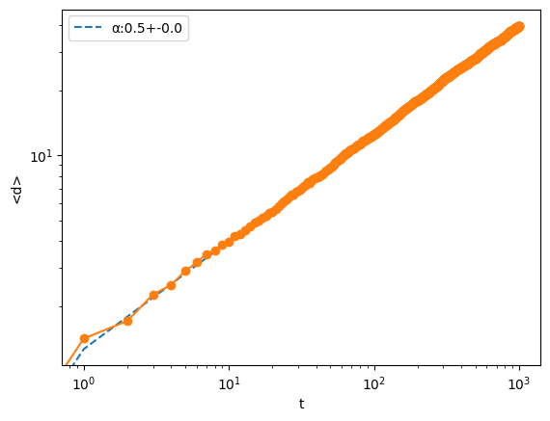
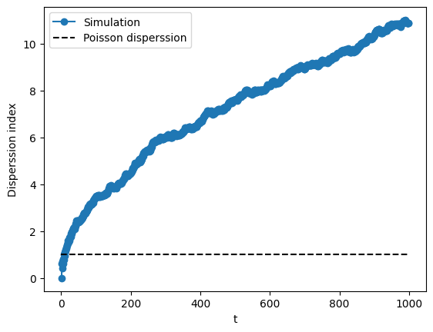
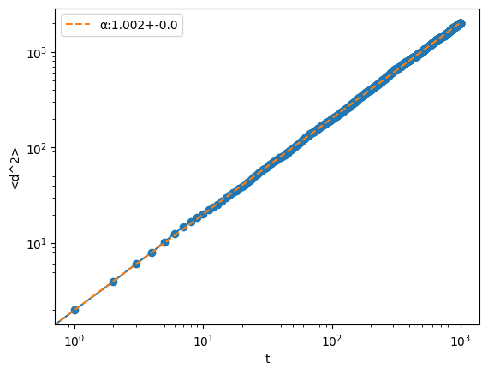
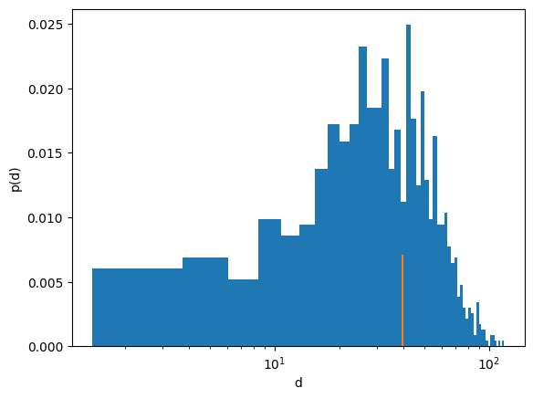
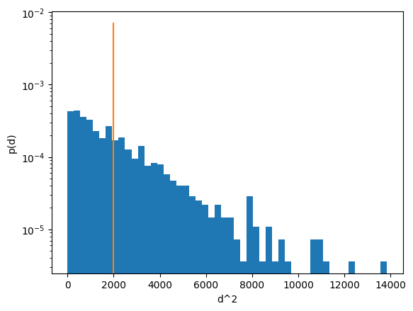
Random Walkers simulation
f=1 and p=1 is the same as a simple random walk
Square root
Difussion
Rayleigh distribution

Slide 16
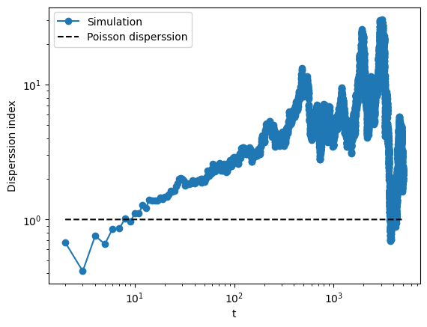
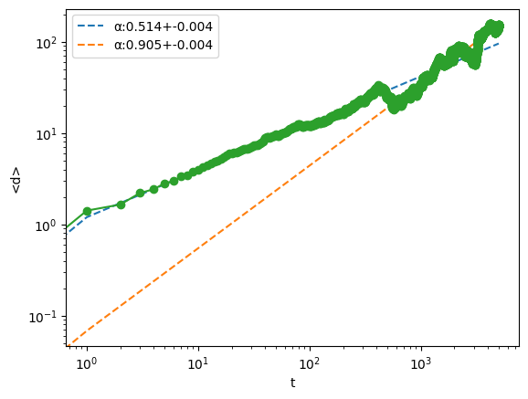
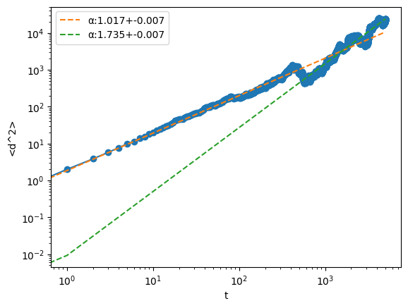
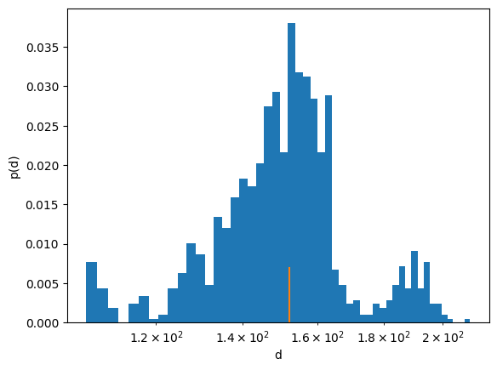
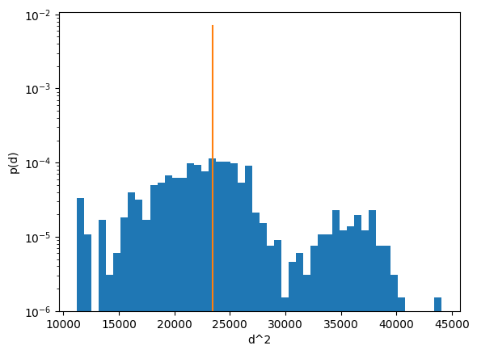
Random Walkers simulation
f=2 and p=1 is the same as a simple random walk
Splitted population?

Slide 17
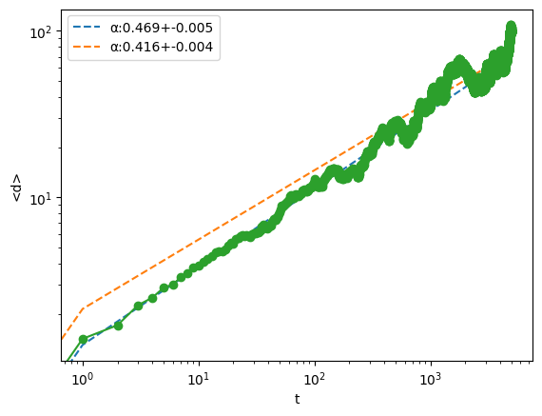
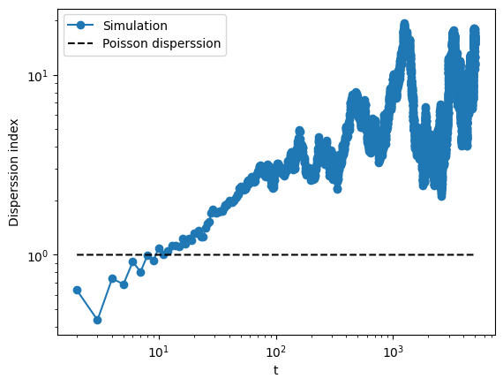
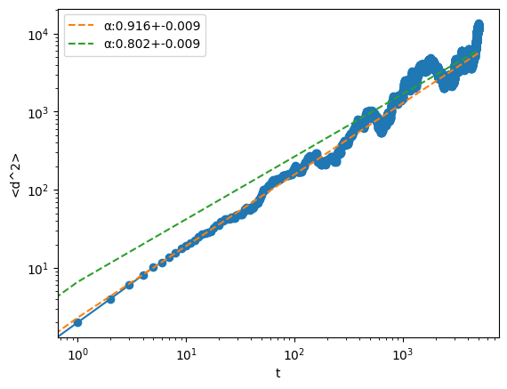
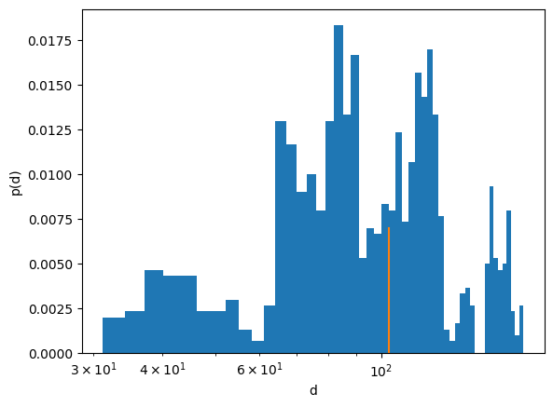
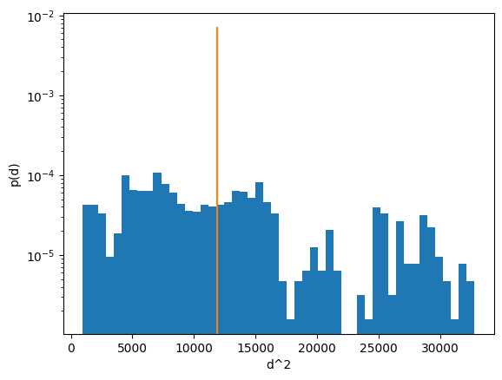
Random Walkers simulation
f=3 and p=1 is the same as a simple random walk
Seems that f does not affect alpha

Slide 18
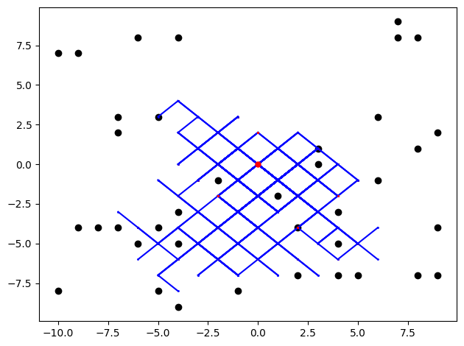
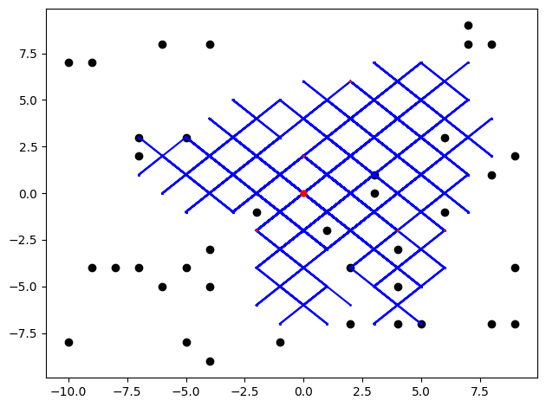
Random Walkers simulation
f=1 p=0.9 (10 steps, n_0=1, N_max=10**2)
f=10 p=0.9 (10 steps, n_0=1, N_max=10**2)
No visible difference

Slide 19
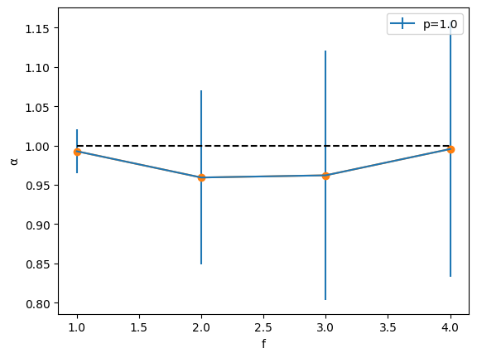
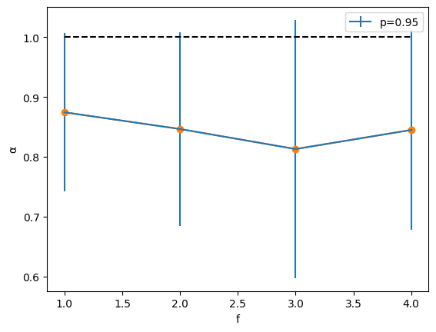
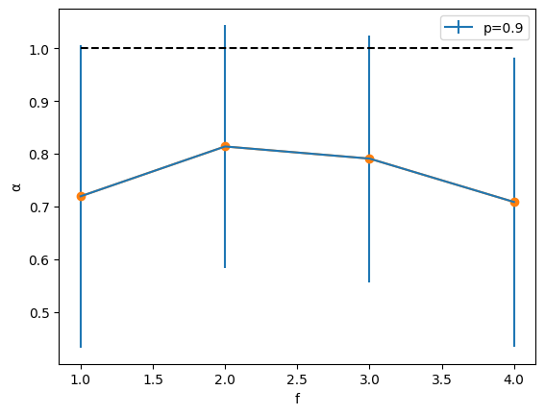
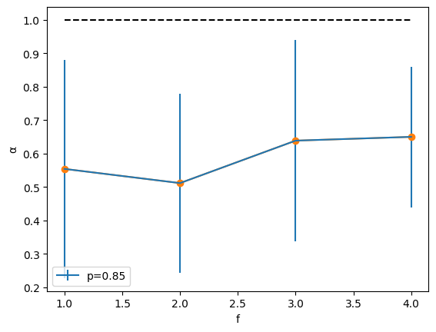
Random Walkers simulation
N_max=1000
n_steps=1000
n_0=100
Averaged over 20 runs

Slide 20
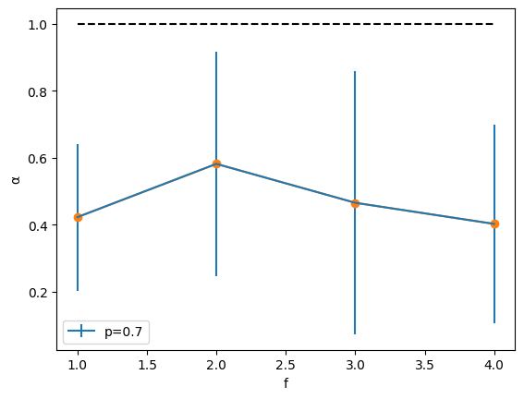
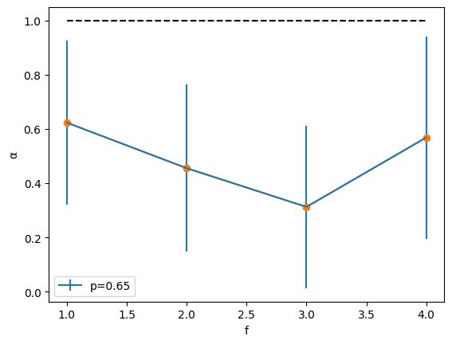
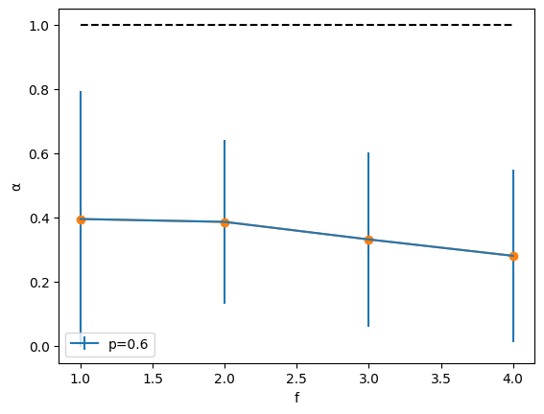
Random Walkers simulation
N_max=1000
n_steps=1000
n_0=100
Averaged over 20 runs

Slide 21
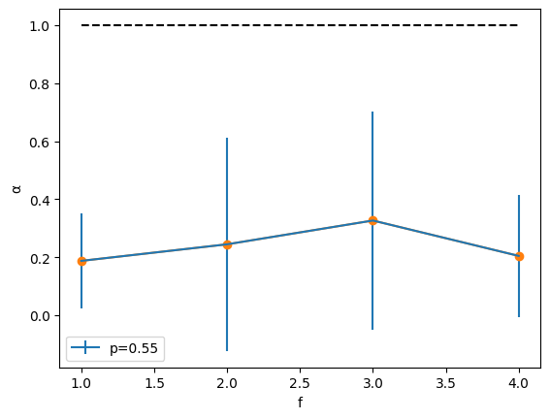
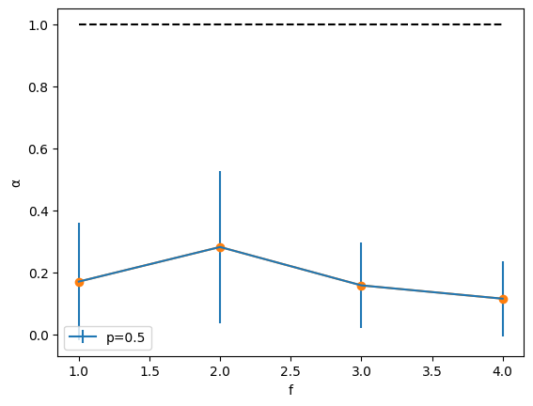
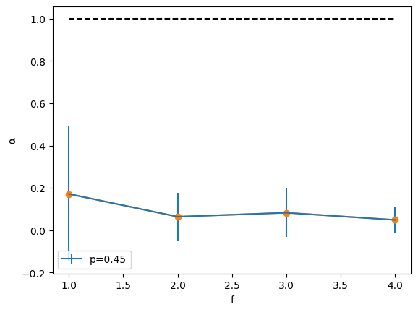
Random Walkers simulation
N_max=1000
n_steps=1000
n_0=100
Averaged over 20 runs

Slide 22
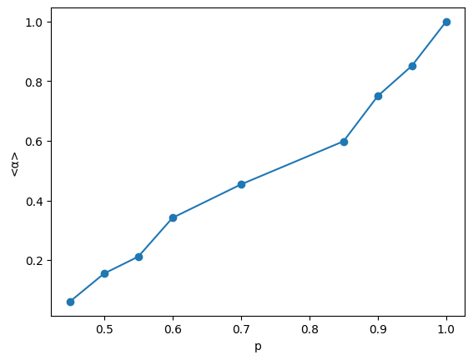

Random Walkers simulation
N_max=1000
n_steps=1000
n_0=100
Averaged over 20 runs

Slide 23
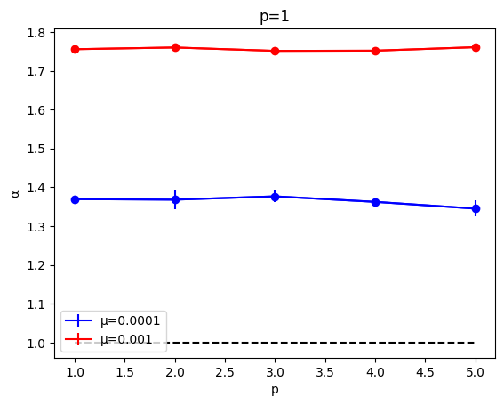
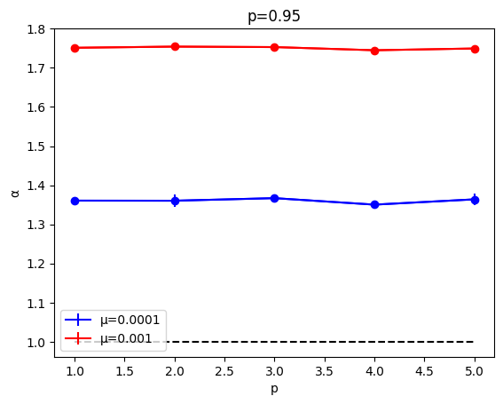
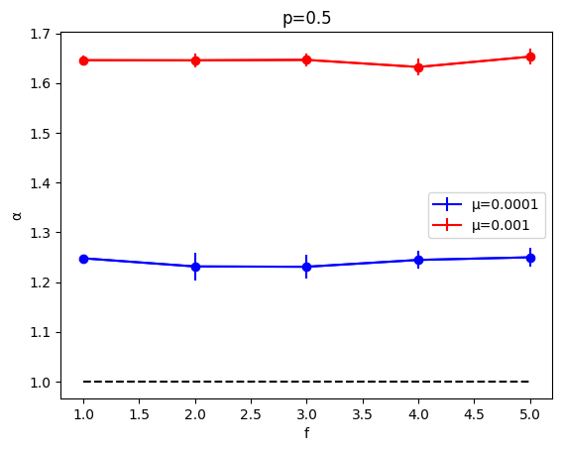
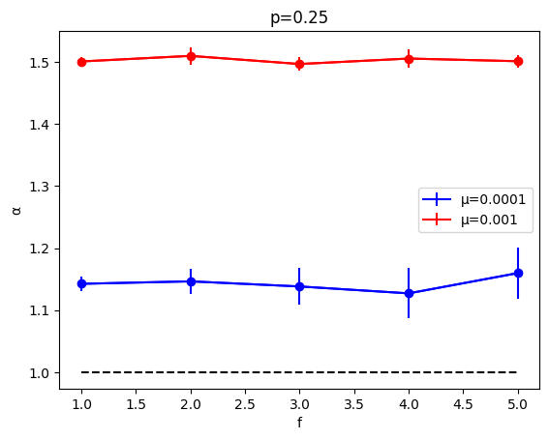
Neutral model
-New genotype created will have fitness f with probability p, and zero with 1 – p.
n_0=100
n_steps=100
N_max = 10**4
Averaged over 5 runs

Slide 24
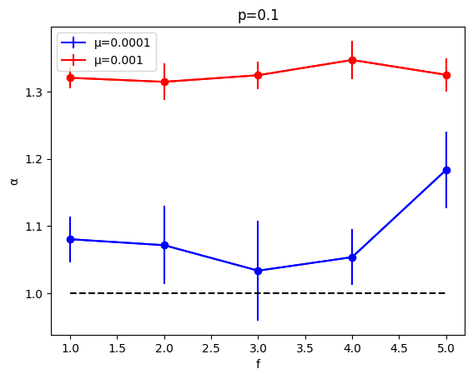



Neutral model
-New genotype created will have fitness f with probability p, and zero with 1 – p.
n_0=100
n_steps=100
N_max = 10**4
Averaged over 5 runs

Slide 25
Neutral model
-New genotype created will have fitness f with probability p, and zero with 1 – p.
n_0=100
n_steps=100
N_max = 10**4
Averaged over 5 runs

Slide 26

Neutral model

