Slide 1
Proteins evolution
coding
non-coding
AAG-CGC-TTC-CGT
AAG-CGC-UUC-CGU
A2 (end)
K - R - F - R

Slide 2
Proteins evolution
Proteins distributions → abundance vs. rank in each step and temp
EMPTY FOR NOW!

Slide 3
Proteins evolution
Most abundant proteins and evolution in time & temp

Slide 4
Most abundant Proteins
Select most abundant proteins:
For each step, temp, select the 10 most abundant proteins and add them to a list
At the end, count the number of times each proteins appears. Sort them by the abundance in this list (biggest to smallest).
Results (next slide)
WARNING: In my coding proteins are referred as aminoacid strings, aminostrings, or aminoS . This will be changed to avoid confussions.

Slide 5
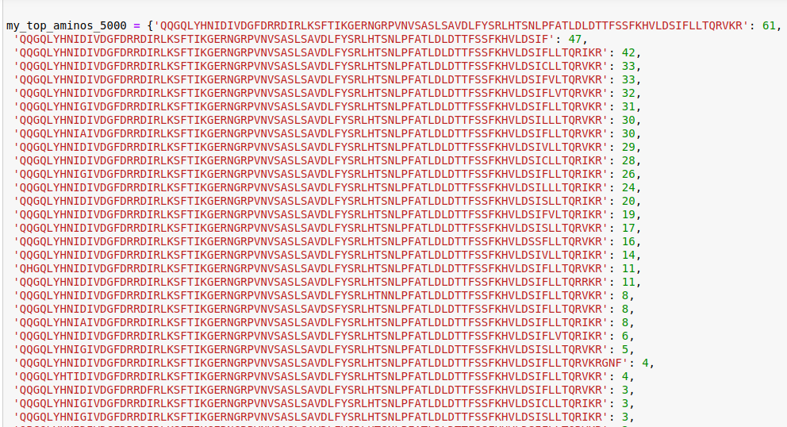
Amino1 is shorter than usual!
deleterious?
deleterious?

Slide 6
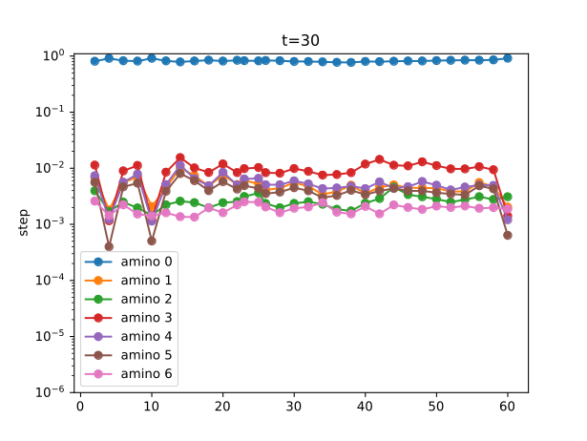
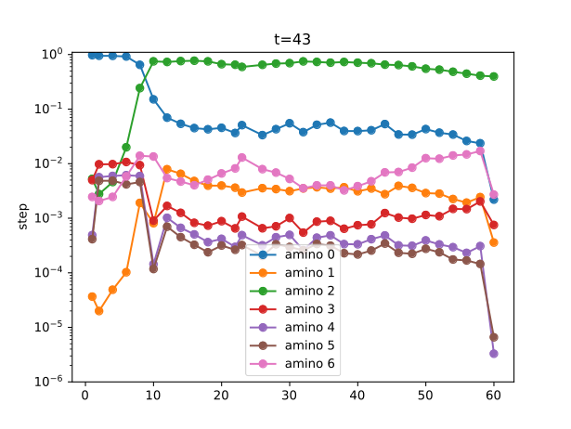
Proteins evolution
Amino1 tiene menos longitud que los demas!
Y → relative abundance
X → steps

Slide 7
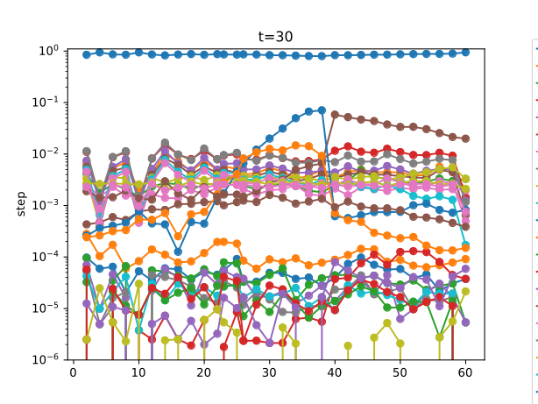
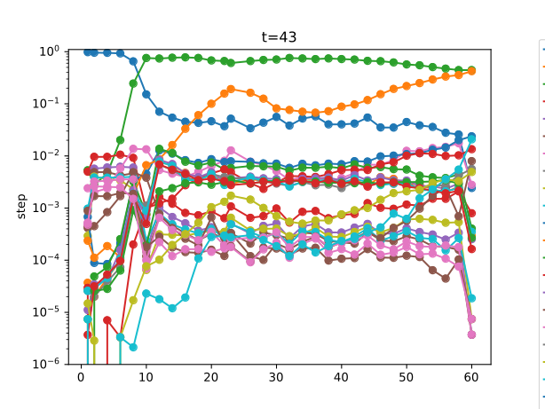
Proteins evolution
Same as prevoius but with more curves
Y → relative abundance
X → steps
amino0
amino2
amino11
amino20
amino15
amino0
amino0
amino21
amino15

Slide 8
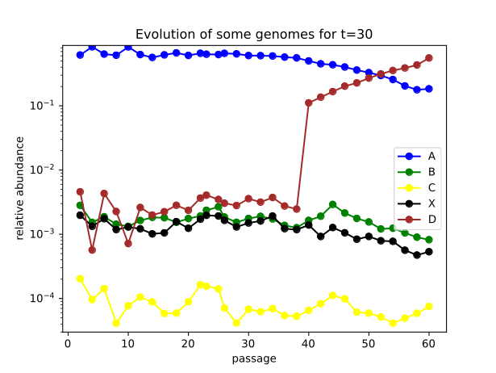
Proteins evolution
Y → relative abundance
X → steps
GENOTYPE
PROTEIN

Slide 9
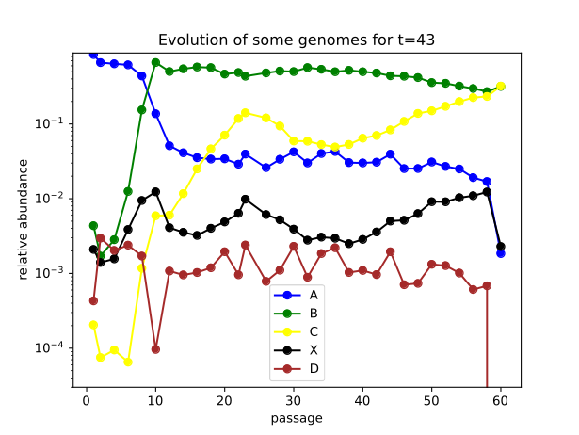
Proteins evolution
Y → relative abundance
X → steps
GENOTYPE
PROTEIN

Slide 10
Amino1, who are its generators? Hubs neighbors?
Aminoacid network? → Borrar proteinas truncadas o con exceso (running)
Size of genotype space coding same aminoacid? Compare with theoretical size? → Ver Biophys. Fig.6

