Slide 1
PROCESS PRESENTATION FOOTBALL
BY PRASANTH.S

Slide 2
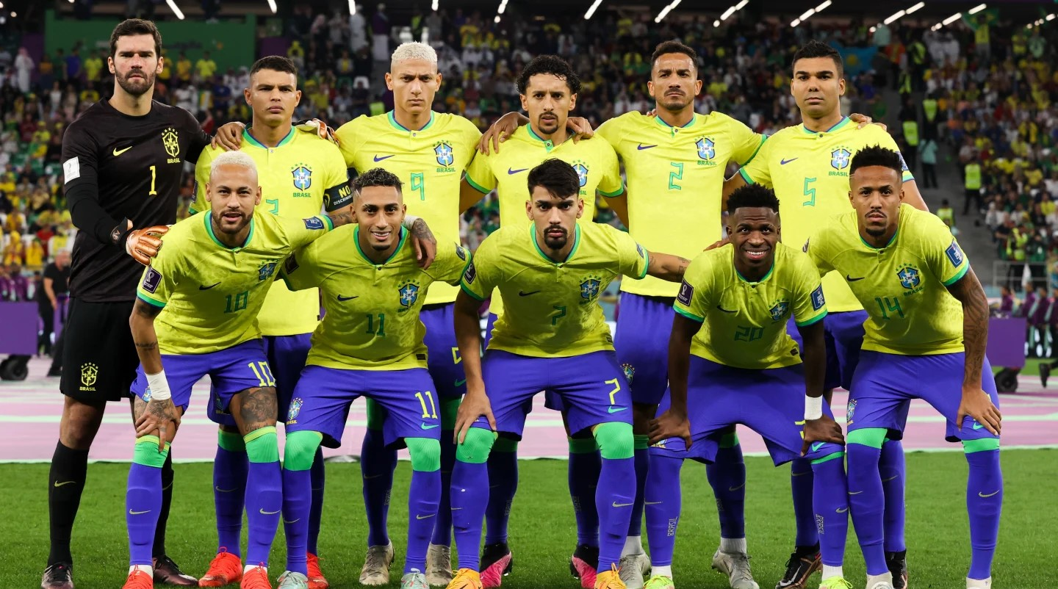

Slide 3
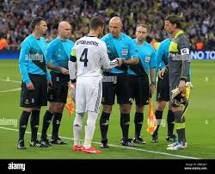
TOSSING

Slide 4
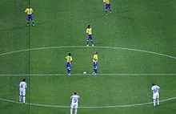
KICKOFF

Slide 5
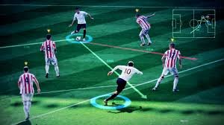
PASSING

Slide 6
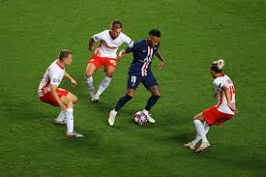
DRIBBLING

Slide 7
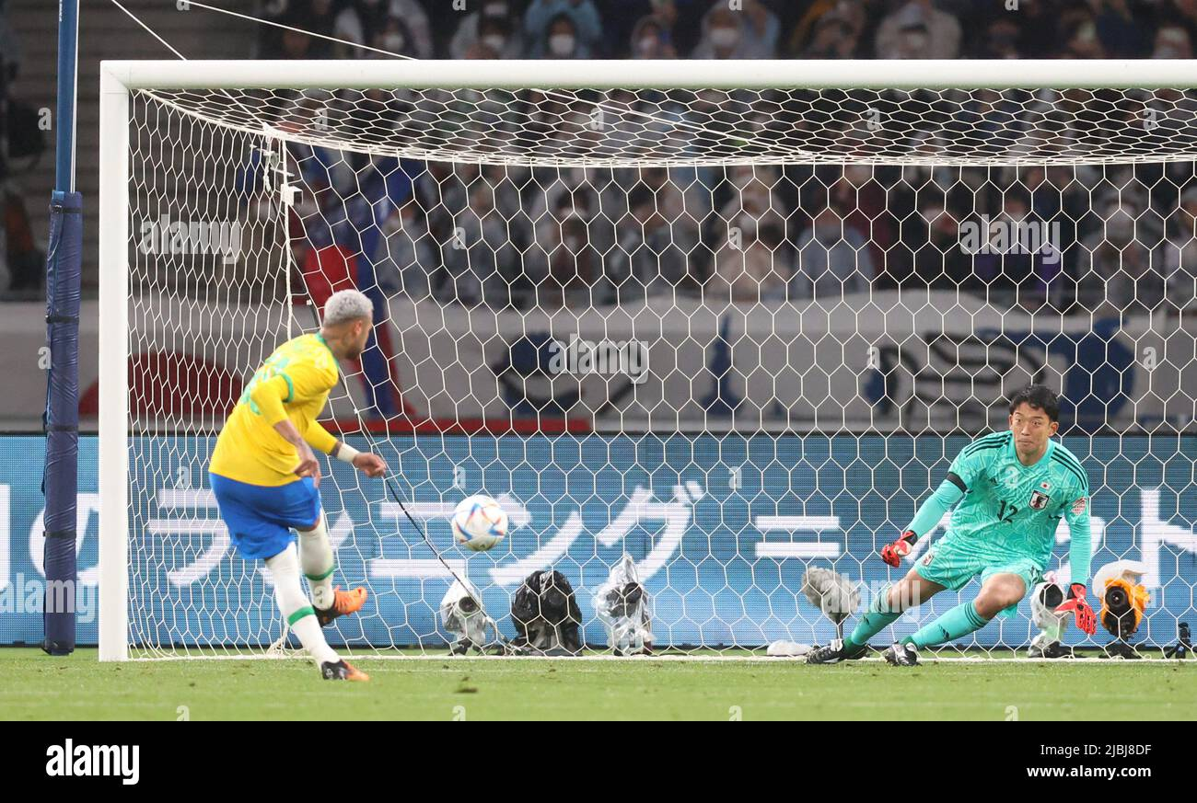
PENALTY

Slide 8
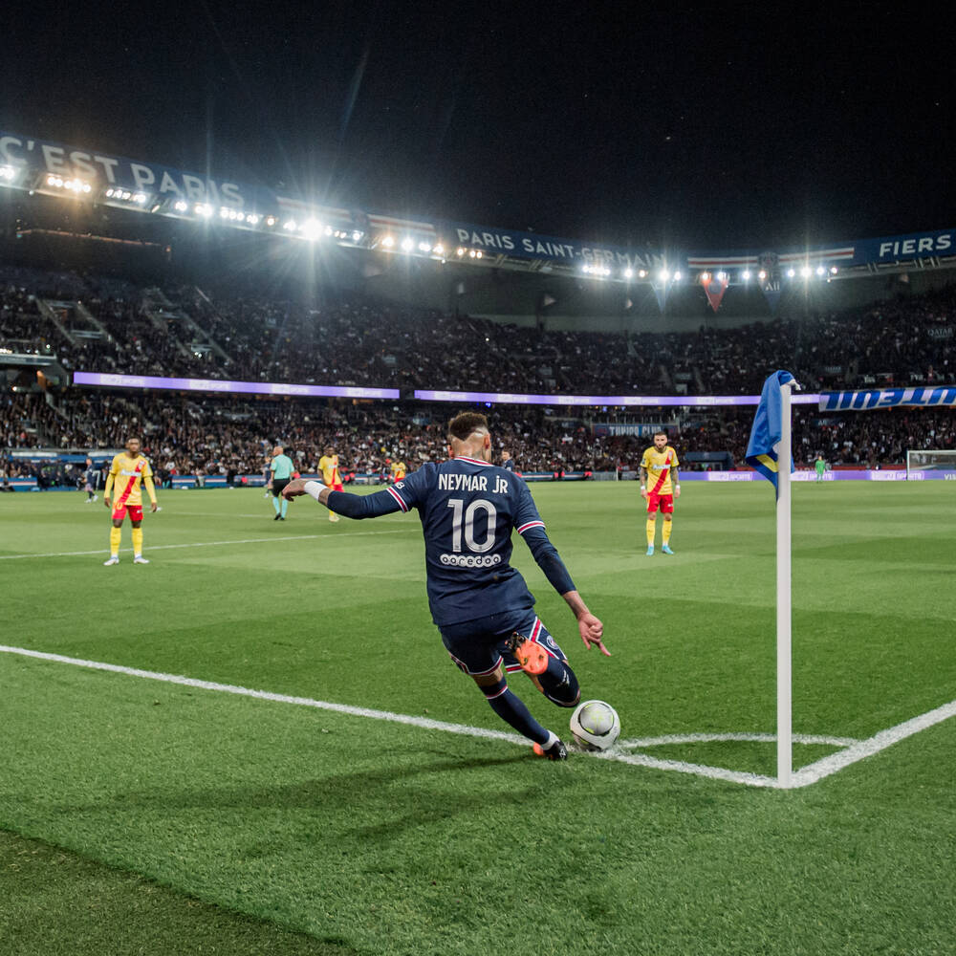
CORNER KICK

Slide 9
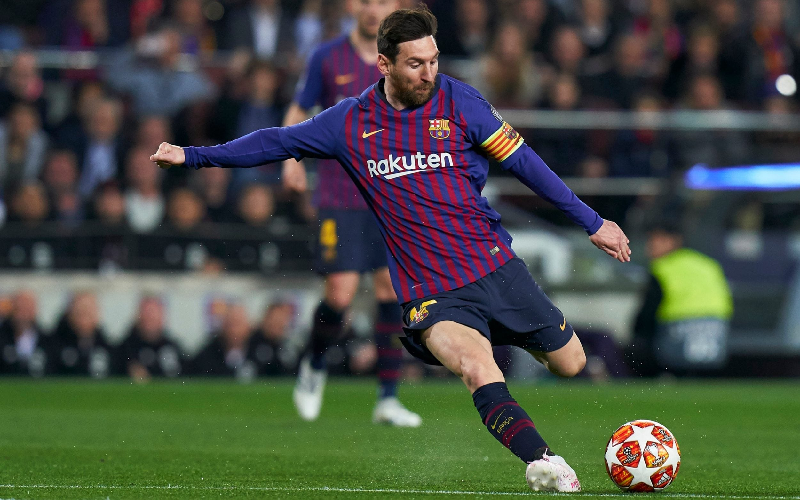
SHOOTING

Slide 10
THANKYOU

