Slide 1
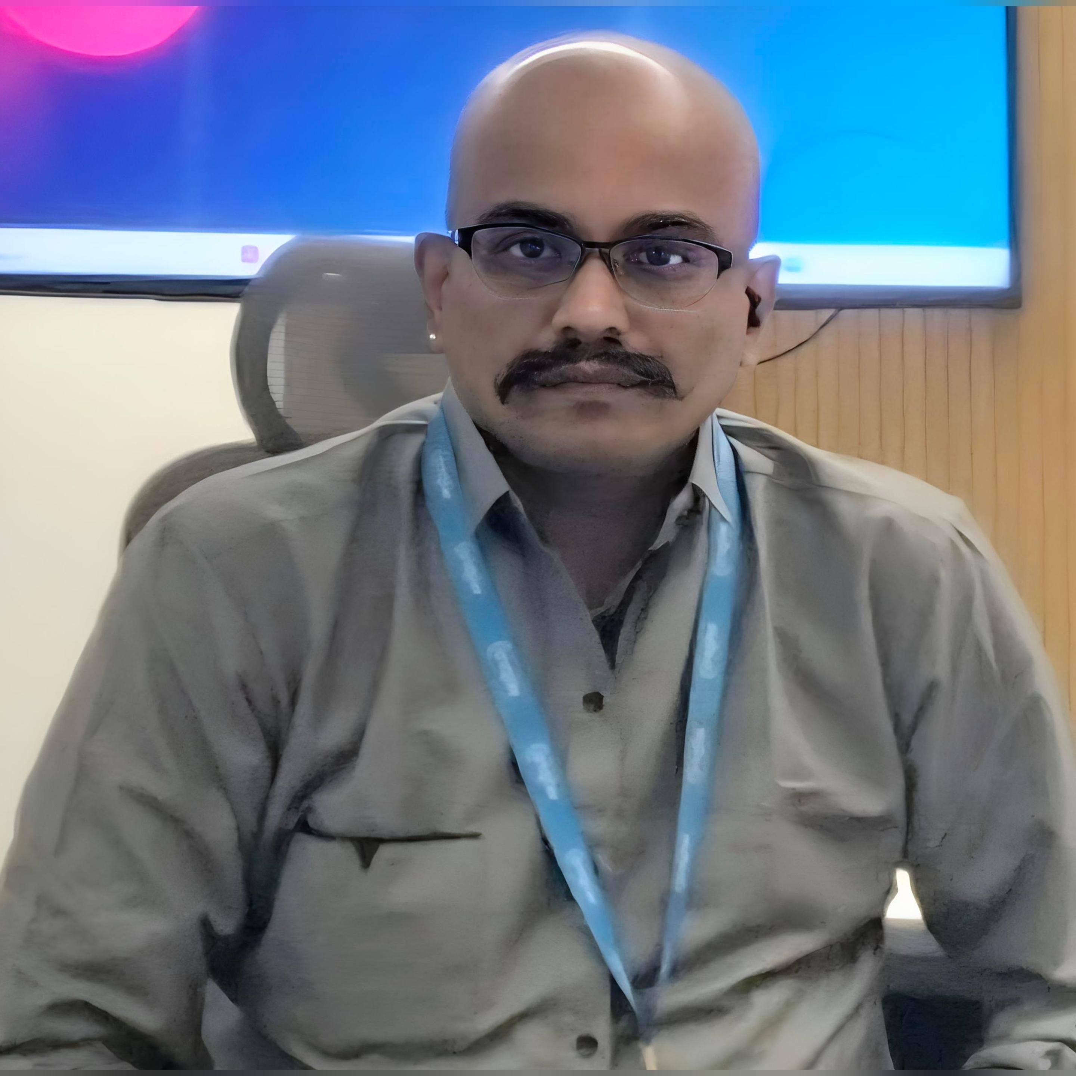
















26+ Years IT Experience • 22+ Years at Wipro • IEEE & ACM Senior Member • Global Charter Lead for DMTS Community 2025
Dr. Magesh Kasthuri
Ph.D. | Deep Learning & Genetic Algorithms
12
16+
18+
50+
35+
1000+
200+
5
3
CIO.com
Articles
CXOTech
Articles
Arch & Gov
Articles
Open Source
For You
Wipro Tech
Blogs
LinkedIn
Shorticles
Total
Publications
US/Euro
Patents
Published
Books
PUBLICATIONS BY PLATFORM
CIO.com
12 articles
Agentic AI, LLMs, SDLC, Enterprise Architecture, Cloud FinOps
CXOTech Magazine
16+ articles
GenAI, FinOps, SDLC Innovation, SLMs, AI CoE, Vibe Coding
Distinguished Member of Technical Staff
(Master) — Top 25 Technologist
Chief Architect (Cloud) & Chief Technologist
Wipro Limited, Bengaluru
Architecture & Governance
18+ articles
GenAI, Cloud, FinOps/GreenOps, Microservices, LLM/SLM, BFSI
Open Source For You
50+ articles
Cloud, Blockchain, AI/ML, Java, Quantum Computing, DevOps, IoT
Wipro Tech Blogs (Medium)
35+ articles
Agentic AI, AWS/Azure/GCP, FinOps, BFSI, Multi-agent solutions
EXPERTISE
DZone + Enlore + Tealfeed
30+ articles
Kubernetes, Java, FinOps, Cloud Strategy, GenAI, Multi-cloud
▪ Agentic AI & Generative AI
▪ Cloud Architecture (AWS / Azure / GCP)
Journals (SCOPUS/Springer/IEEE)
15+ papers
Deep Learning, Blockchain, Agentic AI, BFSI, RL, BCI
▪ LLM / SLM Development & Optimization
Cutter IT Journal (US)
2 articles
Blockchain as a Service, FinTech Architecture, SmartCity
▪ Enterprise & BFSI Architecture
▪ Blockchain & Distributed Ledger
▪ Big Data, FinOps & GreenOps
▪ DevOps, Microservices & Cloud Native
CERTIFICATIONS & PROFESSIONAL MEMBERSHIPS
▪ Quantum Computing & IoT / Edge
PROFILE LINKS
Microsoft
Azure / AI / Data
AWS
ML / Architect
Google Cloud
Digital Leader
Oracle
GenAI / Vector AI
IBM
Big Data Architect
Blockchain
Council Expert V2
FinOps
Practitioner
IEEE
Senior Member
ACM
Senior Member
Wipro DMTS
Master
linkedin.com/in/magesh-kasthuri
CAREER HIGHLIGHTS & RECOGNITION
cio.com/profile/magesh-kasthuri
Top 25 Technologist
Elevated to DMTS Master (Top 25) from 2019; Global Charter Lead 2025
cxotechmagazine.com/…/dr-magesh
5 Patents
US/Euro patents in AI, Cloud & Blockchain — inventor of Wipro's first Blockchain patent
architectureandgovernance.com
Awards
8x Best Knowledge Expert; 2x Outstanding Contribution (Zurich); 2x Credit Suisse Excellence
Books & Research
3 published books in 7 languages; 2 Wiley/Springer book chapters; SCOPUS/IEEE journals
Google Scholar | ResearchGate
Global Speaker
Invited speaker at international conferences in Zurich, Switzerland & IEEE ComSoc Bangalore
orcid.org/0000-0001-9581-2543

