Slide 1
Version Control

Slide 2
How do you share code?
Discussion

Slide 3
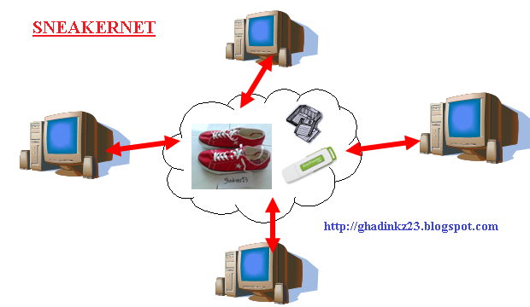
How we share code
Working in a team, you need to share code
How?
Email attachments?
Sneakernet?
What if two people edit the same file at the same time?
Google Docs? Dropbox?
No merging in Dropbox
GoogleDocs not meant for code

Slide 4

We’ll use git
What does git do for you?
Version control and source control
tracks all changes submitted to the codebase
revert changes
Create working braches without affecting stable releases
Tells you when there are merge conflicts
Why git?
Because “everyone” is using it
You’re likely to use it when you get a job
It’s free

Slide 5
git
Version control software
Linux/Linus
Remote server hosts your repository
Every user maintains a local copy of the entire repos
Need to install git if it doesn’t come with your OS

Slide 6
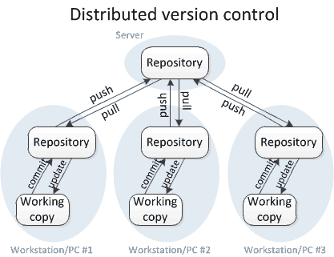
git is..

Slide 7
Scenario
Bob writes a bug just before a big release
With poor version control
The customer is not happy
With proper version control
Bob was working on separate branch
Bob pushes to the release branch
The team will revert to the last commit before Bob’s blunder
Customer never sees the bug

Slide 8
(some) git Commands
Make a repo
init
Update a repo
add
commit
push
Connect to a remote repo
clone
Update local repo
pull

Slide 9
Making a repo
init
Creates a new git repo in the current directory
Or create a repo in GitHub

Slide 10
Updating the Repo
add <filename>
Tell git that you want it to track <filename>
commit
Updates changes to your local repository
Add a meaningful commit message
push
Updates the remote repo with the changes committed to your local repo
Lets your team access your changes
Will warn you to pull first if there are remote changes

Slide 11
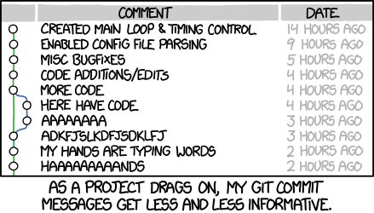
Commit messages
Many different conventions
Choose one
Or not
AngularJS
Whatever you do, make your messages meaningful and descriptive
Your future self and contributors will thank you!
Especially as you move on to bigger and better projects

Slide 12
Connecting to a repo
clone <repoLocation>
Copies the entire repository to your local directory
https
git clone https://hartloff@bitbucket.org/hartloff/cse250-fall2015.git
ssh
git clone git@bitbucket.org:hartloff/cse250-fall2015.git
must create ssh keys and upload your public ssh key to the server

Slide 13
Pull often
pull
Copies the most up-to-date code from the server to your local copy of the repo
Can cause a merge conflict
pull often!

Slide 14
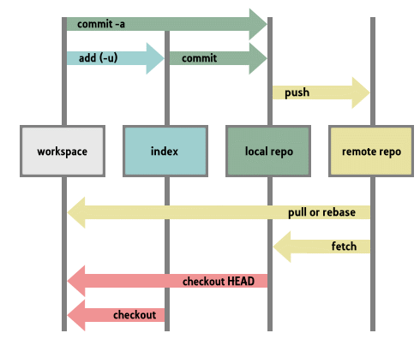
git Structure

Slide 15

GitHub
Provides servers to host git repos
An interface and server for git
Why GitHub?
Because “everyone” uses it
It’s free
If you want to use another service
Let me know
BitBucket

Slide 16
Coming Soon..
Friday: Scrum
Wednesday: Branching
But now, git/GitHub demo

