Slide 1
SRM Institute Of Science And Technology, Vadapalani Campus
DEPARTMENT OF COMPUTER SCIENCE AND TECHNOLOGY
A MINOR PROJECT –(15CS375L)
ON
SENTIMENT ANALYSIS OF TWITTER DATA
By
LOKESH.K Reg.no:RA1711003040036
MAGESHWAR.S Reg.no:RA1711003040087
NISHANTH.G Reg.no:RA1711003040113
Under the Guidance of
Mr.D.MANIKANNAN AP/CSE

Slide 2
INTRODUCTION
The online social media such as Twitter, Facebook, and Instagram allow users to communicate with the whole world.
2. It is used as a platform to write their own opinions about products or share their moments, even influence politics and companies. Twitter for example, almost every huge company have an account on Twitter to know about their customers feedback about their services or products. Sentiment analysis, known as opinion mining, for classifying specific words into positive or negative..

Slide 3
INTRODUCTION
Twitter is the most popular micro blogging website
Tweets are frequently used to express a tweeter emotion on a particular subject
There are firms which poll twitter to analyze sentiments on a particular topic.
The challenge is to gather all such data ,detect and summarize the overall sentiment of a topic

Slide 4
Problem statement
The problem in sentiment analysis is clarifying the given polarity of given text at the document,sentence or at aspect level
Whether the expressed sentiment in a document,a sentence or any tweet about the person is positive or negative
To determine positive sentiment percentage and negative sentiment percentage
To list out top 5 positive tweets and top 5 negative tweets about a topic
To do live streaming of a tweet

Slide 5
SYSTEM REQUIREMENTS
MODERN WEB BROWSER
PPYTHON 3.0 OR ABOVE
TWITTER API
WINDOWS/LINUS OS
NTLK (NATURAL LANGUAGE TOOLKIT) PACKAGE
GOOGLE API

Slide 6
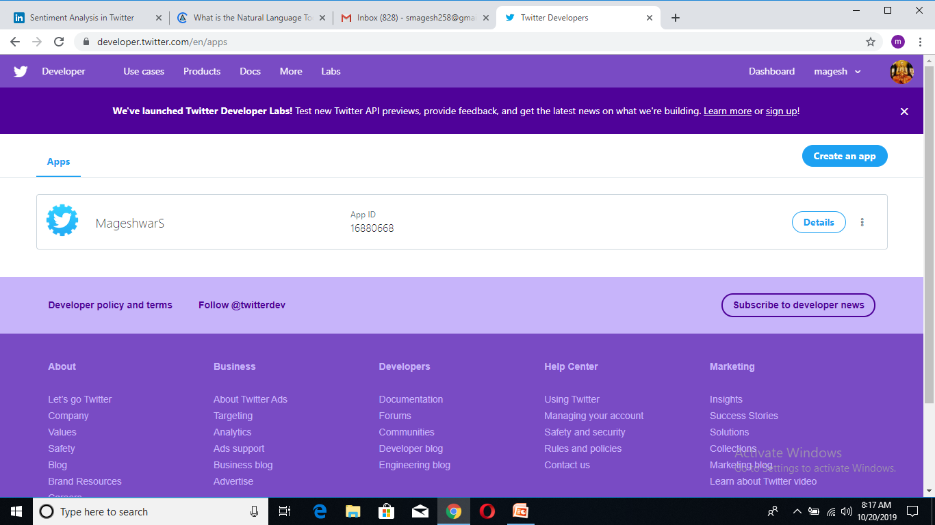
Twitter API

Slide 7
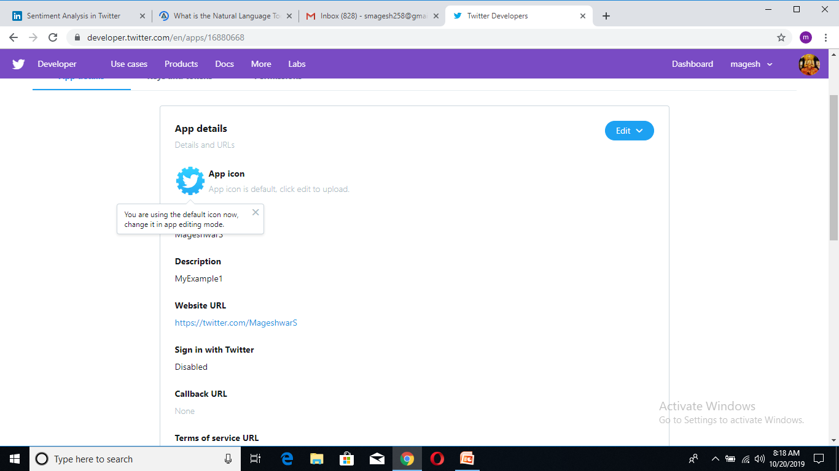
TWITTER API

Slide 8
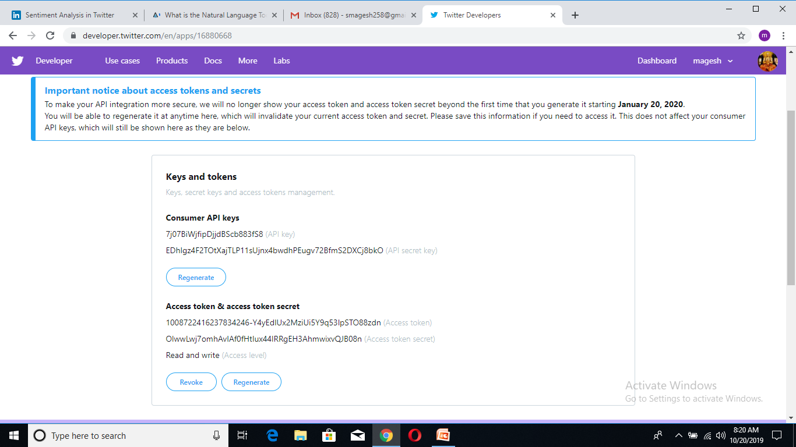
TWITTER API

Slide 9
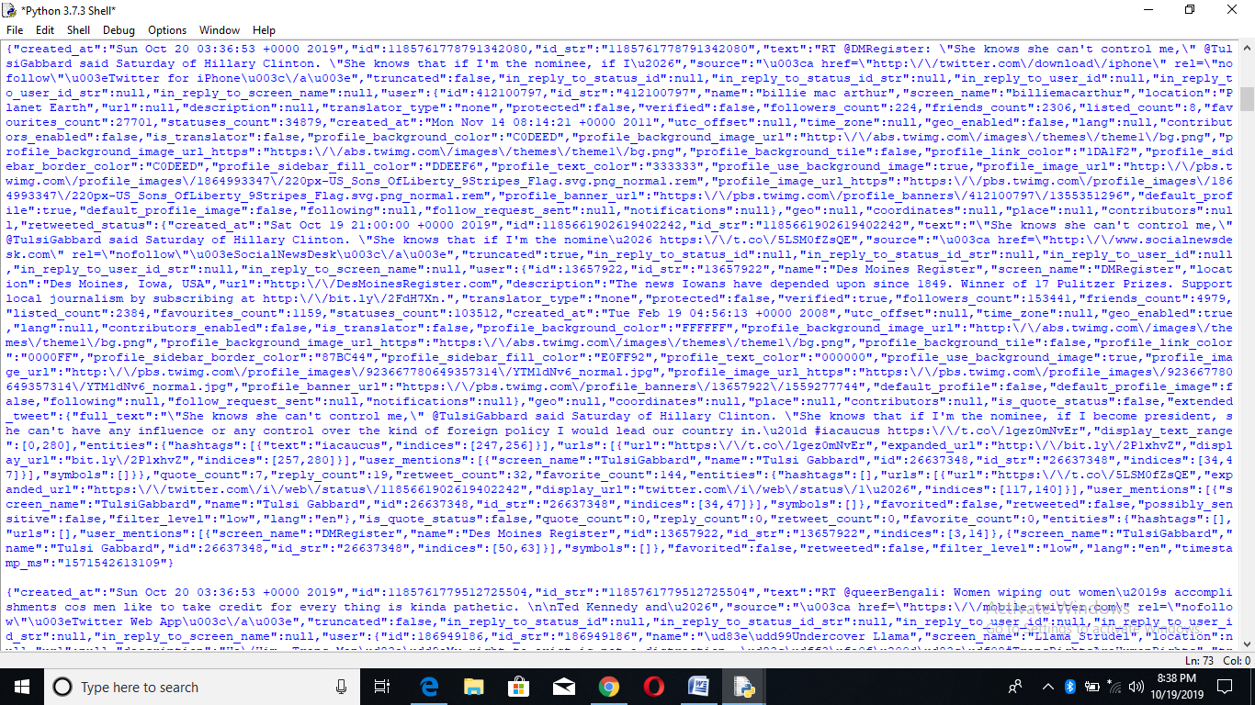
OUTPUT : LIVESTREAMING OF TWEETS

Slide 10
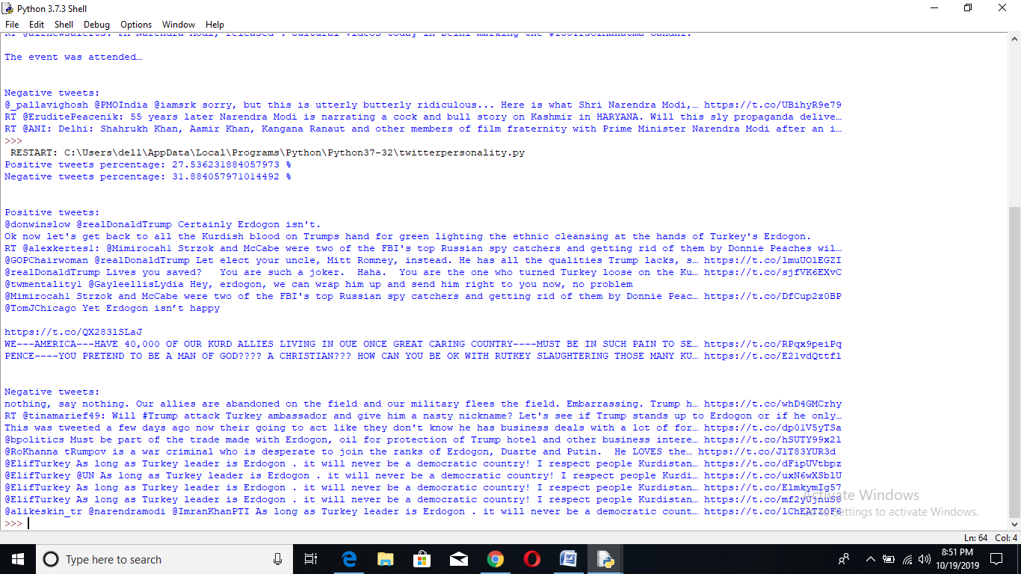
OUTPUT: POSITIVE AND NEGATIVE SENTIMENT

Slide 11
ADVANTAGES OF SENTIMENT ANALYSIS
UPSELLING ALGORITHMS
AGENT MONITORING
IDENTIFIYING KEY EMOTION TRIGGERS
HANDLING MULTIPLE CUSTOMERS
LIVE INSIGHTS
TRACKING CUSTOMER OVERALL SATISTFICATION

Slide 12
THANK YOU

