Slide 1

BLINKIT STORE SALES ANALYSIS
HARSH FATEHCHAND GURNANI

Slide 2

BLINKIT ANALYSIS
BUSINESS REQUIREMENTS
Total Sales: The overall revenue generated from all sales.
Average Sales: The mean revenue per sale.
Number of Items: The total count of items sold.
Average Rating: The mean customer rating for the products

Slide 3
DASHBOARD REQUIREMENTS
1. Total Sales by Fat Content: Objective: Analyze the impact of fat content on total sales. Additional KPI Metrics: Assess how other KPIs (Average Sales, Number of Items, Average Rating) vary with fat content. Chart Type: Donut Chart. 2. Total Sales by Item Type: Objective: Identify the performance of different item types in terms of total sales. Additional KPI Metrics: Assess how other KPIs (Average Sales, Number of Items, Average Rating) vary with item type. Chart Type: Bar Chart. 3. Fat Content by Outlet for Total Sales: Objective: Compare total sales across different outlets segmented by fat content. Additional KPI Metrics: Assess how other KPIs (Average Sales, Number of Items, Average Rating) vary with fat content. Chart Type: Stacked Column Chart.

Slide 4
DASHBOARD REQURIEMENTS
4.Total Sales by Outlet Establishment:
Objective: Evaluate how the age or type of outlet establishment influences total sales.
Chart Type: Line Chart
5. Sales by Outlet Size:
Objective: Analyze the correlation between outlet size and total sales.
Chart Type: Donut/Pie Chart.
6. Sales by Outlet Location:
Objective: Assess the geographic distribution of sales across different locations.
Chart Type: Funnel Map.
7. All Metrics by Outlet Type:
Objective: Provide a comprehensive view of all key metrics (Total Sales, Average Sales, Number of Items, Average Rating) broken down by different outlet types.
Chart Type: Matrix Card.

Slide 5

WHO ARE THE END USERS?
Business Analysts:
Role: Analyze sales data to identify trends, patterns, and anomalies.
Benefit: Gain actionable insights to drive strategic decisions and improve sales performance.
Sales Managers:
Role: Monitor sales performance across different outlets and product categories.
Benefit: Make informed decisions to optimize sales strategies and achieve targets.
Marketing Teams:
Role: Assess the effectiveness of marketing campaigns and promotions.
Benefit: Tailor marketing efforts to maximize ROI and customer engagement.
Store Managers:
Role: Track sales performance at individual outlets.
Benefit: Implement store-specific strategies to boost sales and customer satisfaction.

Slide 6

Technology Used
MICROSOFT POWERBI
MICROSOFT EXCEL

Slide 7
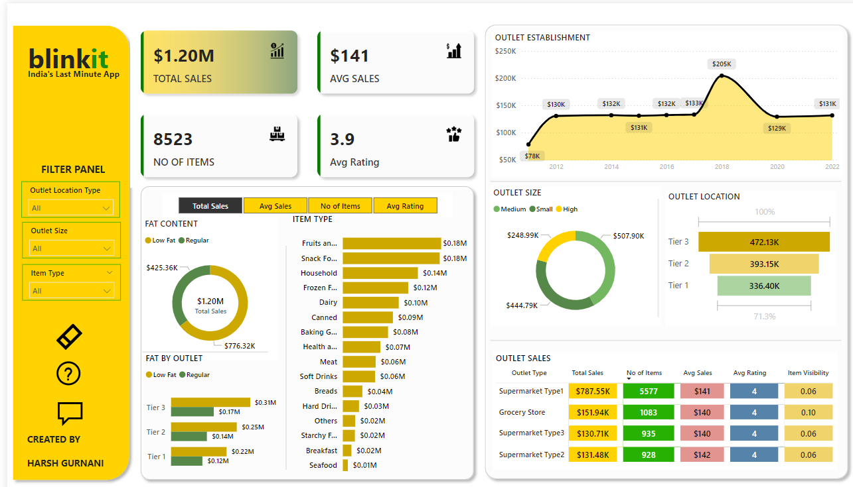
RESULTS
Demo Link

Slide 8
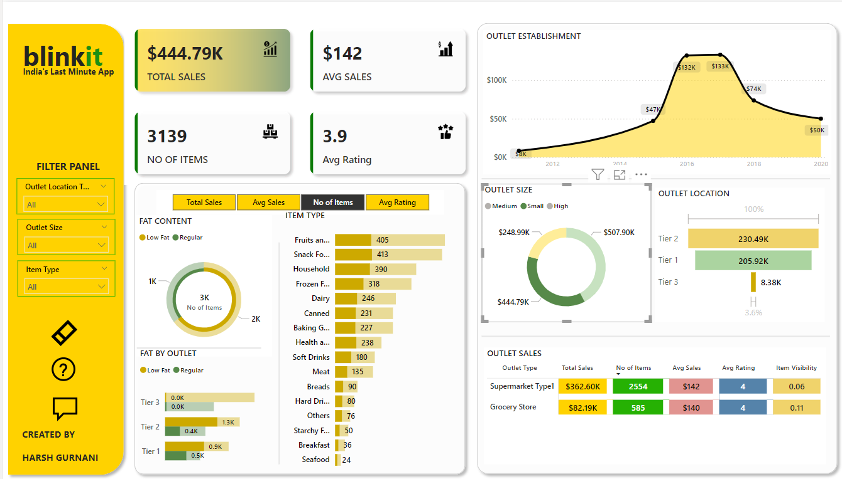
RESULTS

Slide 9
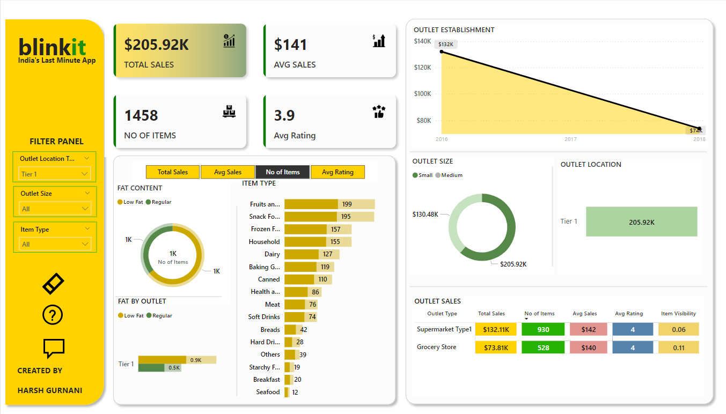
RESULTS

Slide 10
Thank you
FROM HARSH FATEHCHAND GURNANI
.
.

