Slide 1
Core-to-Mod BVA status
Core to Modernize BVAs: Readiness Status
BVA assets give Sellers a reusable path to quantify modernization value with field-ready assumptions.
Product
BVA status
Validation / dependency
Ready for use
IBMC access
Db2
Ready
CSE draft complete; PM capability input captured; ready to demonstrate in Value 360.
Use now for guided seller / IBMC conversations.
Value 360 template once published; interim via C2M / BVE team.
ODM
Ready
CS→Vitality validated. Containerization and SaaS require Antony / Bacary input.
Use now for guided seller / IBMC conversations.
Value 360 after motion packaging; interim via C2M / BVE team.
Cognos
Ready
Draft started in March. PM review still needed to close capability-led value.
Use now for guided seller / IBMC conversations.
.
Pending PM confirmation and Value 360 packaging.
WAS / Liberty modernization
Ready
Scope is WAS to Liberty modernization, created by Doug. Enhancing with containerization and vitality C2M motions . PM engagement with Brian, Craig, Cassi and Kaushik.
Use now for guided seller / IBMC conversations.
Value 360
FileNet (Content Cortex)
In progress
Next product after Db2 sequencin
Not ready yet.
Pending BVA build and PM validation.
.
Planning Analytics
In progress
Sequenced after DataStage. PM team currently busy with demos and pilots.
Not ready yet.
PM collaboration.
All BVAs are available via ISC Value360 tool as customizable templates.
Notes:
Use this slide to answer Rolando’s question directly. State what is ready, what is in progress, and what is planned. Be careful not to overstate readiness. Db2 is the first completed BVA and can be shown in Value 360. ODM has the CS to Vitality motion validated. Cognos and App Runtime are active but still require PM validation before broad field use. DataStage and Planning Analytics are planned next.

Slide 2
Core-to-Mod BVA status
Sellers can use the completed BVAs
Completed BVAs provide a starting model in Value 360. Client-specific value requires validated inputs and assumptions.
Access path
What Sellers gets
Value 360 example view
1
Open Value 360 in ISC
Db2 Core-to-Mod BVA
• Reusable BVA template by product
• Benefit levers tied to modernization
• Starting benchmarks and assumptions
• Client-specific business case after input validation
Go to the Core-to-Mod product template.
Benefit levers
Assumptions
3-year impact
2
Select product + motion
Choose the modernization path that fits the account.
Avoid upgrade cost
Upgrade cycle
$$
Reduce DBA effort
FTE hours
$$
What to avoid
3
Review baseline BVA
Improve availability
Downtime hours
$$
• Do not treat benchmarks as confirmed client value
• Do not present drafts as ready for broad use
• Do not detach value claims from product proof
Start with approved benefit levers and benchmark assumptions.
Speed provisioning
Cycle time
$$
Replace with actual Value 360 screenshot before final external use if available.
4
Add client inputs
Validate environment, costs, effort, downtime, and operating data.
5
Generate client BVA
Use the output for a funded modernization discussion.
Product Modernization Technical View = product proof | Value 360 BVA = client-specific value
Access note: until templates are formally published, requests should route through the C2M / BVE team for guided use.
Notes:
Use this slide to explain what IBM Consulting can do with the completed BVA. The key message is that Value 360 provides a reusable baseline, but the client-specific BVA comes after validating inputs. The Product Modernization Technical View provides product proof. Value 360 provides the quantified client-specific business value. If a real Value 360 screenshot is available before the review, replace the placeholder in the middle with the actual Db2 Business Outcomes view.

Slide 3
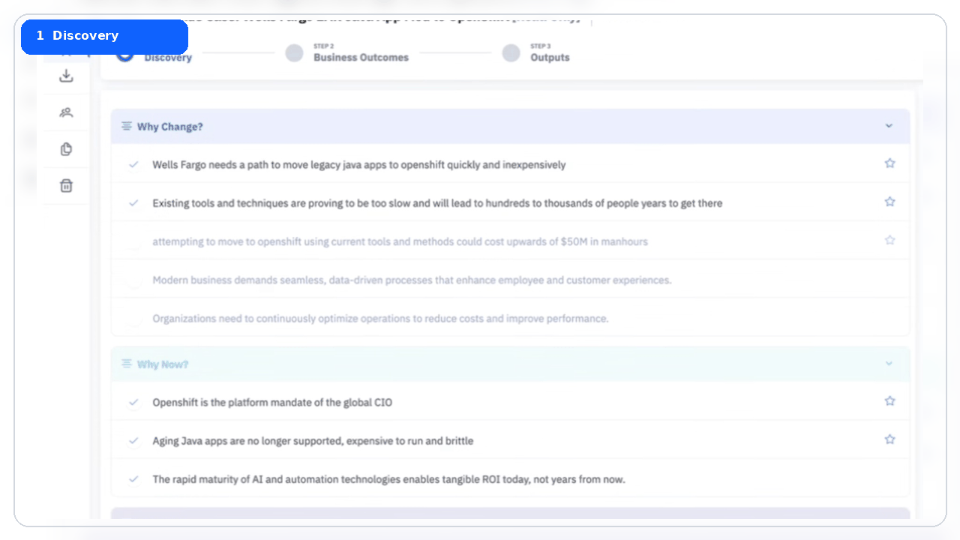
Value360 in ISC: App Runtime seller journey
Executive view
IBM
WAS / Java modernization example: discovery to quantified BVA output
Seller flow
A guided view of how sellers move from
qualitative framing to quantified
business outcomes.
1
Discovery
Why Change / Why Now / Why IBM
2
Business outcomes
Select modernization motion and
benefits
3
Assumptions
Enter client inputs and benchmarks
4
Outputs
Show benefits and cost of inaction
GM framing: high-level seller journey. Detailed motion scope is handled after the review.
Seller access path
ISC → Business Cases → Product modernization BVA template → Discovery → Business Outcomes → Outputs
Client value is finalized after
inputs are validated.
Notes:
The transcript guidance from Rispna was to keep this high level and avoid going into the specific title shown in the raw ISC example, because the seller-entered title can create unnecessary questions. The message should be that ISC / Value360 gives sellers a guided BVA path.
Talk track:
This is an example of what sellers see in ISC / Value360. The journey starts in Discovery, where the seller frames Why Change, Why Now, and Why IBM. Then the seller moves to Business Outcomes to select the modernization motion and value levers. In Assumptions, the seller enters client operating inputs and benchmarks. In Outputs, the model produces the business case output, including benefits, ROI, payback, and cost of inaction.
For this App Runtime example, the existing BVA supports WAS / Java modernization toward Liberty. Containerization benefits are being assessed and added as the BVA is refined. For the GM review, do not lead with detailed motion scope. Keep the story focused on seller usability and the path from qualitative framing to quantified value.

Slide 4
Appendix

Slide 5
Core-to-Mod BVA status
C2M BVAs: readiness view
BVA assets give Sellers a reusable path to quantify modernization value with field-ready assumptions.
1
Ready for use
Db2 BVA
1
Validated motion
ODM CS→Vitality
2
In progress
Cognos, App Runtime, MQ, BAW, FileNet (Content Cortex)
2
Planned next
DataStage, PA
Product
BVA status
Validation / dependency
Ready for use
IBMC access
Db2
Ready
CSE draft complete; PM capability input captured; ready to demonstrate in Value 360.
Use now for guided seller / IBMC conversations.
Value 360 template once published; interim via C2M / BVE team.
ODM
Ready
CS→Vitality validated. Containerization and SaaS require Antony / Bacary input.
Use now for guided seller / IBMC conversations.
Value 360 after motion packaging; interim via C2M / BVE team.
Cognos
In progress
Draft started in March. PM review still needed to close capability-led value.
Use now for guided seller / IBMC conversations.
.
Pending PM confirmation and Value 360 packaging.
WAS / Liberty modernization
Ready
Scope is Vitality and Containerization. PM engagement with Brian, Craig, Cassi and Kaushik.
Not ready yet.
Pending BVA build and PM validation.
FileNet (Content Cortex)
In progress
Next product after Db2 sequencin
Not ready yet.
Pending BVA build and PM validation.
.
Planning Analytics
In progress
Sequenced after DataStage. PM team currently busy with demos and pilots.
Not ready yet.
PM collaboration.
Executive message: Db2 and ODM are the first completed BVA’s and are published in Value 360. Cognos and App Runtime are active, with PM validation as the main dependency.
Notes:
Use this slide to answer Rolando’s question directly. State what is ready, what is in progress, and what is planned. Be careful not to overstate readiness. Db2 is the first completed BVA and can be shown in Value 360. ODM has the CS to Vitality motion validated. Cognos and App Runtime are active but still require PM validation before broad field use. DataStage and Planning Analytics are planned next.

Slide 6
Seller enablement
Db2 modernization: connect technical proof to funded value
15-minute executive seller pitch for modernization conversations
Start with the buyer question
“What does this change do for my business, and is it worth funding?”
Seller move
1
Open with Why Change, Why Now, Why IBM
The gap
Sellers can explain upgrade urgency and product features. The hard part is connecting Db2 modernization to a defensible business case.
2
Pick one modernization motion
3
Show the technical view
The bridge
Use the technical view as product proof. Use Value 360 to estimate the value, then refine it with client inputs.
4
Use Value 360 for the BVA
The outcome
Do not lead with the tool. Lead with the client problem.
A first meeting that is credible, business-driven, and simple enough to earn the next working session.
Db2 modernization seller pitch | v4 | 1
Notes:
Start with the buyer question. Sellers can explain upgrade urgency and product features, but the conversation becomes harder when the client asks what the change does for the business and whether it is worth funding. The bridge is simple: the Product Modernization Technical View gives product proof, and Value 360 turns that proof into a business value assessment. The seller should not lead with tool training. The seller should lead with the client problem and the three whys.

Slide 7
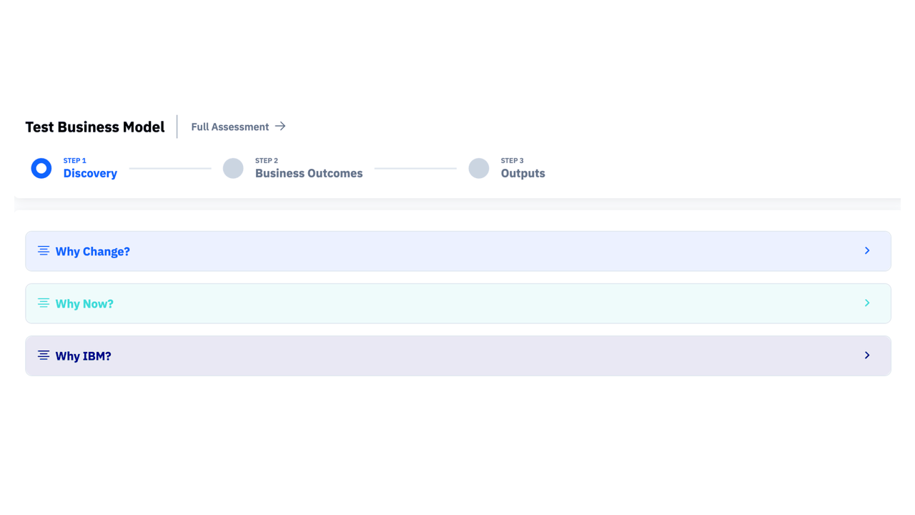
Value360 in ISC: what sellers see – Db2
A guided path from discovery to quantified BVA output
Seller flow
The screens show how a seller moves from qualitative framing to quantified business outcomes.
1
Discovery
Why Change / Why Now / Why IBM
2
Business outcomes
Select modernization motion and benefits
3
Assumptions
Enter client inputs and benchmarks
4
Outputs
Show benefits and cost of inaction
Animated seller journey in ISC / Value360
Seller access path
ISC → Business Cases → Product modernization BVA template → Discovery → Business Outcomes → Outputs
Client value is finalized after inputs are validated.
Notes:
This slide is meant to answer what the BVA looks like inside ISC and how a seller would use it. The animation cycles through four screens. First, the seller starts in Discovery with Why Change, Why Now, and Why IBM. Second, the seller moves into Business Outcomes, selects the relevant modernization motion, and reviews the available benefit levers. Third, the seller enters key assumptions and client inputs. Fourth, the outputs show quantified operational benefits and the cost of doing nothing. The core message for the GM review is that these BVAs are not static spreadsheets. They become a repeatable seller workflow inside ISC and Value360. The seller starts with guided discovery, selects product-backed outcomes, refines assumptions with client data, and produces a business value output that can support a deeper modernization conversation.

