Slide 1

IBM Financial Services Market
Core to Modernization Pilot Program
FSM – Product Connect, June 19
Meeting attendees:
Core Software Product Management:
Priya Srinivasan, Carrie Rogers, Stacy Nawrocki,
Will Streit, Martin Oberhofer, Melissa Modjeski
FSM Technical Sales:
Krishnan NR, Rolando Franco, Monika Aggarwal
May 11, 2026
Notes:
1
Group Name / DOC ID / Month XX, 2022 / © 2022 IBM Corporation

Slide 2



FSM Product Connect with | Meeting Agenda
Focus: validate where Core Product is involved, what needs leadership help, and how we support client-facing modernization.
01
Status: Blueprint assets
02
Product Engagement on Modernization pilots
03
Client briefing sessions
• Quick recap of core assets
  • Business Value Assessment (BVA)
  • Product Modernization Technical View
CSE credibility: Product Modernization Technical View + BVA + product proof
• Product Engagement Review: where Product is already engaged
• Executive Ask View: what needs Product leadership help
• Portfolio Heatmap: patterns across products and pillars
• Align on Product role in client-facing modernization sessions
• Confirm PM, roadmap, and product proof support model
• Identify where executive presence or sponsorship is needed
• Connect briefings to account motion and follow-up ownership
Outcome: validate asset purpose and usage.
Outcome: agree on visibility and routing.
Outcome: confirm support model and next events.
✓
Target close:
Validate Product involvement views, confirm leadership asks, and align on client briefing support model.
Core Software Modernization | Product Connect

Slide 3
Core to Modernization (C2M)
Heritage
New
C2M
Sales Plays
MMA
Product Pillars
Core to Modernization Motions
Outcomes
Why
What
How
Measures of Success
Core to Modernize ensures modernization is purposeful, repeatable, and value-driven.
The mission of our FSM Core to Modernization organization is to establish a standardized, repeatable technical engagement model across IBM’s Core Software portfolio focused on protecting our client’s core, modernizing it with intent, and expanding value where trust and adoption are proven.
Apps & Runtime
How the bank’s core and customer-facing applications actually run day-to-day (securely, reliably, and at scale) so money moves correctly, decisions execute instantly, and services stay available.
Application Integration
How data and transactions flow in real time between channels, decision engines, and systems of record so a customer action becomes a completed banking outcome.
Business Automation
How lending, payments, compliance, and servicing decisions are executed consistently and at speed — combining rules, workflows, and AI to reduce manual effort and human error.
Data Architecture
How financial data is structured, governed, and shared so decisions are based on trusted, well-understood information that both humans and machines can interpret and audit.
Vitality
Keep platforms current, secure, supported
Containerization
Modernize with flexibility while protecting the core
Managed or as a Service
Maximize operational value at scale
Expansion
Grow adjacent usage based on proven value
Client
Operational stability & resilience
Faster time to value
Reduced risk & technical debt
IBM
Protected annuity revenue
Deeper trust & loyalty
Repeatable modernization at scale
3
Notes:
3
Footer

Slide 4
FSM Product Connect
Executive update | May 2026
◎
Objective: convert reactive product escalations into a proactive modernization motion across FSM with clearer roadmap alignment, named product coverage, and reusable field assets.
Tracks
Progress
Current focus
Support Needed
♟
Product Connect governance framework
Live
Monthly interlock call scheduled. Responding to field requests: Project Mystic POVs, 2 blocked modernization motions; Product ownership established; Product versions confirmed for Vitality.
PM participation in interlock. Confirm product coverage by pillar, named owners, and fast path for blocked account requests.
▣
Product enablement sessions
13/12*4
AI Editions enablement completed for DB2, MQ & Cognos. Product interviews recorded
PM collaboration needed for remaining enablement sessions, product interview review, and Seismic-ready content.
▥
Business value assessments
12/54
Db2, ODM published in ISC (Value 360)
CSE populated spreadsheet: 4 for Data; 2 for App Runtime, 2 for App Integration; 4 for BA
PM verification needed for BVA value levers, benefit ranges, assumptions, and product-specific proof points.
◇
Product Modernization
Technical View and Benefits
216/216
Draft framework completed. Requests active across priority products. Current architecture delivered from Product in different formats. Core products: 36; reference architecture for 4 motions: 36 × 4.
PM and technical owner collaboration needed to validate current state, target state, deployment paths, and caveats.
◉
Client briefings sessions
3/12
3 completed: Cognos, App Integration, Content Cortex Build repeatable narrative per priority: risk, controls, dependency chain, adoption plan.
1 in works: Java Modernization
PM support needed for client briefing content, roadmap guardrails, product speakers, and account-specific validation.
◎
Product engagement model
Design
Product Management Connect Agentic Workflow design ready for review.
Review multi-agent architecture design for product intake ticketing. Confirm triage rules, workflow owners, and approval path.
Notes:
Product Modernization Technical View and Benefits

Slide 5
Client Briefing (modernization events)
🎯 Objective: activate client-facing modernization sessions by product pillar, using a repeatable model that supports urgent single-client needs and scalable multi-client motions.
🎯 Pillar / briefing
📊 Progress
Current focus
👥 Client Event Activation Framework
Design
Pillar-led model defined. Product, Kelcey, Ecosystem Engineering, Sales, and Marketing support model being aligned.
👥 App Runtime / WAS
Scheduled
Multi-client event – July 14
📊 Application Integration
2 confirmed
May 13: AI-Infused Middleware multi-client session covering Sterling, webMethods, API Connect, and Aspera.
🎯 Business Automation
In progress
CP4BA expansion and utilization growth. Confirm target accounts, product support, audience, and event narrative.
↳ Content Cortex
Product launch
June 24: Content Cortex product launch. Position under Business Automation as part of the modernization event path.
📊 Data Architecture
In progress
Build repeatable sessions around Db2, DataStage, watsonx.data, and related modernization triggers. Align owners and timing.
↳ Cognos Analytics
Scheduled
July 16–17: Multi-client Cognos Analytics session scheduled. Focus on agentic analytics, proactive decisions, governance, and PA cross-play.
Cognos Analytics is shown under Data Architecture. Content Cortex is shown under Business Automation.

Slide 6
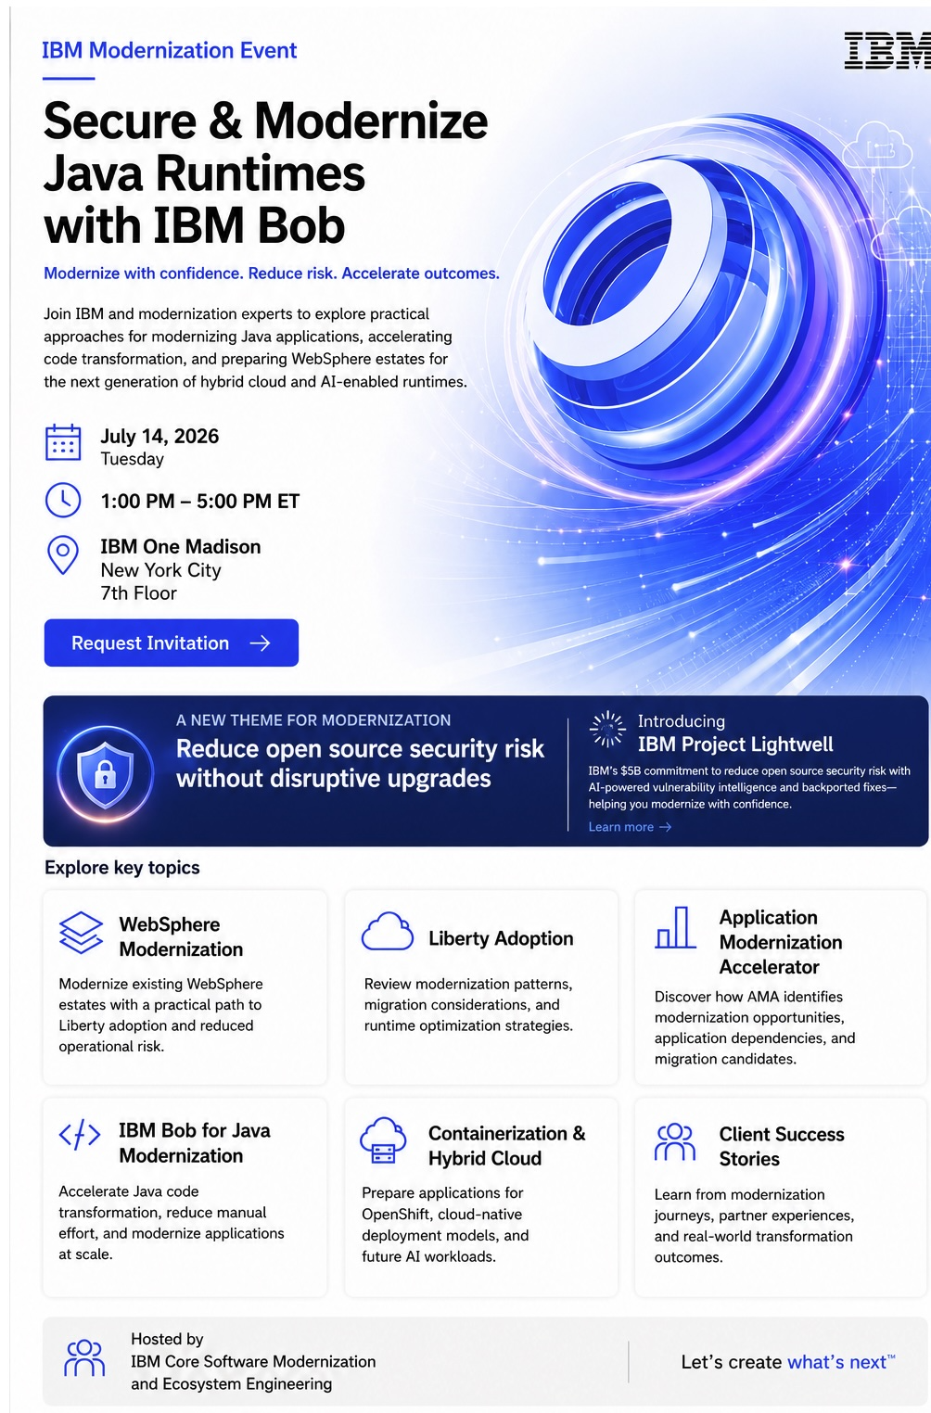
Client Briefing (modernization events)
🎯 Activate client-facing modernization sessions by product pillar, using a repeatable model that supports urgent single-client needs and scalable multi-client motions. Focused client facing sessions to give IBM and early seat in the client’s modernization journey, especially around renewals and aging estates
Cognos Analytics is shown under Data Architecture. Content Cortex is shown under Business Automation.

Slide 7
Product engagement – client outcomes
Positive field examples show where PM partnership improves client confidence, removes blockers, and moves modernization work forward.
Product Management engagement works best at high-leverage moments: roadmap clarity, product blocker resolution, dev engagement, product enhancement request prioritization, and validation of modernization assets.
Scale pattern: enablement + reference architecture + BVE validation
Client / product
PM engagement
Client outcome / field signal
Wells Fargo
Connect:Direct containers
James Joseph, PM, and Dev worked daily with Wells Fargo on a PoC to containerize Connect:Direct on Red Hat OpenShift.
Successful PoC. Wells announced a new internal service offering. Entitlement trade-up likely tied to Q4 ELA pull-ahead.
BofA
DataStage modernization
Shreya Sisodia addressed product blockers and gave the client confidence in the modernization path.
Client trust increased. DataStage modernization is moving positively.
MetLife, ADP, JPMC, Fiserv
Cognos containers
Greg McDonald, Jim Daly, and Yong Li supported roadmap briefings, PoCs, readiness testing, and dev review of blockers.
$840K MetLife proposal with procurement. $3.1M ADP PoC started. JPMC blocker with Dev. Fiserv readiness near completion.
Citi
Connect:Direct containers
PM prioritized RFEs and pulled Dev into the discussion to understand unique requirements and displacement risk.
Adoption path moving again after blocker escalation.
Travelers
FileNet SaaS + containers on AWS
FileNet PM team stepped in during RFP response and supported demo and collaboration needs where no CSE was assigned.
Stronger RFP response and better client-facing support for a complex modernization ask.
Takeaway
Product Connect has proof points. The next step is making the model repeatable so CSEs get faster enablement, validated reference architectures, and credible BVE assumptions for priority client work.
Notes:
PM engagement already working in the field. we should scale this pattern, not create another process burden.
Use these examples to connect Product Connect to client outcomes: Wells Fargo and Citi for Connect:Direct containers, BofA for DataStage modernization, MetLife/ADP/JPMC/Fiserv for Cognos containers, and Travelers for FileNet SaaS plus containers on AWS.
The ask is focused PM partnership at high-leverage moments: enablement, reference architecture validation, BVE assumptions, and priority client blockers.

Slide 8
Product engagement – client outcomes (contd..)
Positive field examples show where PM partnership improves client confidence, removes blockers, and moves modernization work forward.
PM engagement is creating leverage in live client opportunities: roadmap clarity, modernization confidence, competitive response, and aligned PoC execution.
Scale pattern: roadmap + modernization story + PoC alignment
Client / product
PM engagement
Client outcome / field signal
Principal
Content Cortex: CMOD + CM8 modernization
Matt Warta and Matt Vest helped share the roadmap and modernization story while Principal evaluated competitive alternatives.
PoC is underway. Sales, technical, and product teams are aligned around the client modernization path.
Principal
BAW modernization
Swapnil shared the BAW roadmap and AI capabilities with client stakeholders as they evaluated modernization options and ServiceNow risk.
Two-day client engagement with business users created positive feedback and a path for expansion into new capabilities.
Takeaway
Product Connect is proving value where PMs help the field explain the roadmap, respond to competitive pressure, and turn modernization interest into active PoCs and expansion paths.

Slide 10
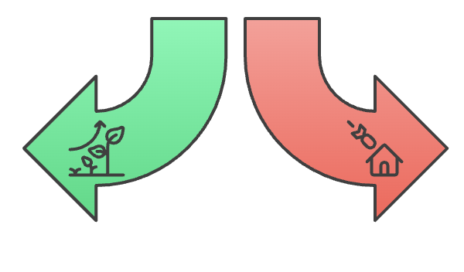
Why Core to Modernize exists?
Goal: evolve the existing footprint without disruption and make it resilient and AI-ready
Core software runs the business
Aging estates increase risk, cost, and change friction
Modernization must be controlled and repeatable
Controlled Evolution
Rip and Replace
Ensures stability and trust while enabling AI adoption without disruption
May introduce risks and costs due to potential disruption

Slide 11
Product Pillars - Priya
Four Product Pillars have been prioritized for Core to Modernization Plays
Application & Runtimes
Application Integration
Business Automation
Data Architecture
Products
WebSphere Application Server
JSphere Suite for Java
Cloud Pak for Applications
Code Assistant for Java
Products
DataPower Software
MQ
webMethods Hybrid Integration
API Connect
Cloud Pak for Integration
Event Automation
App Connect
Aspera
Financial Transactions Payments & Insights
Sterling Managed File Transfer
Sterling Transformation Extender
Sterling Data Exchange SaaS
Sterling Partner Engagement Manager
Sterling B2B Integration
Products
Robotic Process Automation (RPA)
webMethods BPMS
Cloud Pak for Business Automation
Business Automation Workflow
Automation Decision Services
Process Planning
Operational Decision Management
Content Manager (CM8)
Content Manager On Demand
Filenet Content Manager / Content Cortex
Capture
Decision Optimization
Products
watsonx.data integration
DataStage
Data Replication
Cloud Pak for Data
Db2
Informix
Netezza
watsonx.data
watsonx BI Assistant
Business Analytics Enterprise
SPSS Modeler
Cognos Analytics
Planning Analytics
Optim
Master Data Management
SPSS Statistics
watsonx.data intelligence
Clients
State Farm
The Bank of New York Mellon Corporation
JPMorgan
Chase & Co.
Mastercard International
Citigroup
Fidelity
United Services Auto Association
Truist
Clients
Bank of America
State Farm
JPMorgan
Chase & Co.
Fiserv
United Services
Auto Association
The Bank of New York Mellon Corporation
Global Payments Inc
Fidelity
Clients
State Farm
Bank of America
Fidelity
PNC Financial Services Group
Navy Federal Credit Union
Automatic Data Processing
State Street Corporation
Citigroup
Allstate Insurance Company
Clients
Bank of America
Mastercard International
JPMorgan
Chase & Co.
State Farm
Wells Fargo
Progressive Corp
PNC Financial Services Group
United Services Auto Association
US Bancorp
PNC Financial Services Group
Automatic Data Processing
Global Payments Inc
Wells Fargo
Morgan Stanley
Fiserv
State Street Corporation
Progressive Corp
Charles Schwab Corporation
Morgan Stanley
Truist
Fifth Third Bancorp
Progressive Corp
State Street Corporation
FIS - Fidelity Info Services
Citigroup
MetLife
Goldman Sachs Group, Inc
MetLife
The Bank of New York Mellon Corporation
FIS - Fidelity Info Services
Truist
Mastercard International
Wells Fargo
Charles Schwab Corporation
The Vanguard Group Inc
Navy Federal
Credit Union
Fidelity
Morgan Stanley
Charles Schwab Corporation
New York Life Insurance Company
Principal Financial Group Inc.
Key Equipment Finance
Nationwide Mutual Insurance
https://ibm.seismic.com/Link/Content/DCC7FMWGhTpR8G2Fh77BQhmBq3H3

Slide 12
Modernization With Trust Blueprint
Desired outcome:
Stable and supported client systems with risk reduction embedded in autonomous systems
Current client landscape
Modernization approach
Product capability unlock
What runs their business?
Product Versions, integrations with other systems, dependencies,
Business challenges
Regulatory & Audit reqs
Pick one slice (domain) that matters – one environment
Align on what ”clean” means (supported versions, compatibility, controls agreed, rollback defined)
Execute one upgrade end-to-end
Post upgrade – stability
Introduce enhanced capabilities & new patterns
“Autonomous operations”
One successful pilot defined with success criteria, owners, and measurable outcomes
Notes:
We start with the client’s operating reality, not a product pitch. Core upgrades fail when ownership is fragmented and the client feels exposed. Our first goal is trust. We earn it by delivering one scoped upgrade with clean controls, evidence, and a rollback path. Once we prove we can modernize without disruption, we get a seat at the table for the broader roadmap.
What runs the business today: Versions, integrations, dependencies, operating model
Business challenges: Change friction, outages, skills gaps, vendor coordination gaps
Regulatory and audit requirements: Change control, evidence, segregation of duties, rollback, data retention, resiliency

Slide 13
Modernization approach – zoom in
Pick one slice that matters
Pick one end-to-end business flow and its full dependency chain. Apps, integration, data, identity, and operations. Modernize that whole slice together so the upgrade does not break; example customer onboarding, claims intake, fraud,
Align on what clean means
Align with the client sponsor on upgrade acceptance criteria: supported versions, compatibility, controls, rollback, and audit evidence
Execute one upgrade end to end
One IBM owner coordinates IBM product, support, and delivery with the client’s platform, application, and risk owners through one shared plan, one weekly cadence, and one escalation path
Prove it with evidence
Operational stability results, clean execution of the change window, audit-ready artifacts, and a short set of lessons to make the next run faster
Create a repeatable pattern
Capture the steps, prerequisites, and ownership in a simple runbook so the next upgrade is repeatable and quicker, not a reinvention
Scale in waves
Repeat the proven pattern on the next 2–3 targets, then broaden the scope once the operating model is steady
Notes:
One dependency chain means one complete, end-to-end slice of the system that must work together for the business flow to run. It’s the smallest unit you can modernize without breaking production.
This is critical, as if you modernize one product but ignore the chain, you create hidden outages. The client experiences it as “the upgrade broke my workflow,” not “a dependency was missed.
CLEAN MEANS SUPPORTED, COMPATIBLE, CONTROLLED, REVERSIBLE, TESTED, AND AUDITABLE

Slide 14

Upgrading your workflow automation (BAW) platform now works in your best interest
Reduce operational and audit risk, then unlock faster, governable execution
Business logic stays buried, change cycles get slower
Decision logic drifts across applications
Audit prep becomes heavier
Why now?
What breaks when you wait
Why an upgrade pays back
End-to-end orchestration matters more now due to the ‘agentic’ disruption
Governance & traceability expectations
Focus on end-to-end accountability
Workflow becomes a hidden bottleneck
Risk reduction move, not a feature chase
Supported versions & compatibility
Position for modernization (containers, hybrid)
Enables governable orchestration + guardrails
Modernization with trust:
✓Scope one business flow and its full dependency chain
✓ Run one coordinated upgrade w/clear ownership & engineering sign off
✓Agree on “clean” acceptance criteria up front
✓ Produce operational stability results & audit-ready artifacts
A clean upgrade lowers risk now and creates the foundation for faster governable modernization in the future

