Slide 1
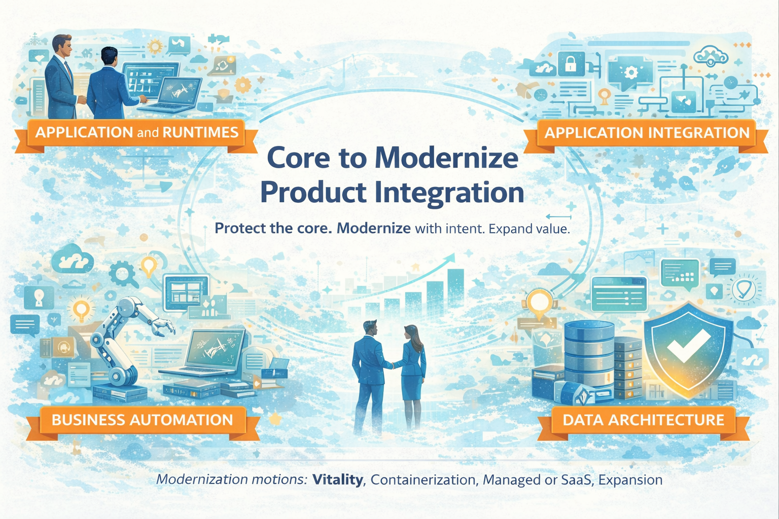
IBM FSM – Modernization Blueprint
Monika Aggarwal, FSM Product Strategy Leader Role, Core Software Modernization
March 19, 2026
Driving post-sale modernization and operational success for FSM clients across business automation, data architecture, application integration, & application runtimes.
Connecting product pillars and account teams to modernize existing client footprints
Notes:
I have owned IBM platforms as a client through multiple modernization programs, and I’ve compared IBM against other vendors. IBM is not the default first stop in most modernization cycles, so we need a story that starts with the client’s existing estate, that earns us the right to talk “modern.”

Slide 2


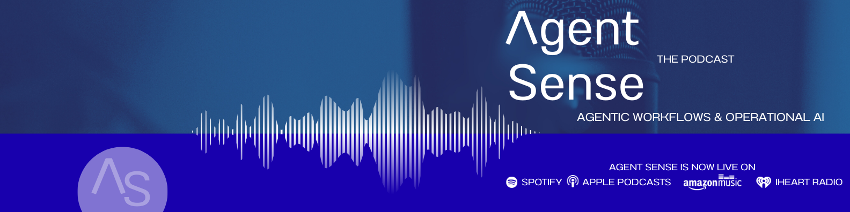
Who is Monika?
Architecture → Enterprise Automation / AI → Product strategy
Early Engineering - Enterprise
Chevron: Full Stack Developer, Information Architect, Solution Consultant for Global CoEX
Enterprise Architecture
Kaiser Permanente: Integration & Workflow Solution Architect
Product Owner: Digital Business Automation, IBM Evangelist
IBM Roles
2021: WW BA, Process Mining, AI Assistants Technology Product Leader
2025: Data & AI Tech Sales leader
2026: Product Strategy Leader, FSM
Chandigarh College of Architecture, Bachelors
California State Univ, East Bay, MS Computer Science
Technical depth + enterprise delivery + market execution + product strategy
Notes:
My path started in architecture and computer science, then moved into software engineering at Chevron and enterprise architecture at Kaiser Permanente. From there, I built business automation and AI driven solutions in healthcare, then joined IBM in 2021 to lead worldwide work across Business Automation, Process Mining, and AI Assistants. In 2025, I moved into the Financial Services Market to lead Data and AI technical sales in a complex West territory. Today, I am focused on product strategy and on helping connect product, field execution, and client outcomes in Core to Mod.

Slide 3
Modernizing Core Software: Why are we focused on this?
Goal: Protecting and Growing Core Revenue Streams to Enable 15% Software Revenue Growth.
Software Revenue Segments (as of 2024)
Transactional – 30%
S&S – 34% (839M)
TEL – 5%
SaaS
3%
MLC – 28%
~89% from Core Products
Data Architecture
41%
App Integration
25%
Business Automation
15%
App & Runtimes
13%
Other Core
6%
DB2, Informix , Netezza
Replication, DataStage
Cognos, Planning Analytics
….
Datapower, AppConnect, MQ
Sterling, FTM
Aspera, CP4I
….
BAW, ODM
Filenet, CMOD, CM8
CP4Auto
….
WAS/WASND
JSphere suite
CP4App
….
Current Situation
Desired Outcome
No dedicated focus to protect, support and grow the S&S Core
Protect and Grow S&S Revenue by modernizing Core Products, driving Transactional Growth and TEL revenue
The current operating model and IPL structure limit focus on modernizing and strengthening core products
Enable stronger client retention and revenue expansion through focus on core product and avoid erosion

Slide 4
Modernization With Trust Blueprint
Desired outcome:
Stable and supported client systems with risk reduction embedded in autonomous systems
Current client landscape
Modernization approach
Product capability unlock
What runs their business?
Product Versions, integrations with other systems, dependencies,
Business challenges
Regulatory & Audit reqs
Pick one slice (domain) that matters – one environment
Align on what ”clean” means (supported versions, compatibility, controls agreed, rollback defined)
Execute one upgrade end-to-end
Post upgrade – stability
Introduce enhanced capabilities & new patterns
“Autonomous operations”
One successful pilot defined with success criteria, owners, and measurable outcomes
Notes:
We start with the client’s operating reality, not a product pitch. Core upgrades fail when ownership is fragmented and the client feels exposed. Our first goal is trust. We earn it by delivering one scoped upgrade with clean controls, evidence, and a rollback path. Once we prove we can modernize without disruption, we get a seat at the table for the broader roadmap.
What runs the business today: Versions, integrations, dependencies, operating model
Business challenges: Change friction, outages, skills gaps, vendor coordination gaps
Regulatory and audit requirements: Change control, evidence, segregation of duties, rollback, data retention, resiliency

Slide 5
Modernization With Trust Blueprint
Desired outcome:
Stable and supported client systems with risk reduction embedded in autonomous systems
Current client landscape
Modernization approach
Product capability unlock
What runs their business?
Product Versions, integrations with other systems, dependencies,
Business challenges
Regulatory & Audit reqs
Pick one slice (domain) that matters – one environment
Align on what ”clean” means (supported versions, compatibility, controls agreed, rollback defined)
Execute one upgrade end-to-end
Post upgrade – stability
Introduce enhanced capabilities & new patterns
“Autonomous operations”
One successful pilot defined with success criteria, owners, and measurable outcomes

Slide 6
Modernization approach – zoom in
Pick one slice that matters
Pick one end-to-end business flow and its full dependency chain. Apps, integration, data, identity, and operations. Modernize that whole slice together so the upgrade does not break; example customer onboarding, claims intake, fraud,
Align on what clean means
Align with the client sponsor on upgrade acceptance criteria: supported versions, compatibility, controls, rollback, and audit evidence
Execute one upgrade end to end
One IBM owner coordinates IBM product, support, and delivery with the client’s platform, application, and risk owners through one shared plan, one weekly cadence, and one escalation path
Prove it with evidence
Operational stability results, clean execution of the change window, audit-ready artifacts, and a short set of lessons to make the next run faster
Create a repeatable pattern
Capture the steps, prerequisites, and ownership in a simple runbook so the next upgrade is repeatable and quicker, not a reinvention
Scale in waves
Repeat the proven pattern on the next 2–3 targets, then broaden the scope once the operating model is steady
Notes:
One dependency chain means one complete, end-to-end slice of the system that must work together for the business flow to run. It’s the smallest unit you can modernize without breaking production.
This is critical, as if you modernize one product but ignore the chain, you create hidden outages. The client experiences it as “the upgrade broke my workflow,” not “a dependency was missed.
CLEAN MEANS SUPPORTED, COMPATIBLE, CONTROLLED, REVERSIBLE, TESTED, AND AUDITABLE

Slide 7
Example: BAW Modernization With Trust
Clients resist BAW upgrades as they are disruptive and risky
Desired outcome:
Stable, supported workflow platform that is audit-ready by default and easier to operate
Current client landscape
(where does BAW sit today?
Modernization approach
Product capability unlock (Orchestration + Agentic AI)
Orchestrates business critical workflows
Client pain is in 3 places:
  Version drift & customizations that make upgrades tough
  Integration sprawl and brittle interfaces
  Operations depends on a few experts
Pick one business flow & it’s dependency chain
Align on clean: supported versions, compatibility, reversible, auditable
ONE IBM owner manages upgrade execution end-to-end
Post-upgrade stability & support
Container or Cloud deployment path
Embedded controls w/audit traceability
Governable AI for triage, summarization, and exception handling
One successful pilot defined with success criteria, owners, and measurable outcomes
A tightly defined upgrade gets existing flows back on track while preparing BAW for faster, governable modernization
Notes:
BAW sits in the middle of business-critical work. It orchestrates workflows across core systems, data stores, identity, and downstream applications. That’s why upgrades feel risky.
Desired outcome
We want a stable, supported workflow platform that is audit-ready by default and easier to operate. That means fewer outages, fewer manual steps, and fewer change surprises.

Slide 8

Upgrading your workflow automation (BAW) platform now works in your best interest
Reduce operational and audit risk, then unlock faster, governable execution
Business logic stays buried, change cycles get slower
Decision logic drifts across applications
Audit prep becomes heavier
Why now?
What breaks when you wait
Why an upgrade pays back
End-to-end orchestration matters more now due to the ‘agentic’ disruption
Governance & traceability expectations
Focus on end-to-end accountability
Workflow becomes a hidden bottleneck
Risk reduction move, not a feature chase
Supported versions & compatibility
Position for modernization (containers, hybrid)
Enables governable orchestration + guardrails
Modernization with trust:
✓Scope one business flow and its full dependency chain
✓ Run one coordinated upgrade w/clear ownership & engineering sign off
✓Agree on “clean” acceptance criteria up front
✓ Produce operational stability results & audit-ready artifacts
A clean upgrade lowers risk now and creates the foundation for faster governable modernization in the future

Slide 9
IBM Cloud Pak for Business Automation
Business Automation Workflow(BAW) Modernization
Modernize workflow and case management to reduce manual work, improve auditability, and enable AI-assisted execution on hybrid cloud
Use Case #1
KYC and Anti Money Laundering (AML) review operations
Route alerts and KYC refresh cases to the right teams based on risk, product, geography, and segment.
Enforce SLAs with priority queues, timers, escalations, visibility.
Capture a complete audit trail: evidence, decisions, approvals.
Standardize handoffs across lines of business and external systems.
Use Case #2
Complaints and regulatory handling
Capture complaints from all channels in one case record
Route by issue type, product, region
Enforce deadlines w/SLA’s, timers
Run approvals for remediation, policy exceptions
Modernization Motion Overview
BAW is an enterprise platform for workflow & case management that coordinates people and systems with visibility, governance, and auditability. It fits high-stakes operations where regulators & auditors need traceability, and where cases evolve as documents and facts.
Can be deployed as containers on OpenShift for hybrid cloud. WebSphere exists for compatibility, but containers are the strategic direction.
What’s New in latest releases
Authoring Assistant and Workplace Assistant for faster build and faster case execution
MCP integration so AI agents can invoke workflows through a standard interface
Agentic task execution to automate manual steps in containerized automations
Modernization paths
Vitality: current and stable on supported releases
Containerization: run BAW as containers
Managed or SaaS: reduce ops burden and time to value
Expansion: add capabilities once core is stable
Business Value
Reported average 60% reduction in process time by reducing manual work.
Claims Connection Group: up to 70% faster resolutions and 25–35% cost reduction.
Increased governance, auditability, and hybrid-cloud readiness
Modernization Motion Owner
Kristen Mucci
Modernization Motion SMEs/Coaches
Matt Warta
Thomas Yang
Luke Hale
Notes:
IBM Cloud Pak for Business Automation is a modular set of integrated software components for any hybrid cloud. It unifies workflow, content services, document processing, decision management, RPA and digital labor, and process mining. Teams use AI-assisted low-code and no-code tooling to design automations, analyze and execute workflows, assign tasks to bots, and track performance. Deploy as containers across any cloud or as SaaS

Slide 10
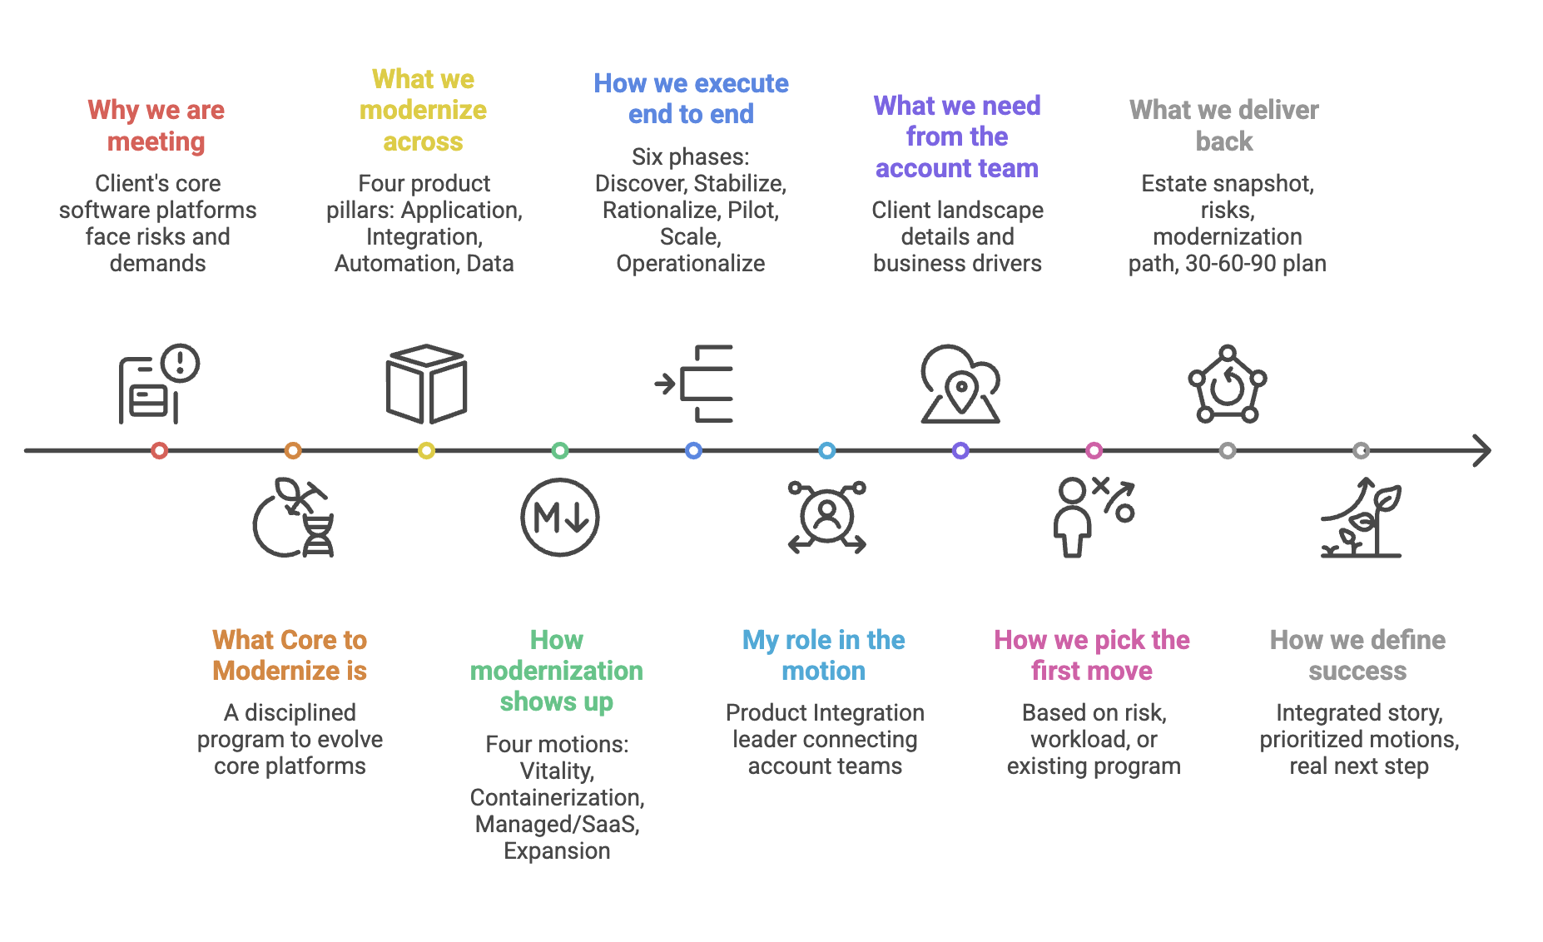
Core to Modernize Process

Slide 11
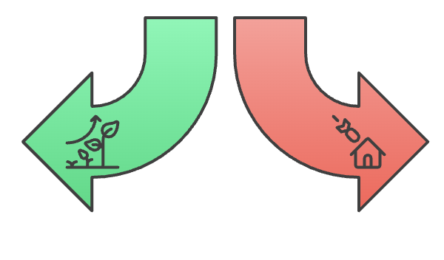
Why Core to Modernize exists?
Goal: evolve the existing footprint without disruption and make it resilient and AI-ready
Core software runs the business
Aging estates increase risk, cost, and change friction
Modernization must be controlled and repeatable
Controlled Evolution
Rip and Replace
Ensures stability and trust while enabling AI adoption without disruption
May introduce risks and costs due to potential disruption

Slide 12

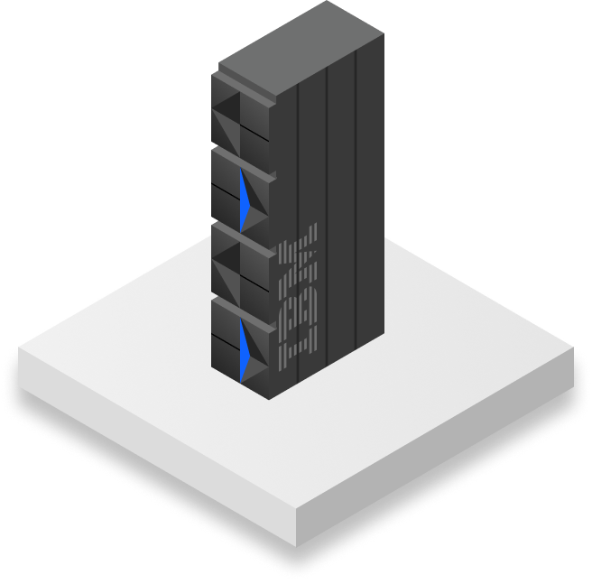
Modernization Motions
Vitality
Ensuring version currency and platform stability through proactive upgrades, migrations, and application of patches to keep clients on supported, secure, and high-value releases.
Containerization
Modernizing application architectures by shifting from traditional deployments to containerized environments (e.g., OpenShift), improving scalability, portability, and operational efficiency.
Managed or as a Service
Transitioning from client-managed to IBM-managed or SaaS delivery models that reduce total cost of ownership, accelerate innovation, and provide clients with consumption-based flexibility.
Expansion
Growing client footprint by introducing complementary products (cross-sell) and expanding usage or premium capabilities within existing solutions (up-sell) to maximize value realization.
Core Software Modernization
Z Modernization Fast Start Program
Driving modernization of Z architectures by adopting contemporary frameworks, enabling greater scalability, security, and efficiency.
Z Software Modernization

Slide 13


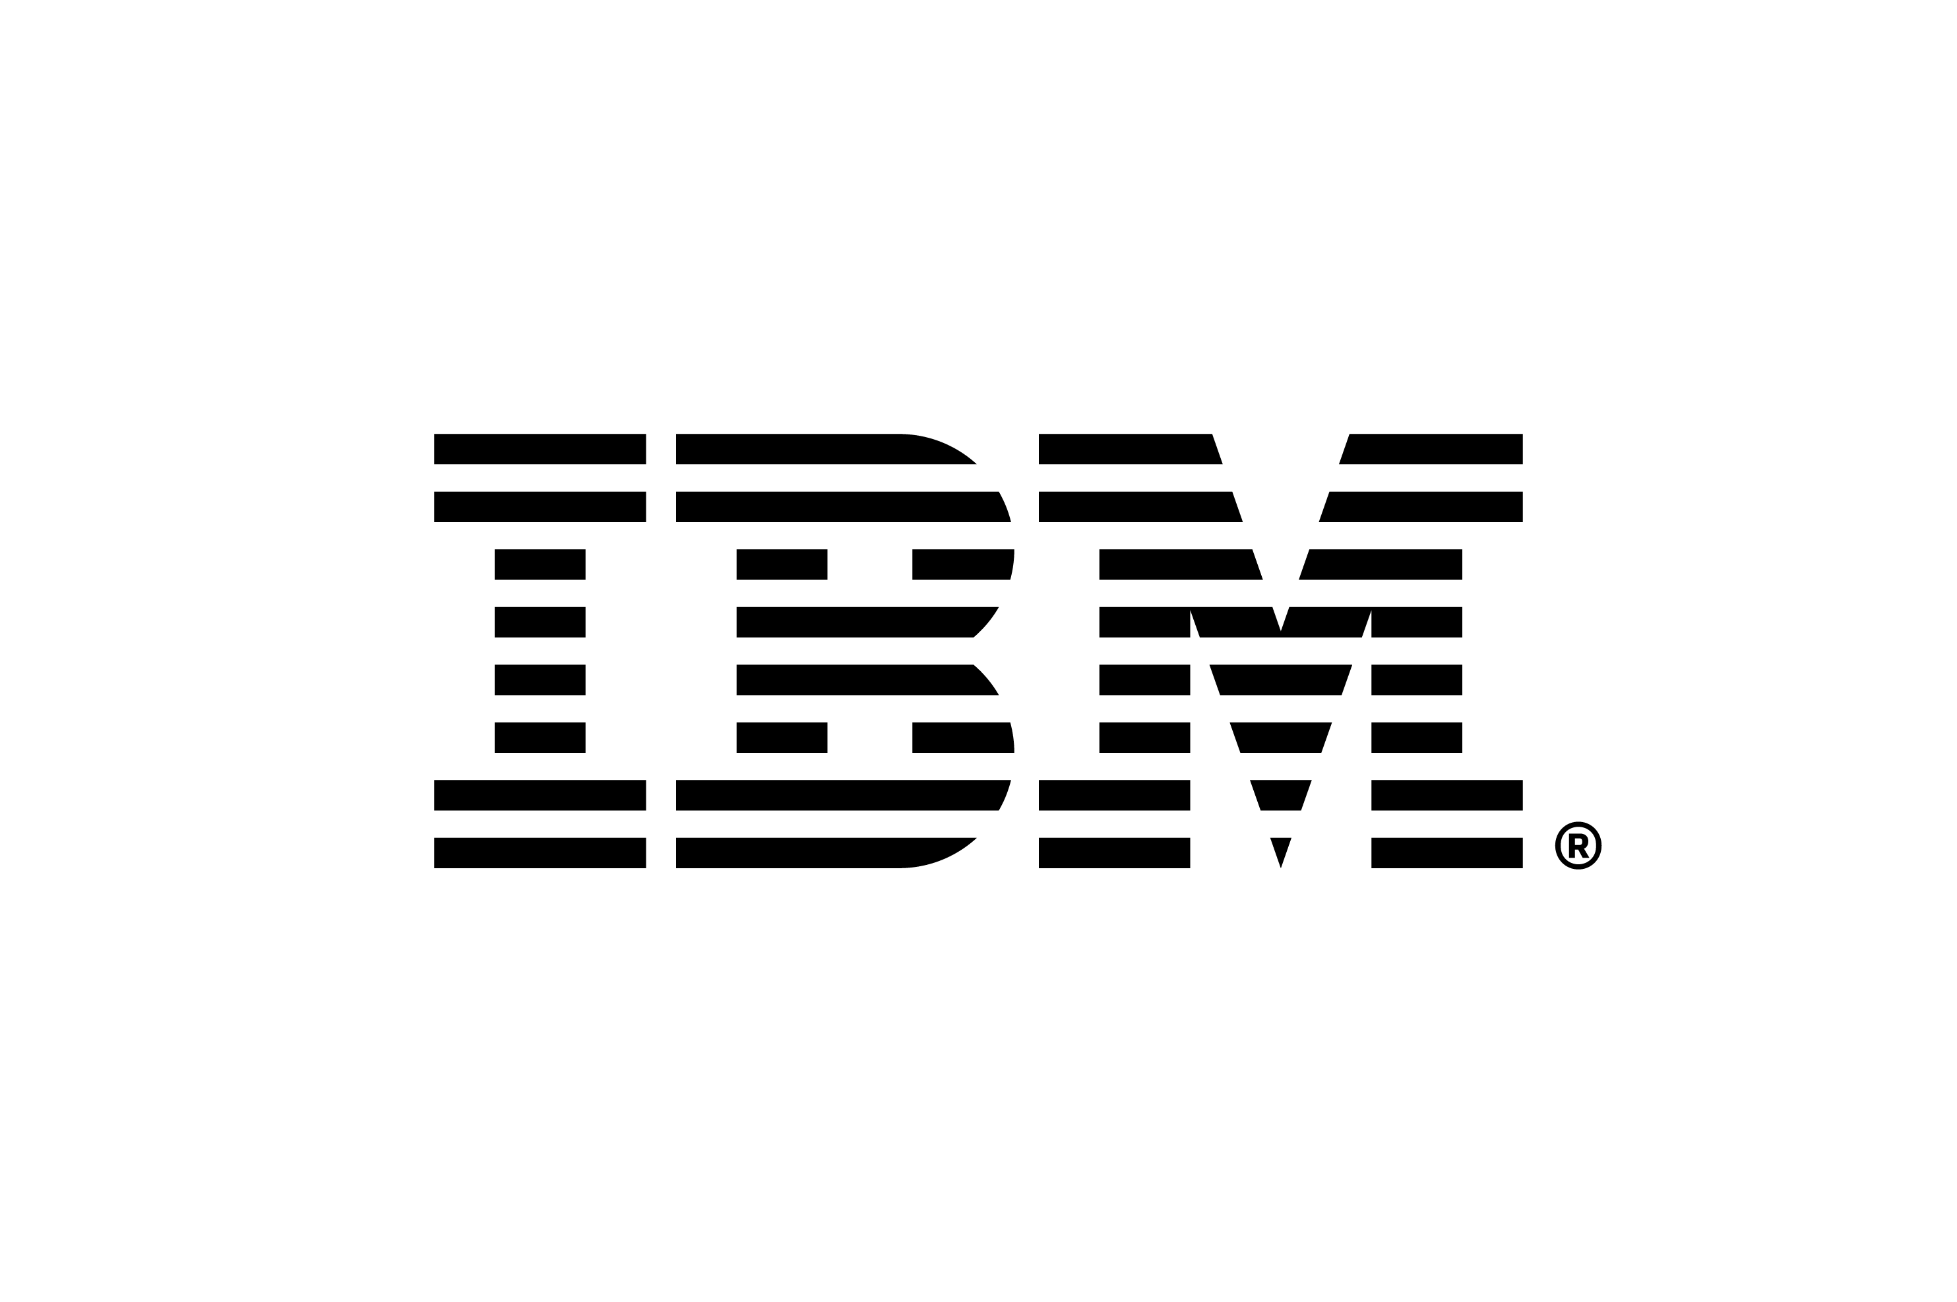
Wells Fargo
OBaaS powered by watsonx.Orchestrate

Slide 14

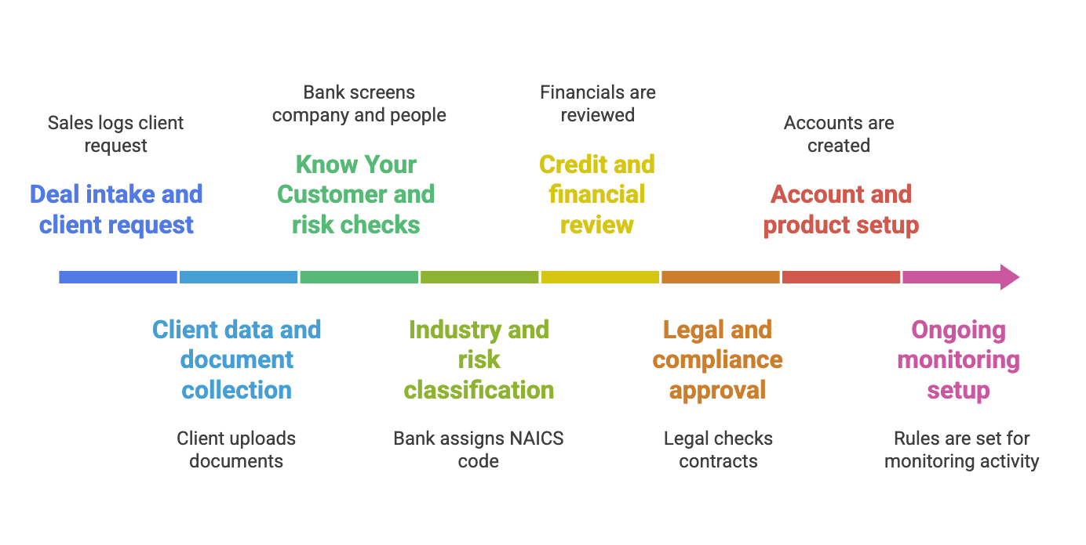
Process: Commercial & Investment Banking Onboarding
CIB onboarding touches many systems
Each step depends on the last
Most delays come from handoffs, re entry, and manual review
Notes:
Deal intake and client request (CRM: Salesforce) – kicks off onboarding; Pain- incomplete data
Client data & document collection (Client onboarding portal, Document management system like SharePoint or OpenText); Pain – docs comes in different formats and could be outdated
KYC & Risk Checks (KYC utilities, Sanctions screening tools); Pain – manual & lengthy, false positives cause delays
Industry & Risk classification (Risk Assessment systems, Industry classification reference data); Pain – teams disagree on risk level
Credit & financial review (Credit risk systems, financial analysis tools); Pain – data is reentered
Legal & compliance approval (Case Management, Workflow tools, Policy repos); Pain – approvals sit in queues
Account & product setup (Core banking, Payment, Trading & Treasury systems); Pain – multiple data entry for each system
Ongoing monitoring (Transaction monitoring, client lifecycle management tools); Pain – monitoring rules are generic

Slide 15
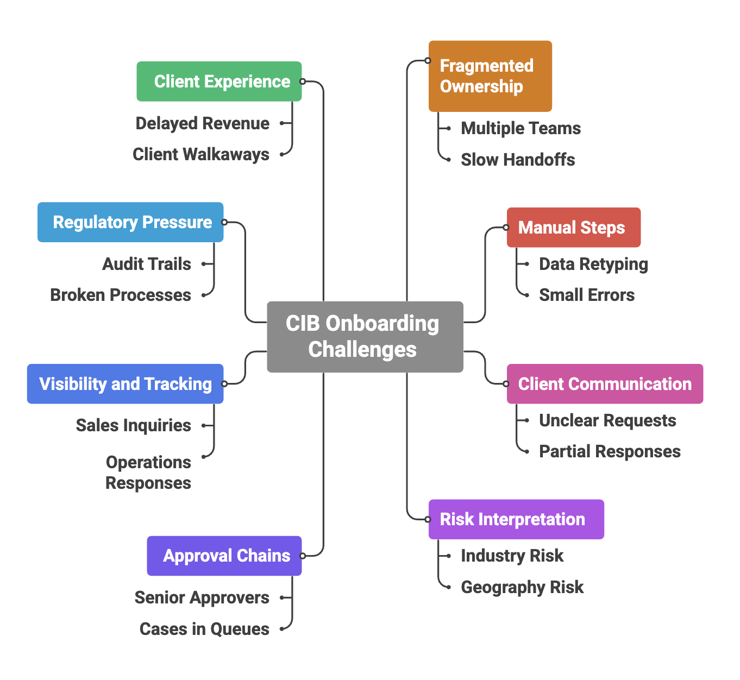
Pain points: Commercial & Investment Banking Onboarding
Notes:
CIB onboarding is slow because it is manual, fragmented, and risk heavy.

Slide 16
Business Challenges: CB & CIB Client Servicing
Servicing today is conducted in product silos with multiple touchpoints, manual processes, and lack of visibility
Heavy reliance on e-mail to manage servicing cases – 66%* of e-mail volume with clients or internal partners are follow ups or status checks on open requests
Confusion on internal team’s roles and where requests should be sent – 21* unique internal partners needed to support a single CIB client
Client requests can contain multiple actions, which are separated and actioned independently resulting in no ability to view relationship activity across products or track to SLAs
No assurance of completion which results in operating risk
Utilizing AI simplifies the delivery model and lowers the cost
Relationship Manager
Today
Case creation & routing
Relationship Associate
GPL
Implementation
Clients go to their Relationship Team or directly to product teams.
GPL Customer
Service
Commercial Lending Operations

Slide 17
Augment workflows with Agents to perform tasks autonomously
While the future is Agentic AI, Enterprises need flexibility in the approach they take across workflows
Hybrid flow
Augmented with Gen AI & AI Agents
Deterministic Flow
Act as programmed
Non-deterministic Flow
Plan and self-correct
Traditional task automation
AI-assisted automation
Agentic AI orchestration
Workflow Design
Decision logic
AI Agents
RAG
Reasoning
Planning
Process Mining
Process Modeling
Tools
IDP
Routing
Self-correction
Accelerates and optimizes the design and building of automations
AI provides an enhanced user experience and drives higher task completion
Allows AI to perform the work reducing the need for human intervention
Design practice for agentic workflows:
Deterministic rules for routine steps,
AI reasoning for judgment calls, and
Human validation for anything that carries risk
Notes:
From the far left with Deterministic Flows we have traditional workflows process discovery through Mining and Modeling tools, together with execution engines for Workflow and Decision Logic to execute pre-described process or Case management patterns. This covered a broad range of of processes but required in-depth knowledge of the process inputs, flows, data elements, and human or system resourse capabilities.
The non-deterministic flows address a separate problem statement to build self correcting systems that are less brittle and even address the predictive flows where the end-state is not known at inception.
The center box of hybrid flows is more like the goldilocks scenario which provides the advantages of RAG for example, without the risk of hallucinations. Or the ability to assemble Agents using prebuilt tools to to build complex, yet trusted solutions to provide unprecedented productivity gains.
Use case: Ingest a new client request, create the onboarding case, and route it to the right teams.
Design rule
Rules for routine steps.
AI for judgment calls.
Humans for anything with risk.
Step 1 deterministic intake and case creation
What must be fixed
If a request comes from CRM, portal, or email, create one onboarding case.
If the client type is corporate, use the CIB onboarding template.
If products include credit, markets, or payments, attach the required workflows.
Generate a case ID and timestamp.
Why this is deterministic
There is no ambiguity.
This is plumbing.
AI adds no value here and adds risk.
Step 2 agentic reasoning for understanding the request
Where AI helps
Read the free text request from sales or the client.
Summarize what the client is actually asking for.
Identify implied needs that were not checked in the form.
Example. Client asks for payments but mentions hedging FX exposure.
Flag missing information clearly.
What the agent produces
A short structured summary.
Suggested product tags.
Confidence score.
The agent does not route yet.
Step 3 deterministic smart routing rules
What stays rule based
If product includes credit, route to credit risk.
If cross border activity is present, route to compliance.
If industry is high risk, route to enhanced due diligence.
If region is EMEA or APAC, route to the correct regional team.
Why this matters
Routing rules must be explainable.
Auditors expect logic, not intuition.
Step 4 agentic reasoning for edge cases
Where judgment is needed
Identify conflicts.
Example. Client looks low risk but operates in a sensitive country.
Example. Sales selected one product but the narrative implies more.
The agent recommends additional routing.
It explains why.
It does not override rules.
Step 5 human validation for risk based routing
Where humans step in
If the agent flags high uncertainty, require a human review.
If routing adds enhanced due diligence, require compliance confirmation.
The human approves or adjusts routing before work starts.
Why this is critical
Wrong routing wastes weeks.
Wrong routing hides risk.
Humans must own that call.
Final takeaway
Auto create the case with rules.
Understand the request with AI.
Route with policy.
Let humans approve when risk appears.

Slide 18
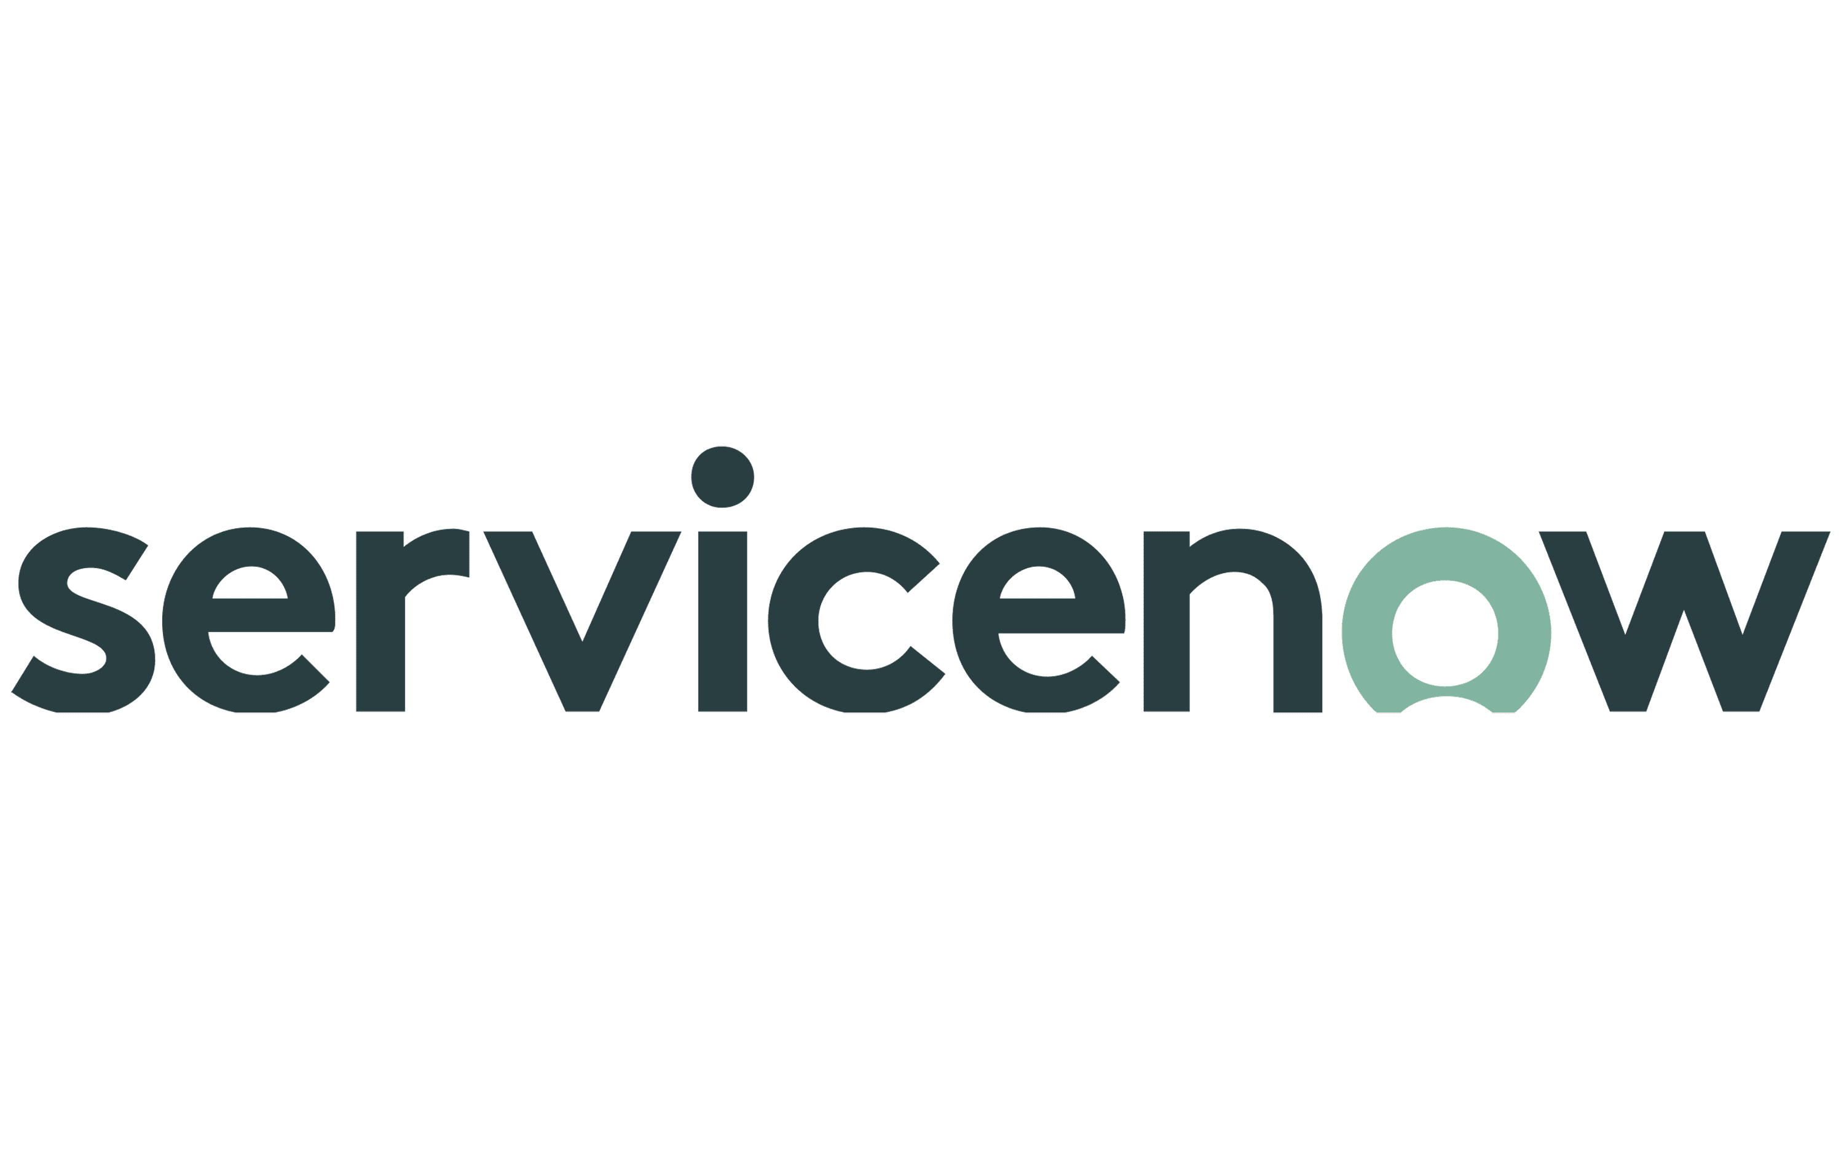




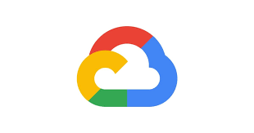
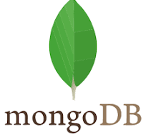



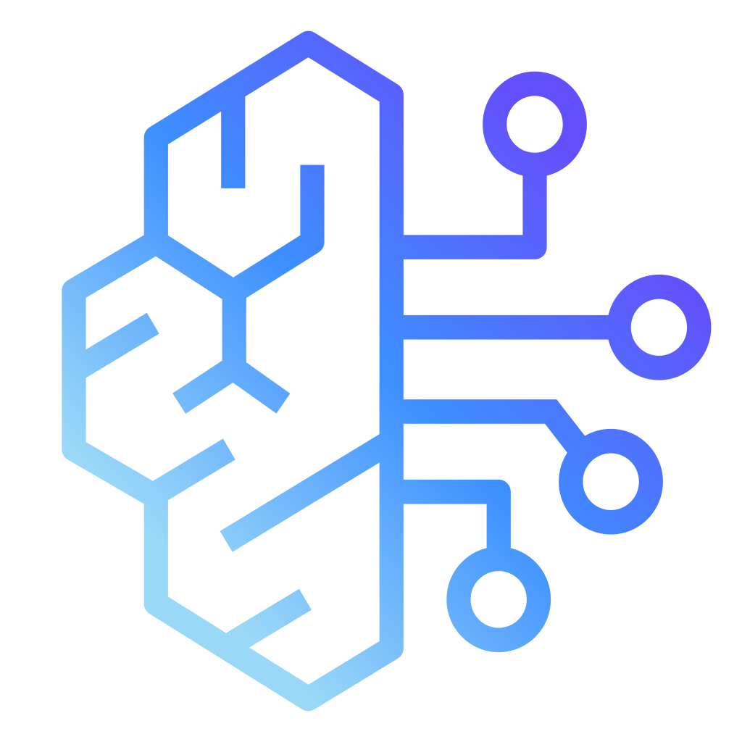


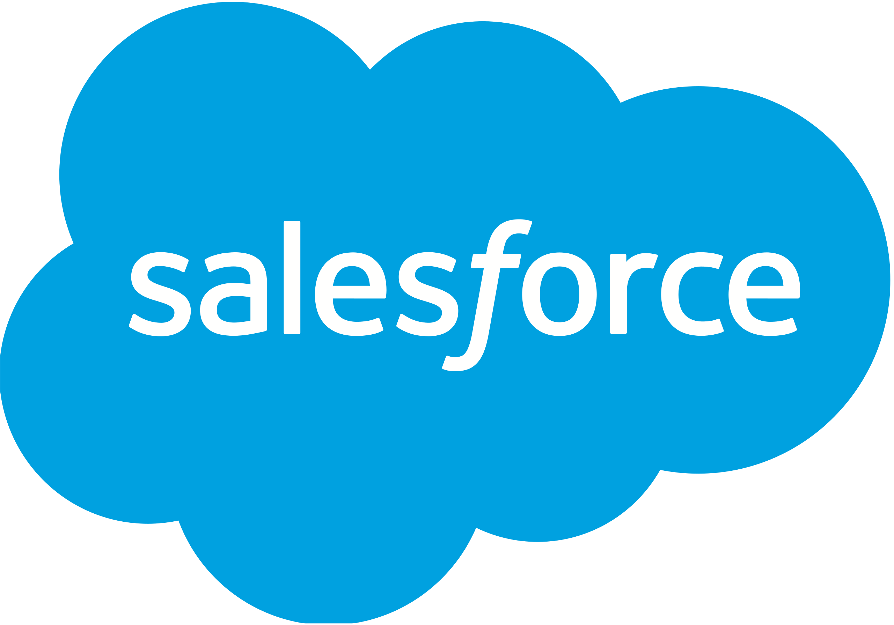

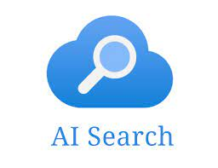

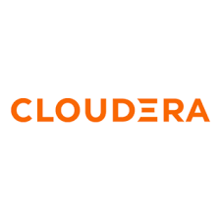
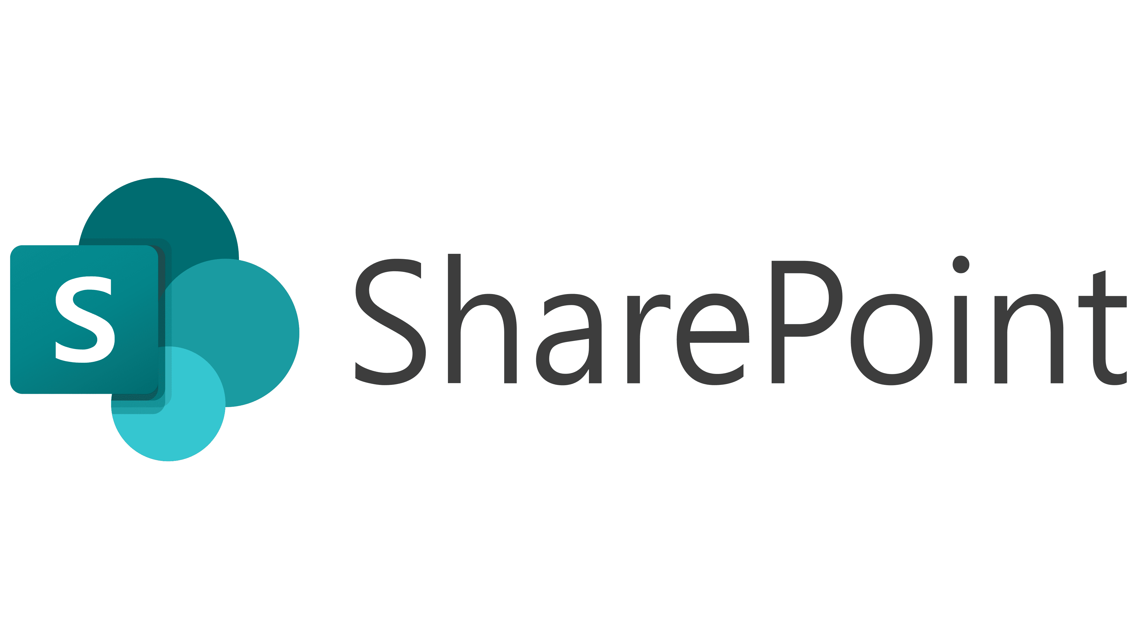

IBM + Wells Fargo: Future Agent Landscape
Collaborator AI Agents: Custom, 3rd party & IBM Agent Catalog
User Interface
Orchestration Engine (WxO)
Custom, 3rd party and IBM pre-built agents that can leverage tools and knowledge to complete tasks
ServiceView
GSS
Contract Master
WCIS
BAMOE
Authentication
SSO / OKTA / SAML 2.0
CSTN
WCAO
OLF
IBM Custom Agents
WF Employees
Agentic control plane
Agentspace
Tools/Integrations: Tool Builder & Prebuilt Tools Catalog
(Bring-your-own model)
Connectors, integrations and tools: Things the agent can access and utilize to complete tasks
WF HR Professionals
MS Teams
IBM OOTB General tools
Collaborator
Agents
Agentic RAG
Data Sources (SQL, etc.)
GenAI
Tools
Vantage View/Service View
API’s & Apps
Web Search
MCP / A2A /
ACP Tools
Actions and workflows
Routing
Tool Calling
Reasoning
+100s more…
Digital Onboarding and Servicing Platforms
Knowledge / Data: Client specific and general data
Disambiguation
Planning
Reflecting
Integrated knowledge and data layer the agent can use to surface insights
The Orchestration control plane is a multi-agent, multi-tool supervisor, router, and planner, facilitating complex task execution
Agent Knowledge
WF
Data System
Language
Multiple Language Speech Transcription and Translation
watsonx.data
© IBM 2025
Notes:
Top box – degreed and cornerstone logos in collab ai agents
also need better up and TA agent (WF logo)
agent space right hand side of top box
tools section workday instead of sap, put agent space as a tool
data google, query, cloudera
Employee Engagement Agent

Slide 19

Current State Understanding
Current state
Understand Client Request
Create Service Case
Route Request
Manually Perform Actions
Follow-ups and Escalations
Respond Back to Customer
Typical end-to-end duration:
5-15 days
Read client email and determine need
Login to ServiceView to create case and enrich it
Route request to appropriate team
Swivel chair to multiple systems and perform requested action(s)
Follow-up with multiple teams, manually confirm if task has been completed
Create and send response to client
Future State: Leverage WxO to ingest, create cases, route, action, track, & confirm cases
Ingest Client Request, Auto-create Request, Use Smart Routing
AI Agent Task Automation
Sub-set of tasks
Manually Perform Actions
Track, Monitor, Confirm, and Respond to Client
Future state
Typical E2E duration: 5-45 mins
Client enters request on Vantage or emails; WxO-Contextual Extraction with Agentic RAG
WxO creates the servicing request with tasks
WxO routes request based on skill, availability, and complexity
BAMOE infused with WxO executes tasks autonomously
Operatives review AI Agent exceptions, perform manual tasks (if any)
BAMOE with WxO for task tracking / alerts, API confirmation of request completion
WxO based response to client of service request completion
Typical end-to-end duration:
5-45 minutes
AI agent performs task autonomously
AI agent performs hybrid task
Powered by WxO No-code / Low code Multi-Agent Context Aware Orchestration
WxO- IBM watsonx.Orchestrate
Notes:
60% CB, 40% CIB

Slide 20
IBM's Target State: CB & CIB Client Servicing – Utilizing AI simplifies the delivery model and lowers the cost
Servicing today is conducted in product silos with multiple touchpoints, manual processes, and lack of visibility
Heavy reliance on e-mail to manage servicing cases – 66%* of e-mail volume with clients or internal partners are follow ups or status checks on open requests
Confusion on internal team’s roles and where requests should be sent – 21* unique internal partners needed to support a single CIB client
Client requests can contain multiple actions, which are separated and actioned independently resulting in no ability to view relationship activity across products or track to SLAs
No assurance of completion which results in operating risk
Today
Target State
IBM WxO
Relationship Manager
Middle Office
AI ingest,
case creation, routing
Case creation & routing
Vantage
Vantage View
GPL Customer Service
Relationship Associate
Clients enters request on Vantage
GPL
Implementation
GPL
Implementation
GPL Customer
Service
Clients go to their Relationship Team or directly to product teams.
Relationship Manager
Relationship Associate
Commercial Lending Operations
Commercial Lending Operations
AI tracking, monitoring, and notifications

Slide 21

Power of Agents in BAMOE with watsonx Orchestrate
Business Automation Manager
Open Editions
AI
Intelligent Process Automation
:
Leverage Agents Inside provided within IBM BA offerings – standardized in their approach & implementation
Adopt Inhouse Agentic Framework made available in IBM BA portfolio to modernize in-place without looking elsewhere
Federated Agentic Orchestration strategy with bi-directional leverage of agentic frameworks –depending on our client’s entry point
watsonx Orchestrate™
PAMOE
Agents
Agents Inside
Access & leverage BA from Agentic Frameworks
AI
Intelligent Decision Automation
DMOE
Federated Agentic Framework allowing bi-directional orchestration to match client entry point
Agents Inside
Content Services
AI
Custom Built Agents
FileNet Content Manager
Agents Inside

Slide 22
Call to Action – Build Trust!
Goal: Engage your account teams and get the client excited about their modernization journey
Review the AI Edition Client Decks on IBM Core Software Products page
AI Editions Enablement series: Core Software AI Editions Enablement: modernization story, product roadmap tour, and industry use cases
Client Landscape: Engage your clients and complete Discovery Assessments – Acceleration & Data Usage
ISC Technical Sales Activities Hygiene: Opportunity & Activity Discipline in ISC
Product Connect: Engage your product manager early and keep informed

Slide 24
FSM Product Strategy Leader Role, Core Software Modernization
Connecting product pillars and account teams to modernize existing client footprints
Role Focus
Integrating w/product pillars
Align roadmaps & dependencies
Working w/account teams
Embed with FSM account teams and CSEs & 1 IBM view
Inventory existing client footprint
Identify risk, technical debt, and candidates
Shape integrated modernization roadmaps
Integration point across all Core to Modernize product pillars
Ensure modernization is coordinated, not siloed
Translate product strategy into account execution
Protect core revenue and enable expansion
Partner with pillar leaders across:
Business Automation
Data Architecture
Application and Runtimes
Application Integration
Sequence modernization motions
Standardize patterns and messaging
Feed field signals back to product
Drive repeatable plays to pipeline and renewal
Client Outcomes: : Lower risk & technical debt, clear modernization path without rip and replace
IBM Outcomes: Protected S&S revenue; Repeatable modernization at scale

Slide 25
Product Pillars
Four Product Pillars have been prioritized for Core to Modernization Plays
Application & Runtimes
Application Integration
Business Automation
Data Architecture
Products
WebSphere Application Server
JSphere Suite for Java
Cloud Pak for Applications
Code Assistant for Java
Products
DataPower Software
MQ
webMethods Hybrid Integration
API Connect
Cloud Pak for Integration
Event Automation
App Connect
Aspera
Financial Transactions Payments & Insights
Sterling Managed File Transfer
Sterling Transformation Extender
Sterling Data Exchange SaaS
Sterling Partner Engagement Manager
Sterling B2B Integration
Products
Robotic Process Automation (RPA)
webMethods BPMS
Cloud Pak for Business Automation
Business Automation Workflow
Automation Decision Services
Process Planning
Operational Decision Management
Content Manager (CM8)
Content Manager On Demand
Filenet Content Manager
Capture
Decision Optimization
Products
watsonx.data integration
DataStage
Data Replication
Cloud Pak for Data
Db2
Informix
Netezza
watsonx.data
watsonx BI Assistant
Business Analytics Enterprise
SPSS Modeler
Cognos Analytics
Planning Analytics
Optim
Master Data Management
SPSS Statistics
watsonx.data intelligence
Clients
State Farm
The Bank of New York Mellon Corporation
JPMorgan
Chase & Co.
Mastercard International
Citigroup
Fidelity
United Services Auto Association
Truist
Clients
Bank of America
State Farm
JPMorgan
Chase & Co.
Fiserv
United Services
Auto Association
The Bank of New York Mellon Corporation
Global Payments Inc
Fidelity
Clients
State Farm
Bank of America
Fidelity
PNC Financial Services Group
Navy Federal Credit Union
Automatic Data Processing
State Street Corporation
Citigroup
Allstate Insurance Company
Clients
Bank of America
Mastercard International
JPMorgan
Chase & Co.
State Farm
Wells Fargo
Progressive Corp
PNC Financial Services Group
United Services Auto Association
US Bancorp
PNC Financial Services Group
Automatic Data Processing
Global Payments Inc
Wells Fargo
Morgan Stanley
Fiserv
State Street Corporation
Progressive Corp
Charles Schwab Corporation
Morgan Stanley
Truist
Fifth Third Bancorp
Progressive Corp
State Street Corporation
FIS - Fidelity Info Services
Citigroup
MetLife
Goldman Sachs Group, Inc
MetLife
The Bank of New York Mellon Corporation
FIS - Fidelity Info Services
Truist
Mastercard International
Wells Fargo
Charles Schwab Corporation
The Vanguard Group Inc
Navy Federal
Credit Union
Fidelity
Morgan Stanley
Charles Schwab Corporation
New York Life Insurance Company
Principal Financial Group Inc.
Key Equipment Finance
Nationwide Mutual Insurance
https://ibm.seismic.com/Link/Content/DCC7FMWGhTpR8G2Fh77BQhmBq3H3

