Slide 1

IBM Financial Services Market
Core to Modernization Pilot Program
FSM – Business Value Assessment Seller Enablement
Prepared by:
Monika Aggarwal
Diana Cabrera
May 11, 2026
Notes:
1
Group Name / DOC ID / Month XX, 2022 / © 2022 IBM Corporation

Slide 2
Seller enablement
Db2 modernization: connect technical proof to funded value
15-minute executive seller pitch for modernization conversations
Start with the buyer question
“What does this change do for my business, and is it worth funding?”
Seller move
1
Open with Why Change, Why Now, Why IBM
The gap
Sellers can explain upgrade urgency and product features. The hard part is connecting Db2 modernization to a defensible business case.
2
Pick one modernization motion
3
Show the technical view
The bridge
Use the technical view as product proof. Use Value 360 to estimate the value, then refine it with client inputs.
4
Use Value 360 for the BVA
The outcome
Do not lead with the tool. Lead with the client problem.
A first meeting that is credible, business-driven, and simple enough to earn the next working session.
Db2 modernization seller pitch | v4 | 1

Slide 3
Seller enablement
Start with the three whys
Use the three whys to anchor the conversation before showing architecture or BVA outputs
Why Change?
Why Now?
Why IBM?
Aging Db2 environments create support risk, operational friction, delayed AI readiness, and avoidable upgrade pressure.
Renewals, platform moves, skills pressure, resilience expectations, and AI initiatives are already forcing decisions.
IBM can connect the modernization path, Db2 capabilities, technical proof, and Value 360 BVA into one defensible story.
Client-facing line
“Based on similar environments and approved benchmarks, these are the areas where clients typically see value. To calculate the value for your environment, we would validate the inputs with you.”
What changed from rehearsal: Start with the why narrative. Then use the architecture view. Then show the Value 360 output as a starting point, not a finished client answer.
Db2 modernization seller pitch | v4 | 2

Slide 4
Seller enablement
Pick one modernization motion
Keep the first meeting focused. Do not walk the client through every possible path.
Vitality
Containerization
SaaS / Managed
Tradeup / Expansion
Becoming current, supported, secure, and ready for newer Db2 capabilities.
Moving to a standardized Kubernetes operating model with repeatable deployment patterns.
Shifting operational responsibility for infrastructure, upgrades, HA, DR, and backup.
Extending Db2 with AI Edition, vector support, autonomous operations, and broader data use cases.
Seller rule: Work with the account team and CSE to select the motion before the meeting. The goal is a focused discussion, not a tour of every possible plan.
Client ask: “Can we validate if this is the right path, then use your inputs to build the business case?”
Avoid making modernization feel like a large rip-and-replace program.
Db2 modernization seller pitch | v4 | 3

Slide 5
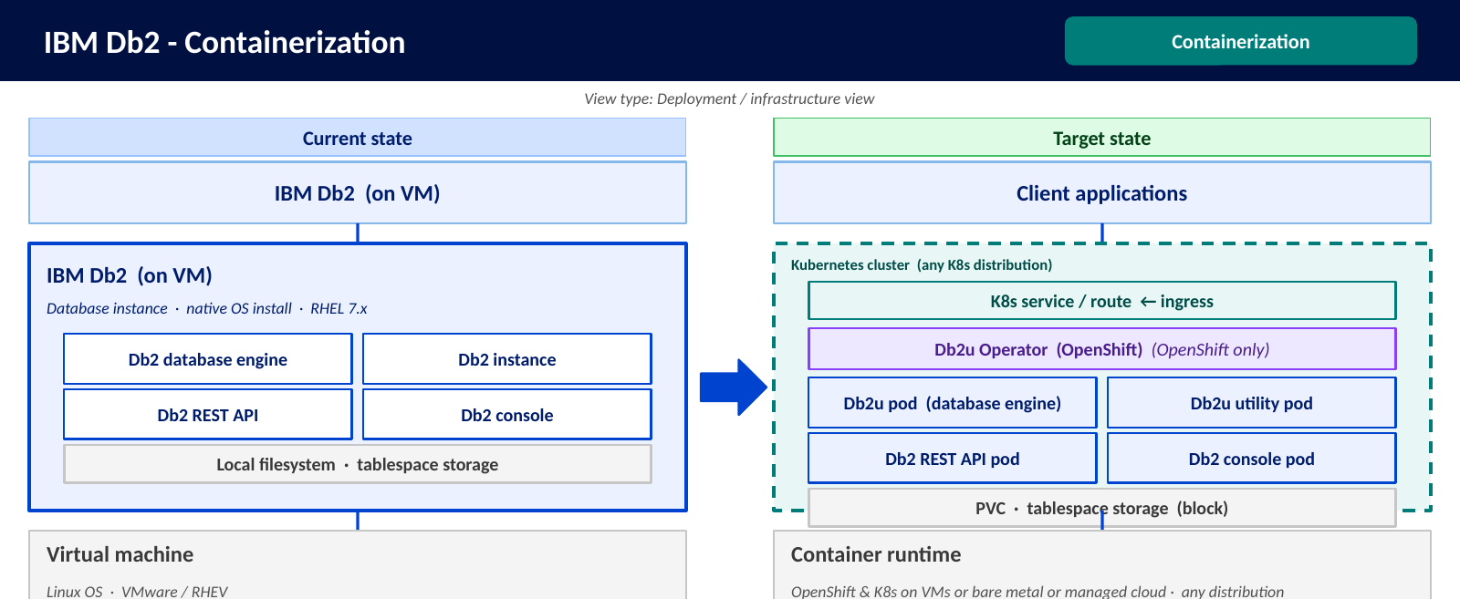
Seller enablement
Technical view = product proof
Use the technical view to explain what changes. Do not use it as the value calculation.
Seller talk track
“This view shows the technical change and the Db2 capabilities enabled by the move.”
Use it to confirm:
• current-state pattern
• target-state direction
• capability gaps
• operating model change
Then move to Value 360 for the value estimate.
Example shown: Containerization
Use one technical view to show current state, target state, and enabled Db2 capabilities.
The generic benefit text on the technical slide is not the BVA. It is only a prompt for the Value 360 model.
Db2 modernization seller pitch | v4 | 4

Slide 6
Seller enablement
Value 360 = the client-specific value layer
Start with informed benchmarks. Refine with client data. Build the BVA output.
1
Create informed baseline
2
Validate client inputs
3
Build BVA output
Use approved benchmarks and product-backed assumptions to show where value may appear.
Collect data on environments, costs, DBA effort, downtime, provisioning time, and operating priorities.
Use the model to produce quantified benefits, strategic objectives, estimated impact, cost of delay, and next-step discussion.
What sellers should say
What sellers should not do
“These are starting assumptions. The client-specific value depends on your environment and operating data.”
Do not present benchmark assumptions or generic benefit labels as confirmed client value.
Value 360 provides the business case engine. The technical view provides product proof. Client data makes the BVA real.
Db2 modernization seller pitch | v4 | 5
Notes:
G

Slide 7
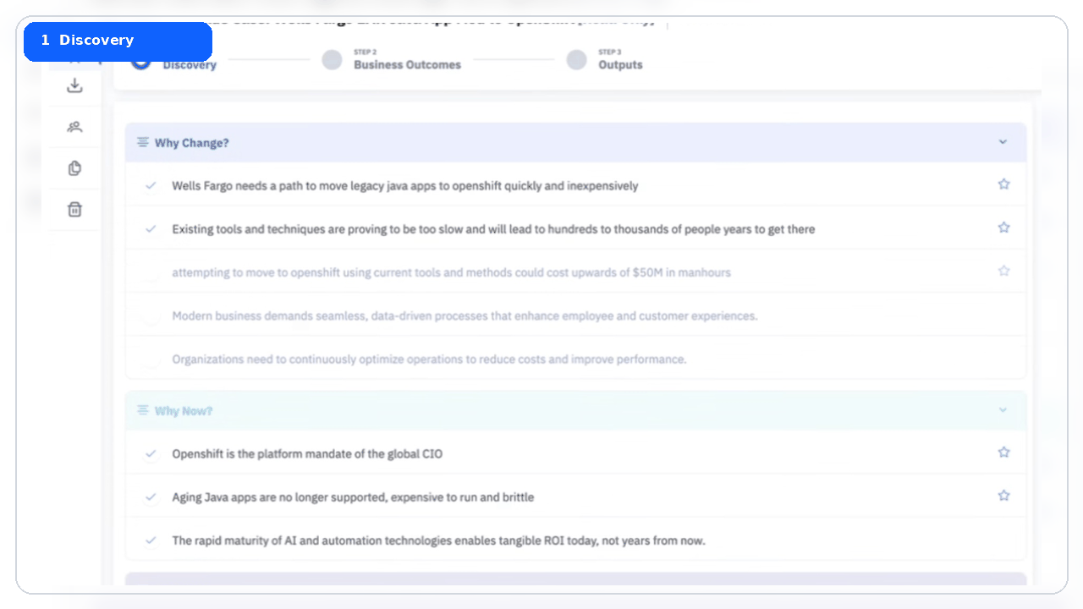
Value360 in ISC: App Runtime seller journey
WAS / Java modernization example: discovery to quantified BVA output
Seller flow
A guided view of how sellers move from
qualitative framing to quantified
business outcomes.
1
Discovery
Why Change / Why Now / Why IBM
2
Business outcomes
Select modernization motion and
benefits
3
Assumptions
Enter client inputs and benchmarks
4
Outputs
Show benefits and cost of inaction
GM framing: high-level seller journey. Detailed motion scope is handled after the review.
Seller access path
ISC → Business Cases → Product modernization BVA template → Discovery → Business Outcomes → Outputs
Client value is finalized after
inputs are validated.

Slide 8
Seller enablement
15-minute seller pitch flow
The goal is not to close the architecture. The goal is to earn the next working session.
0–2 min
2–5 min
5–8 min
8–12 min
12–15 min
Open with the three whys
Why change, why now, why IBM. Anchor on the client issue.
Select one motion
Confirm the relevant modernization path with ATL, CSE, and client context.
Show the technical view
Explain current state, target state, and product capabilities.
Frame the potential value
Use Value 360 benchmarks and assumptions as a starting point.
Ask for the next step
Validate target state, collect BVA inputs, or schedule a deeper session.
Client-facing close: “Can we validate the target-state view and the assumptions, then build a client-specific BVA so you can see what this could be worth for your environment?”
Ask for: Target-state validation • BVA inputs • technical + value working session • controlled pilot
Db2 modernization seller pitch | v4 | 6

